Slide 1
上海交通大学嵌入式课程暑期培训 基于TI Cortex M3 主讲人：方向忠 教授

Slide 2
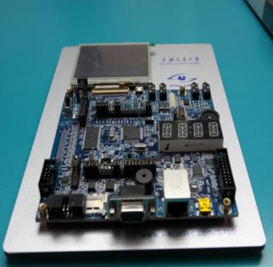
硬件系统
嵌入式处理器: LM3S9B9x
内存: 32MB SDRAM
接口:
UART
I2C/SPI
LCD Touch Screen
USB (OTG)
CAN
LAN (MAC + PHY)
I2S
ADC
Timer
PWM
三轴加速度传感器 etc.

Slide 3
教学内容
微机原理及接口技术
基于Proteus
内存扩展
8255, 8259, 8253, etc.
嵌入式系统实验
使用CCS/KEIL+StellarisWare开发TI M3
硬件部分: GPIO, Timer, PWM, LCD, Sensor, ADC
软件部分: Register, API, Interrupt Routine, …
系统设计: Spirit level, Whac-A-Mole, Snakes,…
Notes:
3

Slide 4
实验设计
基础实验
Lab Number | Lab Name | Comments
0 | Boot Loader | Demonstrative Experiment
1 | GPIO | Register Visit; Bitband
2 | SysCtl | Clock Control, PLL
3 | SysTick & Timer
4 | Interrupt(NVIC) | Interrupt Service Routine
5 | WatchDog
6 | UART | RS-232
7 | I2C | PCA9557, NixieTube
8 | PWM | Breathing LED, Buzzer
9 | LCD Operation | Graphic Library
10 | ADC | Thumbwheel Voltage, Temperature
11 | Accelerometer | Tri-axial

Slide 5
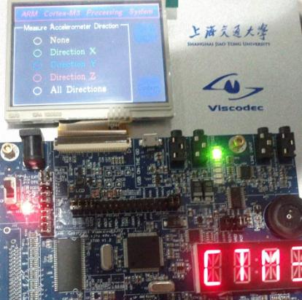
实验设计
创新实验
TouchScreen Operation
Grlib Widget Operation
USB Module
CAN Module
Audio Processiong

