Slide 1
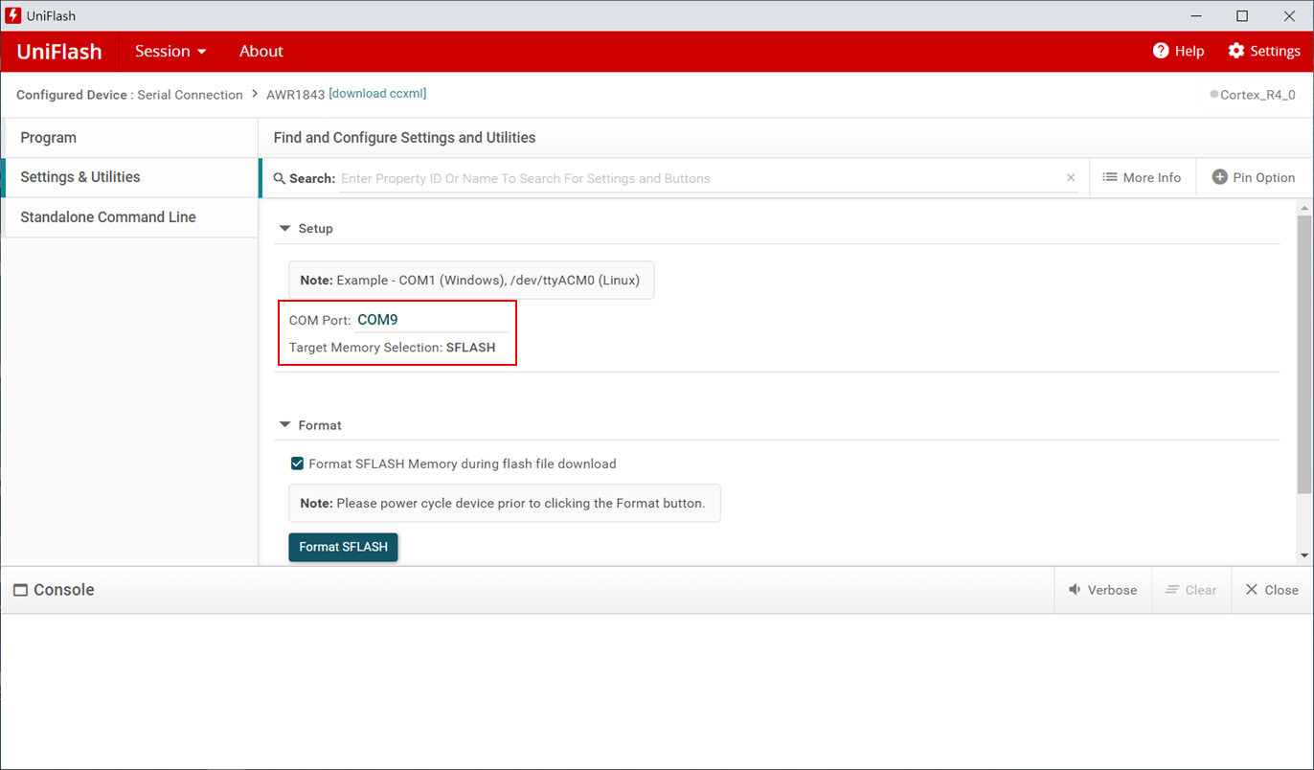
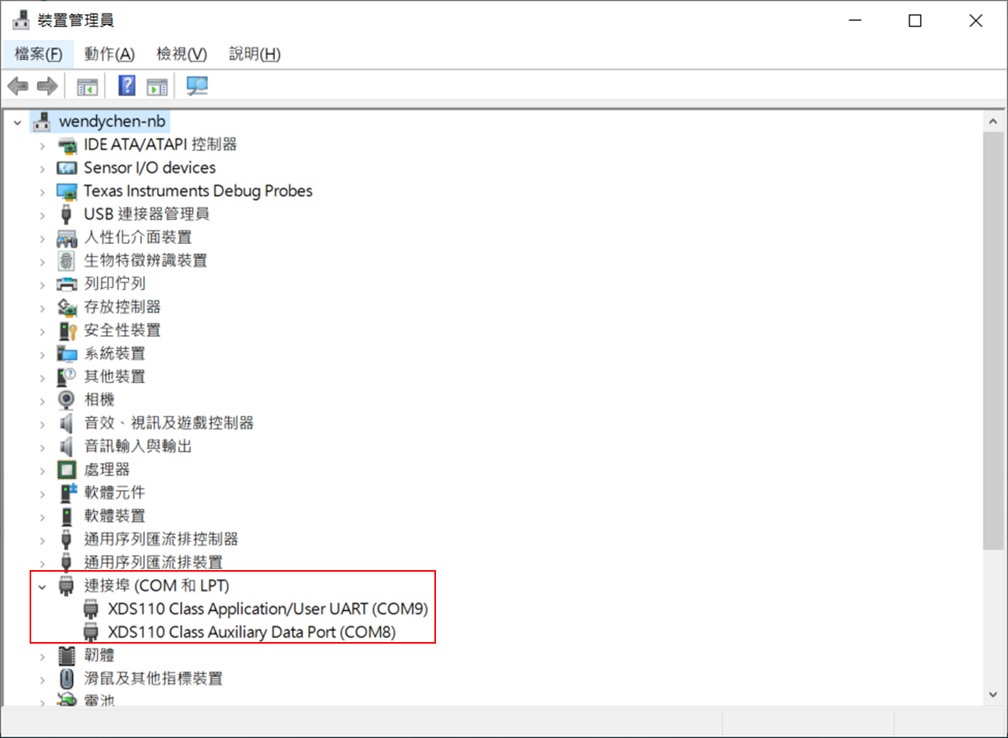
1.連接埠設定

Slide 2
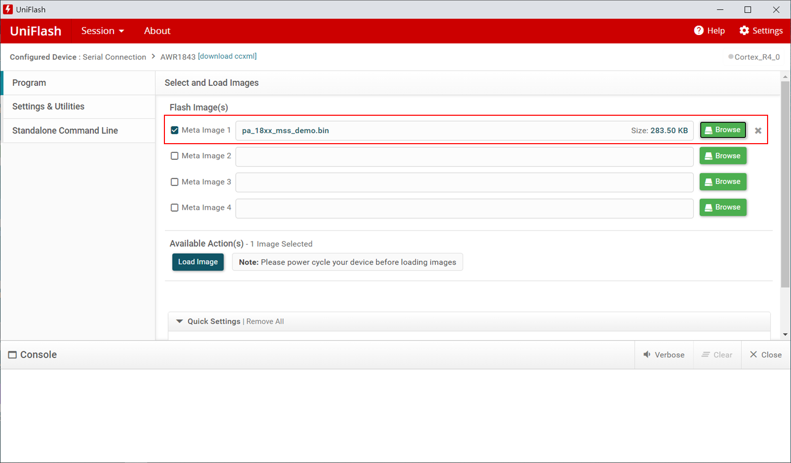
2.燒入文件設定

Slide 3
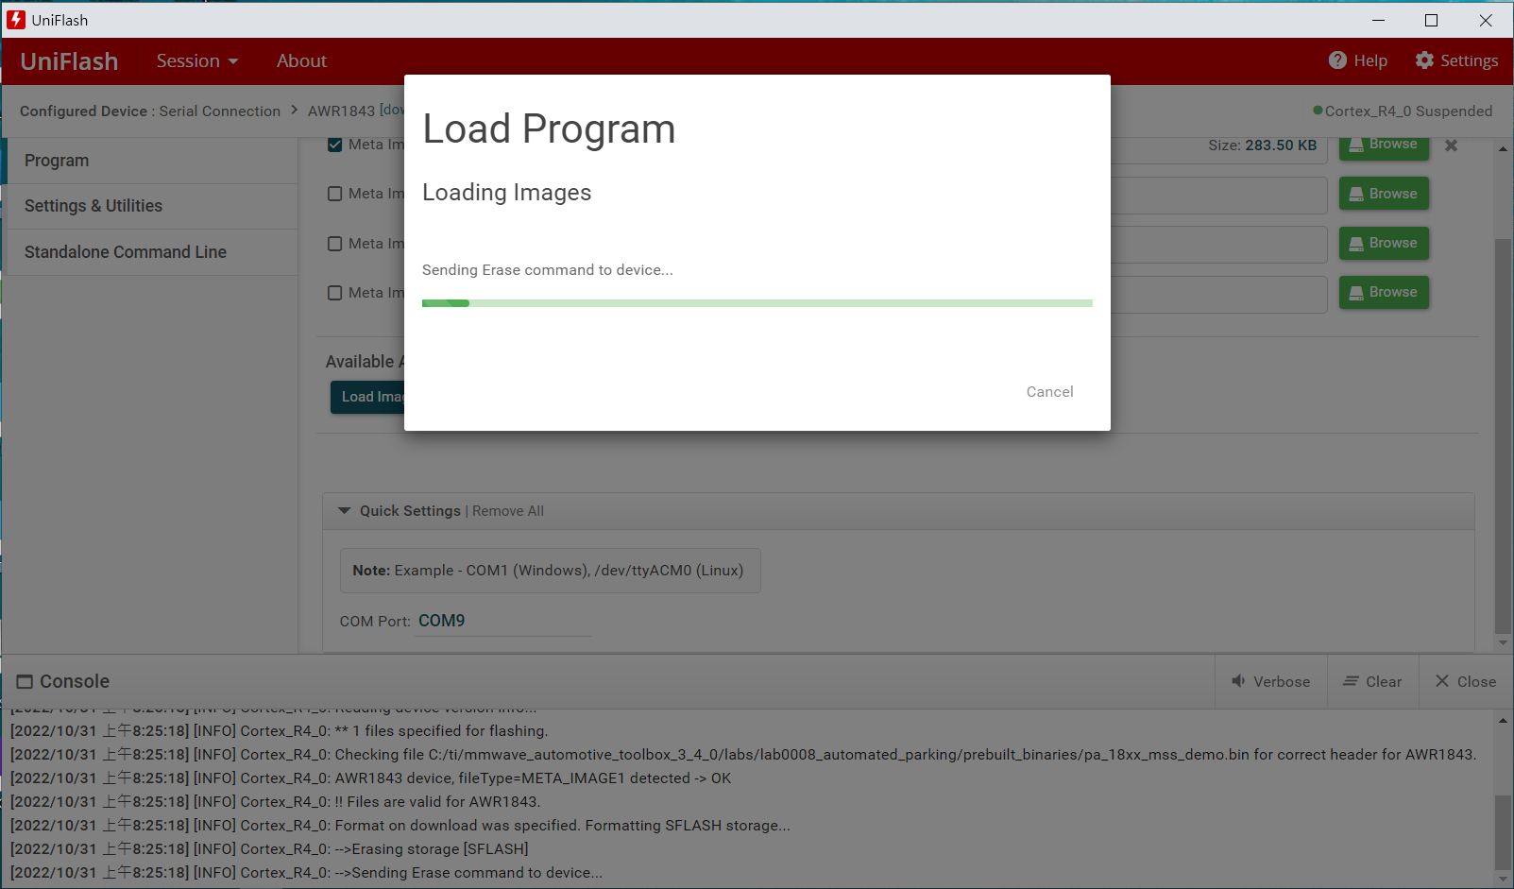
3.燒入問題頁面
不知為何燒入頁面一直停在此畫面，另一塊AWR1843則可以正常燒入，會是Flash硬件出問題嗎?

Slide 4
4.Console
[2022/10/31 上午8:25:17] [INFO] Cortex_R4_0: Initialization complete.
[2022/10/31 上午8:25:17] [INFO] Cortex_R4_0: Flashing process starting...
[2022/10/31 上午8:25:17] [INFO] Cortex_R4_0: Connecting to COM Port COM9...
[2022/10/31 上午8:25:17] [INFO] Cortex_R4_0: Reset connection to device
[2022/10/31 上午8:25:18] [INFO] Cortex_R4_0: Set break signal
[2022/10/31 上午8:25:18] [INFO] Cortex_R4_0: Connection to COM port succeeded. Flashing can proceed.
[2022/10/31 上午8:25:18] [INFO] Cortex_R4_0: Reading device version info...
[2022/10/31 上午8:25:18] [INFO] Cortex_R4_0: ** 1 files specified for flashing.
[2022/10/31 上午8:25:18] [INFO] Cortex_R4_0: Checking file C:/ti/mmwave_automotive_toolbox_3_4_0/labs/lab0008_automated_parking/prebuilt_binaries/pa_18xx_mss_demo.bin for correct header for AWR1843.
[2022/10/31 上午8:25:18] [INFO] Cortex_R4_0: AWR1843 device, fileType=META_IMAGE1 detected -> OK
[2022/10/31 上午8:25:18] [INFO] Cortex_R4_0: !! Files are valid for AWR1843.
[2022/10/31 上午8:25:18] [INFO] Cortex_R4_0: Format on download was specified. Formatting SFLASH storage...
[2022/10/31 上午8:25:18] [INFO] Cortex_R4_0: -->Erasing storage [SFLASH]
[2022/10/31 上午8:25:18] [INFO] Cortex_R4_0: -->Sending Erase command to device...

