Slide 1
DAC38RF82 Test

Slide 2
DAC38RF82 8 bit mode
Test Setup:
Fdac = 9000Msps external clock
Int 1X
IF = 200MHz tone
LMF = 811
Shunt installed on JP10

Slide 3
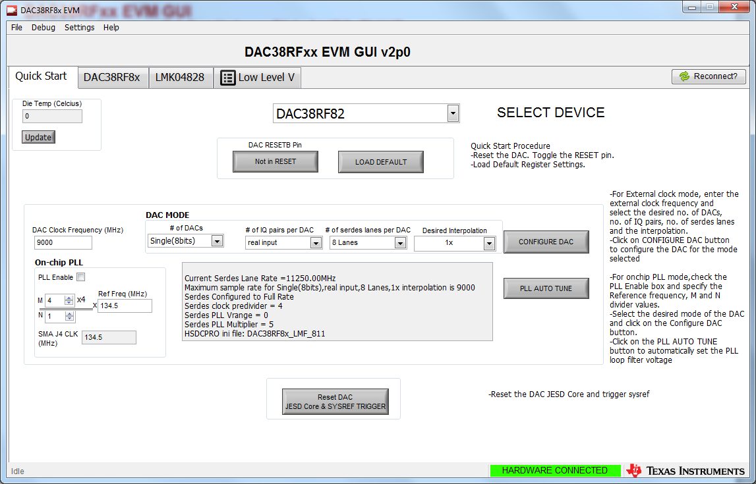
DAC38RFxx EVM GUI

Slide 4
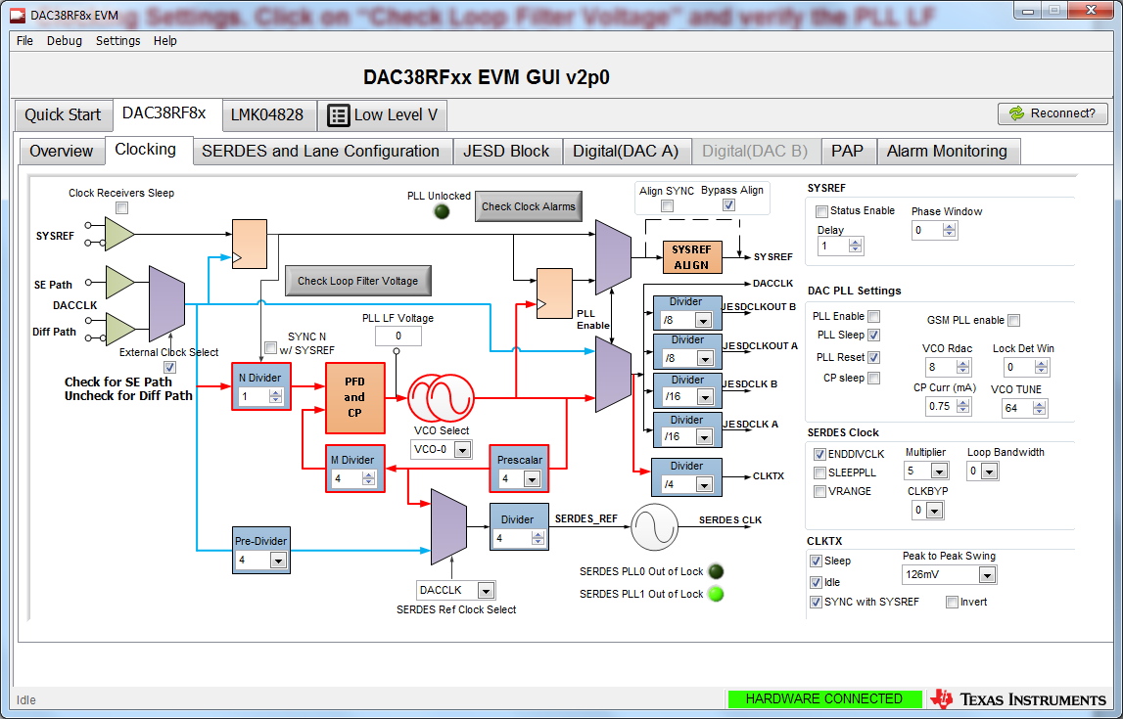
Clocking Settings

Slide 5
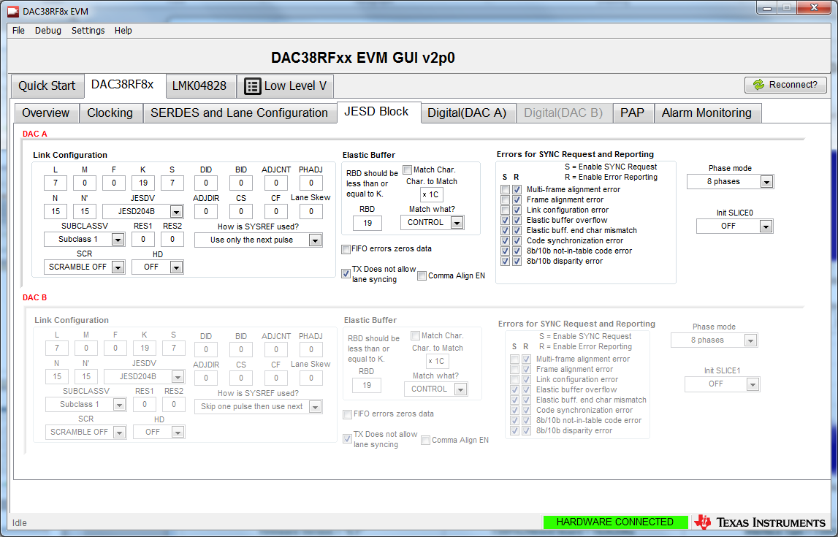
K = 20 Max SYSREF = Lane rate / (10 * F * K) = 56.25MHz.

Slide 6
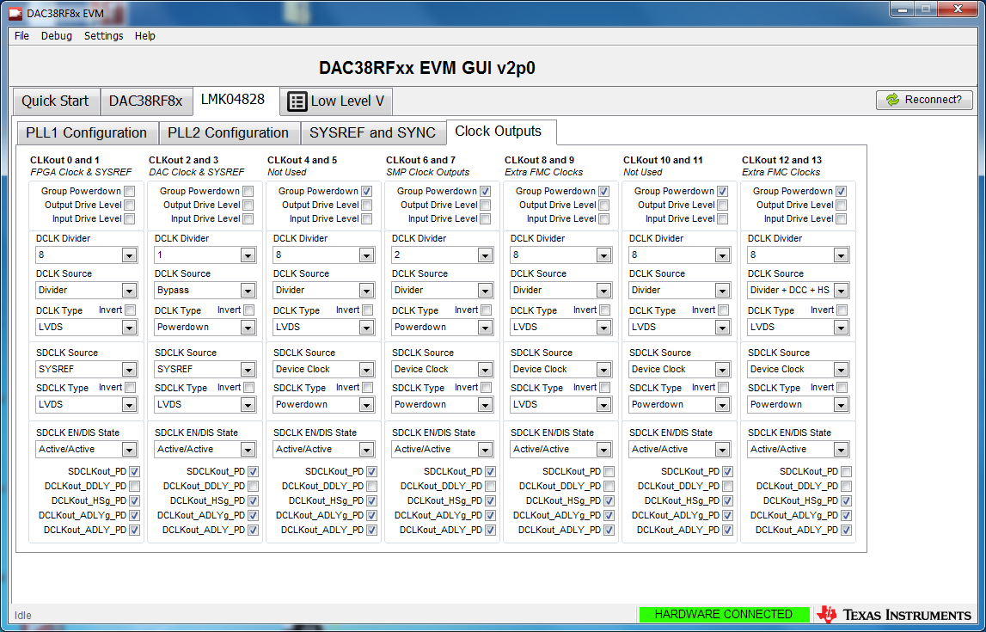
LMK Clock output Settings TSW clock = 281.25MHz

Slide 7
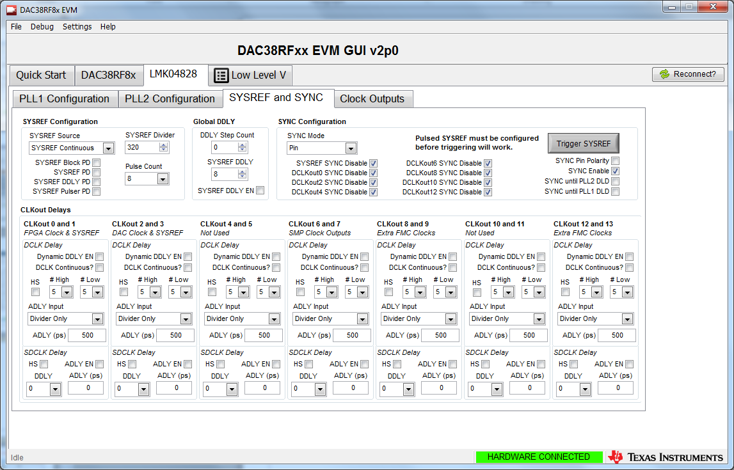
LMK Clock output Settings SYSREF = 9000/320/4 = 7.03125MHz

Slide 8
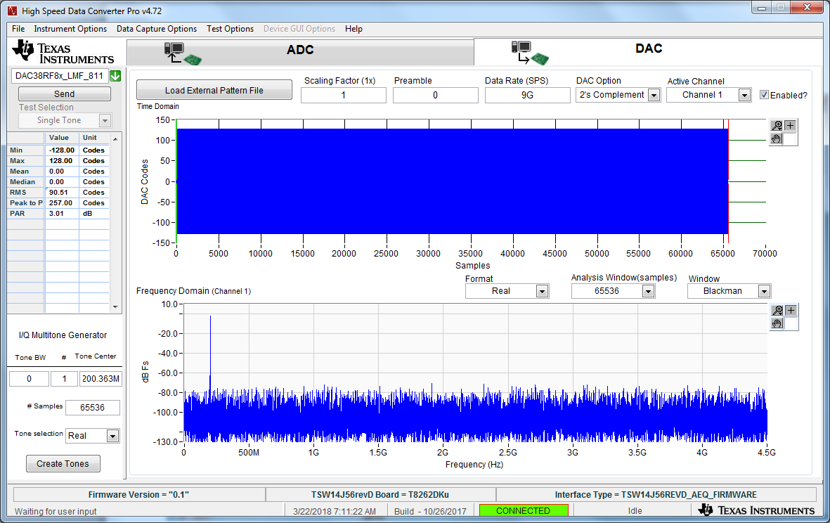
TSW14J56 Settings. Load HSDC Pro as shown below. Click on “Create Tones”, then “Send”

Slide 9
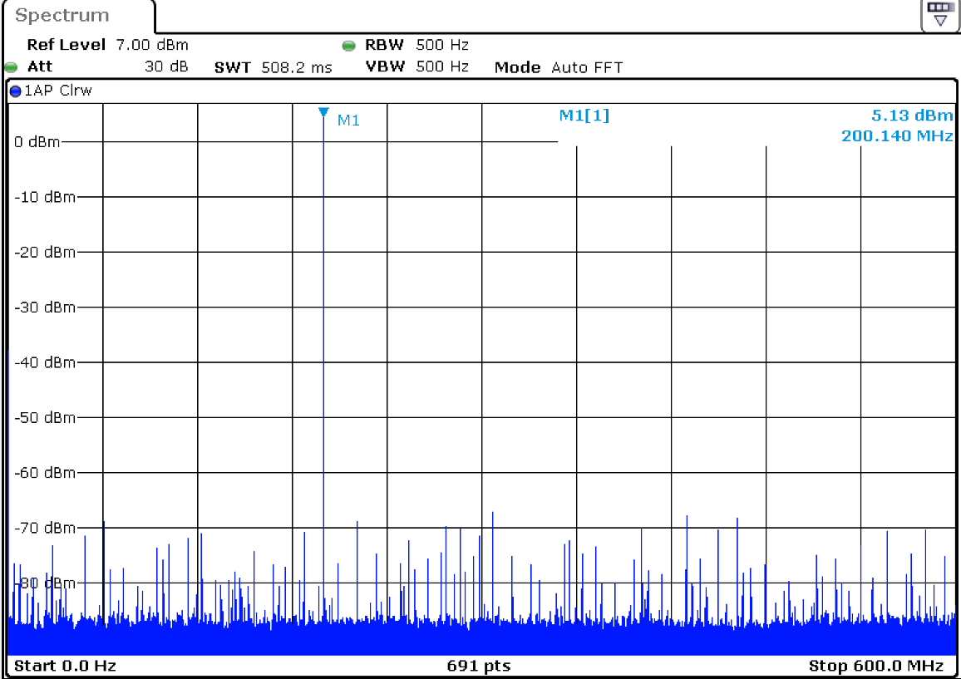
DAC output at SMA J6

