Slide 1
AJ9213-U5 SC0000015890 Defective Analysis Report
Jan’4. 2023， Testing Team

Slide 2
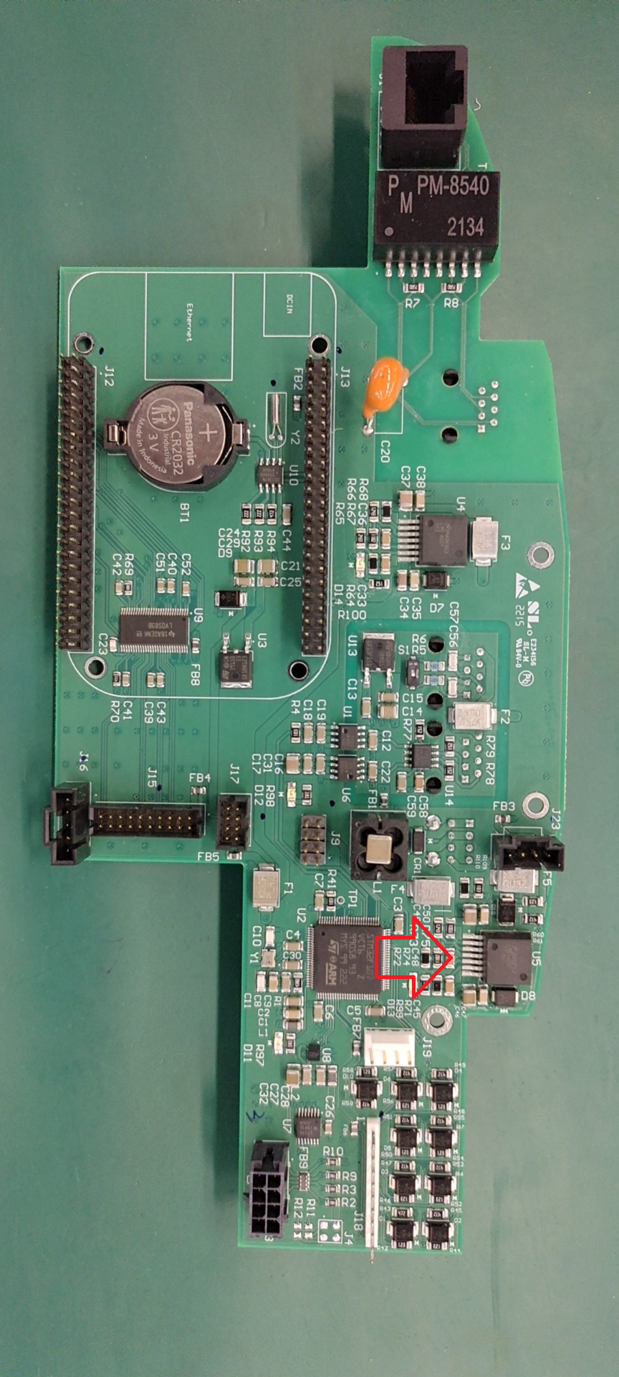
Background
Project: Caretream
Part number: AJ9213A
Defect Component: U5
Part Number: SC0000015890
MPN: LMZ14202
Failure order:3143961-X-X; 3236096-X-X
Failure Qty: 20pcs
Fail rate: 50%
Failure Description:5Vdc Missing

Slide 3
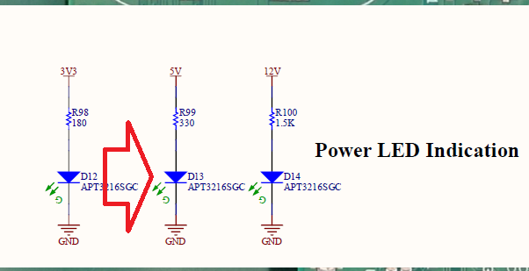
FCT fail：5vdc Missing，D13 of the dut is off.

Slide 4
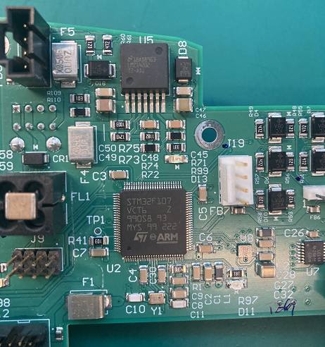
Anysis: Visually and X-ray inspect welds

Slide 5
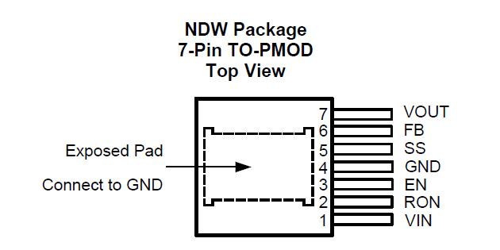
Anysis：PCBA can pass FCT after replaced U5.but replaced pass rate less than 40% . The difference can be found by comparing the ground impedance of the bad U5 pin with the new material with a multimeter by multimeter, The following table is the comparison of four bad U5:
U5 Pin | New U5 | Bad U5(1) | Bad U5(2) | Bad U5(3) | Bad U5(4)
1 VIN | 7 MΩ | 1.1 MΩ | 1.1MΩ | 0.9 MΩ | 1.1 M
2 Ron | 13 MΩ | 13 MΩ | 13 MΩ | 13.1MΩ | 13.3 M
3 EN | 14 MΩ | 2 MΩ | 8.5 KΩ | 2 Ω | 13.65 M
4 GND
5 SS | 10 MΩ | 2.8 KΩ | 8.5 KΩ | 7.2 Ω | 2.8Ω
6 FB | 16 MΩ | 2.8 KΩ | 15.4 MΩ | 399 KΩ | 390KΩ
7 VOT | 6 MΩ | 5.57 MΩ | 5.64m | 1.3Ω | ∞

Slide 6
conclusion： the U5 bad enough that the PCBA has no 5vDC output. The supplier is required to investigate the root cause of the failure？

