Slide 1

Practical EMI Considerations for Low-Power AC/DC Supplies
Part 1: Introduction to EMI
Bernard Keogh
Joe Leisten

Slide 2
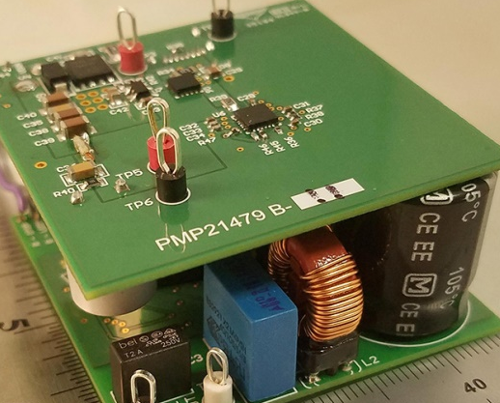
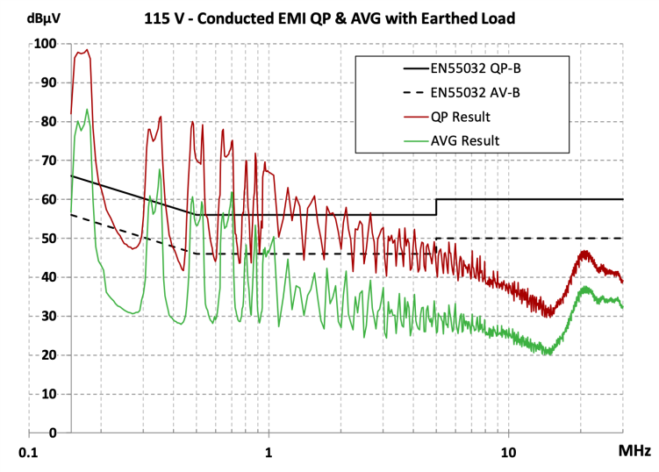
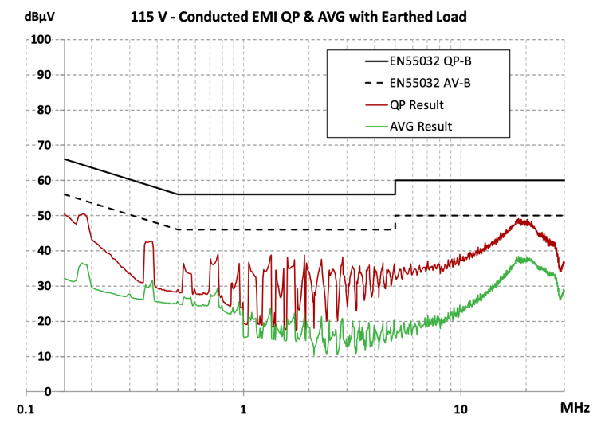
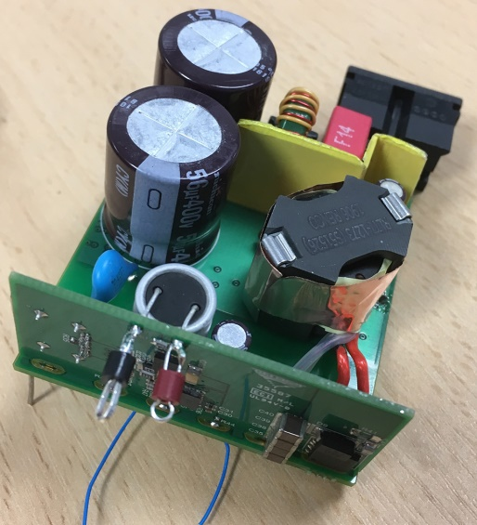
Electromagnetic interference (EMI)
I built my 65 W adapter prototype and resolved all functional issues
I ran first-pass EMI scan – and my design fails – badly! ~100 dBµV
  How can I fix the EMI?
  Where do I start?
This presentation will show how to get to a result like this,
without necessarily adding a big EMI filter
48 dB
Before
After

Slide 3
Agenda
Introduction to EMI testing
What causes EMI
Differential-mode vs common-mode EMI
EMI mitigation options
Analyzing the transformer
Troubleshooting & debug
65 W USB-PD example design using active clamp flyback (ACF) topology

Slide 4
Conducted emissions (CE) standards
Summary of main product standards for conducted emissions
Product Sector | CISPR Standard | EN Standard | FCC Standard
Automotive | CISPR 25 | EN 55025 | --
Multimedia | CISPR 32 | EN 55032 | Part 15
ISM | CISPR 11 | EN 55011 | Part 18
Household appliances, electric tools and similar apparatus | CISPR 14-1 | EN 55014-1 | --
Lighting equipment | CISPR 15 | EN 55015 | Part 15/18
Reference:
Timothy Hegarty, “An overview of conducted EMI specifications for power supplies,” http://www.ti.com/lit/wp/slyy136/slyy136.pdf
Notes:
DOES THIS SLIDE ADD VALUE?

Slide 5
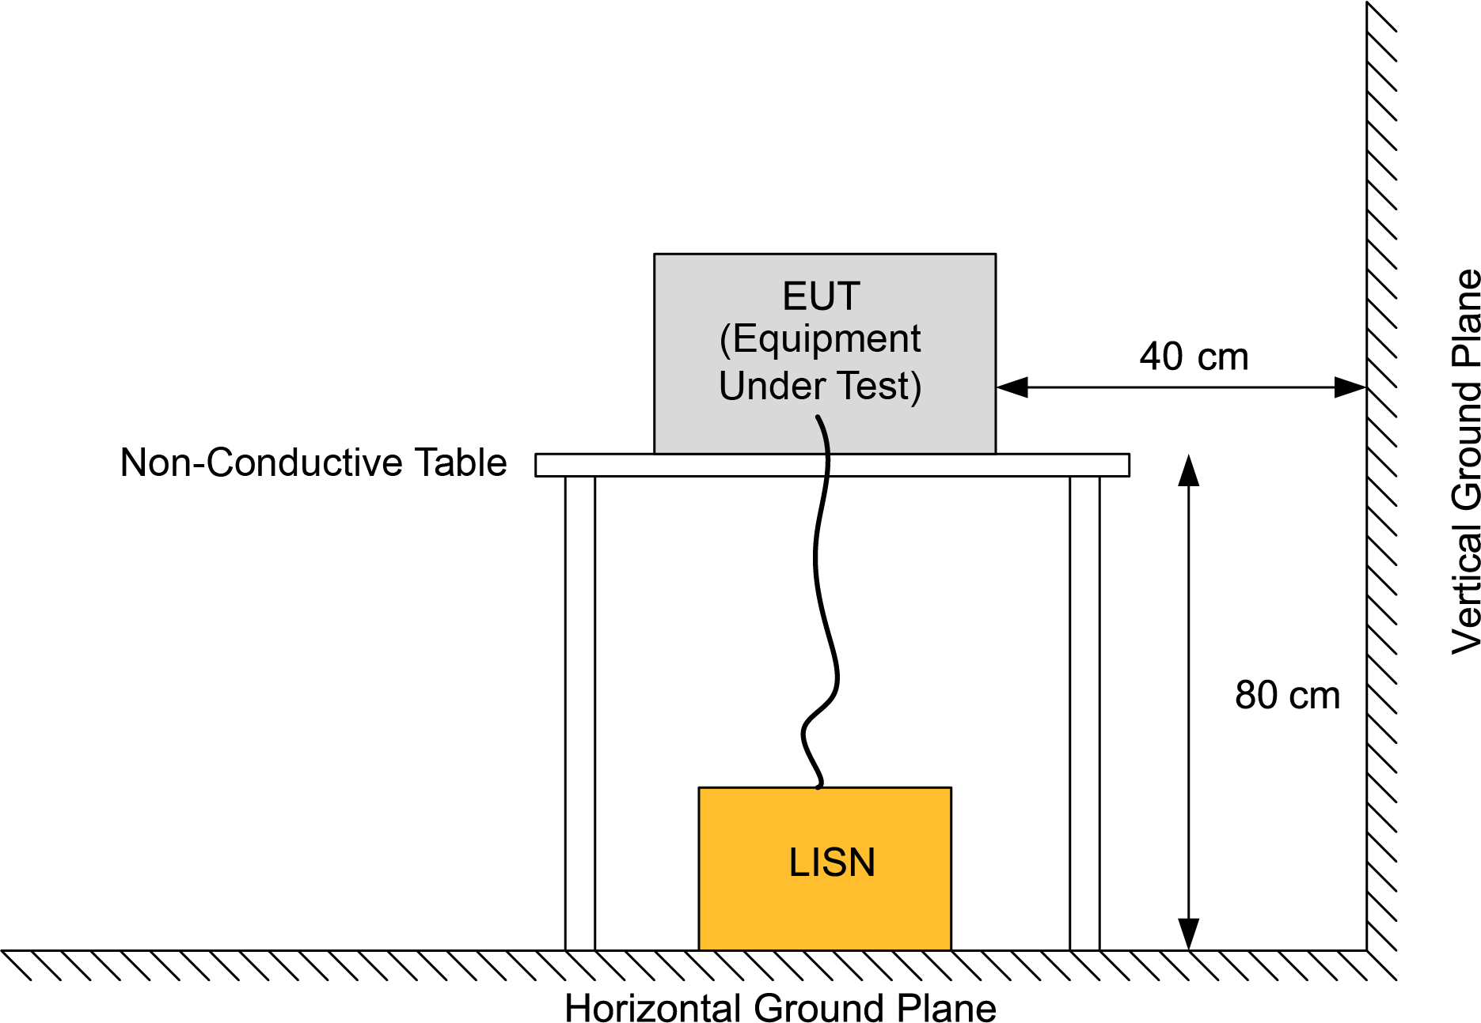
How conducted EMI is measured
Equipment under test (EUT) placed on non-conductive table
Horizontal & vertical ground planes
  Or screened room
EUT powered through line impedance stabilization network (LISN)
Measure high-frequency (HF) emissions from LISN
[1] EN55022, 2010, “Infor­ma­tion tech­nol­ogy equip­ment – Radio dis­tur­bance char­ac­ter­is­tics – Lim­its and meth­ods of mea­sure­ment”

Slide 6
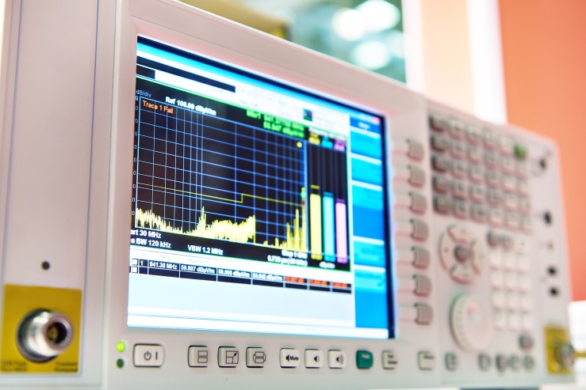
LISN – Line impedance stabilization network
Presents stable, consistent & repeatable line source impedance
Separation of power source noise current for measurement
  Low frequency power current passes straight through from AC source
“Total” noise levels measured separately on L1 (live) and L2 (neutral)
EMI Receiver
** Functional equivalent circuit of a LISN, not a complete schematic **

Slide 7
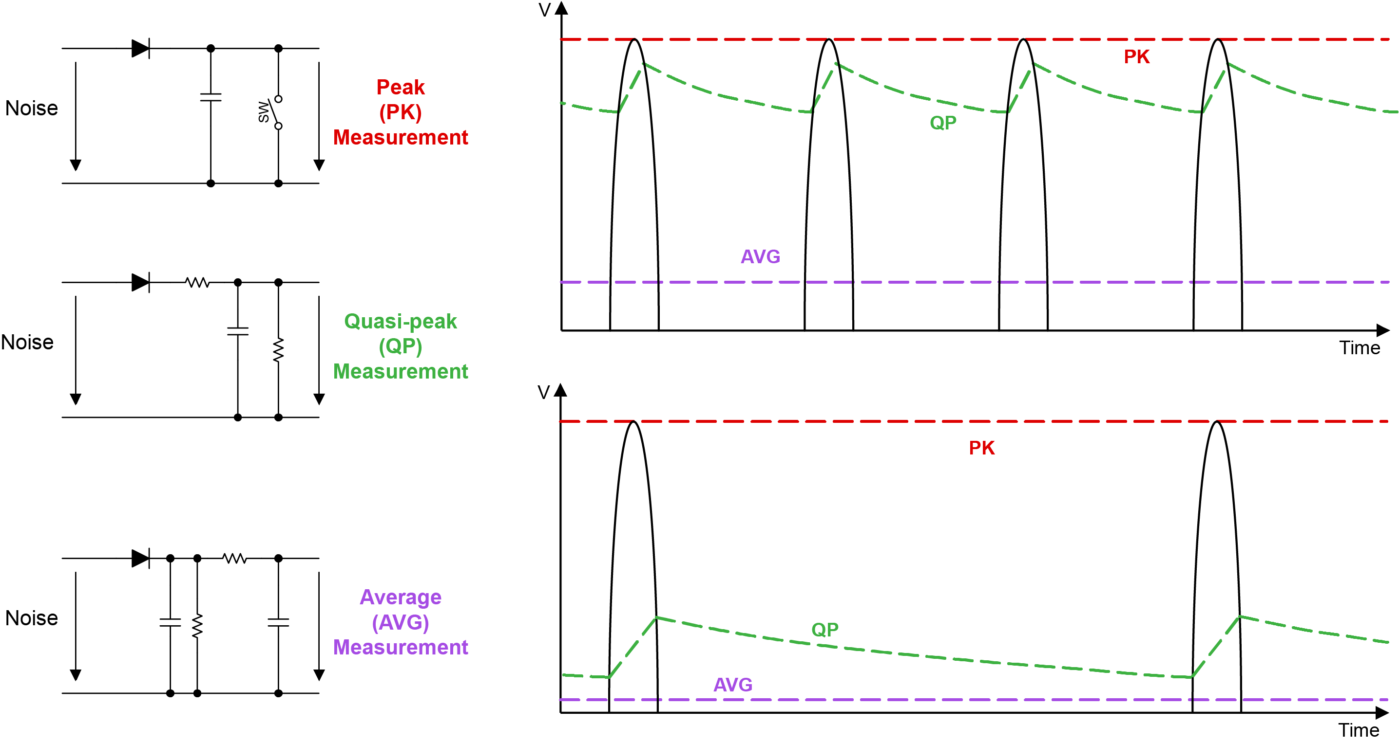
EMI receiver – Built-in detector types

Slide 8
Component parasitics
Parasitic elements are the
dominant cause of EMI issues
EMI noise is coupled & propagated through parasitic elements:
  Capacitive coupling
  Inductive coupling
EMI filter performance is dominated by parasitic elements at higher frequency:
  Parasitic capacitance of inductors
  Parasitic inductance of capacitors
Frequency
Frequency

Slide 9
LISN + EMI filter + power supply
LISN – measures noise
EMI filter – limits noise that gets to the LISN
(CM – red, DM – blue)
Power supply – generates the noise
(parasitic cap – red dotted)

Slide 10
DM EMI filter and current path
DM EMI filter limits DM noise that gets to the LISN
  X-caps divert current away from LISN, keep local to power supply
  DM choke high impedance reduces size of current flowing to LISN

Slide 11
CM EMI filter and current path
CM EMI filter limits CM noise that gets to the LISN
  Y-caps divert current away from LISN, keep local to the power supply
  CM choke high impedance reduces size of current flowing to LISN

Slide 12
Practical EMI Considerations for Low-Power AC/DC Supplies
Part 2: Differential-mode EMI
Bernard Keogh
Joe Leisten

Slide 13
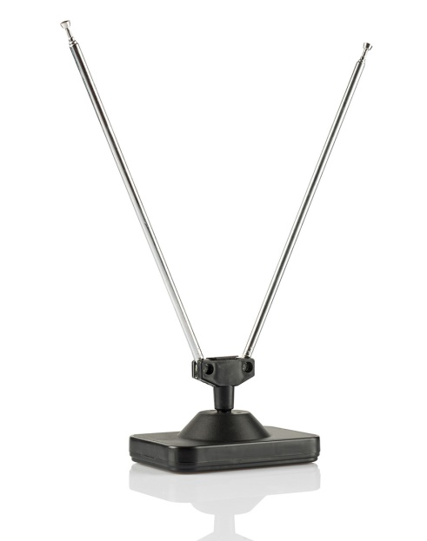
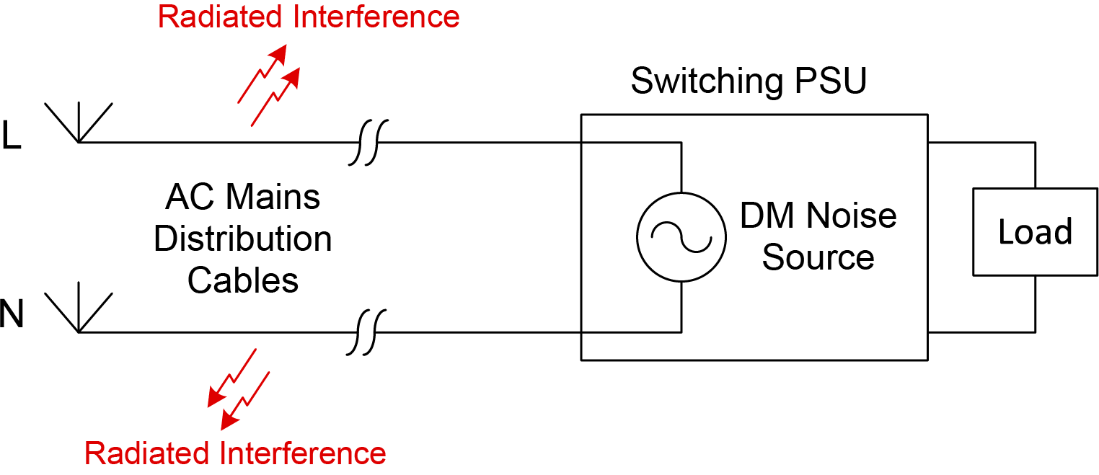
Why care about differential-mode (DM) EMI?
DM noise conducts to the AC utility supply network
Long AC distribution cables – act as good dipole antenna
Will inadvertently radiate switching noise and interfere with radio communications
  (E.g. noise @ ~100 MHz will affect FM radio)

Slide 14
How is DM EMI generated?
Switching ripple current produces ripple voltage across ESR (& ESL)
Ripple voltage is the DM noise that needs to be attenuated/filtered

Slide 15
Mitigation options for DM noise
Include EMI at the design phase
  Make design & component choices to minimize DM EMI signal amplitude
  Chose frequency, inductance, etc. to minimize PK-PK ripple current
  Choose capacitors with low ESR to minimize PK-PK ripple voltage
  Good PCB layout important to minimize EMI
Design sufficient DM LC filter to reduce the ripple that gets onto the AC line input

Slide 16
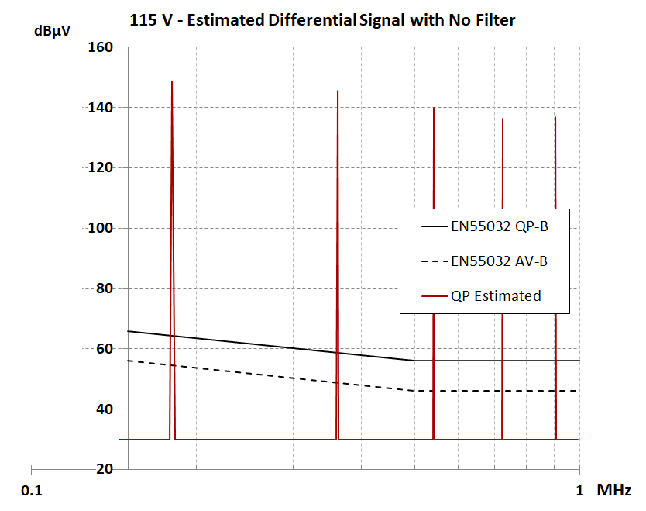
DM filter design methodology
Measure, simulate or calculate time-domain current waveform
Fourier analysis of time-domain switching current
  Convert waveform into harmonic components
Establish required attenuation at each frequency
  To get sufficient margin below the required EMI limit
Design the DM filter to achieve required attenuation
  Need to check all frequencies of interest
  Typically limited by lowest frequency inside measurement band
  Typically EMI starts at 150 kHz for AC/DC PSU
  to meet EN55022 or EN55032

Slide 17
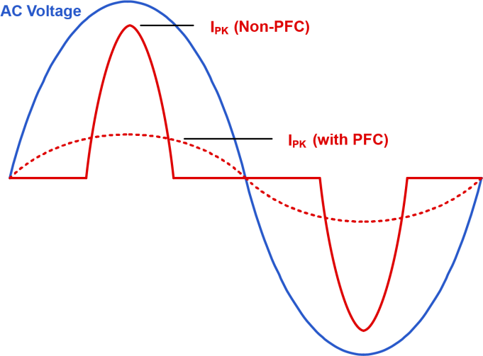
DM filter choke practical considerations
Choke requires high attenuation over wide bandwidth:
  Load current amplitude typically several amps
  At 50 dBμV, current in LISN 50 Ω resistor only ~6.3 µA
Beware inductance roll-off with DC-bias
  Must not saturate to be effective – needs high current rating
  Consider the peak line current for non-PFC – high crest factor
Switching power stage has fast changing magnetic fields
  Beware filter bypassing & noise coupling
Parasitic capacitance across DM inductor very important
  Reduces effectiveness, especially at high frequency
Example: To filter 300 kHz component, typically set LC freq. ~30 kHz
  Expect ~40 dB attenuation at 300 kHz (double-pole ⇒ 40 dB/decade)
  With parasitic cap ⇒ more like 30 dB attenuation only – even worse at higher frequency

Slide 18
Practical EMI Considerations for Low-Power AC/DC Supplies
Part 3: Common-mode EMI
Bernard Keogh
Joe Leisten

Slide 19
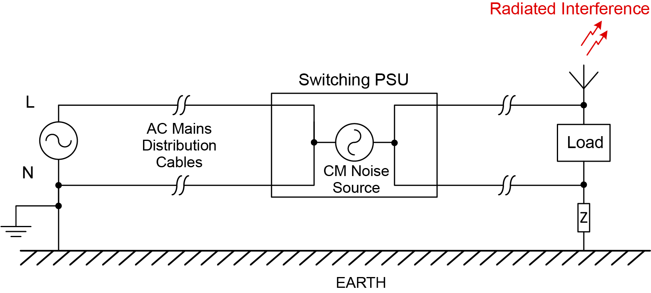
Why care about common-mode (CM) EMI?
Again, AC distribution cables and output load cables act as good uni-polar antenna
CM noise will radiate from the cables and interfere with radio communications

Slide 20
How is CM EMI generated?
Switching voltage across parasitic capacitance causes CM current flow to EARTH

Slide 21
How is CM EMI generated?
Switching voltage across parasitic capacitance causes CM current flow to EARTH
CM noise also radiated to other circuit nodes

Slide 22
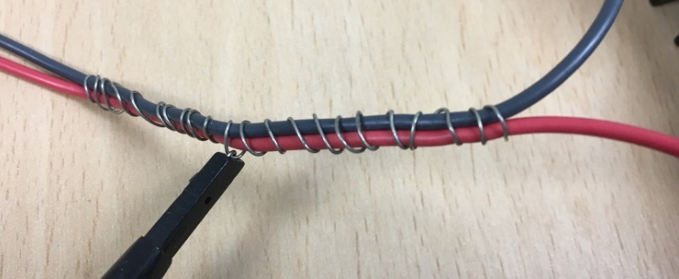
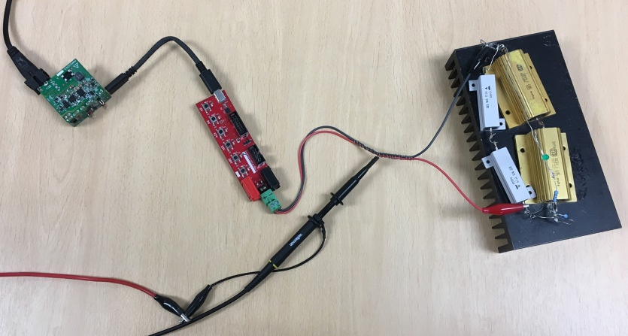
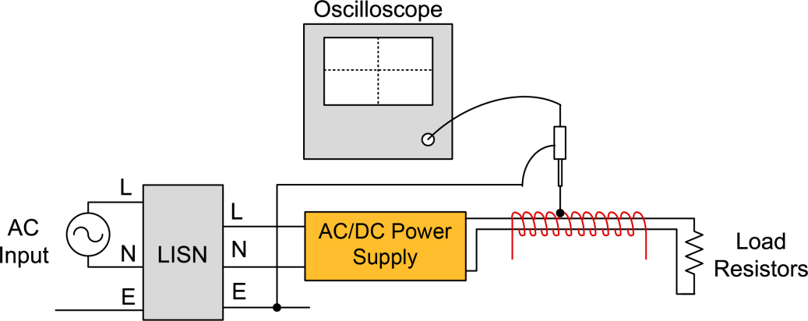
Observing the time-domain CM signal at the output
Useful debug technique – ball-park indication of CM performance
  Remove Y-cap temporarily (maximize signal)
  Power EUT through LISN, with resistor loads
  Wind several turns of wire around the load cables to
  create capacitive sensing coil (pickup coil)
  Connect scope earth lead to LISN earth
  Connect scope tip to sensing coil
  Scope plot shows how much CM is coupled to output

Slide 23
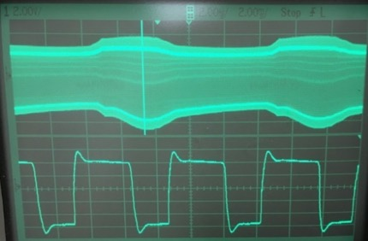
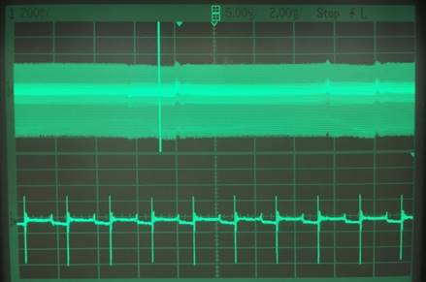
Interpretation of time-domain CM signal
Will see “switch-node” shaped waveform – coupled to output
Large PK-PK amplitude ⇒ bad CM noise
  Will require significant CM filtering to suppress
  Result from ACF example with 100 dBµV EMI
Small PK-PK amplitude ⇒ good CM noise
  “Balanced” structure giving low CM
  Will require much smaller CM filter
Residual HF “spikes” ⇒ should only need small HF CM choke
2 V/div, 2 µs/div
200 mV/div, 10 µs/div

Slide 24
Practical EMI Considerations for Low-Power AC/DC Supplies
Part 4: Mitigation Options for CM EMI
Bernard Keogh
Joe Leisten

Slide 25
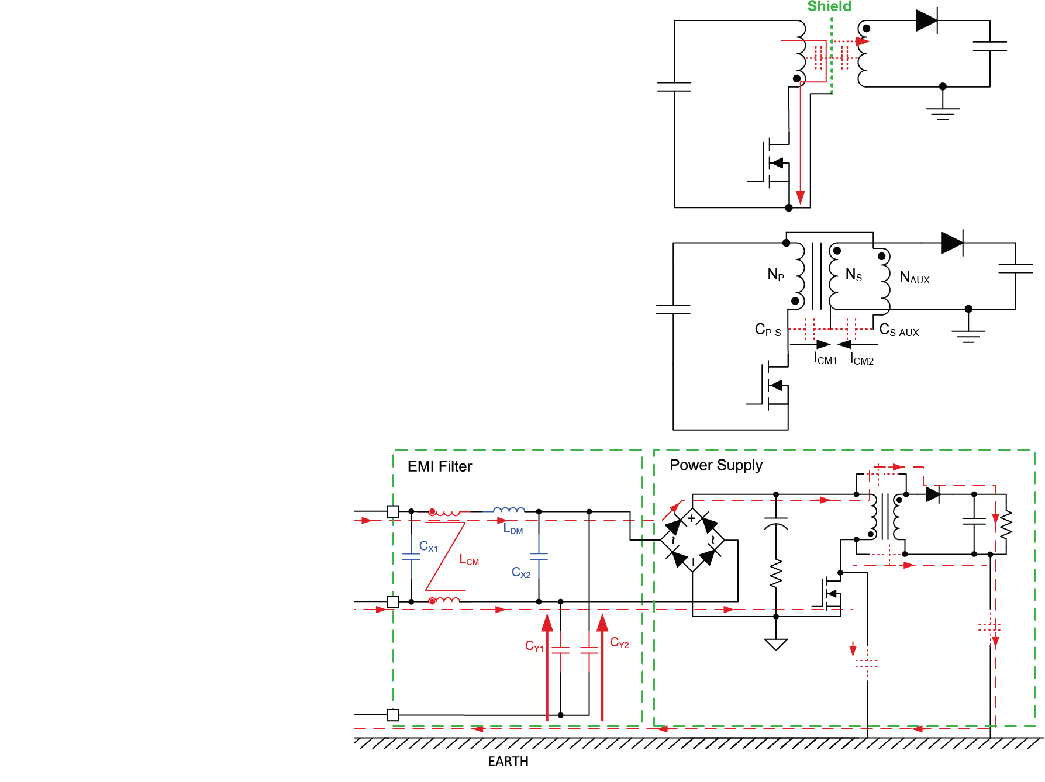
Mitigation options for CM noise
Shielding:
  Reduce flow of HF current to EARTH
Cancellation:
  Arrange transformer and power stage for balanced CM
Filtering:
  Increase impedance of the EARTH return path
  Provide alternative routes for the HF current

Slide 26
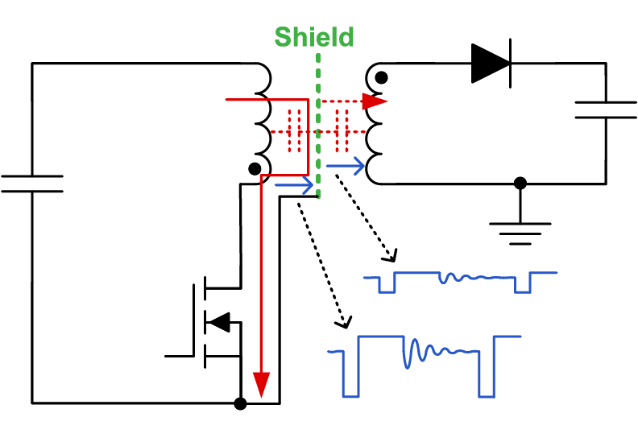
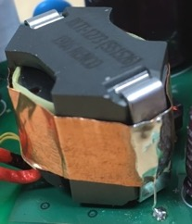

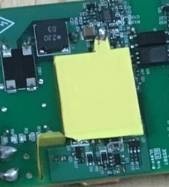
1. CM mitigation by shielding
1
2
Shielding inside the transformer
  Internal shields between pri & sec
Shielding outside the transformer
  GNDed flux-band
Shielding of noisy circuit nodes
  GNDed heatsinks over/around high-voltage switching nodes
Shielding of EMI filter from switching cct.
  GNDed shields/enclosures around filter
4
3

Slide 27
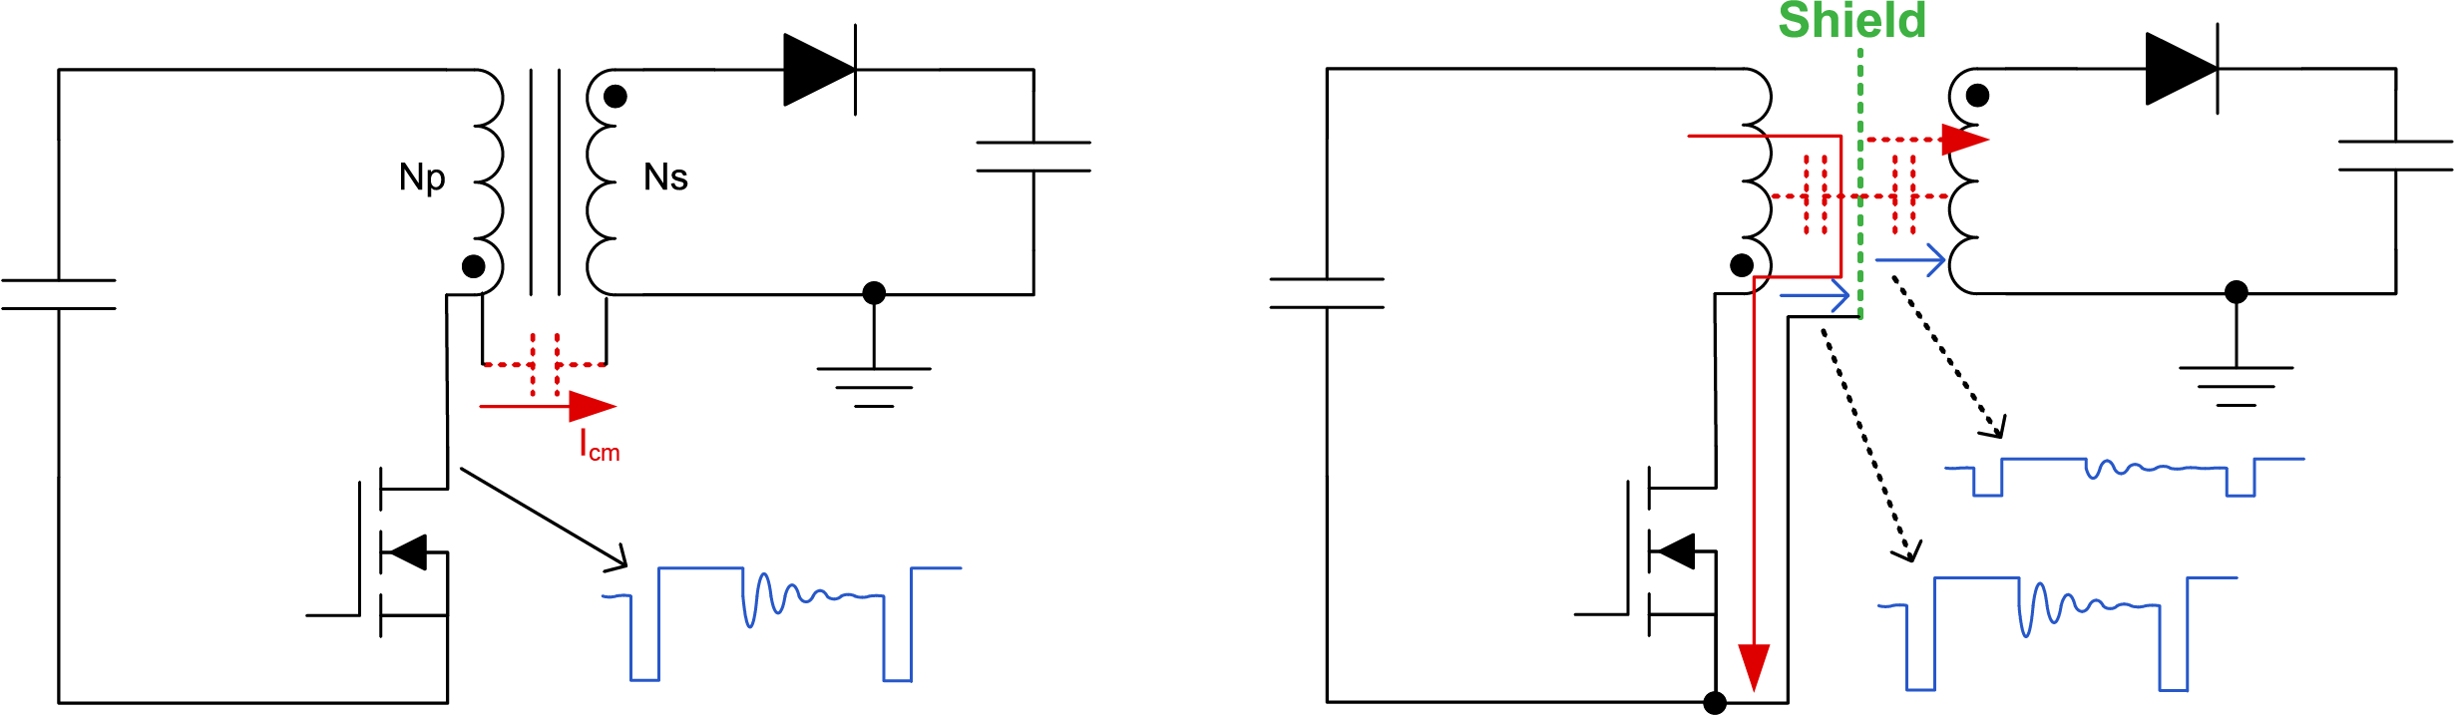
Transformer internal shielding
Shield added to keep most of CM current local to primary
Shield is 1-turn winding ⇒ lower induced voltage, less voltage across parasitic capacitance between shield & sec ⇒ less CM current flows
Shield must be thin (< 50 µm) ⇒ minimize induced eddy current loss
  Eddy currents get very significant as F_{SW} increases

Slide 28
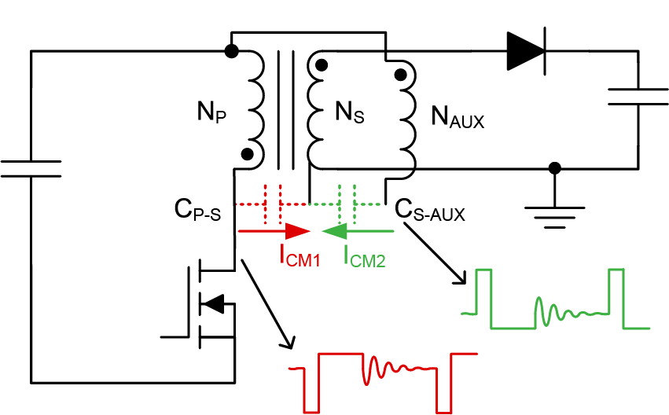
2. CM mitigation by cancellation/balance
Single-ended topologies – can add explicit additional cancellation elements
  Add auxiliary (AUX) transformer winding
  AUX voltage proportional to CM waveform
  Arrange AUX polarity for opposite phase
  Capacitor to inject cancelling current, I_{CM2}, to balance CM current from primary, I_{CM1}
  Injection capacitor explicit physical component added to design
  Or can use parasitic capacitance, e.g. C_{S-AUX}, part of transformer structure

Slide 29
3. CM mitigation by filtering
CM filter uses high-impedance CM chokes and low-impedance Y-capacitors
CM choke limits the flow of CM current from EARTH through the LISN
Y-cap provides low impedance to keep CM current local to primary GND and away from LISN

Slide 30
Practical EMI Considerations for Low-Power AC/DC Supplies
Part 5: Common Choke Practicalities
Bernard Keogh
Joe Leisten

Slide 31

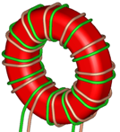
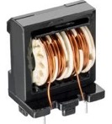
CM filter choke practical considerations
Frequency response of core material
  High-μ cores ⇒ high L value @ low freq, but roll off fast at higher freq
  High-freq cores ⇒ low-μ, smaller L value @ low freq, better vs freq
  Sometimes need to use 2 CM chokes, 1 for LF & 1 for HF
Split-wound vs bifilar-wound toroid
  Split-wound popular, lower cost, “free” DM choke from leakage field
  Bifilar ⇒ 1-side insulated wire, higher cost, but better noise immunity
Parasitic input-output cap – multi-layer windings
  Parasitic cap depends on number of turns & layers
    High C_{PAR} input-output cap ⇒ worse @ HF
  Less layers ⇒ lower L, but also lower C_{PAR}
  Sectional bobbins – used to reduce C_{PAR}
Split-Wound*
Bifilar-Wound*
Multi-Section
*CM choke 3-D images reproduced with permission of Wurth Elektronic

Slide 32
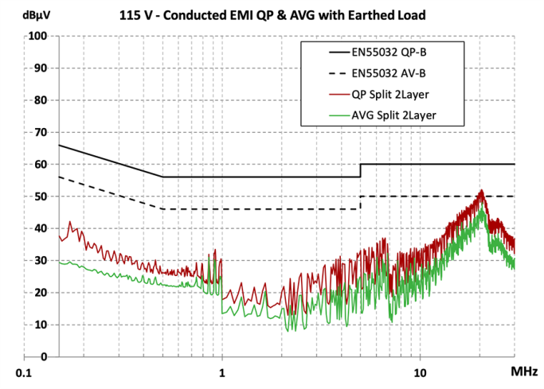
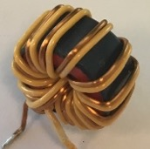
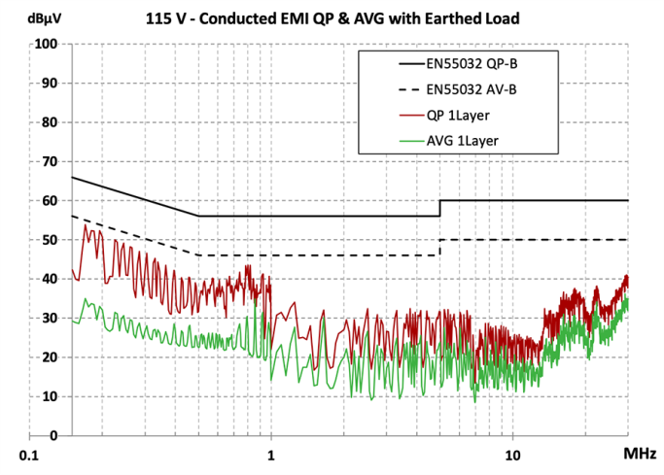
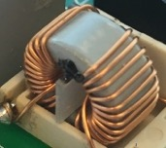
  CM filter choke – Impact of C_{PAR}
Split-wound 2-layer:
  25T, 5.1 mH
  Excess pass margin @ LF
  Low pass margin @ 20 MHz
Bifilar-wound 1-layer:
  14T, 1.1 mH
  Low input-output C_{PAR}
  Lower L at LF, but better at HF
  Better balance across frequency span
Split-wound 1-layer:
  14T, 1.4 mH
  Similar low input-output C_{PAR}
  Similar result as bifilar-wound
Split-Wound 2L
Bifilar-Wound 1L
Split-Wound 1L

Slide 33
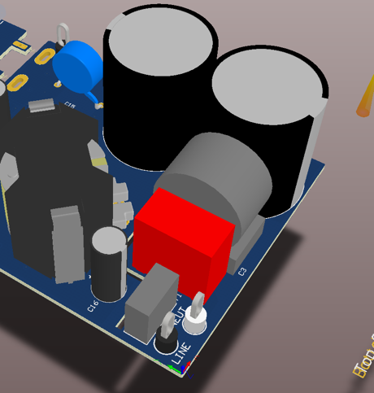

CM choke example
Initial split-wound choke had issues due to asymmetric noise coupling from transformer
  Shows up as big difference in EMI on L vs N
*CM choke 3-D image reproduced with permission of Wurth Elektronic

Slide 34
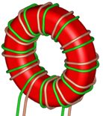
CM choke example
Changed to bifilar-wound choke, much better EMI result; less difference L vs N
Much better noise immunity
12 dB
*CM choke 3-D image reproduced with permission of Wurth Elektronic

Slide 35
Practical EMI Considerations for Low-Power AC/DC Supplies
Part 6: Transformer Impact on CM EMI
Bernard Keogh
Joe Leisten

Slide 36
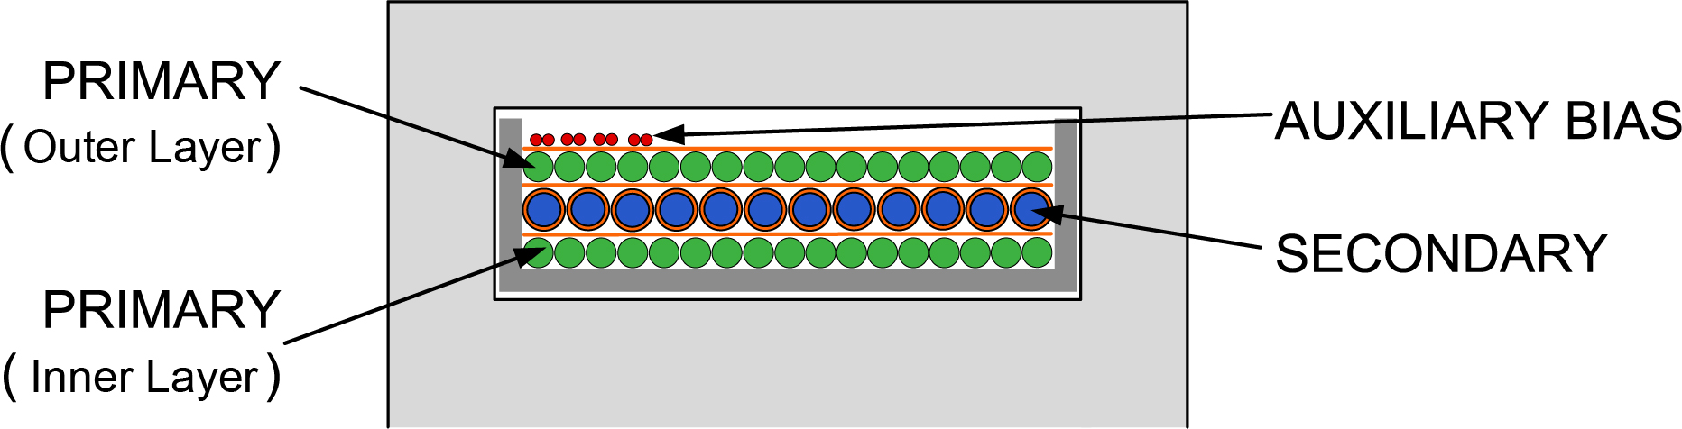
Transformer CM noise analysis – PMP21479 ACF
Initial design – interleaved flyback transformer construction, no internal shielding
Same transformer used for initial test with poor 100 dbµV EMI result

Slide 37
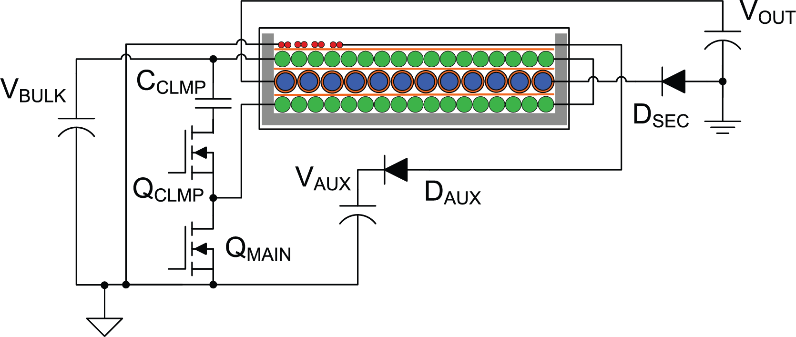
Transformer CM noise analysis – PMP21479 ACF
Circuit connections to the ACF power stage
Note the secondary low-side rectifier – causes inverted secondary winding polarity

Slide 38
Transformer CM noise analysis – PMP21479 ACF
Note that primary and secondary waveforms are inverse of each other
This increases the CM voltage
  Caused by low-side rectifier

Slide 39
Transformer CM balance – PMP21479 ACF
Add CM balance auxiliary layer (purple) in-between inner PRI (noisier) to SEC interface:
  Fill layer completely – acts as shield between PRI & SEC
  Add turns to create CM balance, inject current to balance other PRI-SEC interface
NOTE: this example shows one way to add CM balance
But there are many different ways to achieve the same CM result

Slide 40
Transformer CM balance – PMP21479 ACF
PRI, SEC & AUX bias connections same as before
CM auxiliary layer starts at PRI GND, and winds in SAME direction as SEC

Slide 41
Transformer CM balance – PMP21479 ACF
Waveforms – PRI & SEC same as before
CM AUX – same phase as secondary – but amplitude increased to compensate for outer PRI

Slide 42
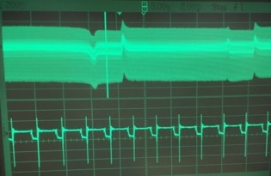
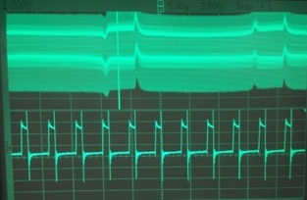
Transformer CM balance – PMP21479 ACF
CM AUX – need to adjust number of turns to balance the CM nulling
Waveforms showing:
A: Slightly under-compensated
  B: Slightly over-compensated
  C: “Just right”
A: 0.2 V/div, 5 µs/div
C: 0.2 V/div, 10 µs/div
B: 0.2 V/div, 5 µs/div

Slide 43
Practical EMI Considerations for Low-Power AC/DC Supplies
Part 7: Final Result and Summary
Bernard Keogh
Joe Leisten

Slide 44

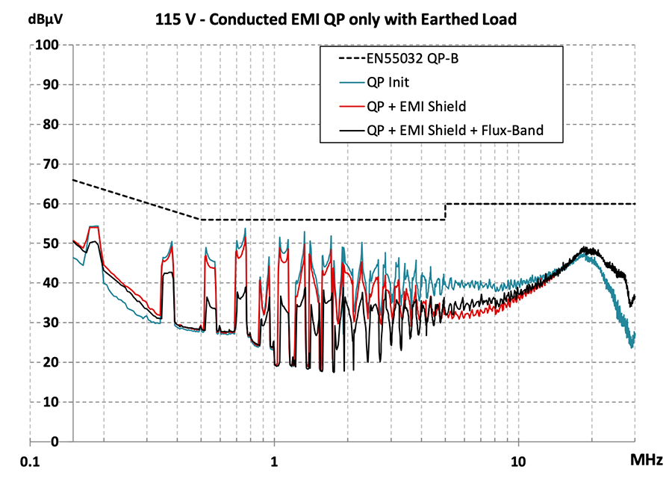
Transformer “housekeeping” best practices
Center-leg air-gaps only – outer legs will radiate
“Noisier” windings on inside of layer structure
Tie ferrite core to local primary GND
Flux-band to minimize stray coupling
  GNDing & flux-banding can give >10 dB improvement!
Interleaving trade-offs
  Lower leakage inductance
  Higher pri-sec parasitic capacitance, higher CM
Be aware of internal construction
  Average CM voltage across the pri-sec capacitance
  Arrange winding layers to minimize voltage difference
    Minimizes CM current
Flux-Band + EMI Shield ~15 dB

Slide 45

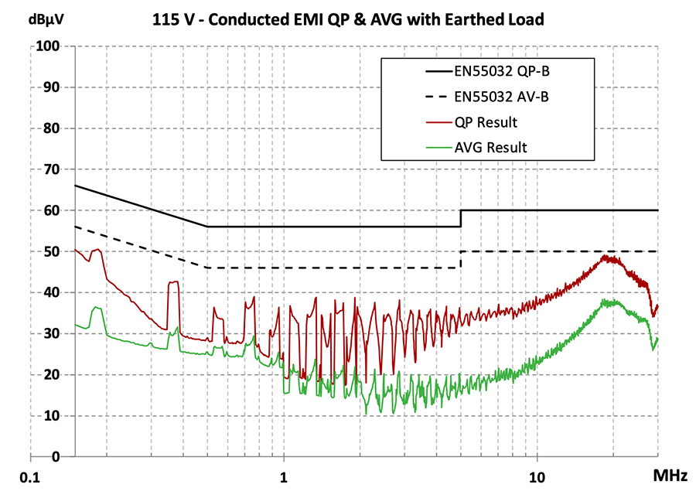
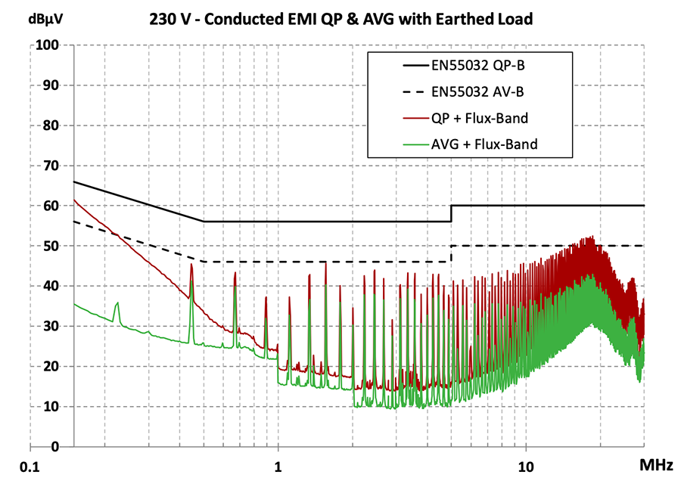

PMP21479 65 W ACF USB-PD – Final result
Improve transformer structure, add CM balance/shield winding layer
Add transformer grounding & flux-banding + EMI shield
Improve CM choke to bifilar-wound type
Improve output capacitor location, improve PCB orientation
  Largely “low-cost” improvements
  Small efficiency penalty (eddy loss in cancellation layer)

Slide 46
Summary & conclusions
Consider EMI right from the start – inherent part of the power supply design
Minimize DM & CM EMI noise at source
DM filter can be designed/calculated/simulated more easily than CM
CM balance is important – as much as practically possible
Debug to establish if EMI issue is CM or DM or both
Assess CM performance in time-domain – compare different transformers
For isolated PSU, transformer is most important component
  Internal construction details, CM balance, shielding, parasitic capacitance, housekeeping
EMI filter components – be aware of parasitics and HF effects
PCB layout and component placement – be aware of stray coupling paths

Slide 47
References
“Understanding and Optimizing Electromagnetic Compatibility in Switchmode Power Supplies,”
Bob Mammano & Bruce Carsten, 2002 TI Power Supply Design Seminar.
  http://www.ti.com/lit/slup202
“Flyback transformer design considerations for efficiency and EMI,”
Isaac Cohen & Bernard Keogh, 2016/7 TI Power Supply Design Seminar.
  http://www.ti.com/lit/slup338
“Input EMI Filter Design for Offline Phase-Dimmable LED Power Supplies,”
James Patterson & Montu Doshi, 2012/3 TI Power Supply Design Seminar.
  http://www.ti.com/lit/slup298
“Designing low-EMI power converters for industrial & automotive systems,”
Perry Tsao, David Baba & JP Fung, 2016/7 TI Power Supply Design Seminar.
  http://www.ti.com/lit/slup362
“Understanding Noise-Spreading Techniques and Their Effects in Switch-Mode Power Applications,”
John Rice, Dirk Gerhke & Mike Segal, 2008/9 TI Power Supply Design Seminar.
  http://www.ti.com/lit/slup269
“65W Active clamp flyback with Si FETs reference design for a high power density 5-20V AC/DC adapter,”
PMP21479, Brian King, 2019.
  http://www.ti.com/tool/PMP21479

Slide 48
Appendix – back-up slides

Slide 49
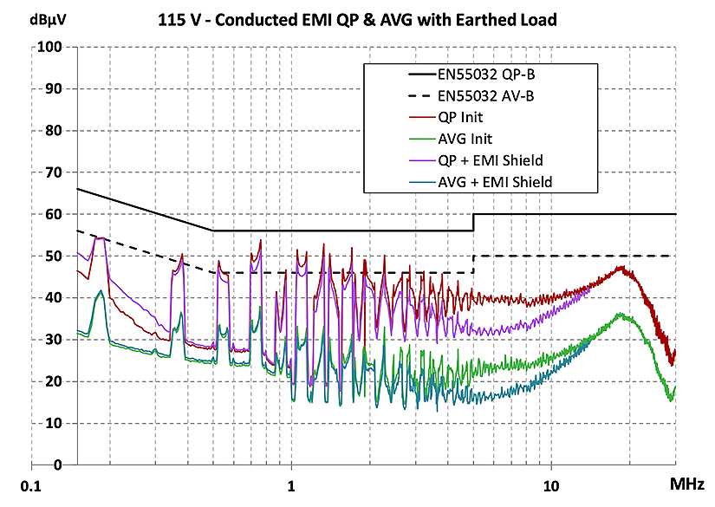
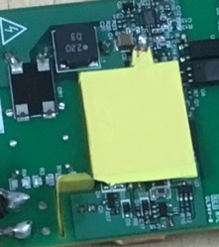
Transformer flux-band detailed results – 115 V
EMI shield only (over switch-node and between EMI filter and transformer)
NO flux-band, ferrite core floating
Biggest improvement ~5-8 MHz

Slide 50
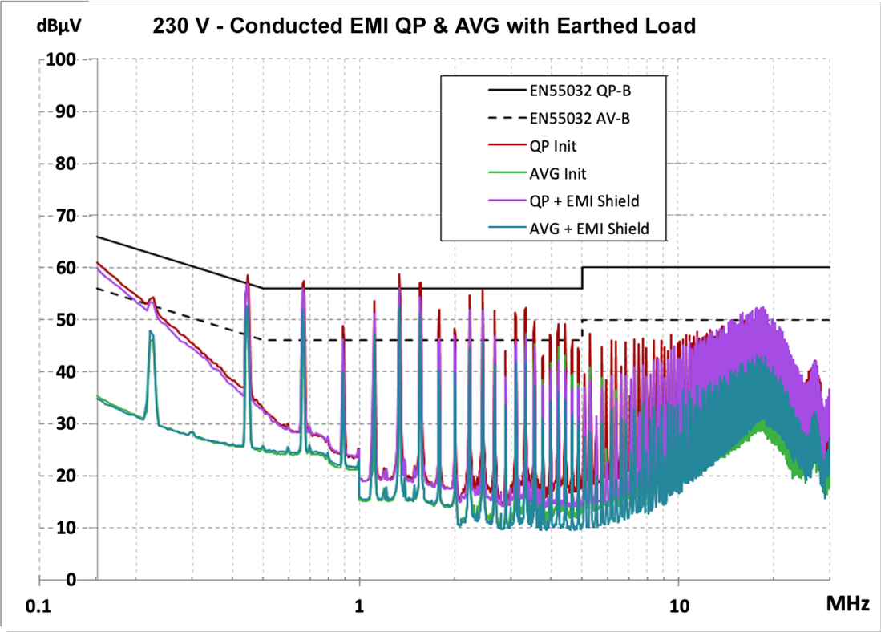
Transformer EMI shield detailed results – 230 V
EMI shield only (over switch-node and between EMI filter and transformer)
NO flux-band, ferrite core floating
Biggest improvement ~3-8 MHz

Slide 51
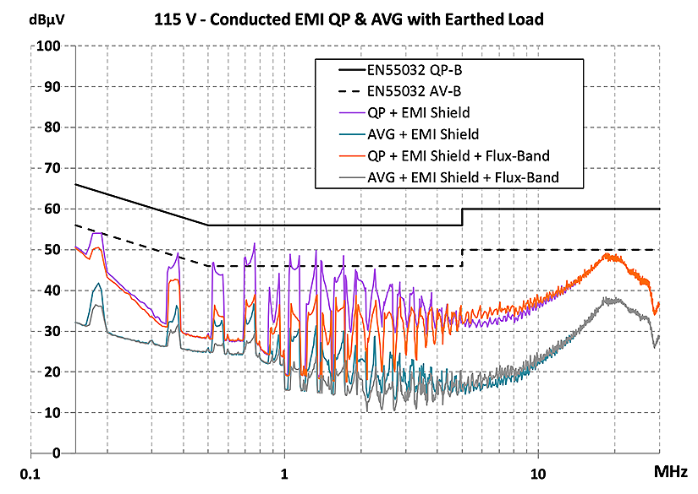
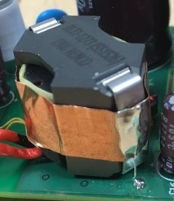
Transformer flux-band detailed results – 115 V
EMI shield only (over switch-node and between EMI filter and transformer)
Add flux-band, connected to local primary GND
Much more significant reduction from 150 kHz to ~4 MHz

Slide 52
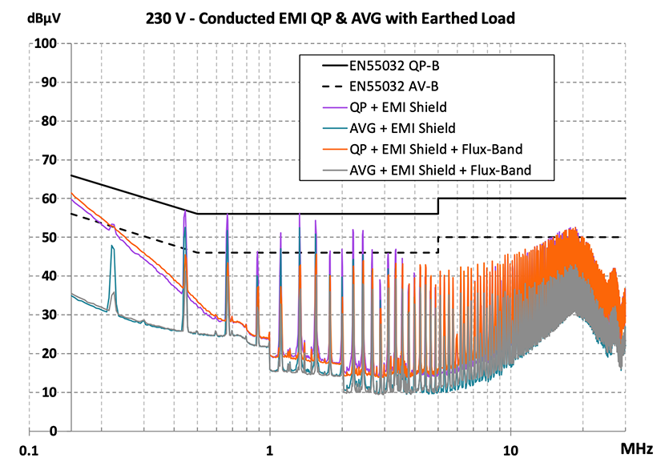
Transformer flux-band detailed results – 230 V
EMI shield only (over switch-node and between EMI filter and transformer)
Add flux-band, connected to local primary GND
Much more significant reduction from 150 kHz to ~4 MHz
  Especially for AVERAGE, which is much tougher at 230 V

