Slide 1
The OptoCoupler or OptoIsolator
Opto-Coupler is commonly used for feedback
Transfers information from the secondary back to the primary side
CTR – Current Transfer Ratio
$CTR=\frac{I_{C}}{I_{F}}$
Copto – Parasitic Capacitance seen across collector and emitter, sets a Frequency Pole inherent to Opto when wired in a common collector/emitter configuration which uses a Pull Up Resistor
$f_{pole}=\frac{1}{2π×C_{opto}×R_{Pullup}}$
V_{F} -Forward Voltage Drop of LED
V_{CEsat} –Voltage between collector and emitter when the LED is forward biased

Slide 2
LMV431 Reference
Reference is used as an error amplifier with open collector output
Reference voltage is 1.24V
LM431 has a Vref of 2.5V
When the voltage present on the Ref pin exceeds the internal reference of 1.24V the Transistor starts to conduct and current sinks from the Kathode to Anode.
This current should be set to ~1mA
The voltage between Kathode and Anode cannot be less than ~1.24V

Slide 3
Typical Flyback Feedback configuration
Biasing the LMV431
$\frac{V_{comp}}{V_{out}}≈−\frac{R_{pullup}}{R_{led}}×CTR$
$I_{Cmax}≈\frac{V_{cc}}{R_{pullup}}$
$I_{Fmax}≈\frac{I_{Cmax}}{CTR}$
$I_{Fmax}≈\frac{V_{out}−V_{ref}−V_{f}}{R_{led}}$
Equating I_{Cmax} to I_{Fmax} and rearranging for R_{led} yields…
$R_{ledmax}≈\frac{\left(V_{out}−V_{ref}−V_{f}\right)}{V_{cc}}×CTR×R_{pullup}$
R_{led} sets the Mid band gain as we will see later
Notes:
Rled set the max LED Current and sets the Mid band gain
Because the Kathode can only go down to Vref there is a limit on Rled.

Slide 4
Inner loop effects of Optocoupler feedback
Benefits of Inner loop
better transient response and lower component count
Ccomp at high frequencies becomes a short
The AC voltage across the LMV431 resulting from the Sense voltage at Vref goes to 0V
Feedback at the Ref pin of LMV431 becomes a “Virtual Ground”
Because Ccomp is a short at high frequencies we would assume that AC output at Vcomp is also zero.
However the LED current is made up of a DC and AC component.
The AC components finds a path in the inner loop seen at the Optocoupler LED

Slide 5
Disabling the Inner loop
Used in cases where the need to select a gain or attenuation without impacting the limits of R_{LED}, you will need to disable Inner loop

Slide 6
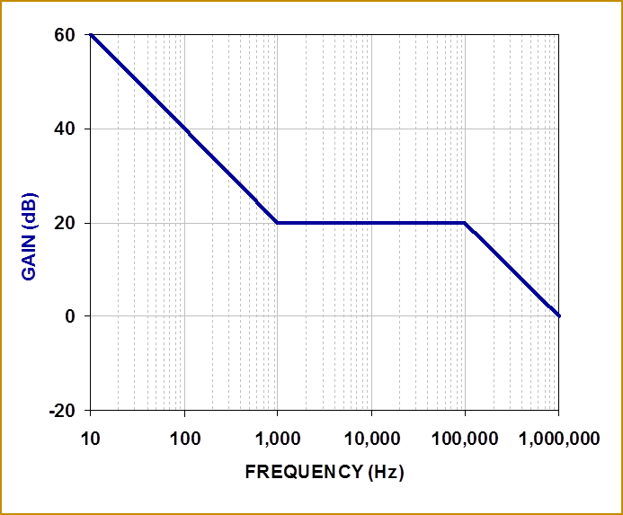
Type II Compensation Optocoupler Feedack
$$AVM=CTR×\frac{R_{pullup}}{R_{led}}$$
$$\frac{{\hat{v}}_{comp}}{{\hat{v}}_{out}}≈−AVM×\frac{1+\frac{ω_{Zea}}{s(i)}}{1+\frac{s(i)}{ω_{pea}}}$$
$$ω_{Zea}=\frac{1}{R_{top}×C_{comp}}$$
$$ω_{pea}=\frac{1}{R_{pullup}×C_{2}}$$

