Slide 1
ChemID determination in BQ Studio
Bhaskar Sompalli, 5/21/2021

Slide 2
ChemID determination: Read from pack in BQStudio
f
Step2: Press Write Word
Step1: Type 0008 here
Step3: Press Read Block
Step4: Note down the Hex value Data
(A5 81 in this case)

Slide 3
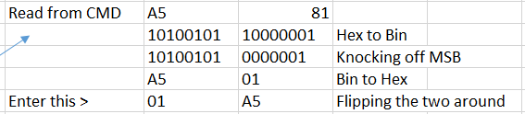
ChemID determination: Excel spreadsheet calculation
Use the spreadsheet provided before.
Follow steps as shown
Step 1: Type in BQ Studio Hex value Data here (A5 81)
Step2: Note down the ChemID value calculated (01 A5 here)

Slide 4
ChemID determination: Enter ChemID into BQStudio
Enter the Hex value for ChemID here
Enter calculated excel sheet value here

Slide 5
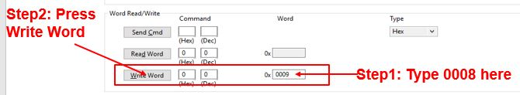
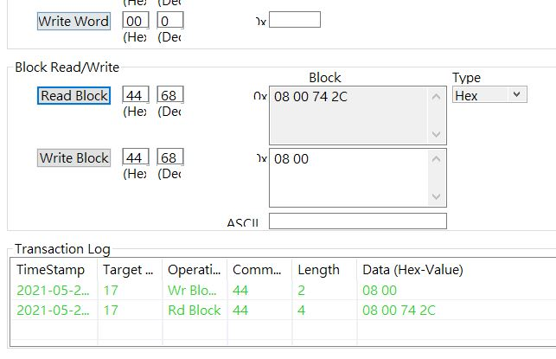
ChemID determination: Enter ChemID into BQStudio
Chemical ID verification problem
After verification, even if the Step1: Type 0008 step is missing, Is executable
It may be the lack of Step1, which causes a probability of error , It's a bug

