Slide 1
Technical Report U1 (PN# C04-06474-01)
Model : TEB
2022.02.08

Slide 2
Problem Statement
Station: ICT
Failure: VCC power Test failed for 3v3.
PN# C04-06474-01
D/C: 2138
3units Failed over 31 units ICT Tested.

Slide 3
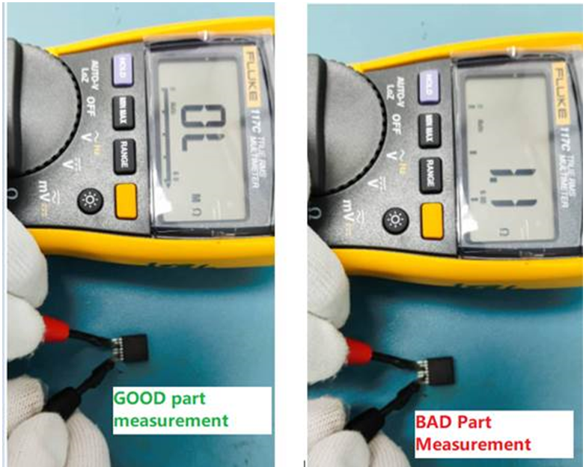
U1 component measurement
Debug Finding/Analysis:
U1 pin3(EN) and Pin5 (SS) impedance measurement.
- Normal Part should get Open Reading.
- Defective Part is Short/Low ohm reading.

Slide 4
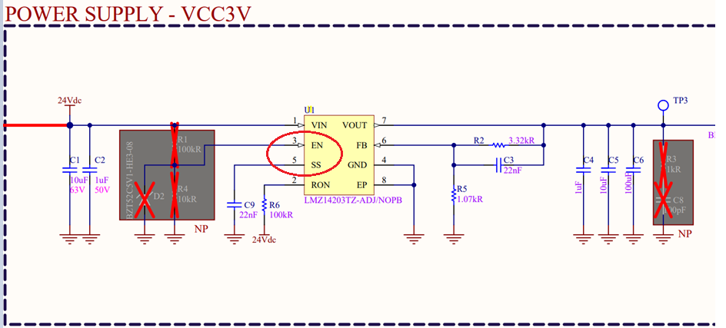
Schematic of VCC 3v3 diagram
U1 pin3(EN) and Pin5 (SS) is independent Signal trace, not draw in parallel.

