Slide 1
TPS25751EVM +BQ25731EVM
Aya Khedr
3/12/25

Slide 2
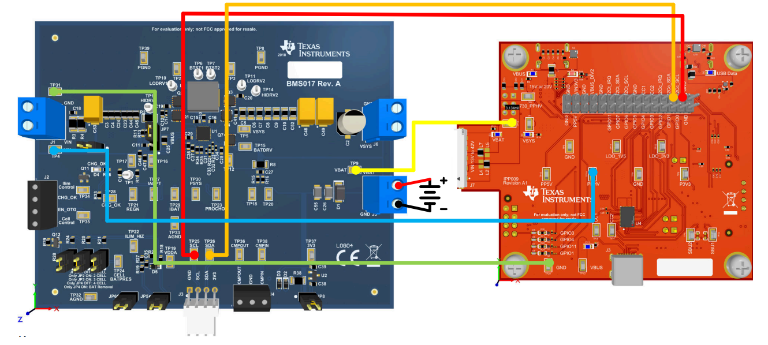
EVM Hardware Connections
*Refer to BQ25713 Section in EVM User’s Guide. BQ25731 EVM connections are the same.

Slide 3
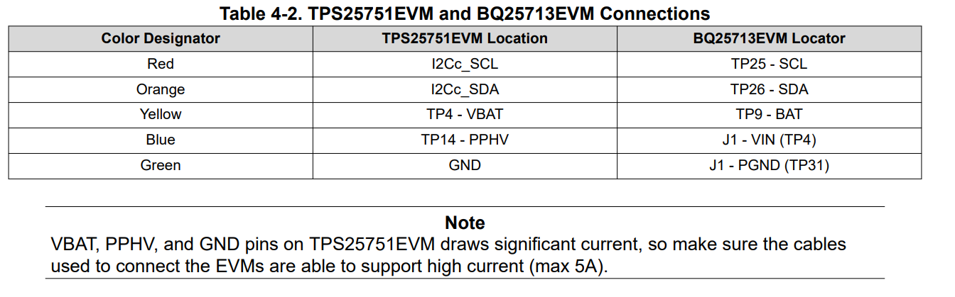
EVM Hardware Connections Continued
*Refer to the BQ25731EVM User Guide for power supply recommendations and setup

Slide 4
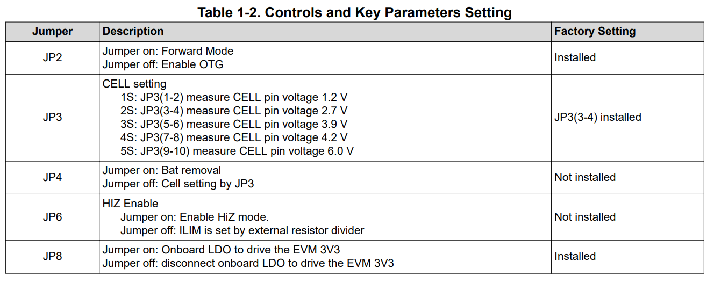
BQ25731 Jumper Settings
Remove JP2
Ensure JP3 setting matches Battery Charging Voltage setting in Q14 in GUI

Slide 5
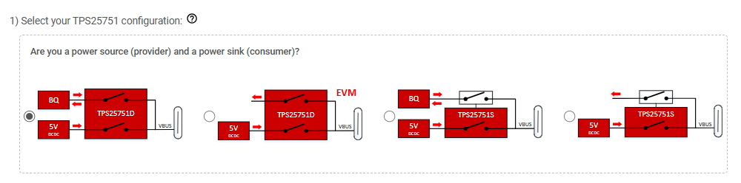
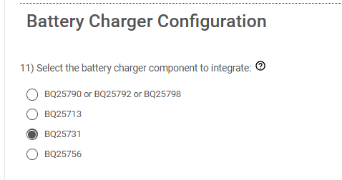
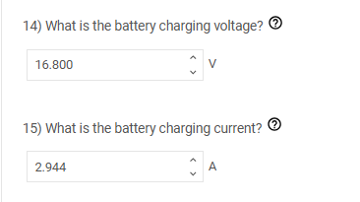
Software Setup
Example for 4S

