Slide 1

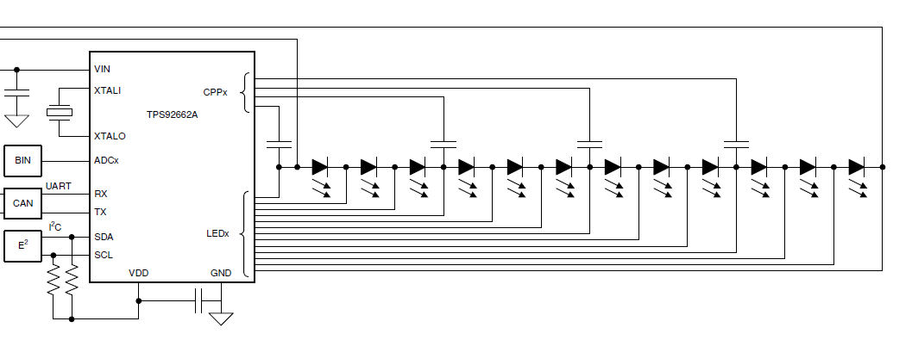
5颗LED
6颗LED

