Slide 1
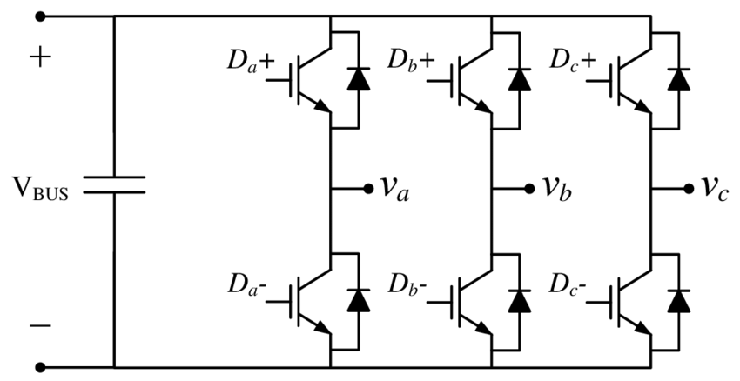
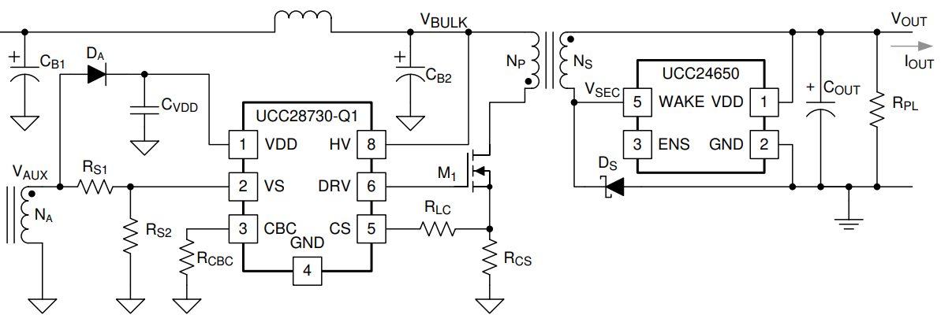
HV Power Supply
IGBT Power Module
HV+
Motor
HV-
Input 350V
Output 14.7V,
3W-25W

Slide 2
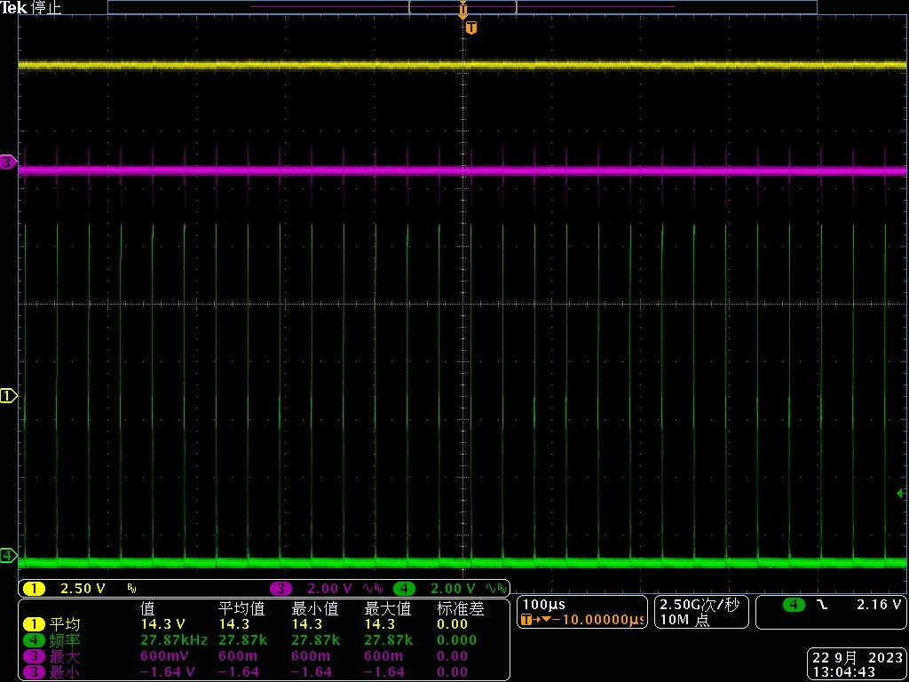
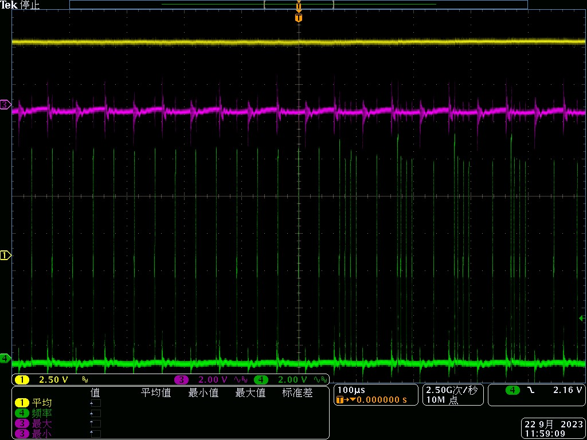
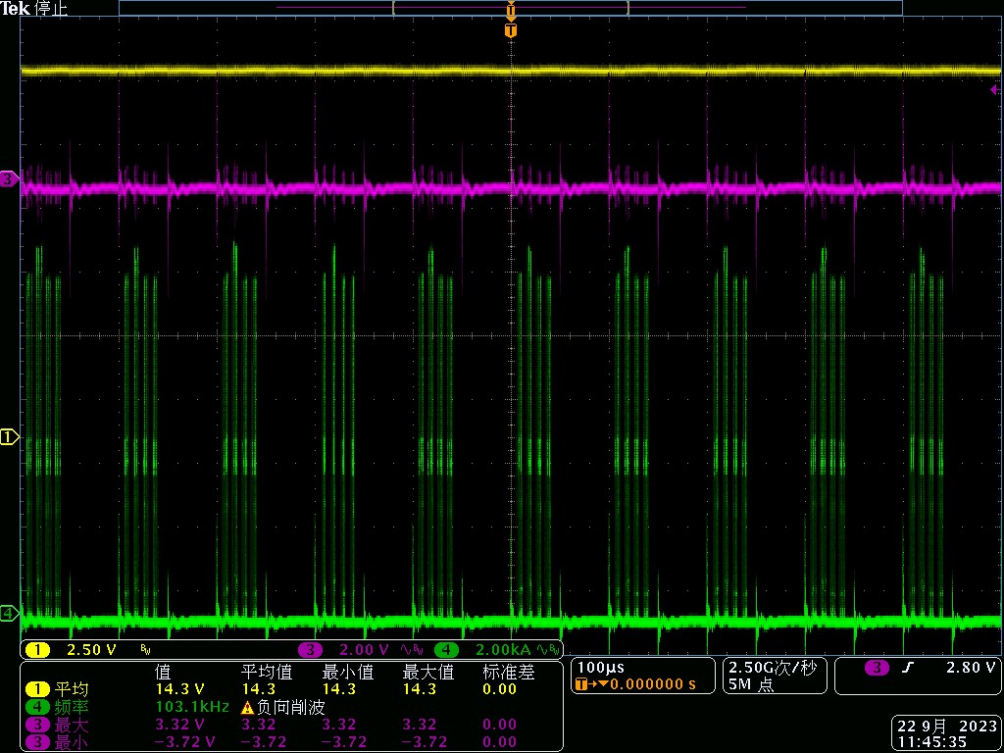
UCC28730 Abnormal Phenomenon ①
CH1：Flyback Output Voltage CH2：HV Input Voltage CH3: UCC28730 PWM Signal
IGBT module not running，
@-40 ℃ ——105℃ environment temperature
IGBT module running ，
@25℃ environment temperature
IGBT module running ，
@105℃ environment temperature
Abnormal phenomenon：
When the IGBT module is not running, UCC28730 DRV pin output normal PWM pulse.
When the IGBT module is running, , UCC28730 PWM output pulse changed, even spacing single PWM pulse changed to four continuous short interval pulses, at 105℃ environment temperature, all single pwm pulses are changed to abnormal pattern.
IGBT模块不工作时，UCC28730输出PWM为均匀时间间隔的脉冲。IGBT模块工作后，UCC28730输出PWM出现改变。25°环温时，部分
PWM脉冲出现变化。温度越高，发生变化的PWM脉冲越多， 105°环温时，所有PWM脉冲均发生了变化。
该受干扰情形下，UCC28730的环路控制依然有效，flyback输出电压与电流依旧稳定。

Slide 3
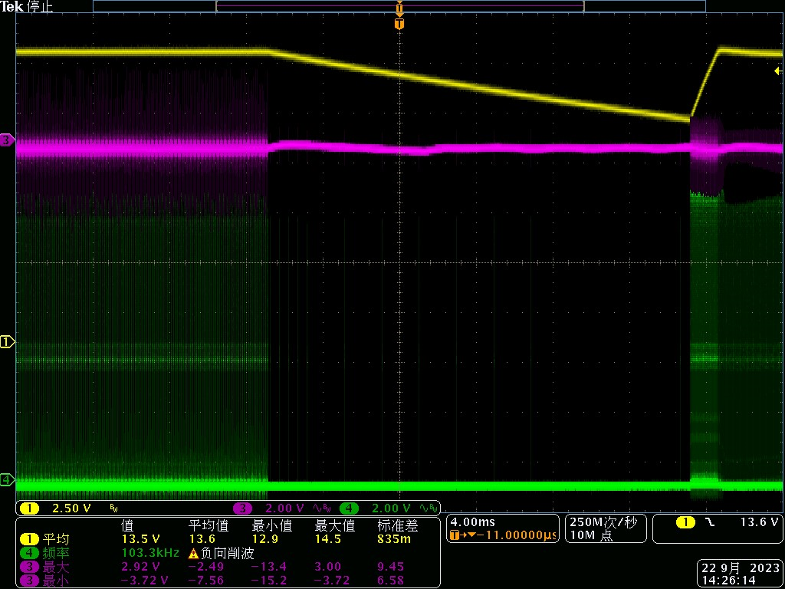
Flyback Abnormal Phenomenon ②
Test Temperature: 105℃
Test process:
（1）IGBT module is running at 10kHz frequency
（2）turn off IGTB module through MCU command
Abnormal phenomenon：
When the IGBT module is turned off by the MCU command, UCC28730 DRV pin suddenly stopped outputting continuous PWM signal for about 20ms, then recover to output PWM again
CH1：Flyback Output Voltage CH2：HV Input Voltage CH3: UCC28730 PWM Signal

Slide 4
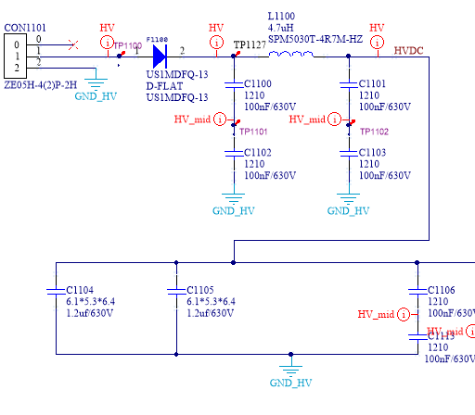
Speculated Cause for UCC28730 abnormal operating
When IGBT module is running, the switching frequency is 10kHz，UCC28730 IC internal analog circuit is disturbed by the 10kHz based frequency noise on the HV input line caused by the IGBT module. IGBT turn off process also caused some noise on the input line will make UCC28730 stopped output.
A CLC filter has been added in the input port of UCC28730, and a common choke also be used on the HV input line, but these solution had no effect, UCC28730 still work abnormally if IGBT module is running.
Input filter

