Slide 1

补充测试/Supplementary Test
报告人： 班国帅
报告时间： 2026.04

Slide 2
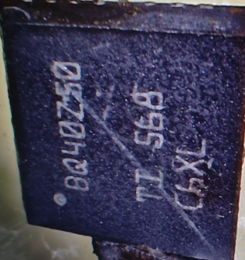
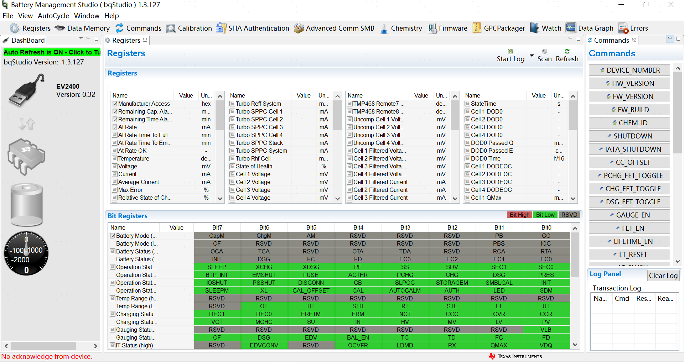
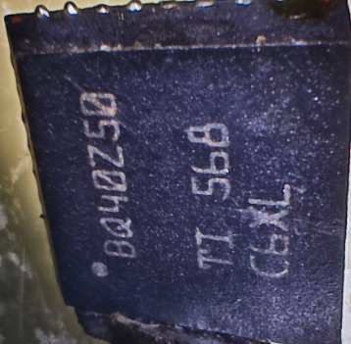
1.
异常芯片情况/Abnormal Chip Condition
通讯情况/Communication Status(NG)
1#
2#

Slide 3
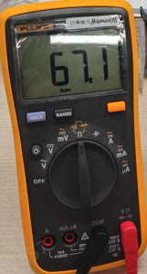
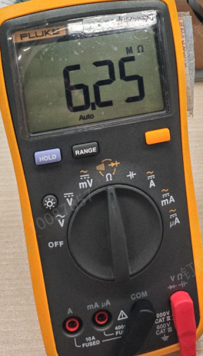
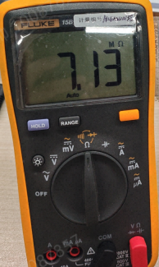
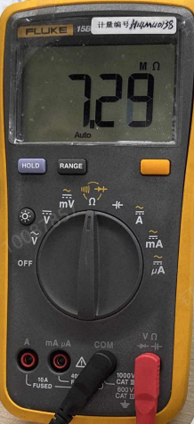
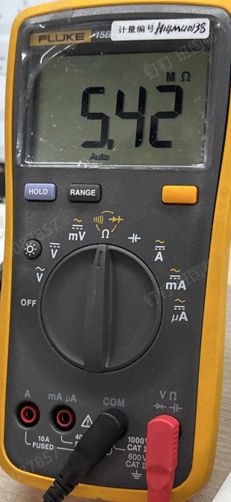
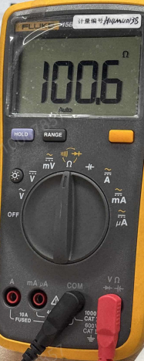
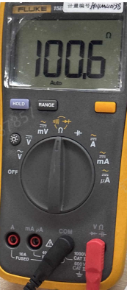
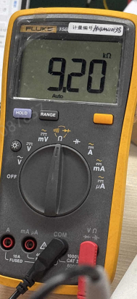
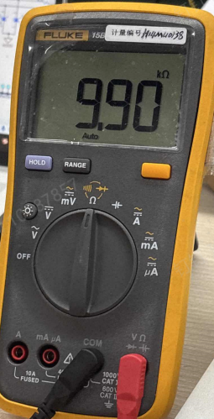
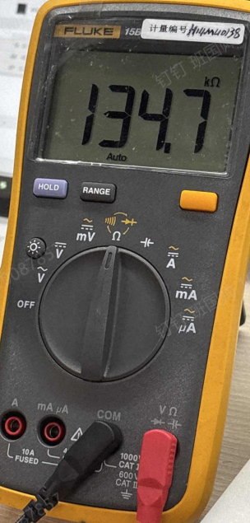
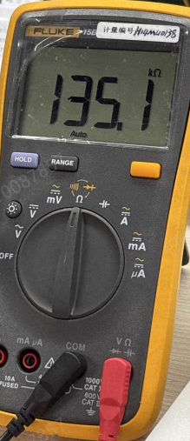
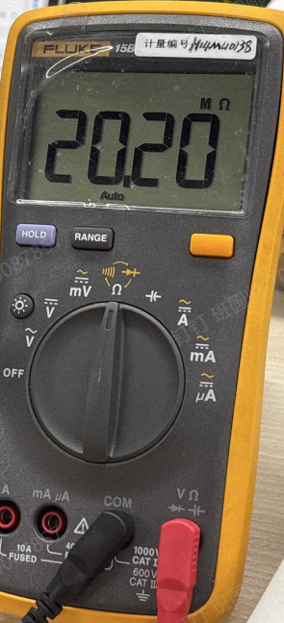
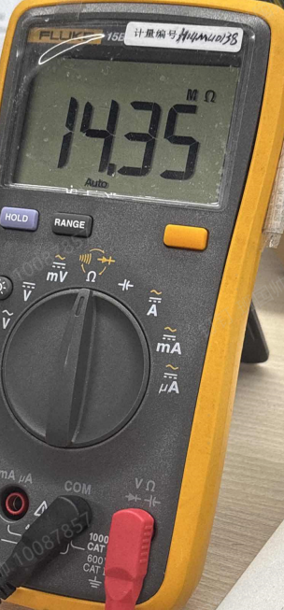
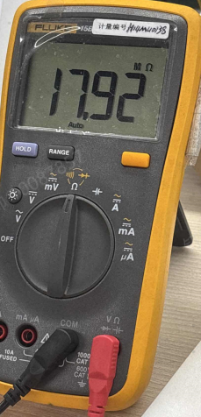
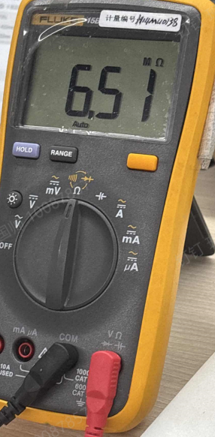
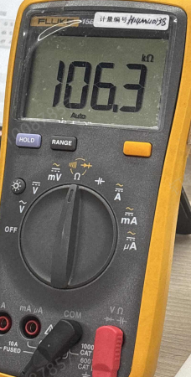
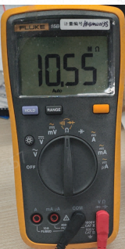
2
引脚电阻/Pin Resistance
VC4
6.25MΩ
VC3
7.13MΩ
VC2
7.29MΩ
VC1
5.42MΩ
SRN
100.6Ω
SRP
100.6Ω
PBI-
67.1KΩ
TS1
9.2KΩ
PRES
9.9KΩ
SMBD
134.7KΩ
SMBC
135.1KΩ
FUSE
20.2MΩ
DSG
14.35MΩ
CHG
17.92MΩ
PCHG
6.51MΩ
BAT
106.3KΩ
PACK
10.55MΩ
备注：未上电。B-对各引脚电阻
Note: Not powered on. Resistance between B- and each pin

Slide 4
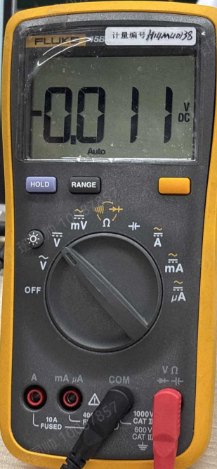
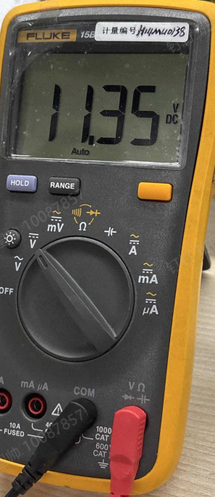
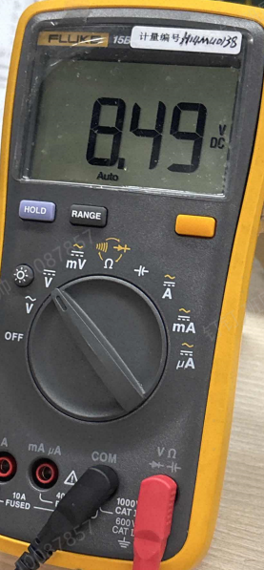
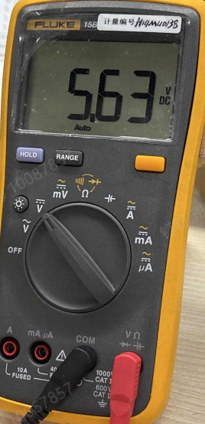
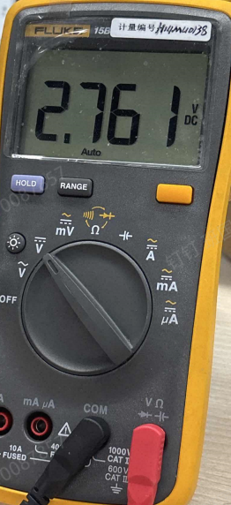
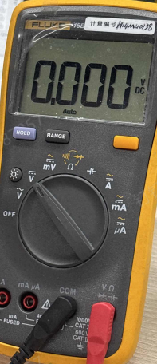
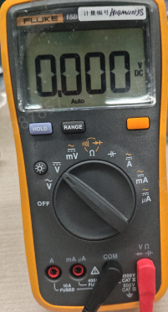
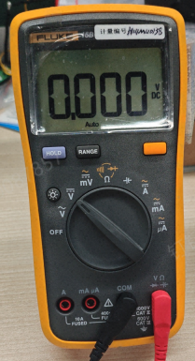
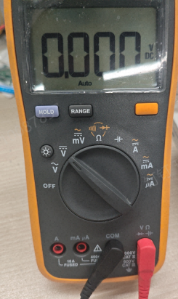
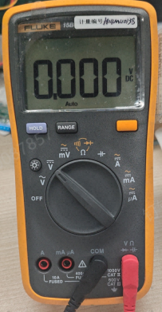
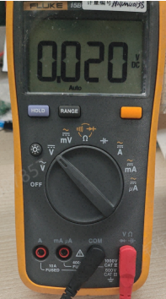
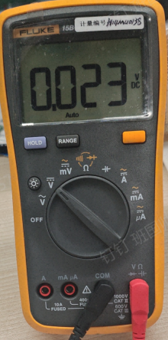
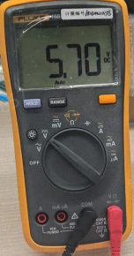
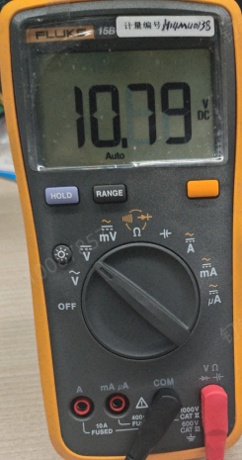
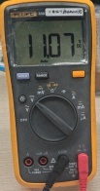
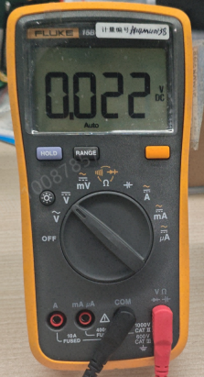
3
引脚电压/Pin Voltage
VC4
11.35V
VC3
8.49V
VC2
5.63V
VC1
2.761V
SRN
0V
SRP
0V
PBI-
0.011V
TS1
0V
PRES
0V
SMBD
0V
SMBC
0V
FUSE
0.020V
PACK
0.0023V
CHG
5.7V
PCHG
10.79V
BAT
11.07V
DSG
0.023V
备注：上电(四串电芯，总电压是11.35V),各引脚对B-的电压
Note: Powered on (4-series cells, total voltage 11.35 V). Voltage of each pin relative to B-.

Slide 5
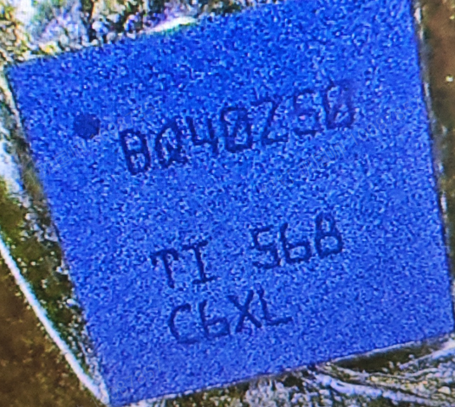
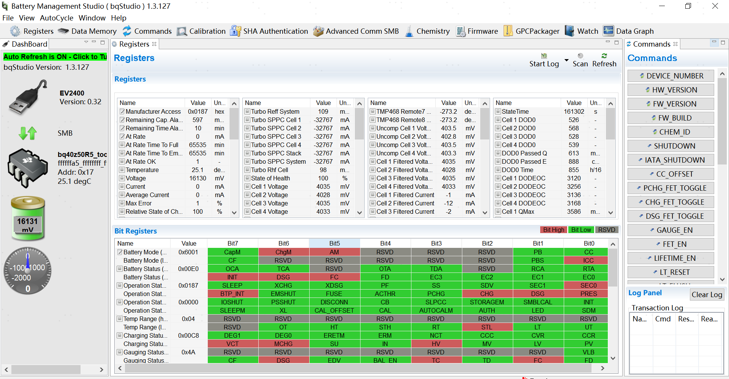
3
正常芯片状况
正常芯片丝印/Normal Chip Marking
通讯情况/Communication Status(OK)
备注：按照A-B-A交叉实验验证不良跟随芯片走
Note: Defect follows the chip as verified by A-B-A cross-test.

Slide 6
Power the Future

