Slide 1
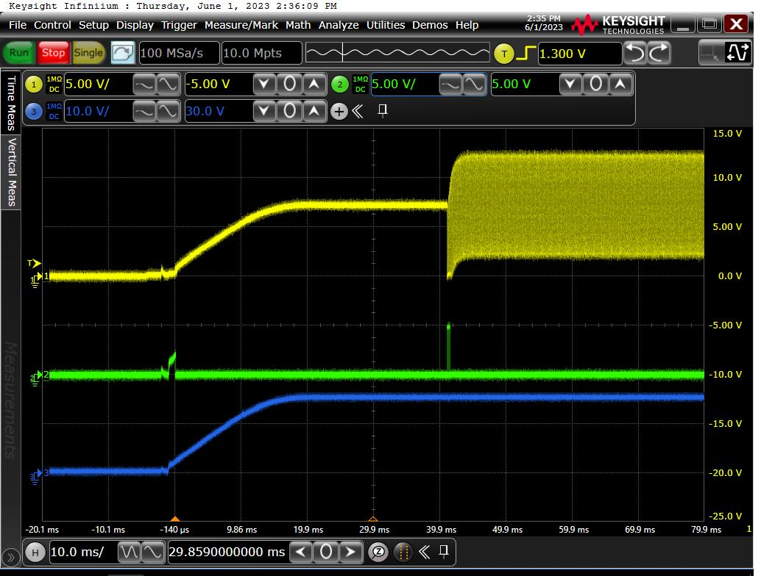
Step 1：Waveform
ch1(yellow):
ResE_AO_Exc_R1
Ch2(green):
OPA564 pin 8 OC flag
Ch3(blue):
OPA564 pin 2 P16V_Res
R927 resistor value = 47kohm
Result:
We can see the OC pin over 2V when R1 is started.
See the next page for more details.

Slide 2
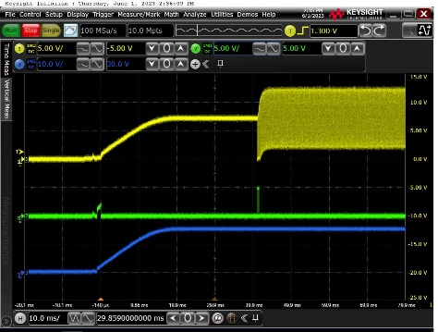
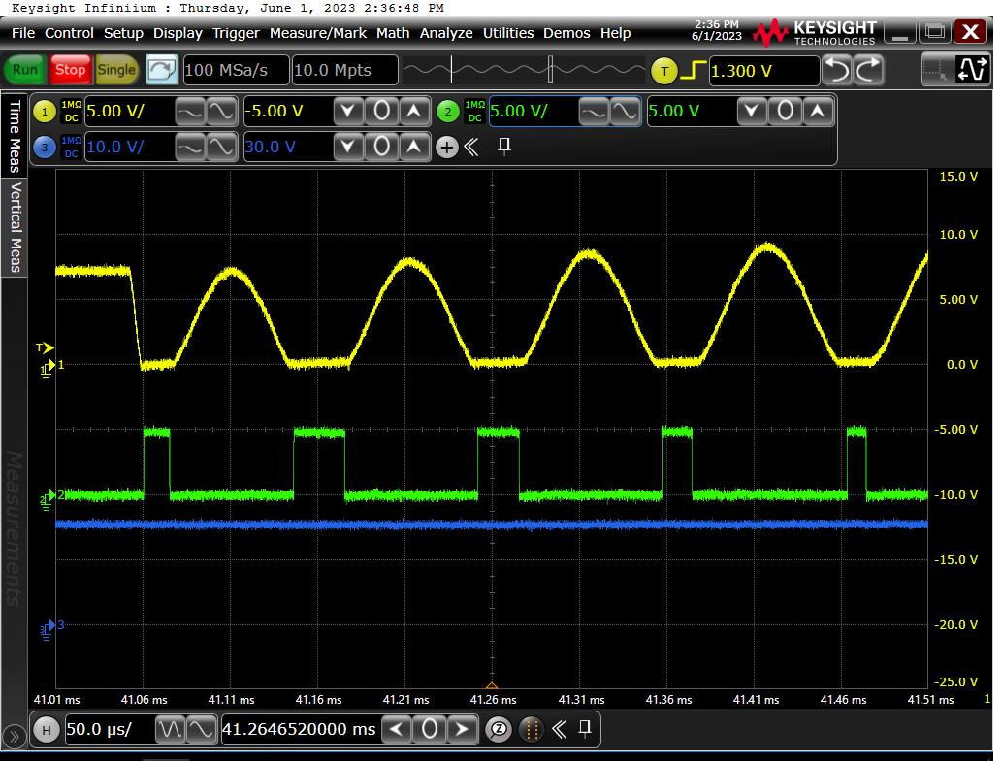
Step 1：Waveform
ch1(yellow):
ResE_AO_Exc_R1
Ch2(green):
OPA564 pin 8 OC flag
Ch3(blue):
OPA564 pin 2 P16V_Res
R927 resistor value = 47kohm
Result:
We can see the OC pin over 2V when R1 is started. 5 PWM pulses were observed. The maximum pulse width is about 30us.

Slide 3
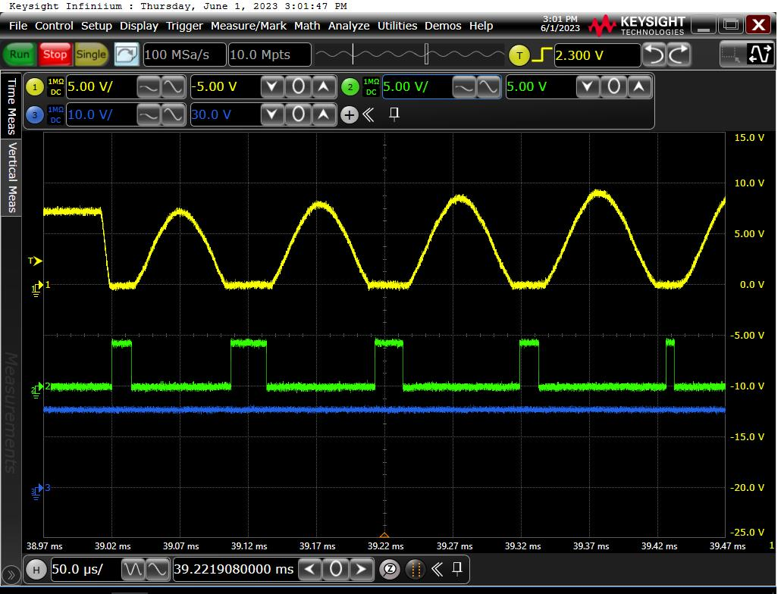
Step 2：Waveform
ch1(yellow):
ResE_AO_Exc_R1
Ch2(green):
OPA564 pin 8 OC flag
Ch3(blue):
OPA564 pin 2 P16V_Res
R927 resistor value = 10 kohm
Result:
When we tried to reduce the OC resistor from 47k to 10k, the OC pulses were still existing.
We want to know why the OC pulses can be always existing in this amplifier? Is there any risk for damage the amplifier?

