Slide 1
Schematic & layout review
9 April, 2025

Slide 2
AM6234 VS Layout guide
9 April, 2025

Slide 3
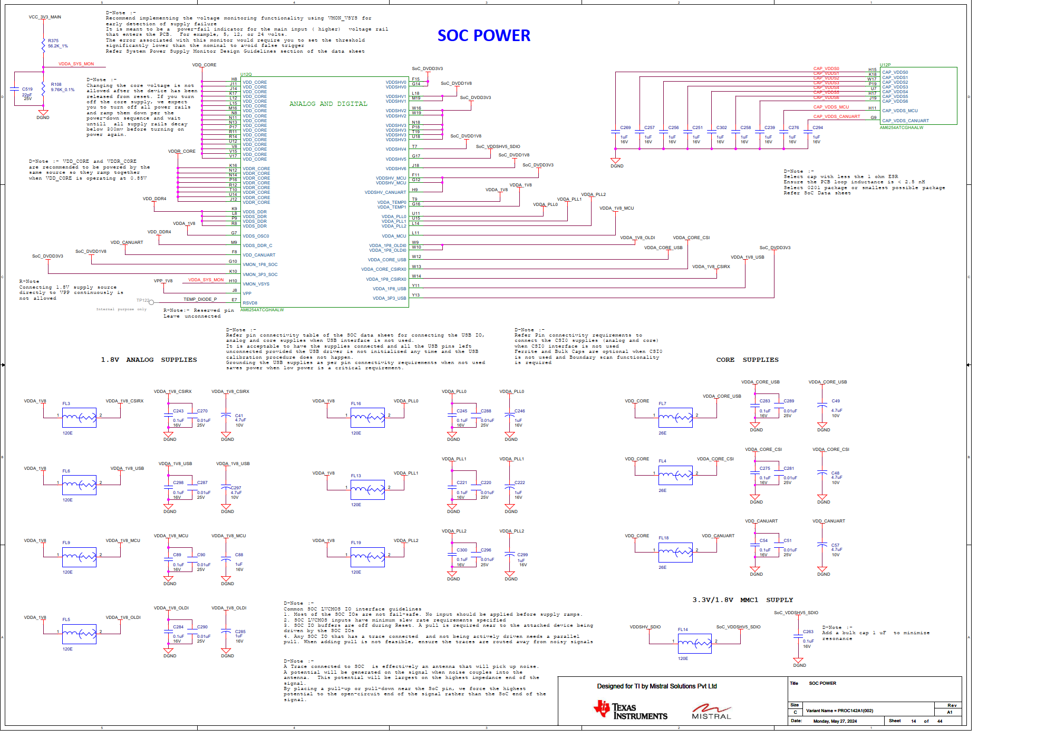
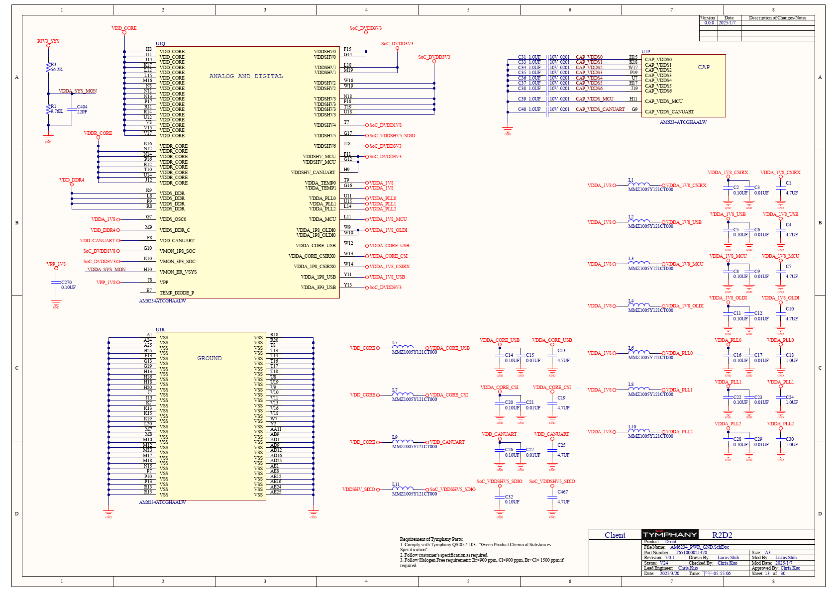
SCH
Low capacitor withstand voltage

Slide 4
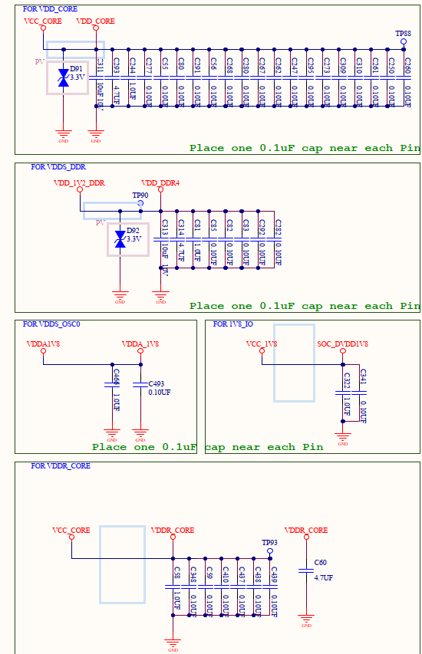
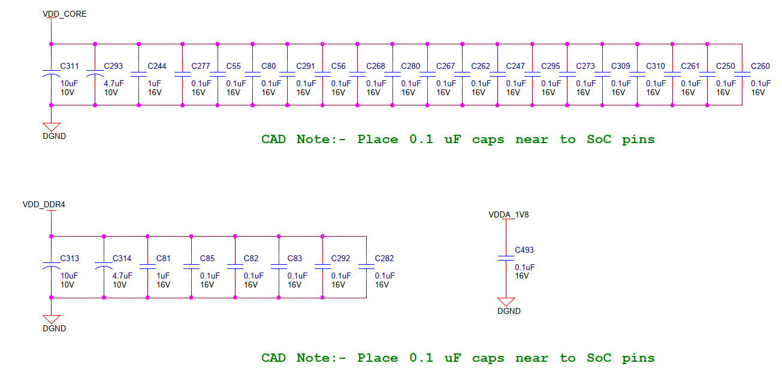
SCH
More add TVS Diode
More add C-1.0uF

Slide 5
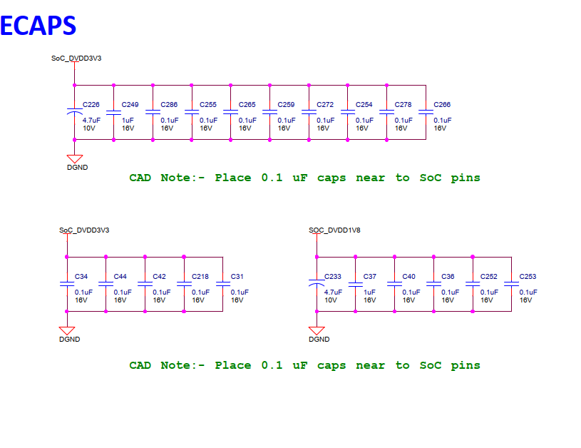
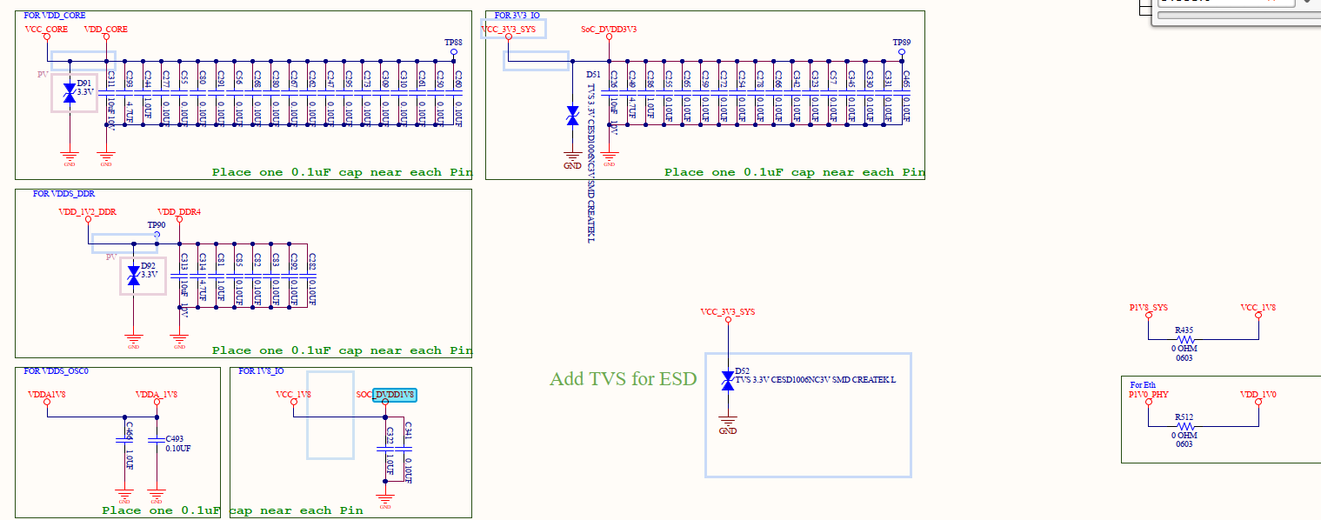
SCH
DVDD1V8 capacitor four less

Slide 6
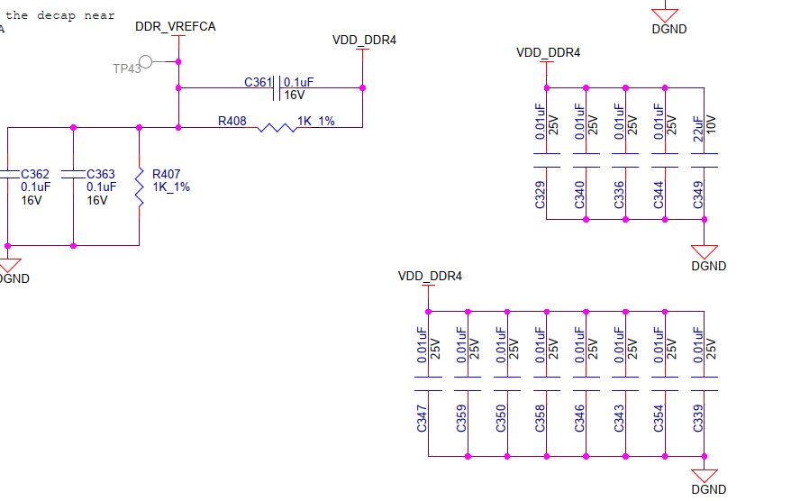
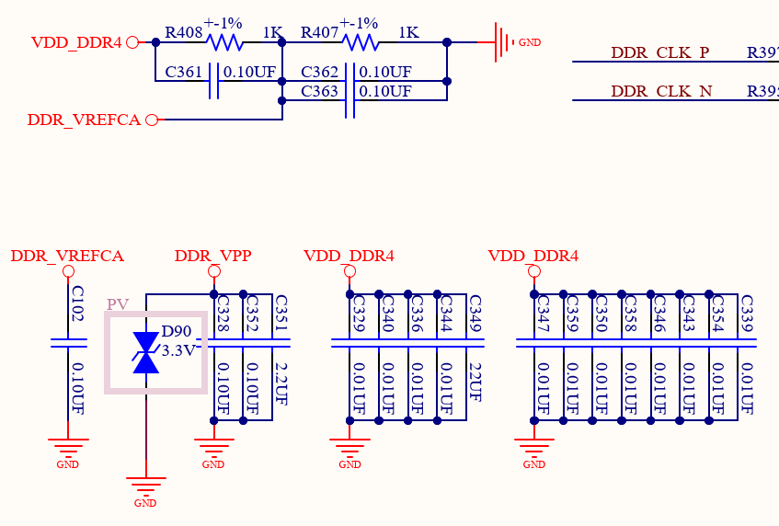
SCH
More add TVS Diode

Slide 7
DP83867ERGZR VS Layout guide
9 April, 2025

Slide 8
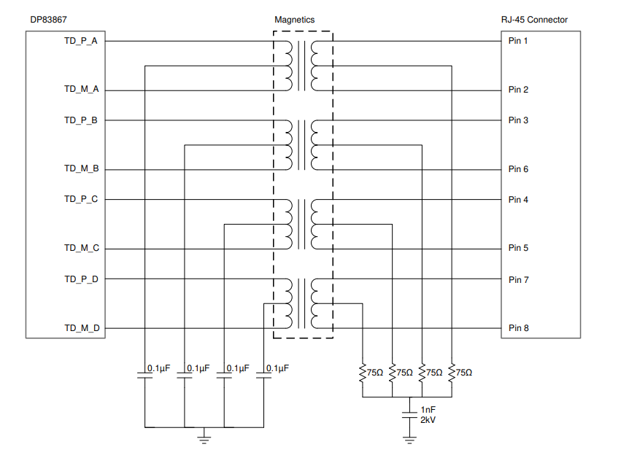
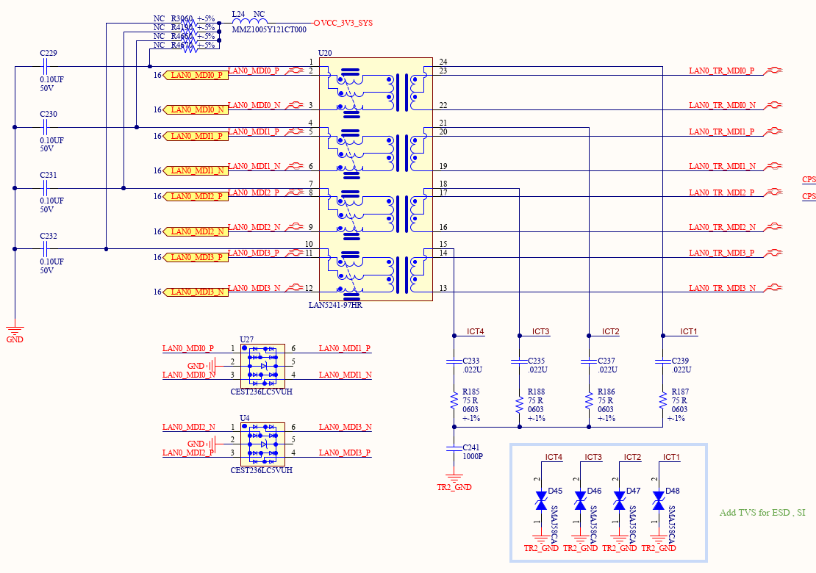
SCH
More 0.22uF

Slide 9
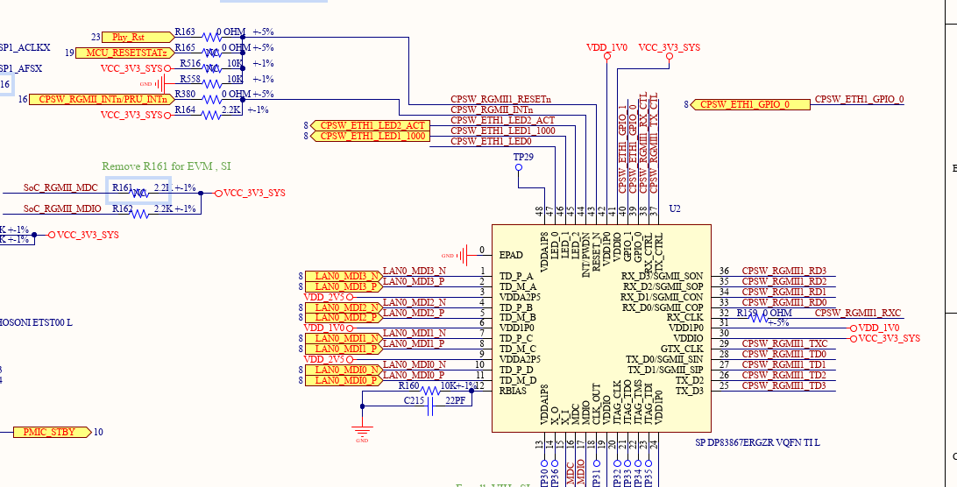
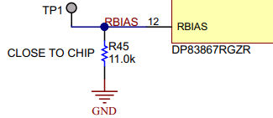
RBIAS
One more 22pF

Slide 10




Q&A

