Slide 1
CLA Hands-On Workshop
C2000 Software Team
Vishal Coelho

Slide 2
Control Law Accelerator
An independent 32-bit floating-point math accelerator
C28x
CPU
ADC
High
Res
PWM
CMP
CLA
Operates independent of the CPU
Clocked at the CPU frequency (SYSCLKOUT)
Enables Execution of algorithms in parallel with the C28x CPU
independent register set, memory bus structure and processing unit
Direct access to peripherals such as ePWM, ADC result and comparator
Low interrupt response time – no nesting of tasks
Executes time-critical control loops concurrently with the main CPU
Collateral Support
Restricted syntax ‘C’ Compiler and math library available (earlier ASM programming model was a barrier to adoption for many customers)
Safety IEC60730 library support for customers interested in UL certification
Application specific libraries for Digital Motor Control, Power and Solar
2

Slide 3
CLA Architecture
CLA is a slave to the main core C28x, and runs out of RAM i.e. C28x is responsible for
copying program and assigning memory
CLA has independent Data Bus and Program Bus
F2837x: Any LSx memory can be configured as CLA data or program memory
F2806x: LS3 is CLA program while either/all of LS0, 1, 2 can be CLA data memory
Access to peripherals such as (Consult device datasheet and TRM)
EPWM, ADC result registers , GPIO, QEP, SD , ECAP , DAC , CMPSS
SPI , uPP ,McBSP & EMIF Memory
Communication between CPU(C28x) and CLA through message RAM
Program RAM
Data RAM
Data Memory
Program Memory
CLA Data ROM
CLA
CPUtoCLAMsgRAM
C28x
EMIF
data
CLAtoCPUMsgRAM
Peripheral Bus
QEP
ADC
CAP
PWM
GPIO
SD
DAC
SPI
McBSP
Notes:
1. *Newer devices like the 2806x and 2805x have access to the eCAP and eQEP modules, shown in blue, while the 2803x line does not

Slide 4
CLA – A Task Driven Machine
CLA Task is an instruction routine, which is triggered by a control peripheral(or through software)
Once a task begins it runs to completion (no task nesting)
End of task can be used to trigger a C28x interrupt
Software Trigger another task mid execution
8 cycles
8 cycles
8 cycles
8 cycles
8 cycles
4
4
4
Notes:
Line through int1 and trigger 1, small grey leading portion for the tasks to show 2 cycle delay

Slide 5
CLA-C compiler
CGT 6.4.0 and above

Slide 6
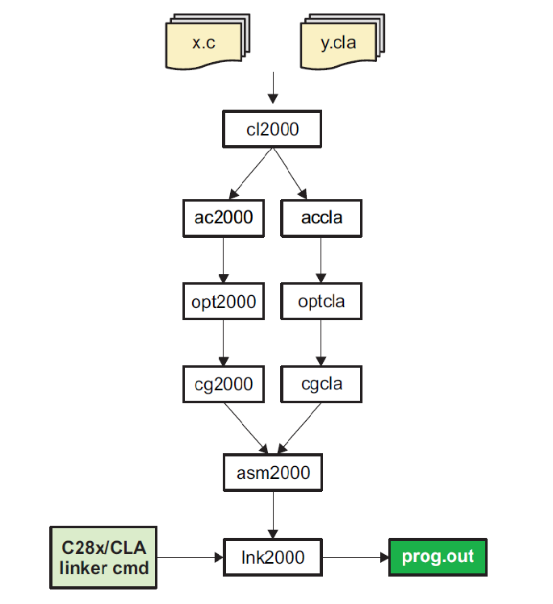
CLA Restricted C Syntax Compiler ..
*.cla file is used to identify the code that needs to be compiled and run on the CLA. Alternatively, .c files can be marked for CLA compilation with the --cla_default file level setting
C standard library not supported
Data Types (Note the differences from C28x data types!! – use stdint types)
char, short & pointers– 16 bits
int, long, float, long double & double – 32 bits
Defining and initializing global data is not supported. The CLA comes out of reset with no resources (memory), no run time support lib (__cinit__) to initialize any variables for the CLA
No stack, Local variables and compiler temps are expected to be placed into a scratchpad memory area “.scratchpad”
Deeper function calls supported (old programming model would only support one level deep function call)
Recursion, function pointers not supported
Notes:
¹ Since CGT 6.4.0 the programming model has changed, CLAScratch is no longer the section name for the scratchpad memory. It is instead replaced by “.scratchpad”. The symbols __cla_scratchpad_start and __cla_scratchpad_end are no longer required in this model. Also

Slide 7
Memory Model
Global Data
Uninitialized global data will be placed in the section ".bss_cla“
Constants
Initialized constant data will be placed in section ".const_cla“ (e.g. const int q=10)
Scratchpad(space requirement determined by compiler)
Local variables and compiler temporary variables placed here- size determined by the user in linker command file
CLA Program
The CLA compiler will place CLA code into section "Cla1Prog" as per the current convention used for CLA assembly.
Heap
There is no C system heap for CLA and hence no support for operation such as malloc.
RAM(LSx)
.bss_cla
.const_cla
.scratchpad
RAM(LSx)
Cla1Prog(_Cla1funcsRunStart)
(_Cla1funcsRunStart)
CLA CODE
Notes:
No .sysmem – malloc not supported
No .pinit – no support for C++, so constructor tables wont be needed
No .cinit – no RTS lib, plus rum time initialization of global variables not permitted
.const_cla – declaring a const variable simply does this:
const float k =10.0
.sect .const_cla
_k .float 10.0
In a standalone application you would place .const_cla on page 1 in flash and memcpy it over to a data RAM, once initialized

Slide 8
CMD File Changes for CLA
.....
MEMORY
{
PAGE 0 :
CLA1PROGRAM : origin = 0x009000, length = 0x001000 /* Physically RAML3 */
PAGE 1 :
CLA1_MSGRAMLOW : origin = 0x001480, length = 0x000080
CLA1_MSGRAMHIGH : origin = 0x001500, length = 0x000080
CLA1DATARAM0 : origin = 0x00A000, length = 0x001000 /* Physically RAML0 */
SECTIONS
{
/* CLA Program Memory */
Cla1Prog: LOAD = FLASHA,
RUN = CLA1PROGRAM ,
LOAD_START(_Cla1ProgLoadStart),
LOAD_END(_Cla1ProgLoadEnd),
RUN_START(_Cla1ProgRunStart),
LOAD_SIZE(_Cla1ProgLoadSize), PAGE = 0
/* CLA DATA */
Cla1Data : > CLA1DATARAM0 , PAGE =1
Cla1ToCpuMsgRAM : > CLA1_MSGRAMLOW, PAGE = 1
CpuToCla1MsgRAM : > CLA1_MSGRAMHIGH, PAGE = 1
/* CLA Compiler Sections*/
.scratchpad : > CLA1DATARAM0 , PAGE = 1
.bss_cla : > CLA1DATARAM0 , PAGE = 1
.const_cla : LOAD = FLASHB,
RUN = CLA1DATARAM0 ,
RUN_START(_Cla1ConstRunStart),
LOAD_START(_Cla1ConstLoadStart),
LOAD_SIZE(_Cla1ConstLoadSize),
PAGE = 1
}
On some devices (F2806x, F2803x, F2805x) CLA has fixed programming (RAML3) and data (RAML0,1,2) space
On others (F2837x) these spaces are configurable
Check datasheet/TRM for memory configurability

Slide 9
The Workshop
A Low Pass FIR Filter

Slide 10
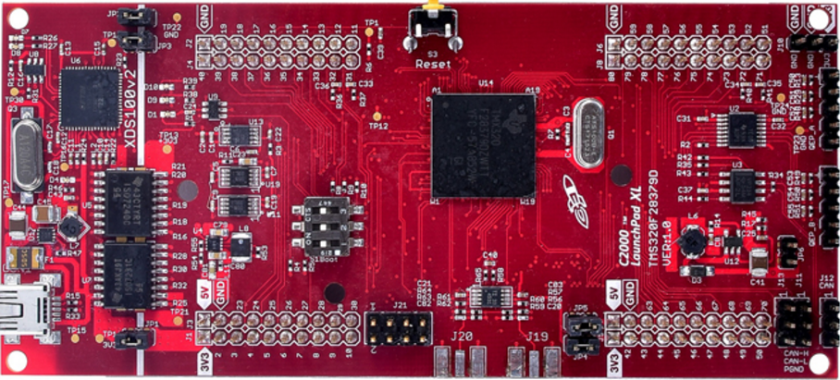
A Simple Low Pass Filter on the C28x
C28x
ADC ISR
1024 pt buffer
FFT
Pin 54: EPWM-4A
LPF
EPWM-4A
EPWM-1A
ADC
Pin 9: ADC-A0

Slide 11
A Simple Low Pass Filter on the CLA
CLA
C28x
CLA Task 1
CLA EOT1 ISR
FFT
1024 pt buffer
Pin 54: EPWM-4A
LPF
EPWM-4A
EPWM-1A
ADC
Pin 9: ADC-A0

Slide 12
Memory Allocation on CLA
Memory
Cla1ToCpuMsgRAM
filter_out
CpuToCla1MsgRAM
Cla1Prog
Physical:RAMLS0_1
code
Physical:RAMLS4_5
.bss_cla
_{D[] (delay line)}
_{filter_in}
CLA comes out of reset with no memory. Must assign programming and data spaces
Inputs/Outputs can be assigned to the message rams (filter_out) or RAM configured for data (runFFT)
Constants are placed in .const_cla (coeffs)
Uninitialized globals are placed in .bss_cla (D[], filter_in) – no auto-initialization routine available; assign as task to zero out the D’s
Local task variables are stored in the scratchpad
.const_cla
_{coeffs}
.scratchpad
_{Local variables}
Cla1DataRam
runFFT

Slide 13
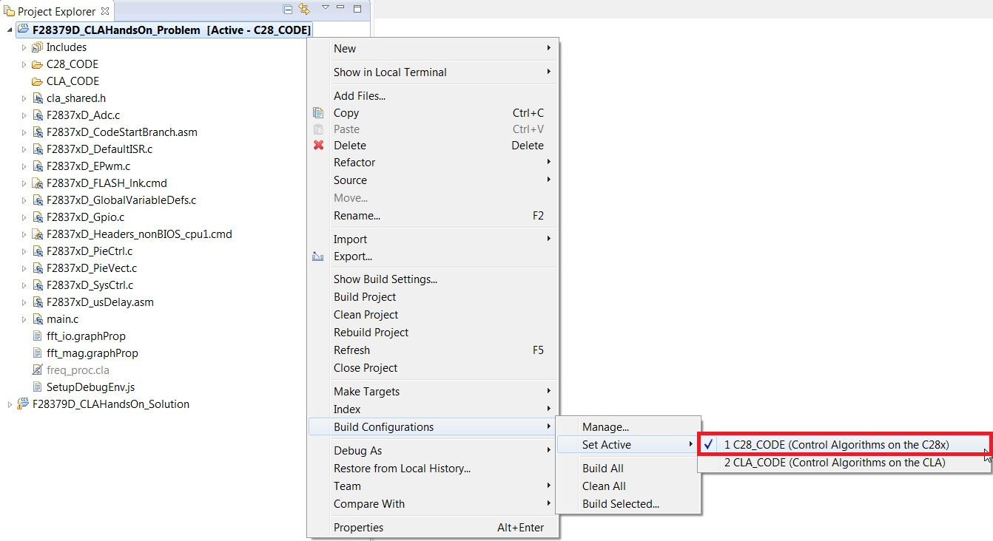
Build the C28x code
In CCS6, open the project “F28377D_CLAHandsOn_Problem”
Switch to the C28_CODE build configuration, create a target configuration file for the 28377D (use the XDS100v2 on-board emulator)
In “main.c” set USE_FILTER to IMPULSE, this build macro will show you the unfiltered samples
Build the code and load it to the Launchpad, make sure pins 54 (EPWM4A) and 9 (ADC-A0) are connected

Slide 14
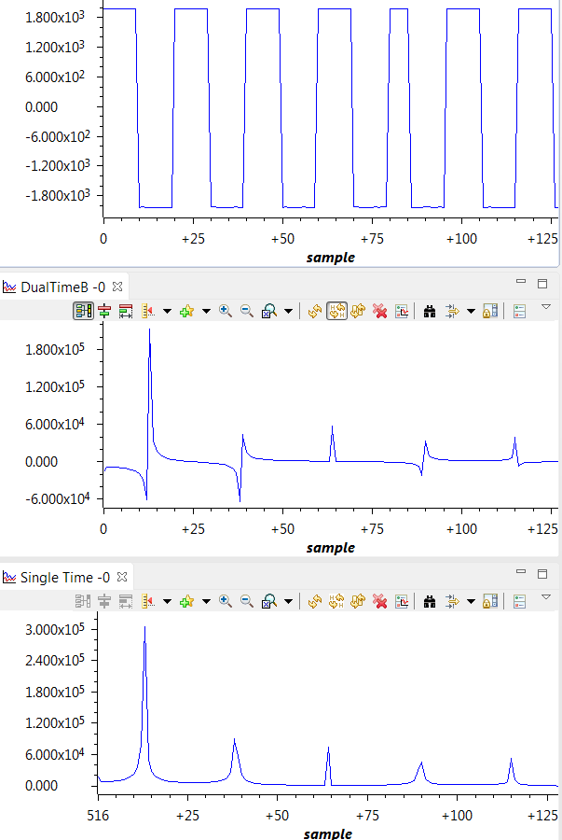
Import graphs and see the unfiltered results
In the debug context go to Tools->Graph->Dual Time
Hit the “import” button and select “fft_io.graphProp” file in the ccs folder
In the debug context go to Tools->Graph->SingleTime
Hit the “import” button and select “fft_mag.graphProp” file in the ccs folder
Run the code, you should see the graphs on the right

Slide 15
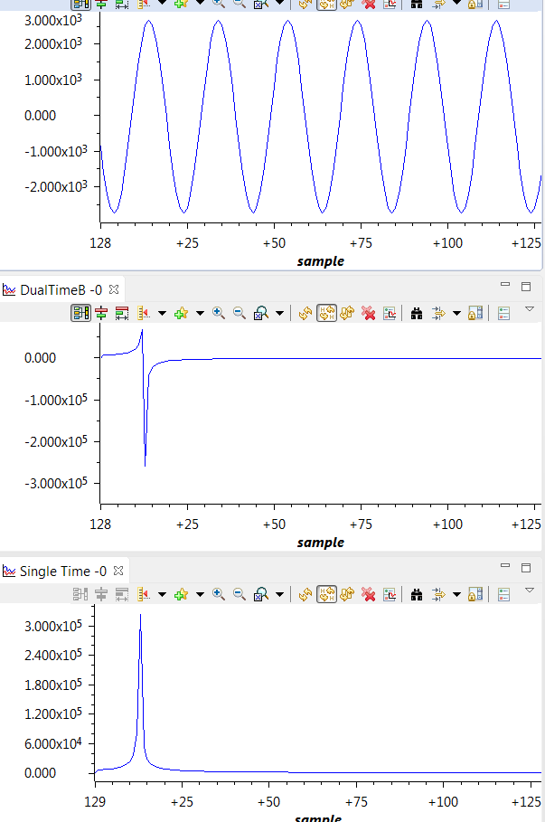
See the filtered results
In “main.c” set USE_FILTER to LPF, this build macro will show you the filtered samples
Clean and build the code
Run the code, you should see the graphs on the right
Notice the odd harmonics are gone and we see a clean sine wave at the output and only the fundamental frequency in the spectrum

Slide 16
Migrating code from C28x to the CLA
Step 1: Switch to the CLA_CODE build configuration. Assign the CLA variables to their respective memory spaces. Based on the memory allocation slide, use the #pragma to place the correct variables in these memory locations
Step 2: Copy the CLA code and constants from FLASH to RAM at runtime. We use the linker defined variables for the “Cla1Prog” and “.const_cla” sections
We need to first add an extern storage qualifier to these variables so the compiler knows they exist
We then use these variables in a memcpy() in the initCLA() – syntax for memcpy() is provided in the comments right above the code
//Task 1 (C) Variables
#pragma DATA_SECTION(<S1:REPLACE_ME>,"Cla1ToCpuMsgRAM");
<S1:REPLACE_ME>;
#pragma DATA_SECTION(<S1:REPLACE_ME>,"CpuToCla1MsgRAM");
<S1:REPLACE_ME>
extern uint32_t <S2:REPLACE_ME>;
extern uint32_t <S2:REPLACE_ME>;
void initCLA( void ){
memcpy(<S2:REPLACE_ME>);
memcpy(<S2:REPLACE_ME>);

Slide 17
Migrating code from C28x to the CLA
Step 3: Give the CLA control over the program and data spaces. You do this through the MMEMCFG register (TRM 9.4.3.2). You must enable bits to
Give CLA control over the program space (RAMLS0/1)
Give CLA control over one of the data RAMs (RAMLS2-5) that is being used in our example
Step 4: When a task is triggered, the CLA will jump to the task by loading the task’s MVECTx register to the CLA’s program counter (MPC). MVECTx contains the address of that task in the lower 64Kw memory. Use the task label (e.g. Cla1Task1) to set the address for task’s 1 and 8 MVECT registers
MemCfgRegs.LSxMSEL.bit.MSEL_LS0 = <S3:REPLACE_ME>;
MemCfgRegs.LSxCLAPGM.bit.CLAPGM_LS0 = <S3:REPLACE_ME>;
MemCfgRegs.LSxMSEL.bit.MSEL_LS1 = <S3:REPLACE_ME>;
MemCfgRegs.LSxCLAPGM.bit.CLAPGM_LS1 = <S3:REPLACE_ME>;
MemCfgRegs.LSxMSEL.bit.MSEL_LS2 = <S3:REPLACE_ME>;
MemCfgRegs.LSxCLAPGM.bit.CLAPGM_LS2 = <S3:REPLACE_ME>;
MemCfgRegs.LSxMSEL.bit.MSEL_LS3 = <S3:REPLACE_ME>;
MemCfgRegs.LSxCLAPGM.bit.CLAPGM_LS3 = <S3:REPLACE_ME>;
MemCfgRegs.LSxMSEL.bit.MSEL_LS4 = <S3:REPLACE_ME>;
MemCfgRegs.LSxCLAPGM.bit.CLAPGM_LS4 = <S3:REPLACE_ME>;
MemCfgRegs.LSxMSEL.bit.MSEL_LS5 = <S3:REPLACE_ME>;
MemCfgRegs.LSxCLAPGM.bit.CLAPGM_LS5 = <S3:REPLACE_ME>;
Cla1Regs.MVECT1 = (uint16_t)(&<S4:REPLACE_ME>);
Cla1Regs.MVECT8 = (uint16_t)(&<S4:REPLACE_ME>);

Slide 18
Migrating code from C28x to the CLA
Step 5: Decide what triggers each task by configuring the CLA1TASKSRCSELx register. It has a 4-bit field for each task with a list of peripheral triggers to choose from (TRM 2.14.7.3) or see the macros available in “F2837xD_Cla_defines.h “
Task 1 must be triggered by ADCINT1
Task 8 has no trigger, it will be forced once in software
Step 5 (contd): You will have to globally enable the tasks you want active through their respective bits in the MIER (enable register). See 5.7.2.15 of the TRM for a description of this register
DmaClaSrcSelRegs.CLA1TASKSRCSEL1.bit.TASK1 =
<S5:REPLACE_ME>;
DmaClaSrcSelRegs.CLA1TASKSRCSEL2.bit.TASK8 =
<S5:REPLACE_ME>;
Cla1Regs.MIER.all = <S5:REPLACE_ME>;

Slide 19
Migrating code from C28x to the CLA
Step 6: Since the CLA does not have any memory at startup, we cant have the boot code’s __cinit() initialize any CLA global variables, therefore, we assign a task to do it
task 8 in our example will zero out the delay elements D[0]. We want to run it once. We have no trigger assigned to it so software forcing is possible.
We enable software forcing through the MCTL register (see TRM 5.7.2.9). We will then run task 8 once. “F2837xD_Cla_defines.h” has some useful macro functions to force each task
Step 7: We want task1 to trigger an end-of-task interrupt.
We configure the PIE vector table to jump to the right ISR (see TRM, Table 1-118)
We enable the PIE group and subgroup for the cla-end-of-task-1 interrupt (see TRM, Table 1-119)
Cla1Regs.MCTL.bit.<S6:REPLACE_ME> = 1;
EDIS;
<S6:REPLACE_ME>();
PieVectTable.<S7:REPLACE_ME> = &<S7:REPLACE_ME>;
PieCtrlRegs.PIEIER11.bit.<S7:REPLACE_ME>=<S7:REPLACE_ME>;
IER |= (<S7:REPLACE_ME>);

Slide 20
Migrating code from C28x to the CLA
Step 8: Copy the filter code verbatim from adcintIsr1() to Cla1Task1() in the “freq_proc.cla” file
Step 9: Write a for loop for task 8 to zero out all FILTER_LENGTH elements of D[]
//**********************
// <<LOW_PASS_FIR_FILTER
//**********************
//Local Variables
int16_t i;
filter_out = 0.0;
filter_in = AdcResult.ADCRESULT1 - (1 << 11);
#pragma UNROLL(FILTER_LENGTH-1)
for(i = FILTER_LENGTH-1; i > 0; i--){
D[i] = D[i-1];
filter_out += coeffs[i] * D[i];
}
D[0] = (float)filter_in;
filter_out += coeffs[0] * D[0];
//**********************
// LOW_PASS_FIR_FILTER>>
//**********************
// Task 8: will clear out the delay line
__attribute__((interrupt)) void Cla1Task8 ( void )
{
<S8:REPLACE_ME>
}

Slide 21
Migrating code from C28x to the CLA
Step 10: The end-of-task1 ISR should do the rest of what adcint1Isr() was doing i.e. it should buffer the filtered values from the CLA and then when the count hits 1024 it should signal the background loop that an FFT should be run on the data.
Copy the code that was doing the buffering in adcint1Isr() and place it in cla1Isr1()
cla1Isr1() should clear out the ADC interrupt flag and acknowledge the interrupt in the PIE module
__attribute__((interrupt)) void cla1Isr1 ()
{
// Clear the ADC interrupt flag so the next SOC can occur
AdcRegs.ADCINTFLGCLR.bit.ADCINT1 = 1;
// store the filtered output
<S9:REPLACE_ME>
// Acknowledge the end-of-task interrupt for task 1
PieCtrlRegs.PIEACK.all = M_INT11;
//asm(" ESTOP0");
}

Slide 22
Debugging

Slide 23
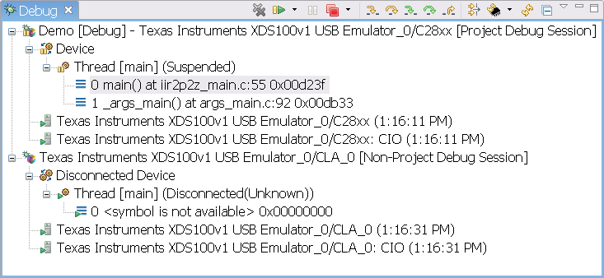
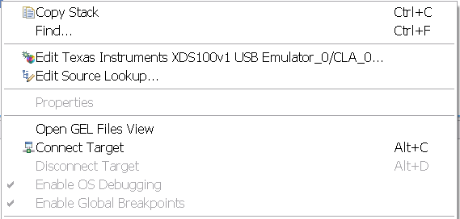
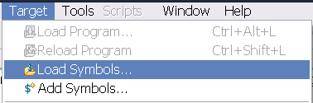
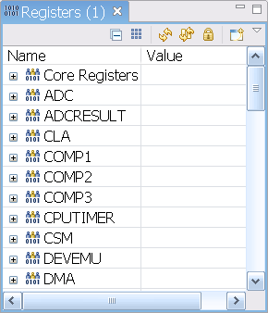
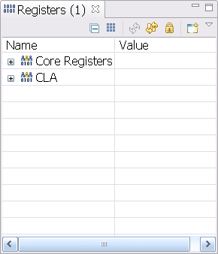
Debugging CLA C code
The CLA can halt, single-step and run independently from the main CPU
Both the CLA and the main CPU are debugged from the same JTAG port
When you launch a debug session the debug view (window within CCS) will have entries for C28x and CLA.
Clicking on CLA changes the context of all windows in CCS to reflect CLA data.
Connecting to the CLA core from the debug perspective enables single stepping
Load Program Symbols onto the CLA from Target menu options to begin debugging

Slide 24
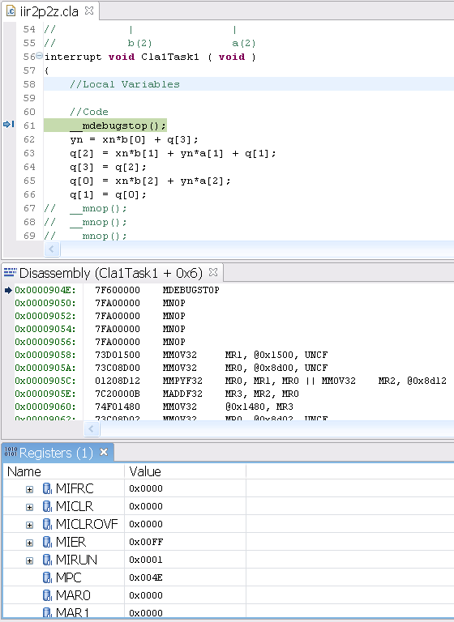

Debugging CLA Code
Insert a breakpoint into CLA code
An __mdebugstop() intrinsic is a CLA breakpoint. It will place the instruction MDEBUGSTOP at that position in assembly.
If you are not connected to the CLA core(i.e. single step disabled), the intrinsic behaves as a MNOP (no operation)
Start the task: CLA will execute code until the MDEBUGSTOP is in D2
Single step or run to the next breakpoint: Single stepping moves the CLA pipeline one cycle at a time
The debugger cannot perform “run to line” or “step over”
Note: For the C28x and C28x+FPU a single step flushes the pipeline.

Slide 25
Tips and Tricks
…and other useful information

Slide 26
Shared Pointers
Pointers are 22-bits (padded to 32-bits) on the C28x, while 16-bits on the CLA.
Sharing a pointer between the cores will cause incorrect address generation on the CLA side (there is a CQ to get the native size of CLA pointers to 32-bits)
You will notice this when back to back writes using the pointer causes data corruption in contiguous locations

Slide 27
Shared Pointers (contd)
C28 compiler assignment
The CLA compiler will
interpret this structure differently
The CLA compiler treats pointers b and c as 16-bits wide and therefore incorrectly dereferences pointer c.
typedef struct{
float a;
float *b;
float *c;
}foo;
/**********************************************
main.c
**********************************************/
//Assign X to section CpuToCla1MsgRam
#pragma(X,"CpuToCla1MsgRam")
foo X;
/**********************************************
test.cla
**********************************************/
__interrupt void Cla1Task1 ( void )
{
float f1,f2;
f1 = *(X.b);
f2 = *(X.c); //Pointer incorrectly dereferenced
//Tries to access location 0x1503 instead
//of 0x1504
}
Element | Address
X.a | 0x1500
X.b | 0x1502
X.c | 0x1504
Element | Address
X.a | 0x1500
X.b | 0x1502
X.c | 0x1503

Slide 28
Shared Pointers (contd)
/**********************************************
Shared Header File
***********************************************/
typedef union{
float *ptr; //Aligned to lower 16-bits
Uint32 pad; //32-bits
}CLA_FPTR;
typedef struct{
float a;
CLA_FPTR b;
CLA_FPTR c;
}foo;
/**********************************************
main.c
***********************************************/
//Assign X to section CpuToCla1MsgRam
#pragma(X,"CpuToCla1MsgRam")
foo X;
/**********************************************
test.cla
***********************************************/
__interrupt void Cla1Task1 ( void )
{
float f1,f2;
f1 = *(X.b.ptr);
f2 = *(X.c.ptr); //Correct Access
}
Solution:
Define a new pointer CLA_FPTR as a union of a 32-bit integer and a pointer to a float.
The CLA compiler recognizes the larger of the two elements(the 32 bit integer), aligns the pointer to the lower 16-bits. Now b and c occupy 32-bits
Instructions dereferencing c access the correct address 0x1504

Slide 29
Benchmarking
Use a Free EPWM to benchmark portions of CLA code
void InitEPwm(void)
{
// Setup TBCLK
EPwm1Regs.TBCTL.bit.CTRMODE = TB_COUNT_UP;
EPwm1Regs.TBPRD = 0xFFFF; // Set timer period
EPwm1Regs.TBCTL.bit.PHSEN = TB_DISABLE;
EPwm1Regs.TBPHS.half.TBPHS = 0x0000;
EPwm1Regs.TBCTR = 0x0000; // Clear counter
// Clock ratio to SYSCLKOUT
EPwm1Regs.TBCTL.bit.HSPCLKDIV = TB_DIV1;
EPwm1Regs.TBCTL.bit.CLKDIV = TB_DIV1;
}
#define READ_CLOCK(X) __meallow();\
EPwm1Regs.TBCTL.bit.CTRMODE = TB_FREEZE;\
X = EPwm1Regs.TBCTR;\
__medis();
#define RESTART_CLOCK __meallow();\
EPwm1Regs.TBCTL.bit.CTRMODE = TB_FREEZE;\
EPwm1Regs.TBCTR = 0;\
EPwm1Regs.TBCTL.bit.CTRMODE = TB_COUNT_UP;\
__medis();
#pragma DATA_SECTION(ulCycleCount,
"Cla1ToCpuMsgRAM");
unsigned long ulCycleCount;
__interrupt void Cla1Task1 ( void )
{
float a;
RESTART_CLOCK;
a = 10;
...
READ_CLOCK(ulCycleCount);
}

Slide 30
CLA Access Violations
Use the Non Master/Master Access Violation (see TRM SPRUHM8, section 2.14.18) Registers to detect access violations by the CLA
#pragma CODE_SECTION(accessViolationISR,
"ramfuncs")
__attribute__((interrupt))
void accessViolationISR(void)
{
// Read the fetch address where the
// violation occurred
fetchAddress =
AccessProtectionRegs.NMCLA1FAVADDR;
EALLOW;
// clear the fault
AccessProtectionRegs.NMAVCLR.bit.CLA1FETCH = 1;
EDIS;
__asm(" ESTOP0");
// Acknowledge the RAM access violation
// interrupt
PieCtrlRegs.PIEACK.all = M_INT12;
}
// Detect any CLA fetch access violations,
// enable interrupt for it (TRM SPRUHM8,
// 2.11.1.7.4 & 2.14.18)
AccessProtectionRegs.NMAVSET.bit.CLA1FETCH = 1;
AccessProtectionRegs.NMAVINTEN.bit.CLA1FETCH = 1;
// Set the ISR for access violation fault
PieVectTable.RAM_ACCESS_VIOLATION_INT =
accessViolationISR;
PieCtrlRegs.PIEIER12.bit.INTx12 = 1;
IER |= M_INT12;

Slide 31
New/Recent CLA Ease of Use Features
Available in v15.12.0.LTS
CLA-only object file compatibility (independent of C28x device options)
--cla_default option to treat .c files as .cla files
Removed language restrictions on integer divide, modulus and unsigned integer compares
_Bool support (no longer requires --c99 option)
Available as of v6.4
Expanded C-language support:
Non-recursive function calls
Recursion and function pointers NOT supported
More than 2 function parameters
No longer necessary to specify scratchpad size
Function frames allocated in .scratchpad section
Linker overlays frames when possible to reduce memory footprint
Fully backwards compatible with CLA assembly and object files

Slide 32
Writing Assembly
See the Assembler guide (SPRU514, 10.2.4) on the calling conventions and section 10.2 on general C language implementation
“Cla1Prog” is the .text equivalent for the CLA
1: Pick the function name _<fn_name>, and make it global
2: It must reside in a subsection of Cla1Prog, with the subsection having the same name as the function
3: define the “.scratchpad stack pointer” – it has to be __<fn_name>_sp
1
.global _setPwmRegsStgA
.sect "Cla1Prog:_setPwmRegsStgA"
.align 2
__setPwmRegsStgA_sp .usect
".scratchpad:Cla1Prog:_setPwmRegsStgA",2,0,1
_setPwmRegsStgA: .asmfunc
.asg #2, AQCTLA_PRD_S
.asg #12, AQCTLA_PRD_M
.asg #65523, N_AQCTLA_PRD_M
.asg @__setPwmRegsStgA_sp + 0, STACK_MR3
;---------------------------------------------------
; Context Save
;---------------------------------------------------
; MR3 is saved on entry, rest saved on call
MMOV32 STACK_MR3, MR3
2
3
4
1
5
4: The stack pointer resides in the section .scratchpad:Cla1Prog:_<fn_name>
5: Save MR3 on entry to the function (if its being used); don’t forget to restore on exit

Slide 33
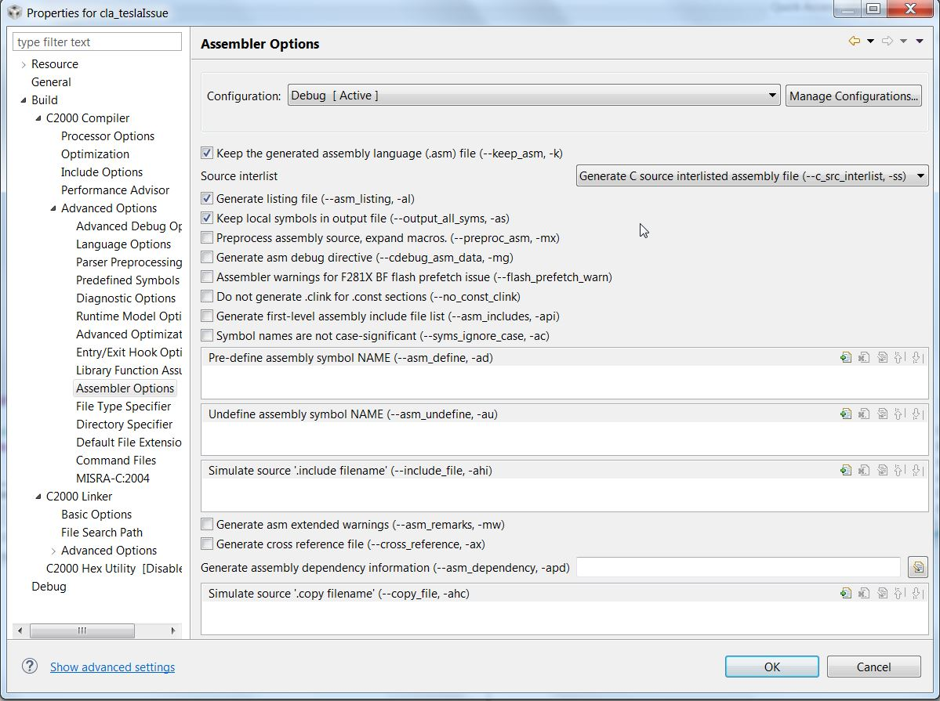
The Assembler is your friend
Under Assembler Options, choose
--keep_asm
--c_src_interlist
--asm_listing (when you are unsure of the opcode)
--output_all_syms (keeps local symbols in file, doesn’t replace them with addresses)

Slide 34
Thank You
http://processors.wiki.ti.com
http://www.training.ti.com
http://e2e.ti.com

