Slide 1
JESD204 High Speed Serial Interface for Data Converters
May 2018

Slide 2
Abstract
The introduction of the JESD204, and in particular JES204B, interface for use between data converters and logic devices has provided many advantages over previous generation LVDS and CMOS interfaces – including simplified layouts, skew management, and deterministic latency. The transition to JESD204 can seem complex at times and this presentation aims to give an overview of the important aspects of this interface and how they can be leveraged in real world applications.

Slide 3
Contents
JESD204 history
Timing signals and terminology
Layers
Deterministic latency
Subclass 0, 1, 2
Configuration parameters
Additional information
Summary

Slide 4
What is JESD204B?
A standardized serial interface between data converters (ADCs and DACs) and logic devices (FPGAs or ASICs) defined by a JEDEC task group
  Serial data rates up to 12.5 Gbps
  Mechanism to achieve deterministic latency across the serial link
  Uses 8b/10b encoding for SerDes synchronization, clock recovery and DC balance
The main benefits of JESD204B
  Simplification of PCB layout due to reduced I/O count and reduced overall board area
  Smaller device packages, less pins
  Increased data rates for given board area
JESD204B is a must for high density / high sampling rate systems!
Notes:
The JESD204B standard provides a method to interface one or more data converters to logic device, such as a FPGA or ASIC over a high speed serial interface in place of a parallel interface which requires many more traces.
This updated interface now has the capability to run up to 12.5Gbps per serial pairs, usually called lanes. The lanes from a converter that are connected to the logic device is called a link. Each lane has its own embedded clock and with the use of special characters created by the 8b/10b encoding, provides a robust, framed serial data interface.
Reduces number of data I/O traces Allows for smaller data converters, which minimizes board area required Uses lane buffering to lessen the lane matching requirement
Allows for a faster interface, as LVDS is limited to about 1.6Gbps Most new high speed converters are going to this standard.

Slide 5
JEDEC Solid State Technology Association
JEDEC Standard JESD204:
Serial Interface for Data Converters
The JESD204B standard can be downloaded from the JEDEC website
You will need to register an account to get access to the standard (this is free)
http://www.jedec.org/standards-documents/results/jesd204
The document contains a list of acronyms/keywords at the beginning with definitions for each.
Notes:
This is a 147 page document
Many figures, tables , ect in this document are from this document.

Slide 6
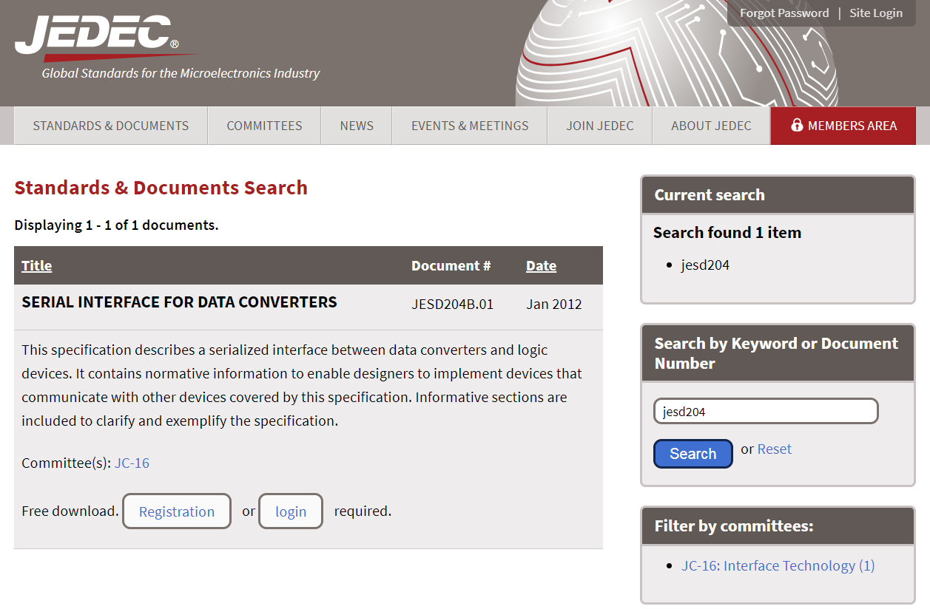
Notes:
1

Slide 7
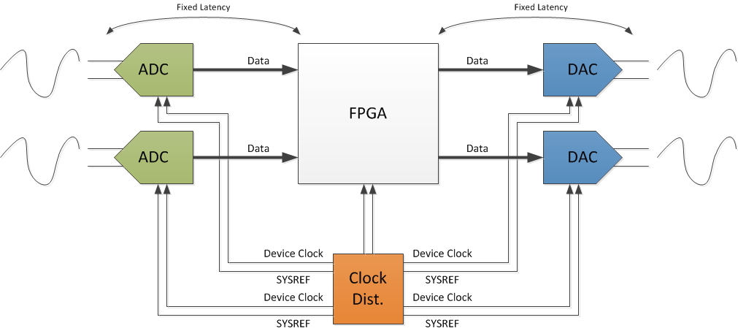
JESD204 System View

Slide 8
History of JESD204 Specification
JESD204 was first introduced in 2006 as the next-generation digital interface for high-speed data converters to replace LVDS
Revision A (2008) added support for multiple lanes and revision B (2011) added support for deterministic latency and faster speeds
Revision C in work (up to 32 high speed Serdes, 28Gbps interface)
 | JESD204 | JESD204A | JESD204B
Introduced | 2006 | 2008 | 2011
Max Rate | 3.125 Gbps | 3.125 Gbps | 12.5 Gbps
Multiple Lanes? | No | Yes | Yes
Multi-Lane Synchronization | No | Yes | Yes
Multi-Device Synchronization | No | Yes | Yes
Deterministic Latency | No | No | Yes
Frame Clock Required | Yes | Yes | No
Source: An early look at the JEDEC JESD204B third-generation high-speed serial interface for data converters
(published 8/11/2011) by Maury Wood of NXP Semiconductors, JEDEC JESD204B TG Chairman

Slide 9
JESD204B Advantages
The high data rates of the SerDes lanes greatly increases data throughput which reduces the total number of lanes required
  Reduces number of data lanes and required number of IO pins and PCB space for routing
  Example: ADC12DJ3200 vs equivalent device with LVDS interface
  Reduces overall device package size
    ADC12DJ3200: 144 ball BGA (10mm x 10mm)
    LVDS equivalent: 256 ball BGA (17mm x 17mm)
  Can reduce required FPGA / ASIC package size too!
Interface | JESD204B (ADC12DJ3200) | DDR LVDS
Data rate per lane | 12.8 Gbps | 1.6 Gbps
# Clock Pins (2 per pair) | 0 | 8
# Data Pins (2 per pair) | 16 | 96
Total Package Pins | 16 | 104
Source: Why JESD204B may solve a lot of your system design headaches
(published 11/19/2012) by Thomas Neu of TI
Notes:
Example compares Quad 16 bit ADC

Slide 10
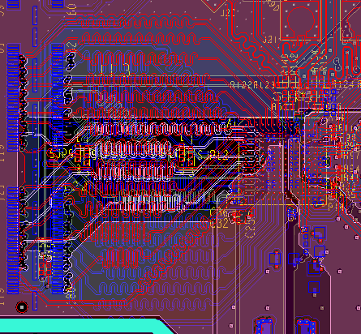
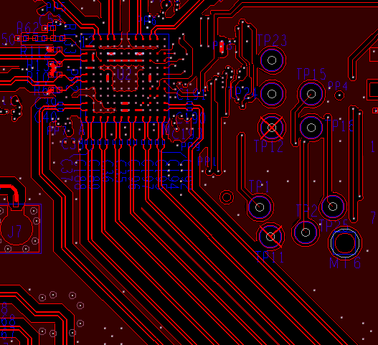
JESD204B Advantages
Footprint & Routing
DAC38J84
(JESD204B Interface)
2014
DAC34SH84 (LVDS Interface)
2011
Simplifies PCB routing
  Does not require trace length matching on data lines
    Eliminates need for “squiggles” to match lengths
    Requires less total routing area
  Lanes can be swapped in the FPGA (or sometimes in the data converter) to avoid having to crisscross traces to improve signal integrity and simplify routing
  Reduces number of board layers used for data interface routing
DAC
DAC
4ch
750 MSPS input
32 lanes
aggregate
48Gbps
input data
4ch
1.25 GSPS
input
8 lanes
Aggregate 100Gbps input data
‘Squiggles’ to match timing of LVDS bus lines
JESD204B bus lines with uncritical timing requirements

Slide 11
JESD204B Advantages
Radical improvement in power efficiency and throughput
50x more efficient interfaces
JESD204C
x2 ?
JESD204C
down by 50% ?
* assuming 16bit data words

Slide 12
JESD204B Challenges
FPGA or ASIC coding can be more complex than previous interfaces
JESD204B IP licensing costs
Latency across the SerDes link may be greater than could be achieved with LVDS or CMOS for latency sensitive applications
High SerDes rates require more careful routing and SI simulations. Could require more expensive PCB materials (or advanced equalization) for high data rates and long reaches
Troubleshooting the interface can be more complicated than LVDS or CMOS, due to protocol having more pieces

Slide 13
JESD204 Timing Signals/Terminology
Notes:
1

Slide 14
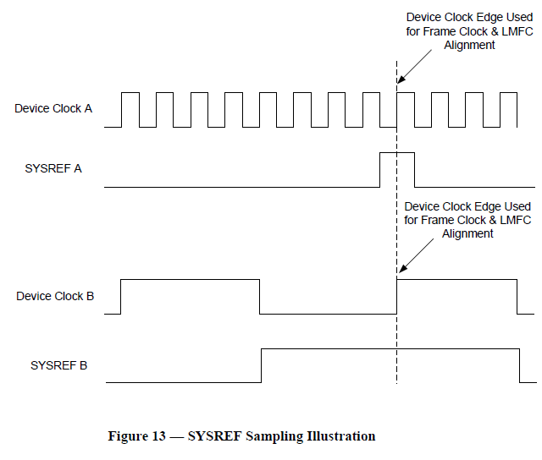
Anatomy of JESD204B System (for ADC)
Lanes of
Multi-
Point
data link
ADC(TX)
FPGA(RX)
ADC
Transport Layer
Data Layer
Data Layer
Transport Layer
Apps
Layer
Frame Clock
LMFC
SYNC~
LMFC
Frame Clock
÷
÷
÷
÷
SYSREF A
SYSREF B
Device clock A
Clock Chip
Device clock B
The only thing that matters for JESD204B subclass 1 is SYSREF to Device Clock timing for the same device. Not SYSREF to SYSREF.
Device clock to device clock timing is application dependent.
Device Clock A
SYSREF A
Device Clock B
SYSREF B
Notes:
14
Anatomy of JESD204B System - Understand the building blocks in physical space.
- Logic Device (FPGA)
- Converters (ADC/DAC)
- Data traces (Color Code = Pink)
- Clocking Device
- Device Clock / Sample Clock (Color Code = Blue)
- SYSREF (Color Code = Green)
- Other SYSTEM stuff.
- SYNC~
- Frame Clock
- LMFC

Slide 15
JESD204 Timing Signals/Terminology
Device Clock
System clock from which the device’s frame, sampling, LMFC clocks are derived (externally applied)
SYSREF (subclass 1 only)
Timing phase reference from which LMFC clocks are generated in subclass 1 implementations (externally applied)
  Source synchronous with device clock
  Rising edge event sampled by device clock determines LMFC alignment
  Periodic, Gapped-periodic, One-shot types
  Required for Deterministic Latency
  SYSREF = LMFC/n (n is a positive integer)
SYNC
Receiver to Transmitter. Used for link initialization.
  Synchronization requests
  Subclass 2 implementations use SYNC as a phase reference for LMFC
  Options for distributing SYNC to multiple devices
  Standard defines SYNC~ (active low) signaling
Notes:
1

Slide 16
JESD204 Timing Signals/Terminology (cont.)
  Frame Clock
    The frame coming out of the transport layer is aligned to the frame clock (device internal for subclass 1 & 2).
    As per JESD204B standard, frame clock period in all the TX and RX devices
    must be identical.
Sample Clock
Clock used to sample data (device internal)
  f_{S} = f_{FRAME} * S ( S = # samples per Frame)
  Local Multi-frame Clock (LMFC) f_{LMFC} = f_{FRAME} / K = f_{LINERATE} / (10*F*K)
    LMFC is aligned to a multi-frame boundary which in turn consists of K number of frames.
    In order to synchronize transmission on all lanes (single or multipoint link), LMFC of
    all the converter devices are aligned with the LMFC of logic device (FPGA).
    All TX and RX devices in a system must have identical LMFC period (device internal).
Notes:
0.5

Slide 17
JESD204 Timing Signals/Terminology (cont.)
CGS: Code Group Synchronization
  Process by which the octets are aligned via during transmission of /K/ symbols.
  Minimum duration for a sync request is 5 frames plus nine octets.
ILAS: Initial Lane Alignment Sequence
  Process by which the frames and multi-frames are aligned.
RBD: RX Buffer Delay
  Elastic Buffer release time is “RBD” frames after LMFC boundary.
  RBD = K is max allowed, but lots of latency. RBD should be minimized for low latency link.

Slide 18
JESD204 Layers
Notes:
0.5

Slide 19
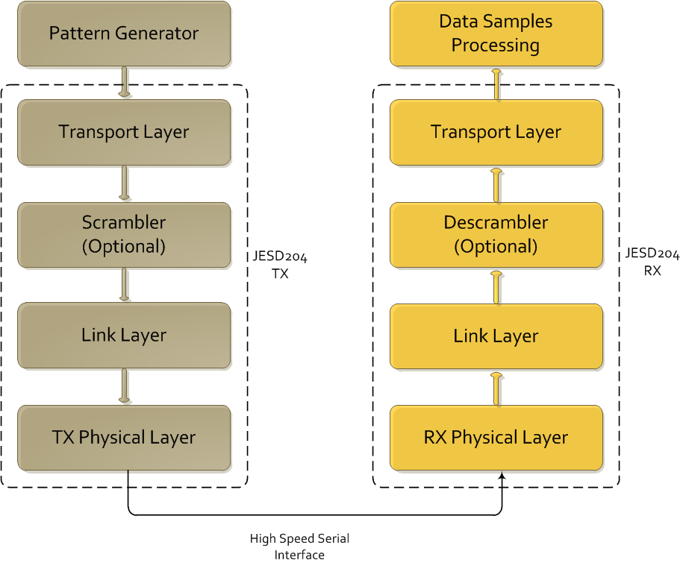
JESD204 Layers
Notes:
0.5

Slide 20

Example Functional Diagram for data transmission and reception between two devices on the link
TX device (ADC or FPGA)
Parallel-to-serial
mapping
8B/10B encoding and character insertion for lane alignment
Clock
Source
Device Clock
SYSREF Clock
SYSREF Clock
SYNC~
Device Clock
8B/10B decoding and character detection for lane alignment
Serial-to-parallel
mapping
RX device (DAC or FPGA)

Slide 21
Transport Layer Overview
Maps the data → octets → frames consisting of multiple octets
Adds optional control bits to samples if needed
  Control bits can be used to communicate status information, mark an inactive converter on the link or control receiver operation
Distinguishes the possible combinations of device/links/lanes/etc.
  Single converter connected to single lane link
  Single converter connected to multiple lanes link
  Multiple converters in a converter device connected to a single lane link
  Multiple converters in a converter device connected to multiple lanes link
Notes:
1

Slide 22
Transport Layer Parameters
Important parameters associated with transport layer include
  L # of lanes per converter device
  M # of converters per device
  F # of octets per frame (per lane)
  S # of samples per converter per frame clock cycle
  K # of frames per multi-frame
  N # of bits per sample
  CS # of control bits per conversion sample
  CF # of control bits per frame
  …
Notes:
1

Slide 23
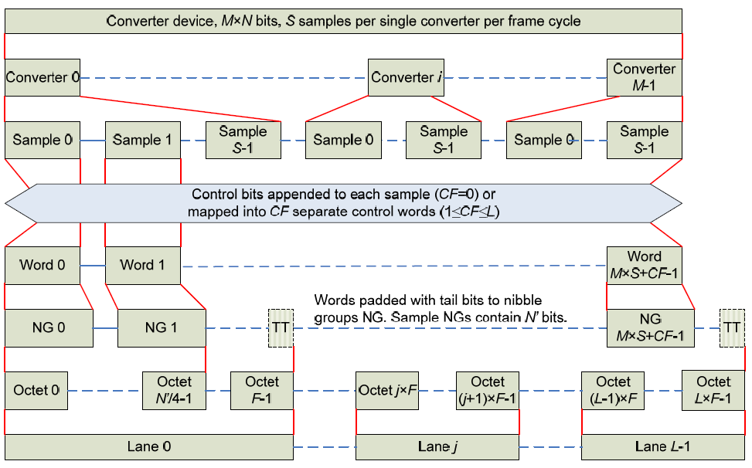
Transport Layer Overview
This chart specifies how samples map to octets, lanes, etc
Notes:
1

Slide 24
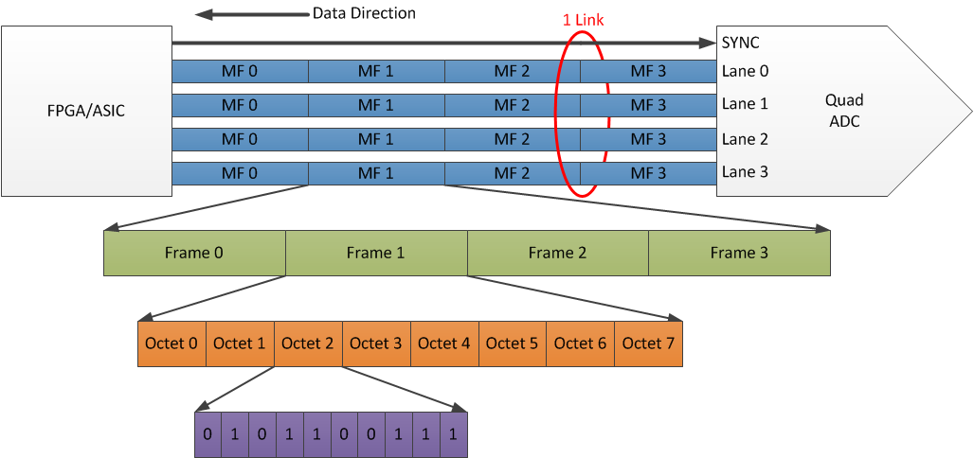
Breaking Down the Terms (16b Quad ADC)
Highest Level
What is the “LMFK” for this link?
Lowest Level
L = 4, M = 4, F = 8, K = 4
What is “S”?
S = 4

Slide 25
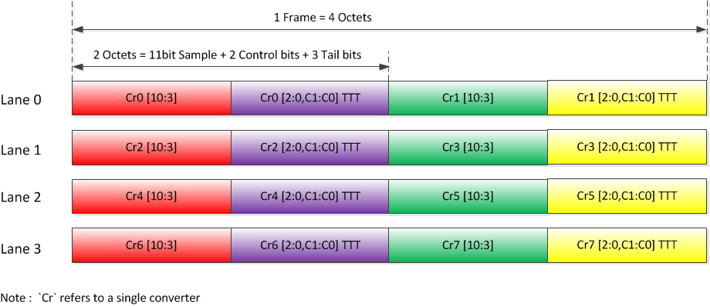
Transport Layer Example
Example: 11-bit octal ADC converter
L = 4, M = 8, F = 4, S = 1, CS = 2
A complex example…
Notes:
2

Slide 26
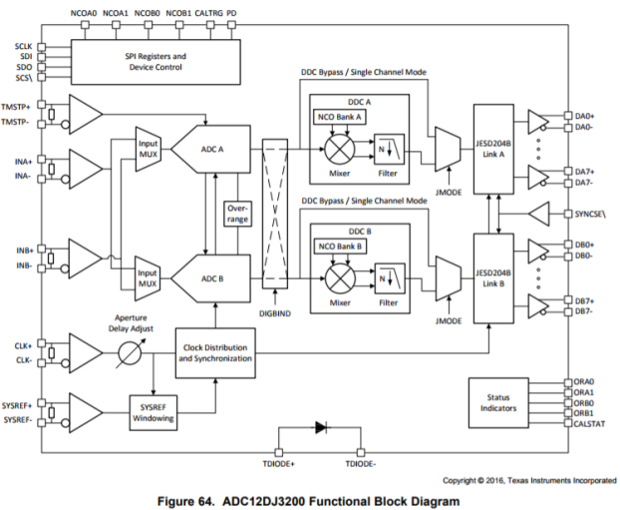
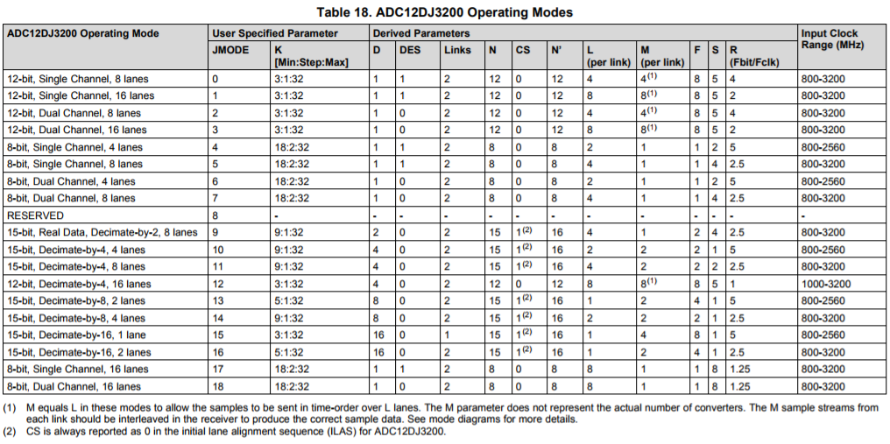
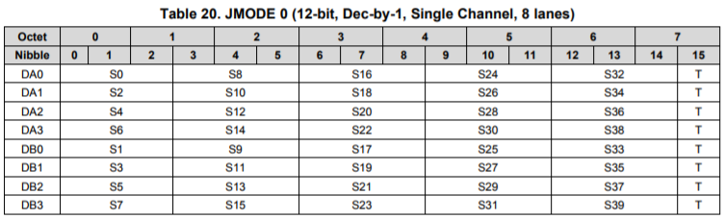
A Fully Flexible Transport Layer?
Most customers implement a transport layer that only meets their desired use cases and not a “fully flexible” transport layer
All JESD204B ADCs and DACs have a finite number of L-M-F-S modes

Slide 27
ADC12DJ3200 JESD204B Modes
F_{BIT} = R * F_{CLK}
Ex: Fs = 6.4 Gsps, F_{CLK} = 3.2 GHz
Assume JMODE 1 (12-bit, single ch.)
F_{BIT} = 3.2 * 2 = 6.4 Gbps

Slide 28
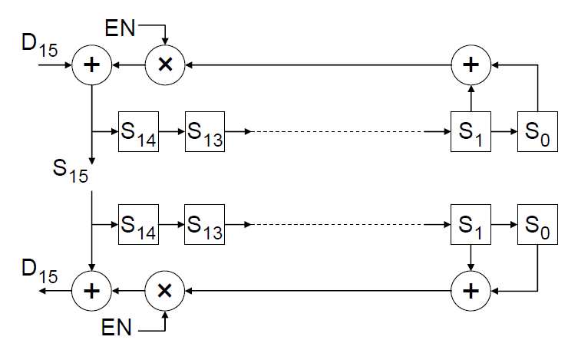
Scrambling
Scrambling randomizes data and spreads the spectral content to reduce spectral peaks that could cause EMI and interference problems
Transport layer output may be optionally scrambled with the polynomial: 1 + x¹⁴ + x¹⁵
Does not add latency, done concurrently with other stages of processing
Notes:
1

Slide 29
Data Link Layer: Responsibilities
8b/10b encoding (TX) or decoding (RX)
Link Establishment
  Code Group Synchronization (CGS)
  Initial Lane Alignment (ILA) and Frame Synchronization
Link Monitoring using control symbols
Notes:
0.5

Slide 30
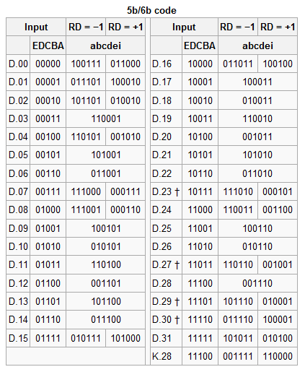
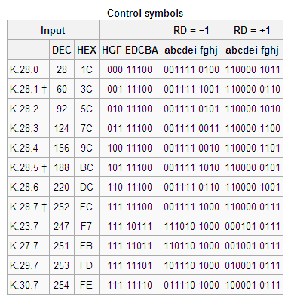
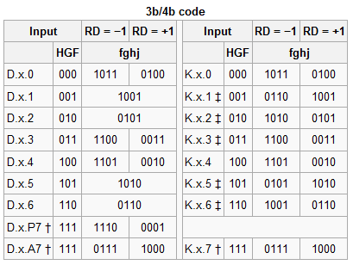
Data Link Layer: 8b/10b Encoding
Encodes 8-bit “octets” into 10-bit symbols
Octet to symbol mapping depends on running disparity (RD)
Coding provides many bit-transitions to enable Clock Data Recovery (CDR) techniques
DC balancing enables AC coupling
Notes:
1

Slide 31
Data Link Layer: Link Establishment
Link Establishment accomplishes TX and RX synchronization
  Code Group Synchronization (CGS)
  Initial Lane Alignment and Frame Synchronization
  Start data transmission
Notes:
2

Slide 32
Code Group Synchronization (CGS)
Section 5.3.3.1
RX requests synchronization by asserting SYNC
TX begins transmitting K28.5 characters (/K/ characters)
RX tries to align it’s “character clock” with the K28.5 characters
  K28.5 = 0011111010 or 1100000101 (depending on disparity)
  Where are the K28.5 characters below?
  11101000111110101100000101110000010111000001010011111010
RX deasserts SYNC after receiving 4 /K/ characters
Code Group Synchronization is achieved after successfully reception of another four 8B/10B characters
During normal operation, if four invalid codes are received in a short period of time then CGS is lost and a new SYNC request occurs
  Minimum duration for a synchronization request is 5 frames plus nine octets

Slide 33
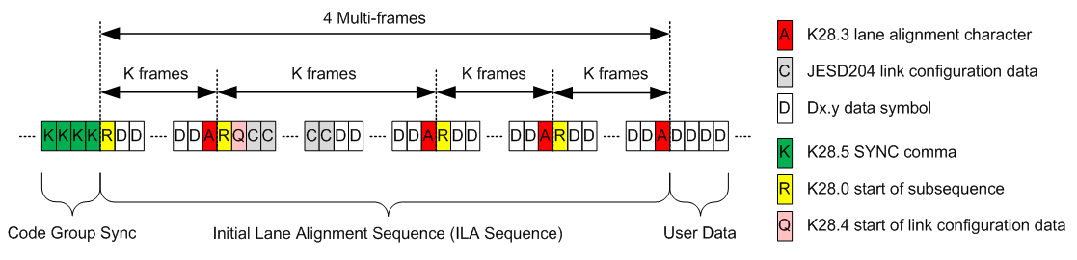
Data Link Layer: Initial Lane Synchronization
Lanes are synchronized using initial lane alignment (ILA) sequence
TX transmits ILA on next multi-frame boundary following CGS
ILA is 4 multi-frames, containing configuration parameters and alignment symbols (A). 2nd multi-frame contains link config information
ILA is never scrambled, even if scrambling is enabled
ILA information may be verified by the RX by using the checksum code
ILA configuration parameters are NOT used to program the RX, the RX must already be set to receive the correct format
Notes:
1

Slide 34
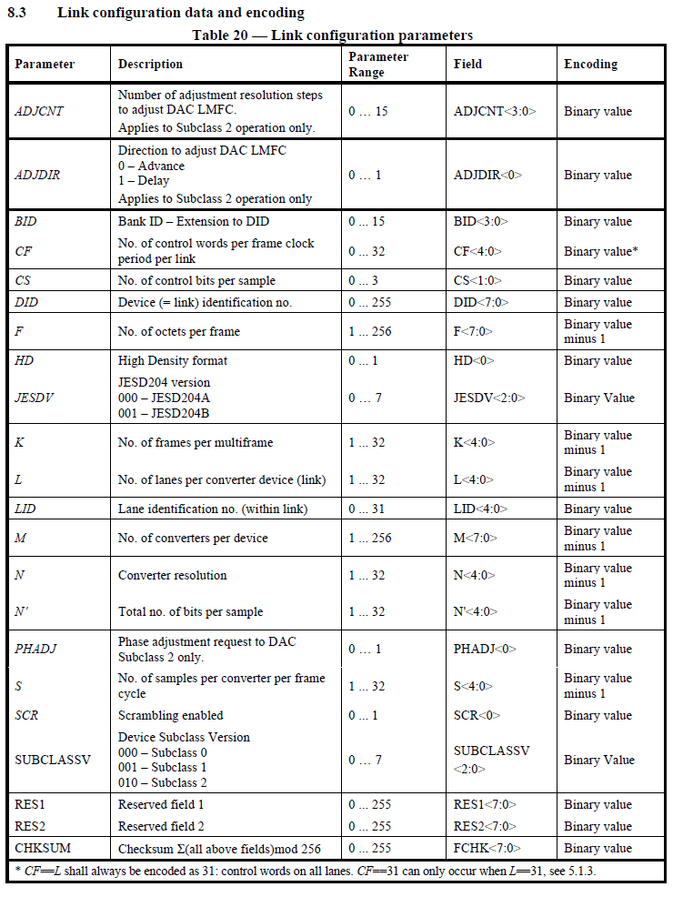
Link Configuration Data
(Parameters for the Initial Frame Alignment)

Slide 35
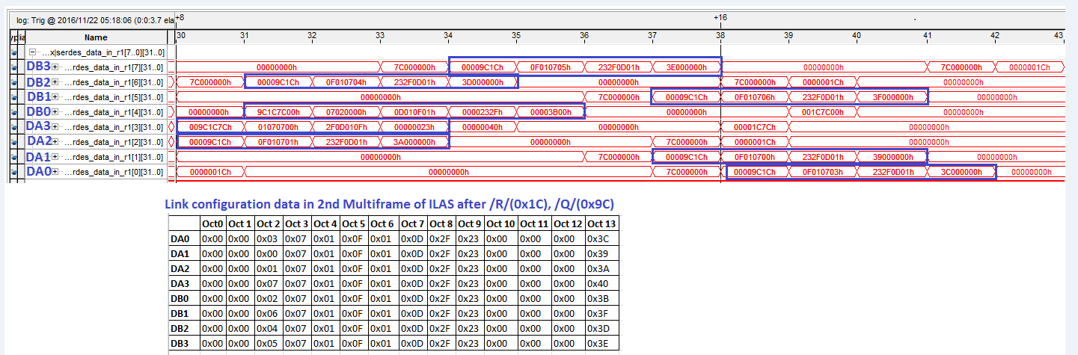
Oct 0 = ADJCNT
Oct 1 = ADJDIR
Oct 2 = Lane ID
Oct 3 = # of Lanes
Oct 4 = F
Oct 5 = K
Oct 6 = M
Oct 7 = N
Oct 8 = Subclass & N’
Oct 9 = S (4:0)
Oct 10 = CF
Oct 11 = Resv
Oct 12 = Resv
Oct 13 = Checksum
00 00 9C 1C 0F 01 07 03 23 2F 0D 01 3C 00 00 00 Lane DA0 LMFS = 8224
1 0 Q R 5 4 3 2 9 8 7 6 13 12 11 10
K F L ID M Checksum (octet 13)

Slide 36
Data Link Layer: Frame Alignment Monitoring
Transmitter sends out user data after ILA sequence
Alignment characters are inserted into data stream in special conditions to re-check alignment
  If last octet in 2 successive frame are equal → transmitter replaces latter octet with K28.7 (/F) symbol (scrambling disabled)
  If last octet of a multi-frame is equal to last octet in previous frame → replace latter octet with K28.3 (/A) symbol
Receiver “undoes” the special character replacement so no information is lost
Most often the receiver will report the error and the system will need to resynchronize
Notes:
1

Slide 37
Data Link Layer: Frame Alignment Monitoring
Transmitter sends out user data after ILA sequence
Alignment characters are inserted into data stream in special conditions to re-check alignment
  If last octet in 2 successive frame are equal → transmitter replaces latter octet with K28.7 symbol (scrambling disabled)
  If last octet of a multi-frame is equal to last octet in previous frame → replace latter octet with K28.3 symbol
Receiver “undoes” the special character replacement
Receiver will re-align it’s frame clock to alignment characters under certain conditions or report an error
TI Information – NDA Required
Notes:
1

Slide 38
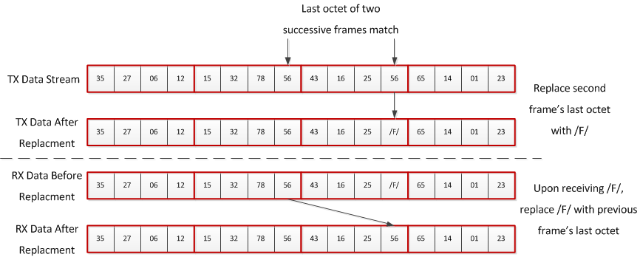
Illustration of Frame Alignment Monitoring
1
1 frame, 4 octets
2
3
Multiframe alignment is the same concept, except that a /A/ character is inserted if the second consecutive frame is the last frame of a multiframe

Slide 39
Error Reporting
  Standard lists the following four errors which must be detected by each receiver.
    8B/10B disparity error
    8B/10B not-in-table code error
    Control character in wrong position (e.g. frame / multi-frame alignment error)
    Code Group Synchronization error
  Receiver may also detect:
    Elastic buffer overflow (indicative of bad RBD value)
    Link configuration error (TX and RX parameters do not match)
    LMFC reset
    Errant SYSREF detected
    And others…
    Some of the errors can be made to retrigger the synchronization request
    Careful implementation of error state machines will aid in link recovery time

Slide 40
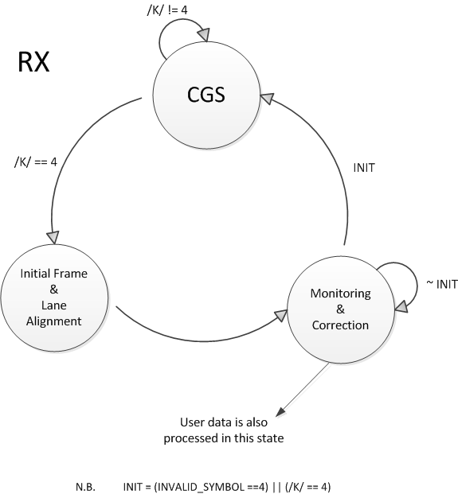
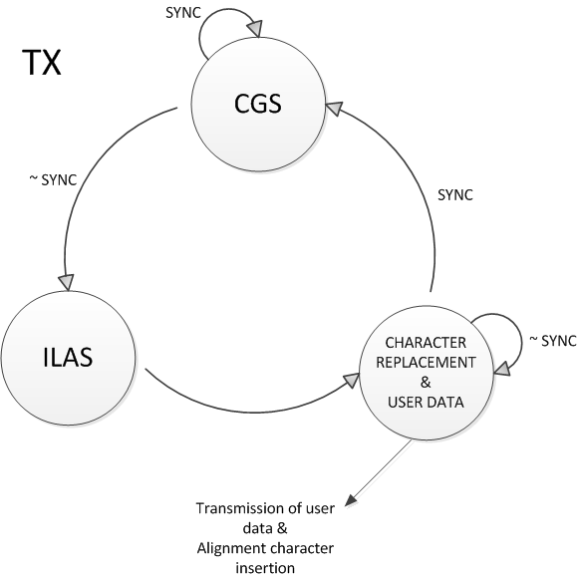
Data Link Layer: Lane Initialization and Monitoring
TX and RX decision flow charts
Notes:
1
Figure below shows a simplified state diagram for the aforementioned link operations. Note that the receiver goes back to initial state if it receives four /K/ = /K28.5/ symbols or four invalid symbols in succession. Similarly the transmitter goes back to the initial state if SYNC signal (active low) is asserted back by receiver.

Slide 41
Physical Layer: Serial Lanes
The physical layer defines the performance of the data transfer and electrical interfaces dominated by the SERDES, CDR and driver/receiver blocks
Point-to-point, unidirectional serial interface
JESD204B defines 3 signal speed-grade variants
Parameter | LV-OIF-Sx15 | LV-OIF-6G-SR | LV-OIF-11G-SR
Data Rates | 312.5Mbps – 3.125Gbps | 312.5Mbps - 6.375Gbps | 312.5Mbps – 12.5Gbps
Differential Output Voltage | 500 – 1000 (mV) | 400 – 750 (mV) | 360 – 770 (mV)
Output Rise or Fall Time (20% - 80% into 100Ω load) | ≥ 50 (ps) | ≥ 30 (ps) | ≥ 24 (ps)
Bit Error Rate (BER) | ≤ 1e-12 | ≤ 1e-15 | ≤ 1e-15
Notes:
1

Slide 42
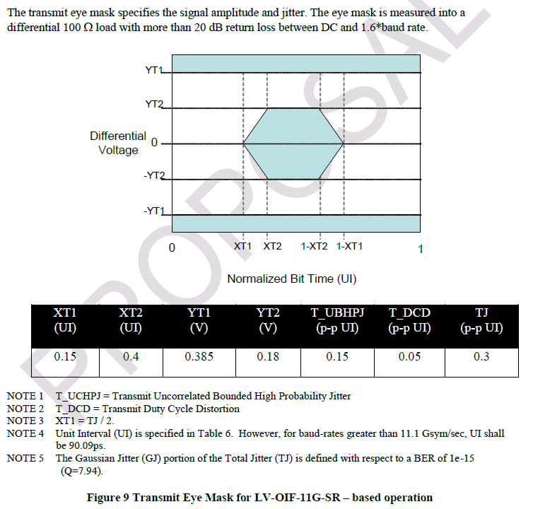
Physical Layer: Serial Lanes
Random Jitter
Random jitter plus Deterministic Jitter (ISI)
Bit-Error Rate for RJ
Notes:
0.5

Slide 43
Deterministic Latency
Notes:
1

Slide 44
Deterministic Latency: Justification
Applications are often sensitive to the variation of system latency
  Synchronous sampling
  Multi-channel phase array alignment
  Gain control loop stability
JESD204 and JESD204A do not achieve known/constant latency across the link across temp/supply/reboot variation
Providing support for devices with internal clock dividers introduces potential for even more latency uncertainty
Notes:
1

Slide 45
Deterministic Latency: Achieved
JESD204B defines the following subclasses related to deterministic latency:
  Subclass 0: DL not achieved (backwards compatible with JESD204A)
  Subclass 1: DL achieved using SYSREF with strict SYSREF to Device Clock timing
  Subclass 2: DL achieved using SYNC~ with strict SYNC~ to Device Clock timing
Deterministic Latency achieved with these architecture features
  SYSREF or SYNC~ are used to provide a deterministic reference phase to all devices for synchronization
  LMFC provides a low frequency reference to avoid frame clock phase ambiguity in the presence of link delay changes
  RX has an “elastic buffer” that absorbs link delay variation in order to align lanes and links
In general, subclass 1 is recommended
  LMFC phase easier to control with source synchronous SYSREF than with system synchronous SYNC~
  SYNC~ to Device Clock timing difficult to meet for > 250 MHz clock
Notes:
1

Slide 46
Deterministic Latency: General Requirements
Elastic buffer must be large enough to store data
  Buffer size is determined by link delay
LMFC period must be longer than the longest link delay (not always true)
  K parameter (frames/multi-frame) determines LMFC period
  1 < K < 32
  17 < K*F < 1024
Receiver buffers store data on all lanes until “release opportunity”
  Release opportunity is ‘RBD’ frames after LMFC boundary, repeats each LFMC cycle
  Simplest case RBD = K → release opportunity on LMFC boundary
  Link latency may be minimized by optimizing the RBD setting
Notes:
1

Slide 47
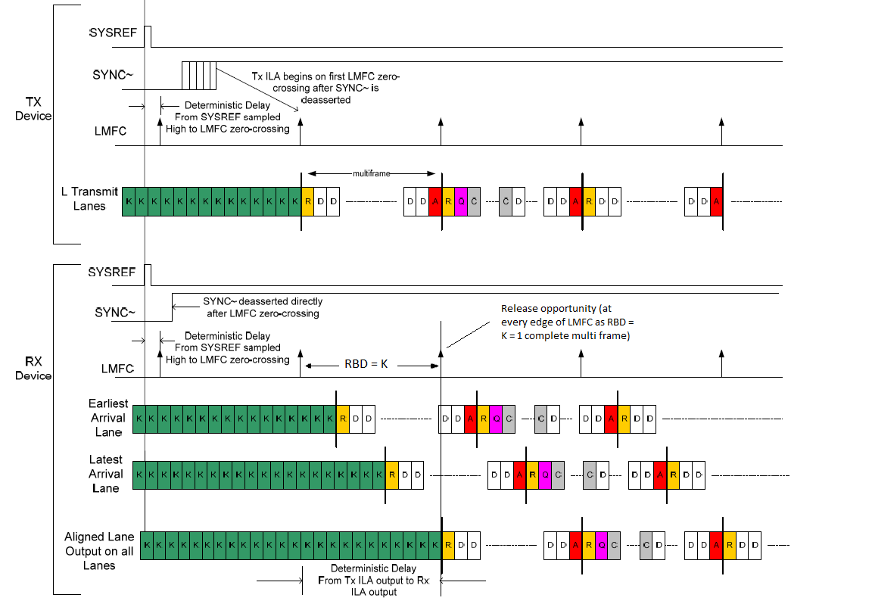
4. All lanes are released on the next LMFC edge and are now aligned
2. After SYNC is received, all lanes send ILAS on next LMFC edge
3. Each lane starts buffering it’s data when it receives the start of ILAS symbol (R)
1. Subclass 1 - SYSREF is used to align LMFCs
K – comma symbols
R - start of ILAS MF
A - end of ILAS MF
D - data
Q – start of config data
C – config data
Notes:
RBD = Receiver Buffer Delay

Slide 48
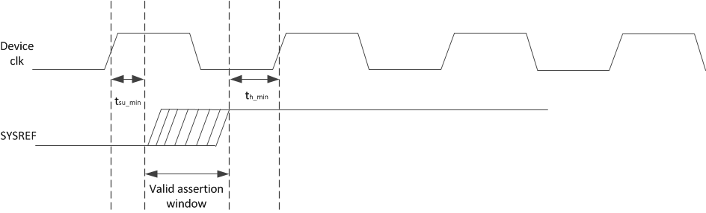
Deterministic Latency: Subclass 1 Requirements
SYSREF must meet setup/hold time with respect to the device clock
In general, SYSREF and Device Clock should come from the same clock source for optimal timing margin over all operating conditions

Slide 49
SYSREF Signal Types
Periodic
  SYSREF always ON with periodic edges
  Risk of interferer spurs near IF due to SYSREF
Gapped-Periodic
  Send periodic edges for a brief pulse of time
  Fewer (or no) spurs
One-Shot
  Single SYSREF pulse and then leave in logic-low state
  No spurs
Frame and LMFC alignment is based on most recent SYSREF rising edge (event) detected
Disabling and gating the SYSREF signal may be employed for AC coupled periodic SYSREF signals
Notes:
1

Slide 50
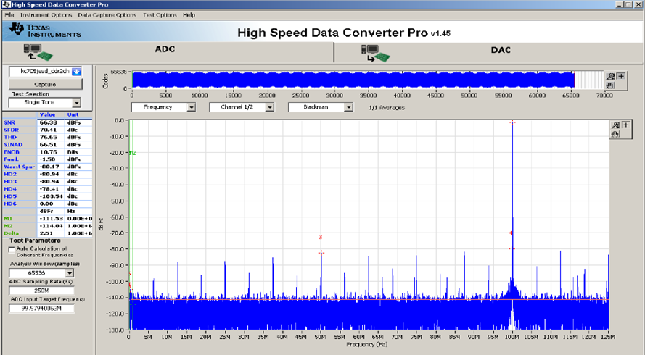
TSW14J56 Capture with SYSREF enabled
Notes:
1

Slide 51
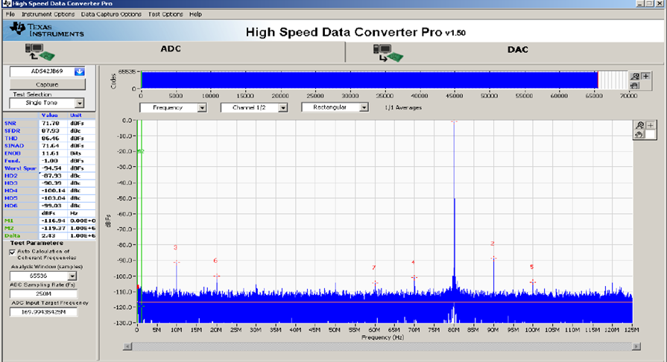
TSW14J56 Capture with SYSREF disabled
Notes:
1

Slide 52
Subclass 0, 1, 2

Slide 53
Subclass 0, 1, 2
Three device subclasses have been defined. Each subclass uses a different link synchronization method.
  Subclass 0: Deterministic latency not supported. Backward compatible with JESD204A. No defined method for aligning local multi-frame clocks. Uses SYNC~ signal.
  Subclass 1: Deterministic latency is supported. Uses SYSREF clock to align local multi-frame clocks to device clocks in both TX and RX devices. May use SYNC~ signal to initiate a lane alignment sequence.
  Subclass 2: Deterministic latency supported. Uses SYNC~ to align local multi-frame clocks.

Slide 54
JES204B Subclasses: 0
Backward compatible with JESD204A but supports high line rates
No support for deterministic (known/constant) latency
Supports alignment of multiple lanes/device
Multi-device synchronization requires strict frame clock frequency and tight SYNC~ setup/hold timing
SYNC~ of subclass 0 has special timing requirements for error reporting
Mixing subclass 0 with subclass 1, 2 devices requires special SYNC~ error reporting considerations
Notes:
1

Slide 55
JES204B Subclasses: 0
TX device
Clock
Source
Frame Clock
SYNC~
Data
Frame Clock
RX device
Critical Timing Path for: Synchronization
Notes:
0.5

Slide 56
JES204B Subclasses: 1
Each device has an internal frame and local multi-frame clock
  Frame clock achieves serial transfer of symbols
  Local multi-frame clock (LMFC) achieves known latency
Requires the SYSREF signal
  SYSREF must be source synchronous with the device clock (critical)
  Phase of SYSREF events determine frame clock and local multi-frame clock alignments
Deterministic latency achieved
Supports alignment of multiple lanes/device
Multi-device synchronization achieved with close attention to device clock and SYSREF distribution
SYNC~ used for synchronization but is not timing critical
Notes:
1

Slide 57
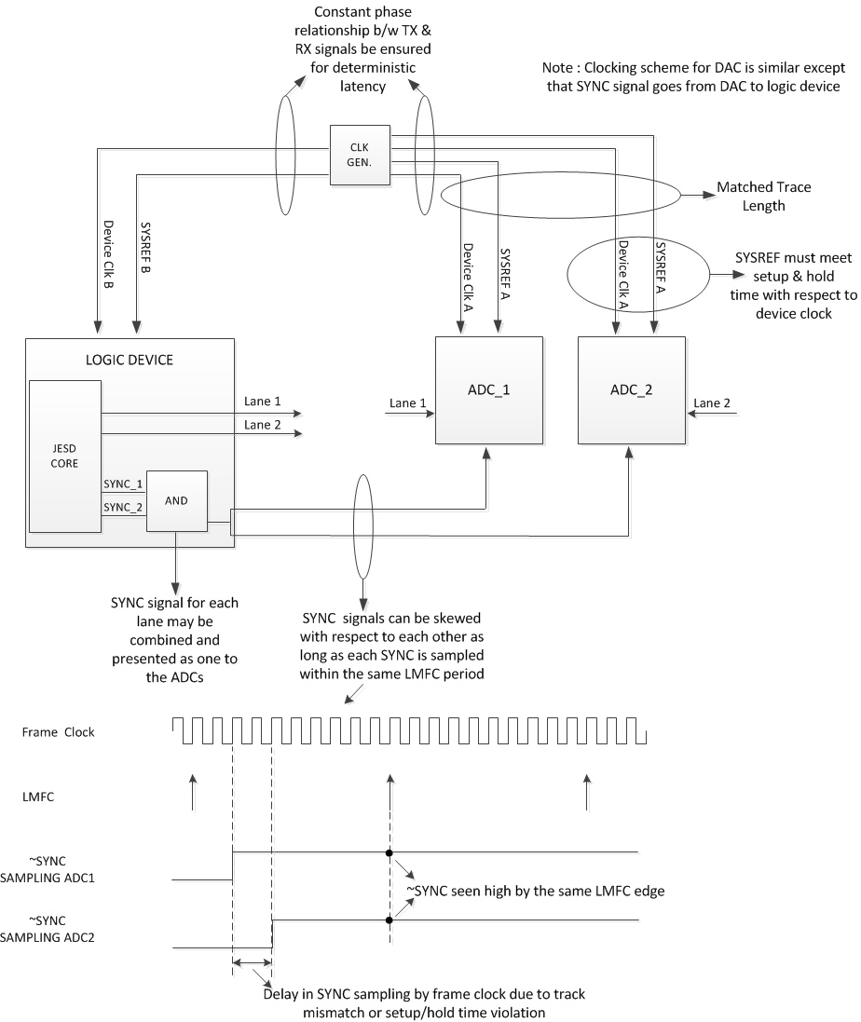
Clocking Scheme - Subclass 1

Slide 58
JES204B Subclasses: 2
Each device has an internal frame and local multi-frame clock
  Same as subclass 1
SYNC~ signal used for synchronization and deterministic latency
  SYNC~ must be system synchronous with the device clock (critical)
  Phase of SYNC~ events determine frame clock and local multi-frame clock alignments
Deterministic latency achieved
Supports alignment of multiple lanes/device
Multi-device synchronization achieved with close attention to device clock and SYNC~ distribution
Since meeting setup and hold time becomes a challenge at higher sampling rates, it is recommended, as per standard, to use Subclass 1 for speeds above 500MSPS for both ADC and DAC.
Notes:
1

Slide 59
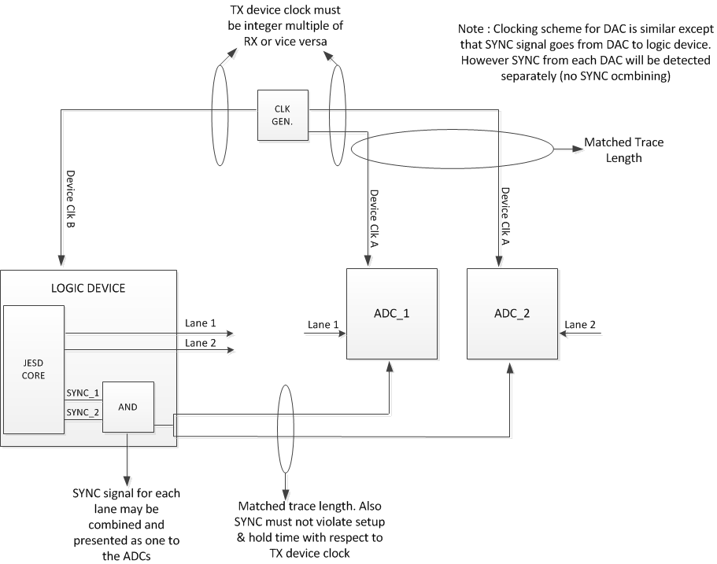
Clocking Scheme – Subclass 2

Slide 60
Additional Information and Training

Slide 61
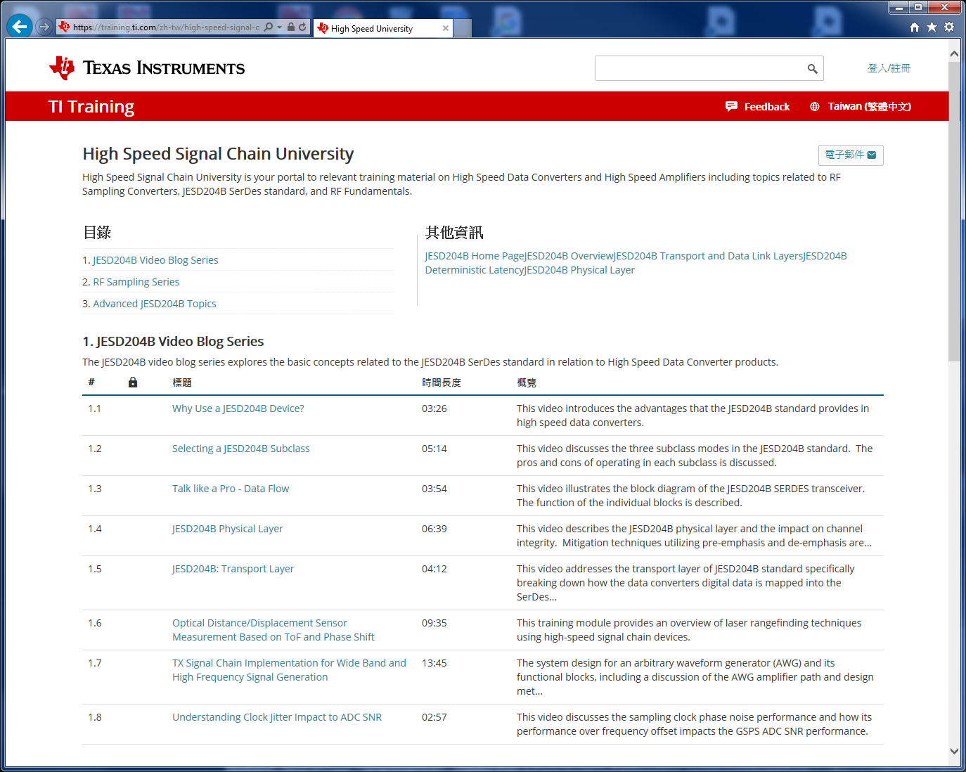
High Speed Signal Chain University

Slide 62
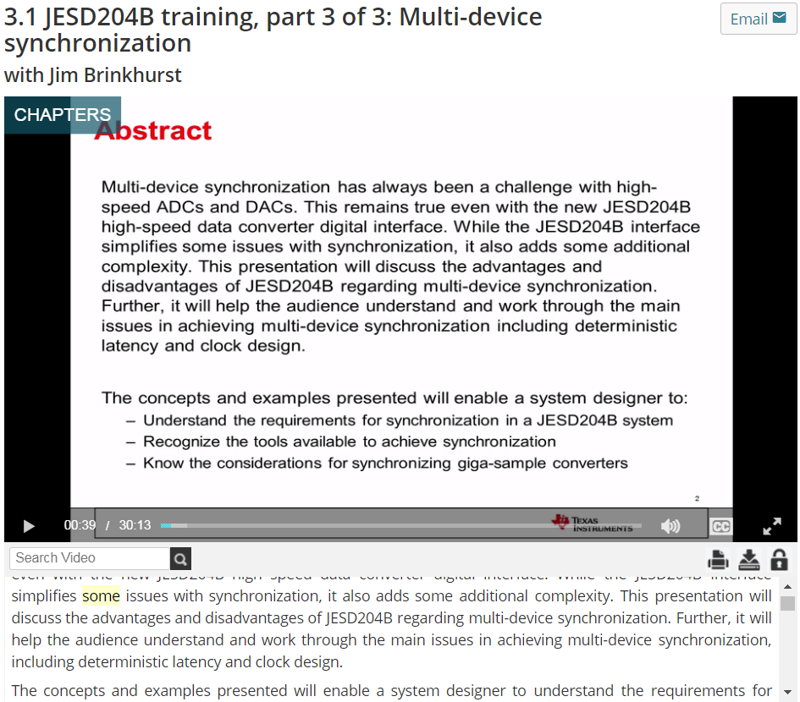
JESD204B Training Videos
Watch on-demand at: https://training.ti.com/JESD204Btraining
Three videos, 30-45 minutes each:
  Overview
  Debug, tools and tips
  Multi-device synchronization

Slide 63
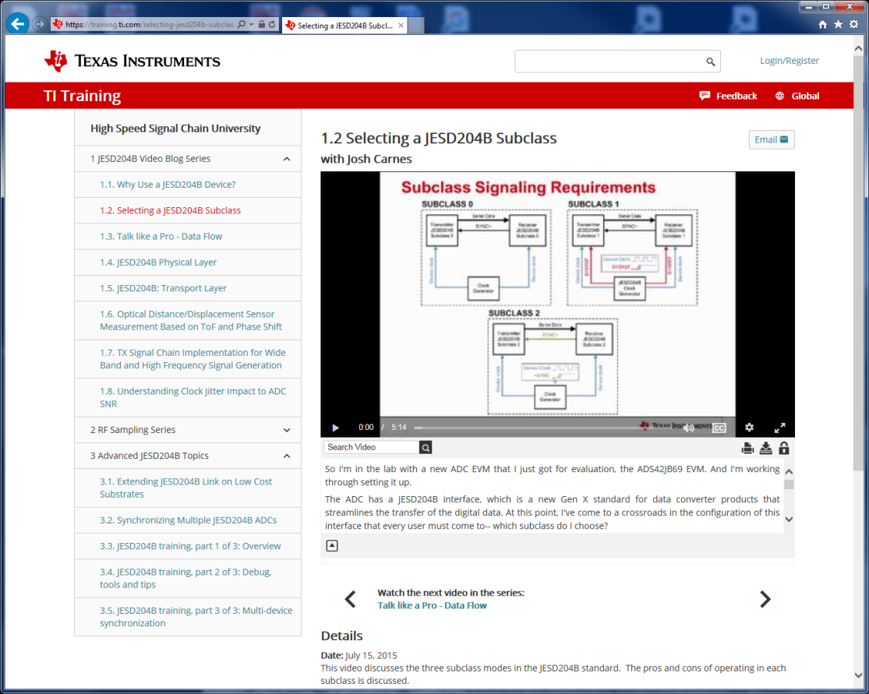
JESD204B Training Videos

Slide 64
Application Notes
Ready to make the jump to JESD204B? (http://www.ti.com/lit/wp/slyy057b/slyy057b.pdf)
JESD204B multi-device synchronization: breaking down the requirements (http://www.ti.com/lit/an/slyt628/slyt628.pdf)
JESD204B Blogs
https://e2e.ti.com/blogs_/b/analogwire/archive/2014/07/30/jesd204b-understanding-the-protocol
https://e2e.ti.com/blogs_/b/analogwire/archive/2014/08/27/jesd204b-how-to-bring-up-your-link
https://e2e.ti.com/blogs_/b/analogwire/archive/2014/09/24/jesd204b-determining-your-link-configuration
https://e2e.ti.com/blogs_/b/analogwire/archive/2014/10/24/jesd204b-understanding-subclasses-part-1
https://e2e.ti.com/blogs_/b/analogwire/archive/2014/10/31/jesd204b-understanding-subclasses-part-2
https://e2e.ti.com/blogs_/b/analogwire/archive/2014/12/22/jesd204b-what-is-deterministic-latency-why-do-i-need-it-how-do-i-achieve-it
https://e2e.ti.com/blogs_/b/analogwire/archive/2015/01/16/jesd204b-how-to-calculate-your-deterministic-latency
https://e2e.ti.com/blogs_/b/analogwire/archive/2015/02/27/jesd204b-how-to-measure-and-verify-your-deterministic-latency
https://e2e.ti.com/blogs_/b/analogwire/archive/2015/03/20/jesd204b-serial-link-quality-tradeoffs-and-tools-for-optimization
Generic search of ti.com for JESD204B will bring up more material such as videos, TI Designs, etc…
Texas Instruments with Altera and Xilinx:
http://www.ti.com/ww/en/xilinx/pg_jesd204b.html
http://www.ti.com/ww/en/Altera/pg_jesd204b.html

