Slide 1
ADC3664EVM FMC clocking option
07/09/2021

Slide 2
Goal
Provide sample clock and DCLKIN to the ADC3664EVM from FPGA via the FMC connector.
NOTE: Please ensure that the Sample Clock and DCLKIN are frequency locked/coherent with one another (share the same reference). This should not be an issue if both PLLs in the FPGA are sharing the same input source.

Slide 3
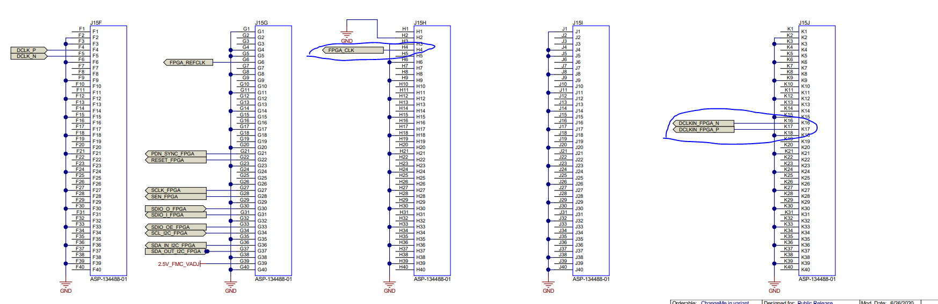
ADC3664EVM FMC signals
The sample clock input is single-ended, and comes from pin H4 of FMC.
The DCLKIN input is differential, and comes from pins K16/K17 of FMC.

Slide 4
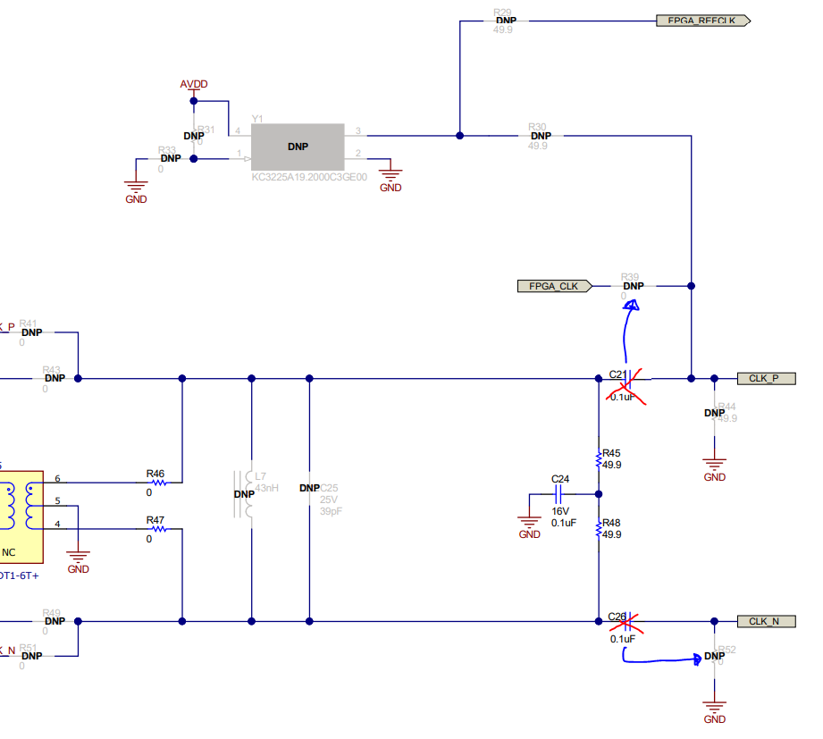
EVM configuration for FMC sample clock
C21: Remove and use for R39.
R39: Install 0.1 uF capacitor (use component C21).
C26: Remove and use for R52.
R52: Install 0.1 uF capacitor (use C26).
R44 can be used if termination is required from FPGA signal.

Slide 5
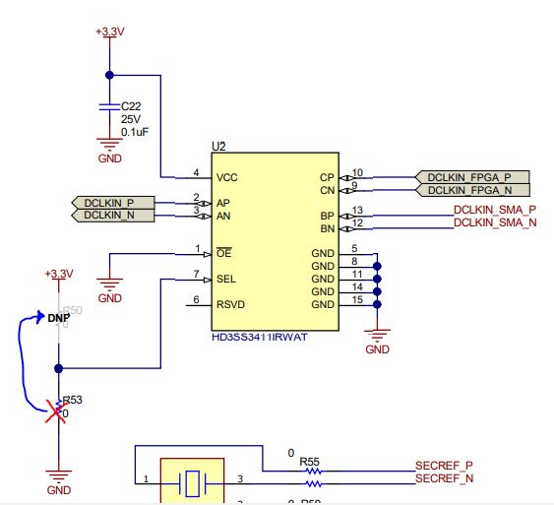
EVM configuration for FMC DCLKIN
R53: Remove and use for R50.
R50: Install 0 ohm resistor (use component R53).
Now LVDS Mux (U2) will pass DCLKIN_FPGA_P/N to DCLKIN_P/N.

