Slide 1
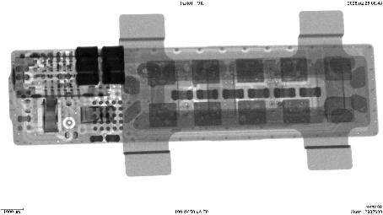
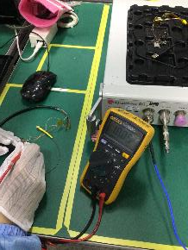
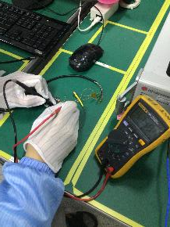
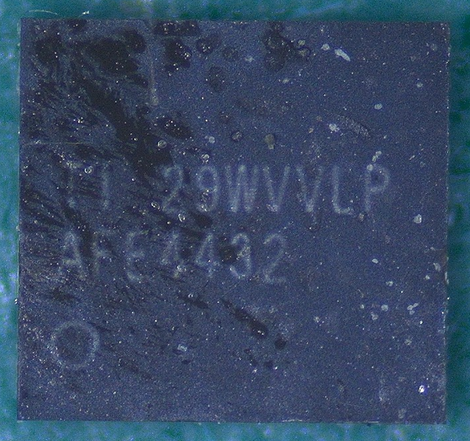
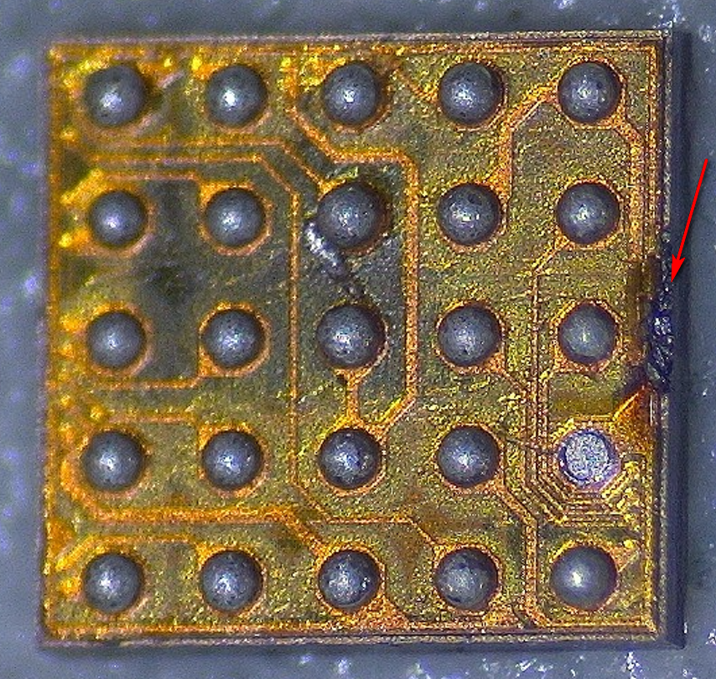
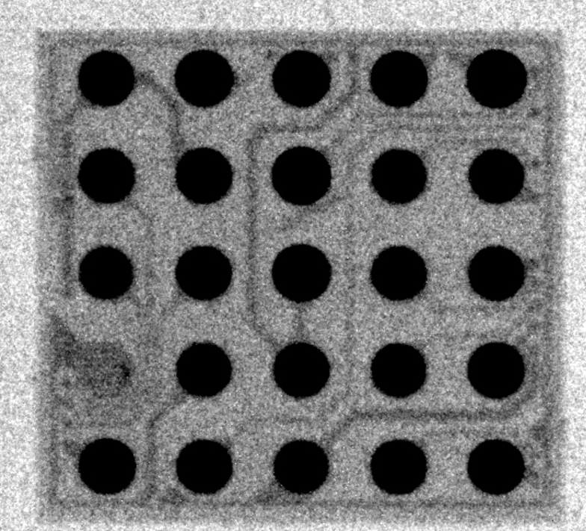
FS01 Sensor Board AFE Failure Analysis
Failure Detail：
• Date/Time Detected：2026/02/26
• Config: FS01 sensor board
• Defect Symptom : mfg afe live 0 0xfff 1
• Station: FT
• Defect Quantity: 1
• Fail Rate: 1/200=0.50%
• Serial Number: NA
• Location: U501(AFE)
• MPN : AFE4432YCHR
• Manufacturer : TI
• Material DC: 20220912
• Material LOT : 2374920JA2
Failure Analysis Steps:
1. There is no abnormality in appearance. No abnormalities were found in X-ray rays, as in the figure below.
U501(AFE: AFE4432) X-ray
2. The voltage of VSYS_4V5 and BK_1V8D is normal, as shown in the above figure. All other functions of the product are normal.
3. After cleaning the surface of the sensor board, the issue persisted, making it unrelated to the PD LED.
4. The AFE chip（U501） was remelted by heating, but the test results still failed.
5. Following the replacement of the new AFE chip（U501）, the mainboard was reconnected for testing. Initial log readings indicated reasonable values.
6. The newly replaced sensor board was tested at the functional testing station, and both retests passed.
7. Remove the AFE chip from the PCBA. It was found that there were some abnormalities on the back side of the component. The factory was unable to perform ball placement verification, so no cross-validation was conducted.
Long Term Correct Action:
1. Send the AFE chip (u501) to suppliers for further analysis.
NG Log：

