Slide 1
JESD204B Design Guidelines, LINK Bring Up, Tools and Debug
e2e.ti.com (TI Support Forum)
April 2016

Slide 2
Abstract
The introduction of the JESD204B interface for use between data converters and logic devices has provided many advantages over previous generation LVDS and CMOS interfaces – including simplified layouts, skew management, and deterministic latency. However, bringing up a link for the first time can be a challenge if not properly prepared. This presentation will give the engineer tips, guidelines, tools, and examples that will assist in the bring up of a JESD204B Interface Link.

Slide 3
Content
Configuration Planning
DAC and ADC examples
TestBench example achieving CGS and ILAS
Board Schematic and Layout Guidelines
Clocking
PCB Material and Routing
HSP JESD204B Evaluation Tools
Altera and Xilinx based Tools
HSDC Pro Software
Additional Information
E2E Forum, Blogs, App notes, ect…
Summary

Slide 4
Configuration Planning

Slide 5
DAC38J84 Example Configuration
Input data
5M Wideband carrier at 30MHz Complex IF
Input Digital Data rate = 737.28Msps
DAC settings:
2X interpolation – DAC output rate 1474.56 Msps
NCO setting at 150M – output IF at 180MHz
LMFS Calculation
LMFS=8411
Use L=8 lanes, M=4 Converters, F=1 Octet per frame, K=20, S=1 Sample per converter per frame
LMFC = Fs/(S*K) = 36.864Msps
SYSREF = LMFC/n = 36.864Msps max (n=1)
Lane rate = ???

Slide 6
How is the DAC LMF chosen?
DAC38J84: 16b Quad DAC with up to 8 lanes JESD204B up to 12.5Gbps/lane
Data rate = 737.28Msps/DAC, 4 DACs = M = 4
Octet rate per DAC: 2 octets (16 bits) per sample
737.28Msps*2 = 1474.56Moctets/sample/DAC
Bitrate per DAC: 8b/10b coding
1474.56Moctets/s*10bits/octet = 14,745.6Mbps
Total bit rate = 4 DACs * 14.7456 Gbps = 58.9824Gbps (total through put)
If we choose L=8 lanes then the lanerate:
Lane rate = 58.9824Gbps/8 = 7.3728 Gbps per lane
LMFS=8411, lane rate = 7.3728Gbps

Slide 7
ADC12J4000 Example Configuration
Input IF = 2.14GHz
ADC Sample rate 3.1Gsps
NCO = 2100M, Decimate 16x
Output 40M IF @ 193.75Msps
LMFS=2221, L=2 Lanes, M=2 logical converters, K = 10, F=2octets/frame, S=1 sample per converter per frame
LMFC = Fs/(dec*S*K) = 19.375Msps
SYSREF = LMFC/n = 19.375Msps max (n=1)
Lane rate = ???

Slide 8
How is the ADC LMF chosen?
ADC12J4000 in decimate 16x mode. Output words are 15I+15Q+2 Over range bits.
Data rate = 193.75Msps/logical ADC, 2 logical ADC outputs = M = 2
Octet rate per ADC: 2 octets (16 bits per sample)
193.75Msps*2 Octet/s = 387.5 Moctet/sample/ADC
Bitrate per ADC: 8b/10b coding
387.5M octets/s*10bits/octet = 3875Mbps
Total bit rate = 2 logical ADCs * 3875Mbps Gbps = 7.750Gbps (total through put)
If we choose L=2 lanes then the lane rate:
Lane rate = 7.750 Gbps/2 = 3.875 Gbps per lane
LMFS=2221, lane rate = 3.875 Gbps

Slide 9
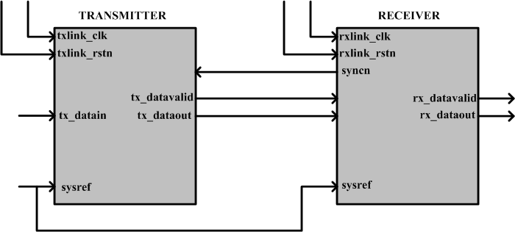
Introduction: TESTBENCH
Transmitter = FPGA or ADC
Receiver = FPGA or DAC
A 16bits ramp will be transmitted through the JESD link and the state of the data at various points in the link will be observed
JESD device clock → txlink_clk = rxlink_clk
LMFS = 2221
Notes:
Sysref = 100/txlink_clk because simulation mode

Slide 10
Getting Started: ACHIEVING CGS
STEP1: Receiver de-asserts SYNCn
The receiver is required to de-assert SYNCn at startup.
Step 2: Transmitter starts sending K28.5 characters
Transmitter starts sending K28.5 (/K/) characters which appear as bc after decoded. IP below uses a 64 bit bus after data is decoded, so data appears as bcbcbcbc.
Altera Quartus Signal Tap display
Notes:
Signal Tap plots

Slide 11
Getting Started: ACHIEVING CGS
STEP3: Receiver must respond to K28.5 transmission by asserting SYNCn
Receiver may fail to assert SYNCn because
Receiver CDR may not be locked to transmitter’s bit stream
Ensure the receiver and transmitter serdes are both running at the same bit rate.
Bit rate = (F * 10 * Fs) / C
Fs = sampling frequency, F = # of octets in a frame
C = Interpolation factor or 1/(decimation factor)
Bad Signal integrity
Use of clock jitter cleaners like the LMK04828 for clock distribution is strongly encouraged

Slide 12
Getting Started: ACHIEVING CGS
STEP4: CGS ends when the receiver de-asserts SYNCn. The transmitter continues sending K28.5 until it detects the rising edge of the LMFC clock. At this rising edge, ILAS begins.
The minimum duration from CGS to ILAS is F + 9octets.
when receiver asserts SYNCn but transmitter does not start ILAS check whether SYSREF is present.
SYNCn
de-asserted
Start
ILAS

Slide 13
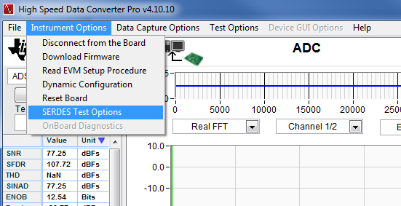
Getting Started: ACHIEVING CGS
Bad signal integrity
Check the eye opening at the receiver
TI High Speed Data Converter Pro GUI (HSDC PRO) software includes an easy to use eye-scan feature to help diagnose the eye opening of the receiver CDR circuit.
Notes:
Not currently in HSDC Pro GUI

Slide 14
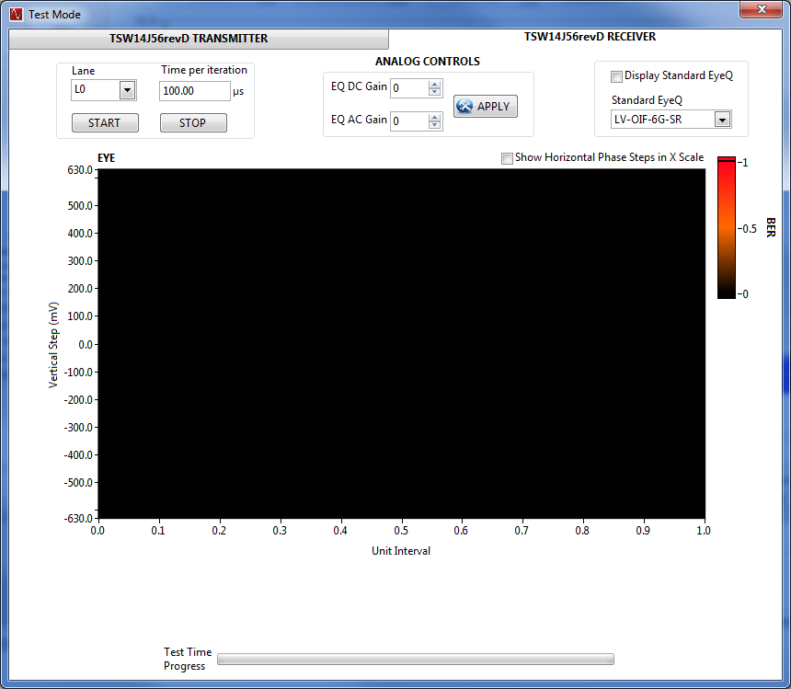
Getting Started: ACHIEVING CGS
Altera developed Eye Scan Tool
Select “TSW14J56revD RECEIVER” for testing with an ADC
Notes:
Not currently in HSDC Pro GUI

Slide 15
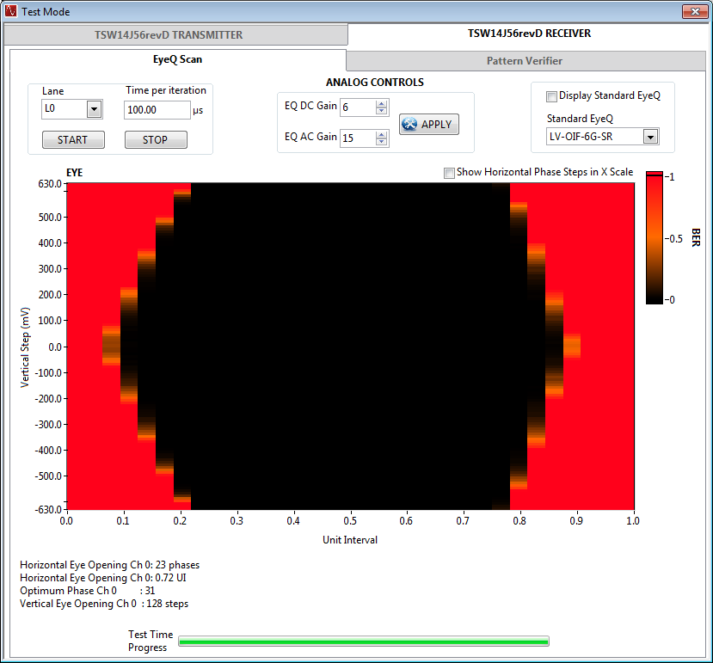
Getting Started: ACHIEVING CGS
Eye scan of Lane 0, maximum Equalization settings
EQ AC Gain sets the gain for the Receiver Linear Equalization Control
EQ DC Gain sets the gain for the RX buffer
Notes:
Not currently in HSDC Pro GUI

Slide 16
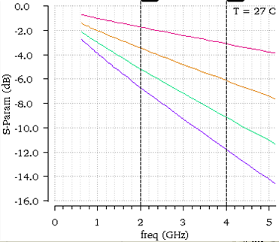
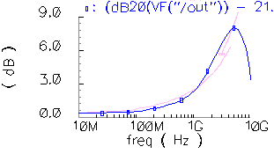
Solutions for Long/Lossy Channels
Equalization can be used to pulse-shape at TX or pulse-correct RX
High-pass profile of equalization counteracts low-pass loss profile of channel
Pre-emphasis
AMPLIFY HIGH frequencies to achieve high-pass profile
De-emphasis
ATTENUATE LOW frequencies to achieve high-pass profile
May require broadband amplification to meet eye requirements at large de-emphasis
5”
10”
15”
20”
Loss profile for microstrip trace lengths over FR4
High-pass emphasis profile (blue)
matches the inverse of the
channel loss profile (pink)

Slide 17
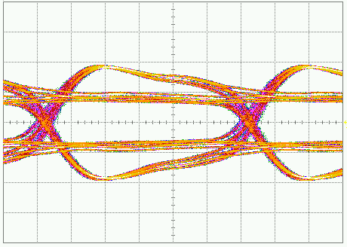
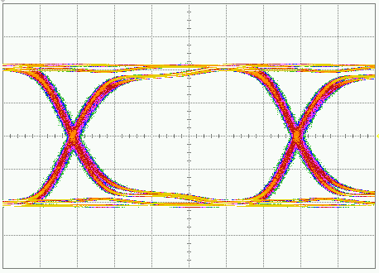
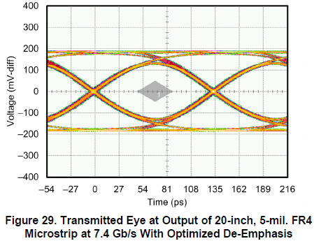
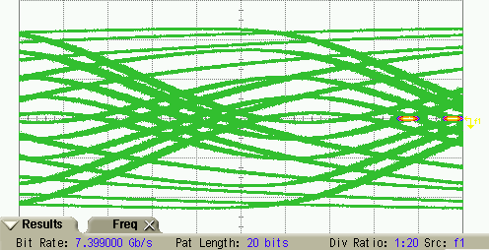
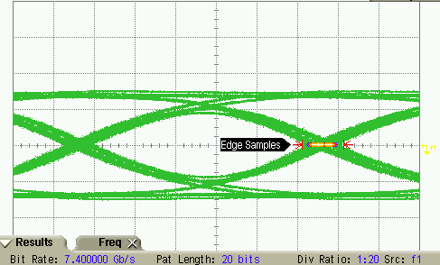
Solutions for Long/Lossy Channels
ADC16DX370 De-Emphasis Waveform @ 5 Gb/s at TX output
Waveform @ 7.4 Gb/s at output of 20-inch FR4 channel
De-emphasis disabled
Maximum De-emphasis
Easily Meets JESD204B RX Eye Spec!!!
De-emphasis disabled
De-emphasis Optimized

Slide 18
Solutions for Long/Lossy Channels
ADC12J4000 Pre-Emphasis Waveform @ 7 Gb/s over 7 inches FR4
Pre-emphasis disabled
Pre-emphasis Optimized
Even Meets TX Eye Spec!!!

Slide 19
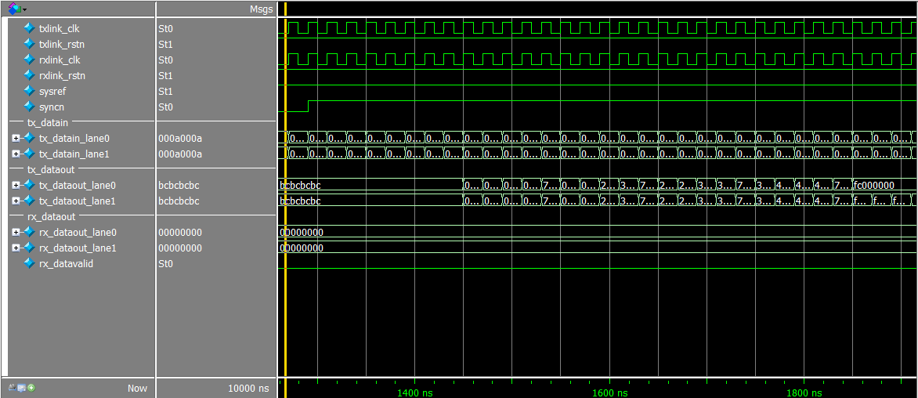
Getting pass ILAS-What to expect
STEP5: ILAS is a minimum of 4 multi-frames (mf = F*K octets) long for subclass 1 and 2 devices
For our testbench, 1 multiframe = 20 octets (F = 2, K = 10)
Device configuration parameters are always transmitted in the 2nd multiframe of ILAS. The ILAS Parameters can be found in JESD204B Overview presentation.
Multiframe-1
Multiframe-2
Multiframe-3
Multiframe-4
User data

Slide 20
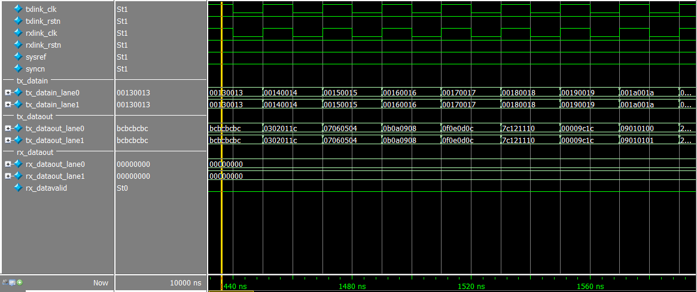
Getting pass ILAS-What to expect
The first and last octet in a multiframe which is part of an ILAS is always K28.0 (0x1c) and K28.3 (0x7c) respectively
The 2nd octet of the 2nd multiframe during ILAS is always K28.4 (0x9c)
Below shows 4 octets per sample, the 1st octet is LSB based.
K28.0=0x1c
K28.3=0x7c
K28.4=0x9c

Slide 21
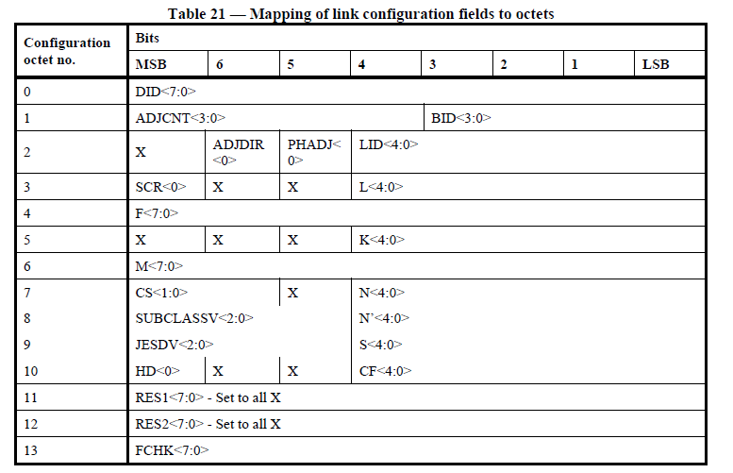
Getting pass ILAS-What to expect
During ILAS, device configuration parameters are transmitted starting from the 3rd octet in the 2nd multi-frame in the order shown in the table below
1st Octet, 2nd mf
Third Octet
Config Octet 0
Octet 5 = K-1 = 9
Notes:
M = 2, K = 10

Slide 22
Oct 0 = ADJCNT Oct 1 = ADJDIR Oct 2 = Lane ID Oct 3 = # of Lanes Oct 4 = F Oct 5 = K Oct 6 = M Oct 7 = N Oct 8 = Subclass & N’ Oct 9 = S (4:0) Oct 10 = CF Oct 11 = Resv Oct 12 = Resv Oct 13 = Checksum 00 00 9C 1C 0F 01 07 03 23 2F 0D 01 3C 00 00 00 Lane DA0 LMFS = 8224 1 0 Q R 5 4 3 2 9 8 7 6 13 12 11 10 K F L ID M Checksum (octet 13)

Slide 23
Getting pass ILAS
STEP6: Transition from ILAS to user data phase
In the transmitter, this transition occurs at the next rising edge of frame clock after the last octet (K28.3 or /A/) of ILAS is transmitted.
In the receiver this transition occurs at the rising edge of the LMFC clock when the last ILAS octet (K28.3 or /A/) is detected in the elastic buffers of all active lanes.
The release point for the elastic buffers in the receiver can also be programmed to be RBD (Release Buffer Delay) frame clock cycles from an LMFC rising edge.
The elastic buffers in the receiver may overflow when inter-lane skew or LMFC clock period is too large compared to the buffer depth.
Keep the inter-lane (or interconnect) skew below 3* max(UI,320ps)
Reduce K (no of frames per multi-frame) when elastic buffer overflow occurs

Slide 24
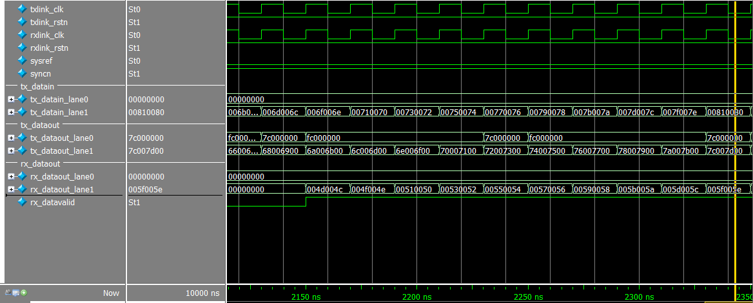
USER DATA PHASE-Alignment character insertion
STEP7: Transmitter sends user data and it becomes available at the output of the receiver
For the testbench, a 16bit ramp is transmitted on lane1 and zero is transmitted on lane 0
Transmitter inserts alignment characters for monitoring frame and multi-frame alignment (K28.7 = 7C and K28.3 = FC).
Receiver replaces the alignment characters with the previous octet received at the same position
Notes:
Mega core has the outputs at 32 bits. MTI had 64

Slide 25
Board Schematic & Layout Guidelines

Slide 26
CLOCKING TIMING
Timing Guidelines for Subclass 1
SYSREF is a time critical signal in subclass 1 and must meet setup and hold time with respect to device clock.
Can be routed as AC or DC coupled. If using AC coupling, cannot use pulse mode.
If using DC coupling (preferred), must make sure common mode is set properly at receiver.
Device clock and SYSREF across multiple converters must be aligned as close as possible
Must have matched length to all transmitters/receivers.
If used as sampling clock for ADC, make sure to terminate properly.
SYNC signal to different ADCs can be skewed. However each SYNC must be sampled within same LMFC period.
SERDES interface should be AC coupled to isolate receiver and transmitter associated IO voltages, which allows each to operate with its own optimum common mode voltage.
Since SERDES output is 8b/10b encoded, this ensures the data is DC-balanced and thus can be AC coupled.

Slide 27
LMK04828 JESD204B Clocking Solution
7 Device CLK / SYSREF pairs
Low Jitter clock source
SYSREF Disable feature
Delay options
LVPECL, LVDS, HSDS outputs
Supports Clock Distribution mode
using external clock source

Slide 28
PCB Info
Board material
When designing for signal speeds above 3Gbps, special PCB materials with a Df (loss factor) of .004 or less should be used.
Megtron 6 (used on TI TSW14J56EVM which runs at 12.5Gbps)
Rogers
Mix high speed material with standard material to save on cost
Route High Speed Serdes traces with special PCB material
Remaining traces routed on 370HR
Saved ~ 36% on board cost on TSW14J56EVM
Board shop has reported that 370HR can be used up to 10GHz with very short traces (1-3 inches)
Suggest running signal integrity simulation before attempting this
370HR has been successfully used up to 6.5Gbps on our TSW14J50EVM low cost solution board.

Slide 29
PCB High Speed Material

Slide 30
TSW14J56EVM stackup
Using mixed material saved
~40% on board cost
JESD204B parts vary in max Lane rate.
Do not use expensive pcb material
if not needed.

Slide 31
Typical PCB fab drawing notes
NOTE: Immersion Silver should be used in place of SMOBC/Immersion Gold
with Nickel plating when routing high speed Serdes lanes on exposed
(top and bottom) layers

Slide 32
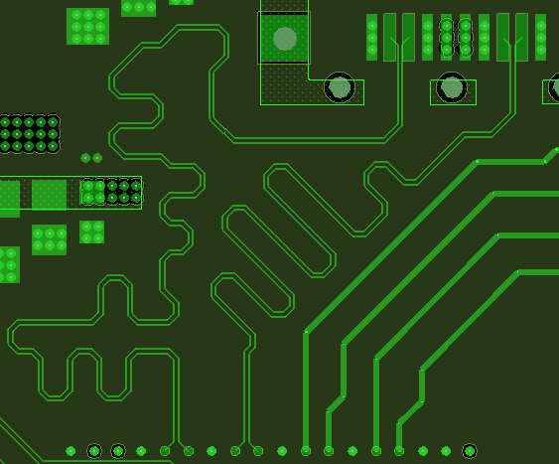
Wiggles to Match Trace Lengths
Wiggles are used to match the lengths of multiple differential pairs.
Recommendations:
Wiggles should follow the recommendations for bends given previously.
Rule of thumb: keep the radius of the wiggle at least 3 times trace width.
Use an equal number of turns in each direction to keep the traces of the differential pair matched.
Lanes of matched length are not necessary for the JESD204b standard. Large mismatch between lanes can result in higher latency.
R > 3xW
Wiggles used to match the length of two differential pairs

Slide 33
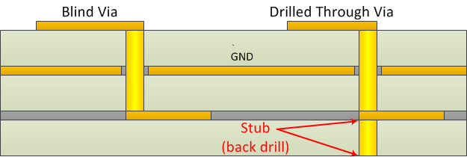
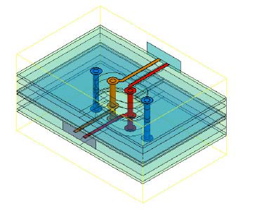
Vias in the Signal Path
A via will present an impedance discontinuity resulting in reflections and a degradation of the signal.
Recommendations:
If vias are used, keep the via delay short compared to the rise time of the signal to minimize reflections.
Avoid stubs from vias to inner layers by having them back drilled. Alternatively, blind vias are a better choice to eliminate stubs.
Simulate the signal path with the vias to determine signal integrity before manufacturing the board.
Vias can be compensated by adding ground vias close by for the return current.

Slide 34
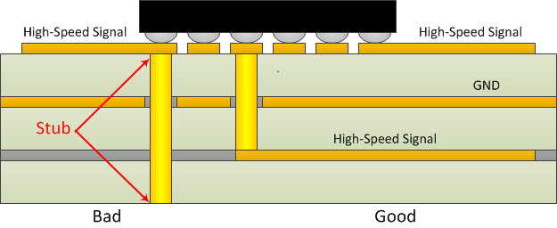
In-Pad Vias for BGA Package
Recommendations:
If In-Pad vias are used with a BGA package and the high-speed serial link signal is coming from an inner layer, follow the recommendations from the previous slide.
If the signal is routed to the ball of the package without going through a via, remove the via from these pins.
In pad vias on low speed signals and ground and power are fine and will help to dissipate device heat.

Slide 35
Reference Planes
Recommendations:
Use a single ground plane as the signal reference.
Do not put splits in the reference plane underneath the signals. The return current for high-speed signals will follow the trace on the reference plane. A split will require the return current to travel around the split.
Keep analog signals separate from digital signals, however a single ground plane is fine. During routing, split the ground plane at the DAC or ADC into analog and digital planes and route the signal traces in their respective domains. After routing, recombine the two ground planes into one.
If using a stripline trace, place reference planes on both the top and bottom of the trace and do not put splits into either of them.
Routing on inner layers has its advantages (better impedance control, no speed issues with Nickel plating, less interference/emissions).

Slide 36
HSP JESD204B evaluation tools

Slide 37
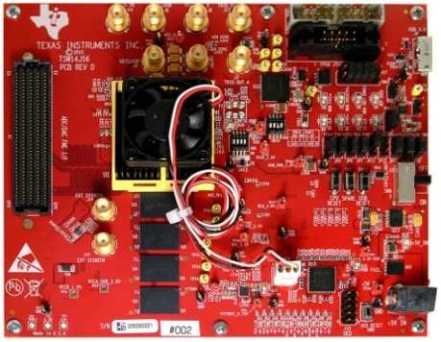
TSW14J56EVM USB3, 2G 16 bit samples Memory, 12.5Gbps Serdes/JESD204B
Specifications
Benefits
Works with all TI’s JESD204B data converters
32Gbit DDR3 memory (2 Gsamples 16 bits)
Supports up to 10 lanes @ 12.5 GBits/ second
Common HSDC Pro GUI
Supports ADC, DAC, TXRX modes
USB 3.0 interface
<3s firmware DL
256Ms – 15s (revB 20mins)
1Gs – 1min
Altera Arria V GZ FPGA (Fastest Speed grade)
Quartus software/JESD204B MegaCore IP
Single platform for evaluation and test of current and future TI JESD204B ADCs and DACs
Generation or analysis of long time domain complex modulated signals
Easy to use software for signal analysis and generation
Flexibility of system evaluation
Applications
Pattern generation and capture of TI’s JESD204b data converters
Notes:
37

Slide 38
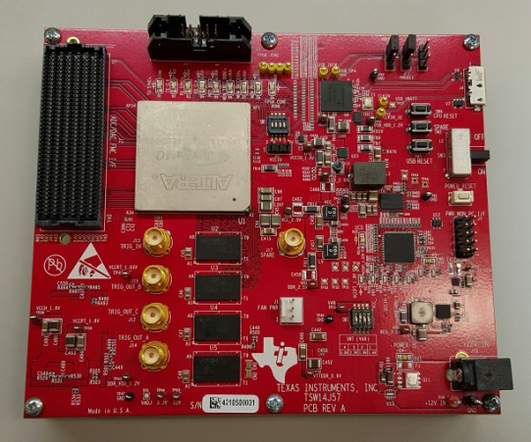
TSW14J57EVM Next Generation ADC / DAC Evaluation Module
Specifications
Benefits
Works with all TI’s JESD204b data converters
32Gb DDR4 memory (2Gsamples 16 bits)
Supports 16 lanes @ 12.5 Gbps, 8 lanes @ 15Gbps
Common HSDC Pro GUI
Altera Arria 10 FPGA
Supports ADC, DAC, TXRX modes
USB 3.0 interface
Standard FMC, FMC+ port connectivity
Single platform for evaluation and test of current and future TI JESD204B ADCs and DACs
Generation or analysis of long time domain complex modulated signals
Easy to use software for signal analysis and generation
Flexibility of system evaluation
Applications
Pattern generation and capture of TI’s JESD204b data converters
Notes:
38

Slide 39
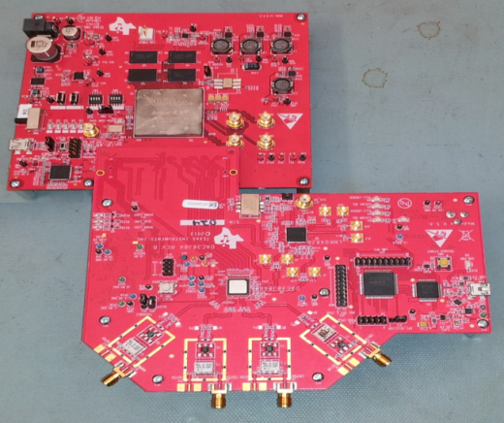
TSW14J50 Low Cost Evaluation Module
Specifications
Benefits
Arria V GX based
8x Serdes Lanes up to 6.3Gbps
4Gbit DDR3 memory (256Msamples 16 bits)
USB 2 interface
Standard FMC port connectivity for all TI JESD EVMs and FPGA eval platforms
Common HSDC Pro GUI same as TSW140x, TSW14J56
ADC, DAC Modes
Single platform for evaluation and test of current and future TI JESD204B ADCs and DACs
Generation or analysis of long time domain complex modulated signals
Easy to use software for signal analysis and generation
Flexibility of system evaluation
Applications
Pattern generation and capture of TI’s JESD204b data converters
Notes:
39

Slide 40
EVM

Slide 41
TI free GUI – High Speed Data Converter Pro Software (HSDC Pro GUI)
Configures FPGA JESD204B for a specific TI ADC/DAC
Provides freq or time domain analysis of captured data
Calculates SNR, SFDR, ENOB, etc….
Same GUI used for generating DAC patterns (notice DAC tab)

Slide 42
HSDC Pro Software – DAC Operation
Notes:
WCDMA 30MHZ
42

Slide 43
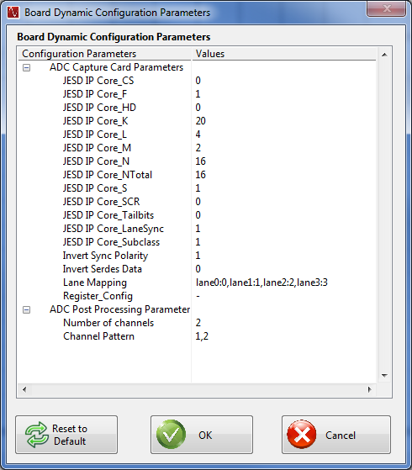
TSW14J56 Dynamic Configuration Parameters

Slide 44
DEBUGGING FEATURES - ADC
LINK LAYER TEST PATTERNS
Repeat initial lane alignment (ILA) sequence
Repeat 12 octet modified random jitter pattern (RPAT)
TRANSPORT LAYER TEST PATTERNS
Long transport layer pattern
Short Transport Layer pattern
PHYSICAL LAYER TEST PATTERNS
PRBS-15
Clock pattern , 101010101010 (D21.5)
Encoded Pattern 1111111100000000
OTHER
DIGITAL RAMP
8-Point sine wave

Slide 45
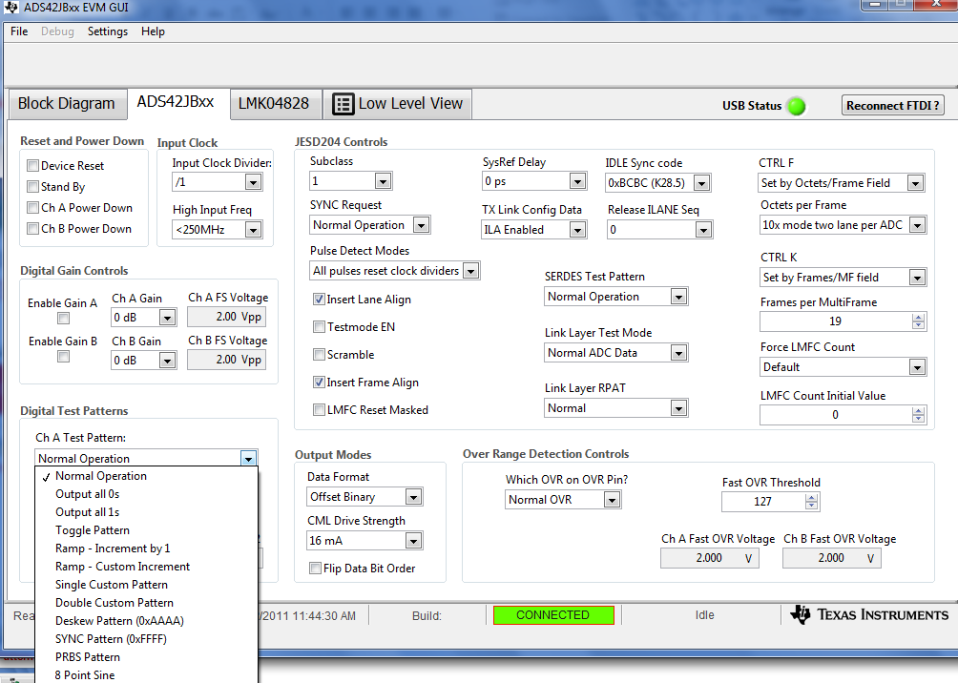
ADS42JB69EVM Test Pattern Options

Slide 46
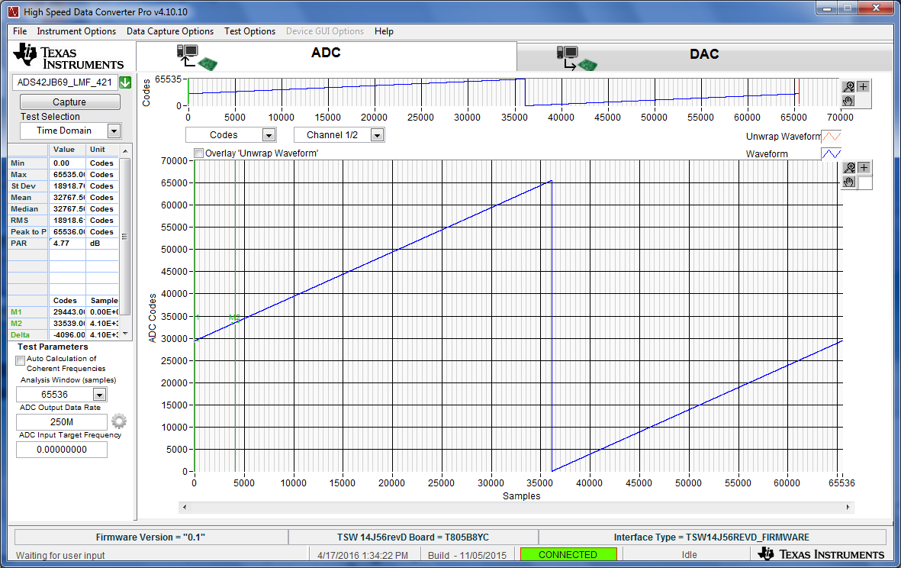
ADS42JB69 Ramp Test Pattern (Codes)

Slide 47
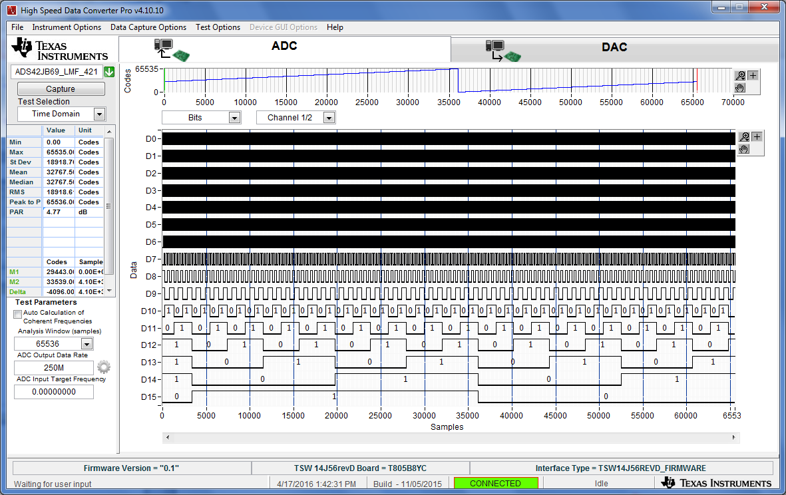
ADS42JB69 Ramp Test Pattern (Bits)

Slide 48
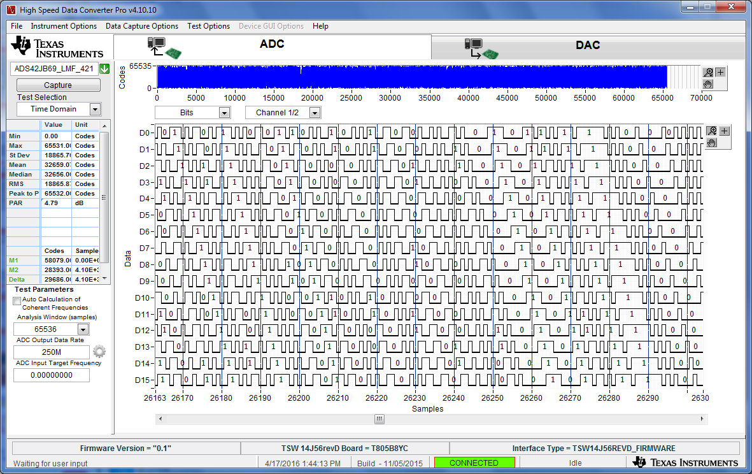
ADS42JB69 PRBS Test Pattern

Slide 49
DEBUGGING FEATURES - DAC
LINK LAYER TEST PATTERNS
Verify repeating /D.21.5/ high freq. pattern for random jitter (RJ)
Verify repeating /K.28.5/ mixed freq pattern for deterministic jitter (DJ)
Verify repeating initial lane alignment (ILA) sequence
RPAT, JSPAT or JTSPAT pattern can be verified using errors counter of 8b/10b errors produced over an amount of time to get an estimate of BER.
TRANSPORT LAYER TEST PATTERNS
Implements a short transport layer pattern check based on F = 1,2,4 or 8.
F = 1 : Looks for a constant 0xF1.
F = 2 : Each frame should consist of 0xF1, 0xE2
F = 4 : Looks for a constant 0xF1, 0xE2, 0xD3, 0xC4
F = 8 : Each frame should consist of 0xF1, 0xE2, 0xD3, 0xC4, 0xB5, 0xA6, 0x97, 0x81

Slide 50
DEBUGGING FEATURES – DAC (Monitors/Alarms)

Slide 51
DEBUGGING FEATURES – DAC (Configuration)

Slide 52
DEBUGGING FEATURES – DAC (SERDES adjustments)

Slide 53
Altera Quartus
- Version 15.0 - JESD204B MegaCore IP

Slide 54
Qsys as Interconnect Fabric between different IP used in the design
Qsys used to quickly connect IP modules together in the reference design
Automatic generation of interconnects, width matching, address decoding, and arbitration logic
Support for Avalon, ARM, AMBA AXI, APB, and AHB
Automatic HDL generation including test benches
Faster verification in the lab using System Console

Slide 55
Easy to use Altera JESD204B IP Megawizard flow to parameterize the JESD204B Core
Example design creation that includes the transport layer
Simple interface to quickly customize the JESD204B IP Core
Helpful mouse-over descriptions for each field

Slide 56
XILINX Vivado - Version 2016.1 just released - JESD204 v7.0 LogicCORE IP - Vivado Design Suite User’s Guide
Programming and Debugging Section

Slide 57
XILINX JESD204B Features

Slide 58
Xilinx Chipscope monitoring 4 JESD RX lanes with SYNC asserted

Slide 59
XILINX IBERT

Slide 60
Additional Information

Slide 61
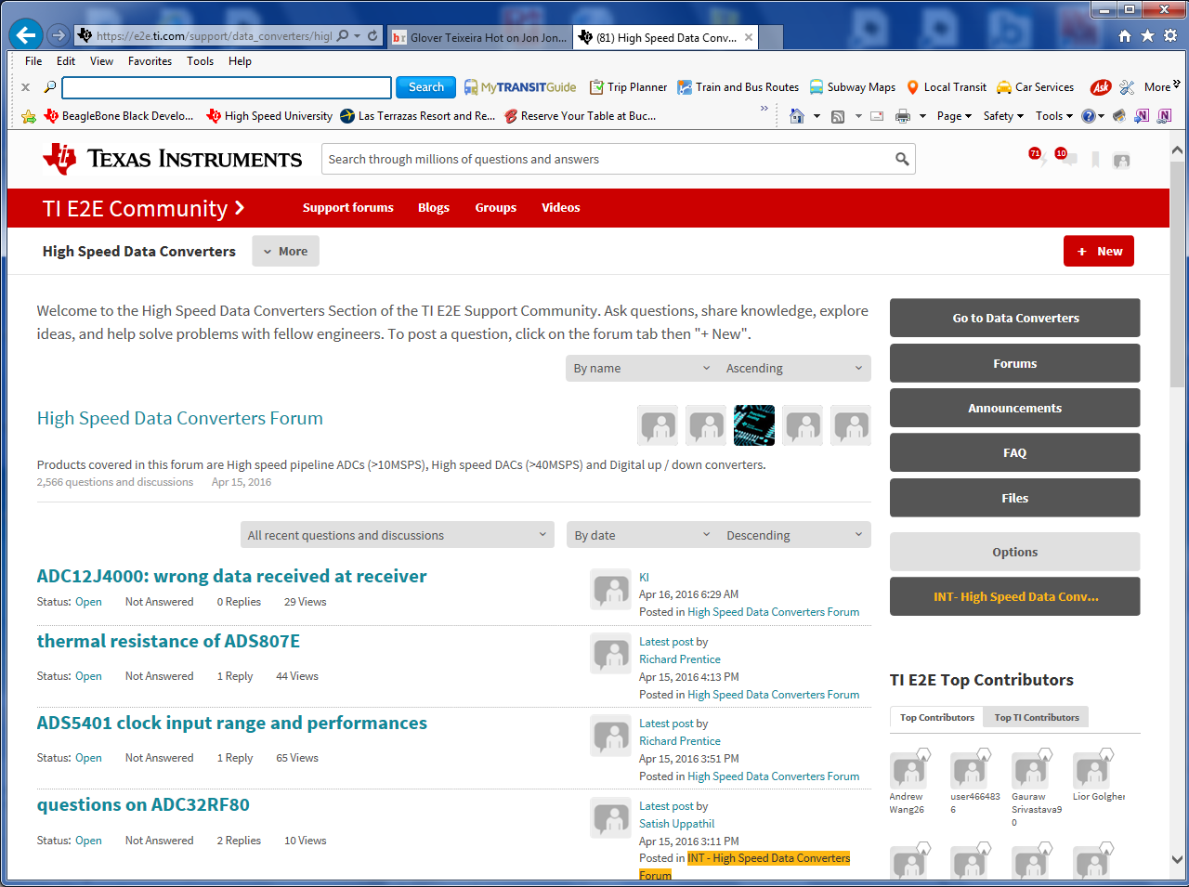
E2E Forum (e2e.ti.com)
TI Information – NDA Required

Slide 62
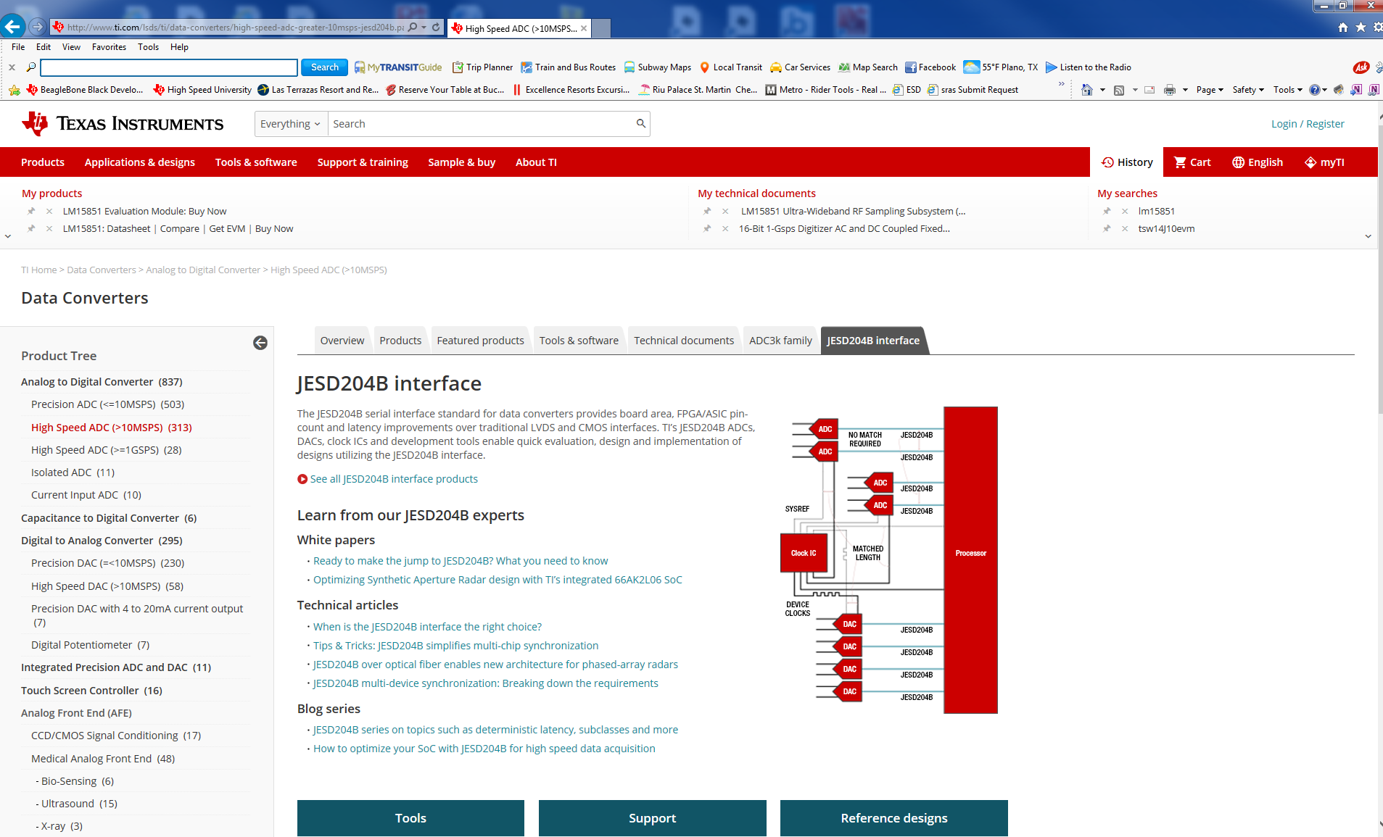
JESD204B Web Page www.ti.com, select data converters, then High Speed ADC, then JESD204B Interface

Slide 63
JESD204B Blogs
https://e2e.ti.com/blogs_/b/analogwire/archive/2014/07/30/jesd204b-understanding-the-protocol
https://e2e.ti.com/blogs_/b/analogwire/archive/2014/08/27/jesd204b-how-to-bring-up-your-link
https://e2e.ti.com/blogs_/b/analogwire/archive/2014/09/24/jesd204b-determining-your-link-configuration
https://e2e.ti.com/blogs_/b/analogwire/archive/2014/10/24/jesd204b-understanding-subclasses-part-1
https://e2e.ti.com/blogs_/b/analogwire/archive/2014/10/31/jesd204b-understanding-subclasses-part-2
https://e2e.ti.com/blogs_/b/analogwire/archive/2014/12/22/jesd204b-what-is-deterministic-latency-why-do-i-need-it-how-do-i-achieve-it
https://e2e.ti.com/blogs_/b/analogwire/archive/2015/01/16/jesd204b-how-to-calculate-your-deterministic-latency
https://e2e.ti.com/blogs_/b/analogwire/archive/2015/02/27/jesd204b-how-to-measure-and-verify-your-deterministic-latency
https://e2e.ti.com/blogs_/b/analogwire/archive/2015/03/20/jesd204b-serial-link-quality-tradeoffs-and-tools-for-optimization
Generic search of ti.com for JESD204B will bring up more material such as videos, TI Designs, etc…
Altera and Xilinx links:
http://www.ti.com/ww/en/xilinx/pg_jesd204b.html
http://www.ti.com/ww/en/Altera/pg_jesd204b.html

Slide 64
Summary of Recommendations
Determine Link Configuration, SERDES data rate, Logic device to be used.
If CGS is achieved but data is invalid, check for lane polarity swap. This can be fixed by most Receiver JESD204B IP
Use ramp test patterns to verify lane mapping. Many designs swap lanes to allow for easier PCB routing. Most Receiver JESD204B IP allows for lane remapping.
If design contains large lane trace length mismatch, may need to increase Receiver Buffer Delay.
Make sure SYSREF is proper frequency (LMFC/n) and enabled to both TX and RX devices during link bring up.
Use provided tools to check signal integrity. Adjust gain and equalization parameters if needed.

Slide 65
Summary of Recommendations
Always take steps to minimize impedance discontinuities, meaning that the traces should be uniform from source to load.
Use differential routing for most designs and stick to it for the full trace length.
Keep the differential trace spacing constant and the individual traces within the pair equal length.
Keep adjacent traces and objects a sufficient distance away to avoid crosstalk.
Only use bends of 45°. Use two 45° bends for 90° turns.
Use multiple small jog-outs to correct mismatch between traces of a differential pair.
Avoid stubs from vias by backdrilling or using blind vias. Add ground vias close by to account for return currents.
Do not split the reference planes underneath the signals.

