Slide 1
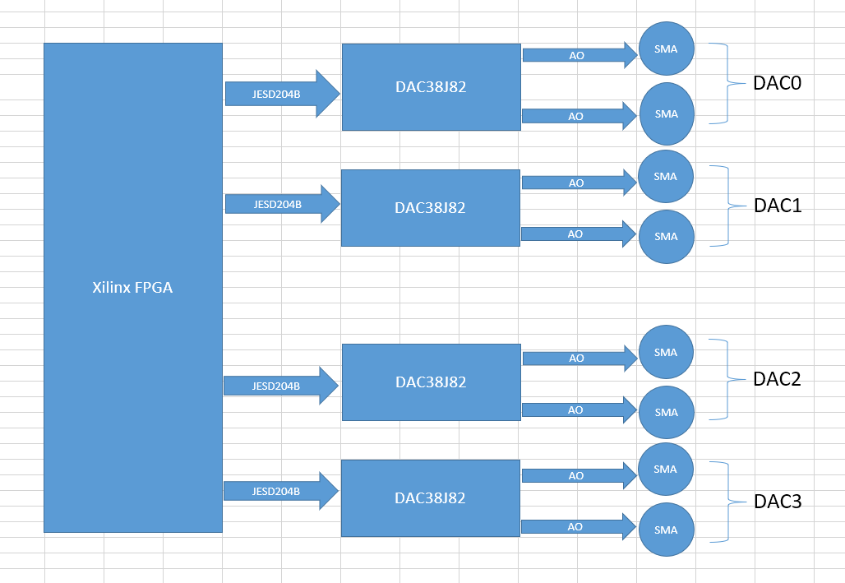
Hardware block diagram

Slide 2
Register log

