Slide 1
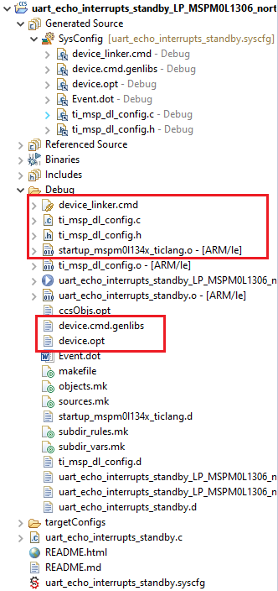
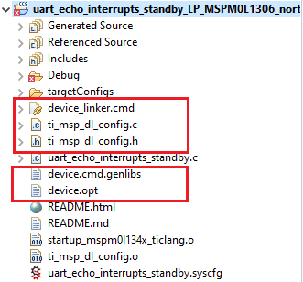
Step.1 Build the project with Sysconfig
Step.2 Choose below highlight files in Debug folder and copy them to root

Slide 2
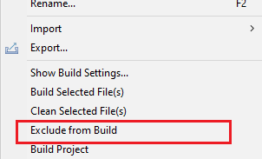
Step.3 Right click .syscfg file, and click Exclude from build.
Step.4 Click build button and error will output in console.

Slide 3
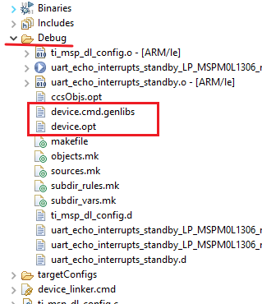
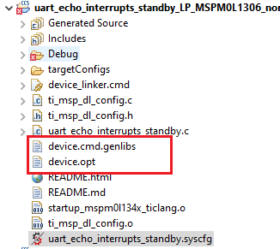
Step.5 Move below files into Debug file, then rebuild

