Slide 1
IPC demo on AM57xx EVM

Slide 2
Default Software Architectures
AM57x
ARM Cortex-A15s
OS = Linux
Dev Host = Linux
DSPs
OS = TI-RTOS
Dev Host = Windows or Linux
OpenCL
+
-
*
=
ARM
Cortex-A15
ARM
Cortex-A15
C66x DSP
+
-
*
=
C66x DSP
IPC
ARM Cortex-M4s
OS = TI-RTOS
Dev Host = Windows or Linux
PRUs
OS = Bare Metal
Dev Host = Windows or Linux
PRU
PRU
ARM M4
PRU
ARM M4
PRU

Slide 3
Change to…
AM57x
ARM Cortex-A15s
OS = Linux
Dev Host = Linux
DSPs
OS = TI-RTOS
Dev Host = Windows or Linux
IPC
+
-
*
=
ARM
Cortex-A15
ARM
Cortex-A15
C66x DSP
+
-
*
=
C66x DSP
IPC
ARM Cortex-M4s
OS = TI-RTOS
Dev Host = Windows or Linux
PRUs
OS = Bare Metal
Dev Host = Windows or Linux
PRU
PRU
ARM M4
PRU
ARM M4
PRU

Slide 4
Compile Steps
Download and install processor sdk both rtos and linux version to the default path.(I used 02.00.01.07 version to ubuntu 14.04)
1, Compile linux kernel.
cd ti-processor-sdk-linux-am57xx-evm-02.00.01.07/
make linux
2, modify ipc config file ipc_3_41_00_08\products.mak
a, TOOLCHAIN_LONGNAME should be the same with processor linux version.
b, Do not set the cgtools which doesn’t necessary, like arm9 a8F… it may bring in some mistake.

Slide 5
Compile Steps
3, Compile IPC software package.
make -f ipc-linux.mak config
make
make -f ipc-bios.mak all
4, Compile IPC demo
unzip ipc_3_41_00_08/examples/DRA7XX_linux_elf/ex02_messageq.zip
modify ipc_3_41_00_08/examples/DRA7XX_linux_elf/ex02_messageq/products.mak. TOOLCHAIN_LONGNAME should be the same like processor sdk linux version.

Slide 6
Compile Steps
5, There is a bug in the main_host.c. please modified the code by moving the Ipc_transportConfig() before Main_parseArgs().
Int main(Int argc, Char* argv[]) { Int status;
printf("--> main:\n");
/* configure the transport factory */ Ipc_transportConfig(&TransportRpmsg_Factory);
/* parse command line */ status = Main_parseArgs(argc, argv);
make

Slide 7
Run the demo
6, Copy the demo to filesystem /lib/firmware/.
ex02_messageq\dsp1\bin\debug\server_dsp1.xe66
ex02_messageq\dsp2\bin\debug\server_dsp2.xe66
ex02_messageq\host\bin\debug\app_host
ex02_messageq\ipu1\bin\debug\server_ipu1.xem4
ex02_messageq\ipu2\bin\debug\server_ipu2.xem4
7, link the demo.
ln -s server_dsp1.xe66 dra7-dsp1-fw.xe66
ln -s server_dsp2.xe66 dra7-dsp2-fw.xe66
ln -s server_ipu1.xem4 dra7-ipu1-fw.xem4
ln -s server_ipu2.xem4 dra7-ipu2-fw.xem4

Slide 8
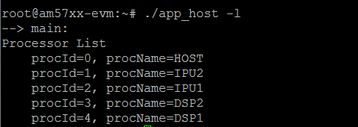
Run the demo
8, reboot the board, there is an known issue. To work around, please to restart the lad_dra7xx without -g, that is, /usr/bin/lad_dra7xx -l lad.txt.
killall lad_dra7xx
/usr/bin/lad_dra7xx -l lad.txt
9, run the demo

Slide 9
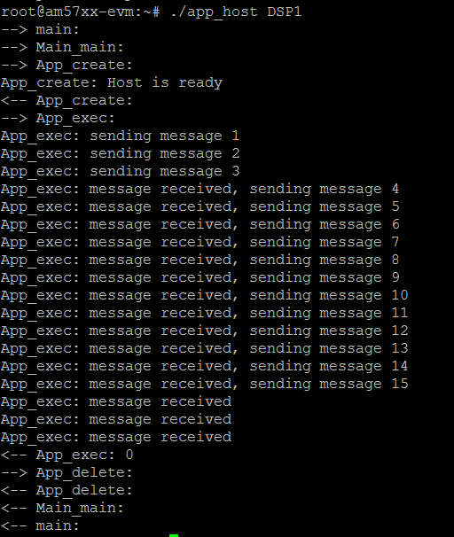
Run the demo

Slide 10
Run the demo
./app_host DSP1
./app_host DSP2
./app_host IPU1
./app_host IPU2

