Slide 1
TPS65270 peak current mode loop compensation
Prepared by Tony Huang
Aug, 2012

Slide 2
Agenda
TPS65270 introduction in brief:
Peak current mode introduction:
Peak current control block diagram:
Peak current mode small signal analysis:
Design example:
Conclusion:
Q&A:

Slide 3
TPS65270 introduction in brief
TPS65270 is a dual channel DCDC with peak current mode implementation with integrated synchronous rectifier power FET.
2. TPS65270 has been designed with 5-16V wide input, and loading capability up to 3/2A output currents. Individual SS and EN pins, adj. frequency (300kHz ~ 1.4MHz), Power on sequencer, automatic Power-Save-Mode for light load operations

Slide 4
Peak current mode introduction
PCM employed a current sampling RAMP to compare with output of the EA(Error amplifier), hereby generate the regulated duty cycle as showed in above Figure.
PCM benefited the fast response by input or loading transient, with current and voltage loops to realize higher crossover frequency.
.

Slide 5
The overall control block diagram implementation

Slide 6
Buck converter small signal analysis
The average model and Small signal model.
The gain function from inductor current to output can be got as below:
The gain function from duty cycle to inductor current can be got as below:
Considering the practical crossover frequency is much higher than the corner frequency
The average model | The Small signal model

Slide 7
Gain functions derivation
The gain function from Vin to inductor current can be got as below:
The gain from control to duty cycle can be got as below:
Sn is the rising slope of the inductor current;
Se is the slope compensation rising slope element.
Ts is the switching cycle.

Slide 8
Sampling Hold function analysis
The discrete equation can be derived to describe the sampling-hold behavior:
“Sf” is the inductor current ramp down slope.
. Then, the gain from inductor current to control voltage can be got as below:

Slide 9
Sample hold function analysis
>Based on “Z” domain stability theory, the single pole should meet below condition:
>As a result, the slope compensation element “Se” should meet adequately→ It’s the
criteria for slope compensation:
>With substituting “Z” with “ ” and considering zero order sampling-hold gain , Then:
The below is the gain block description for H(S):
Based on the above block and H(S) function, we can get the sampling hold
function He(S) as below:

Slide 10
Simplify the sample-hold function
The approximated gain from control to inductor current should be:
The approximate gain from control to inductor current should be:
Then the simplified schematic can be showed as below

Slide 11
Verify the model based on TPS65270 PCM(I)
Condition: The frequency is 635kHz, input is 12V and output is 3.3V/2A & 7.7/1A.
For channel 2 with 3.3V output:
TPS65270 slope compensation: Se=0.18V/us; Then:

Slide 12
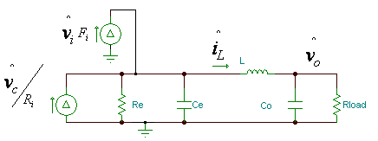
Verify the model based on TPS65270 model (II)
The overall small signal modeling for TPS65270 with 3.3V/0.65A output.

Slide 13
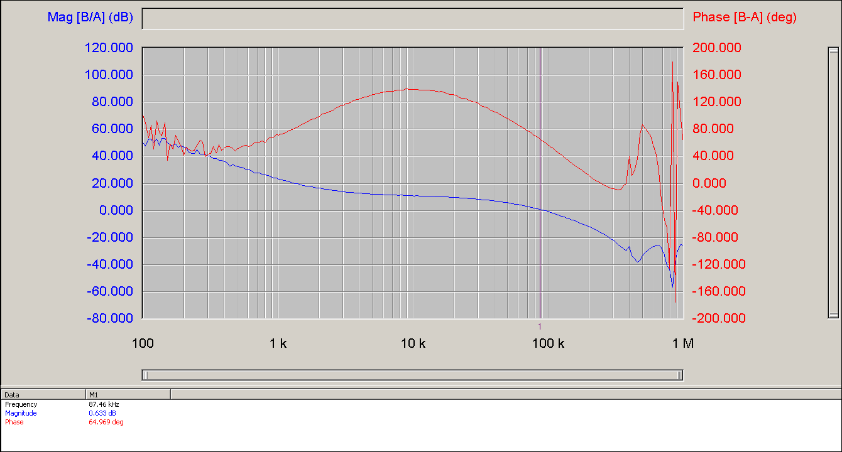
Verify the model based on TPS65270 model (III) Well Matched
AC simulation results
revealed a 58degree
phase margin and
80kHz
crossover frequency.
Lab test results:
The loop parameters can
be got as 86kHz crossover
frequency and 60degree
phase margin.

Slide 14
Design example based on TPS65270:
Topic: Vin=12V; Vout=3.3V@2A; fs=600kHz; L=4.7uH
Vin(V) | Vout(V) | L(uH) | f(kHz) | Ri | Se(V/us)
12 | 3.3 | 4.7 | 600 | 0.1 | 0.18
Sn(V/us) | Sf(V/us) |  | Re | Ce(nF)
0.19 | 0.07 | -0.30 | 3.03 | 59.88
The small signal modeling from control to output:

Slide 15
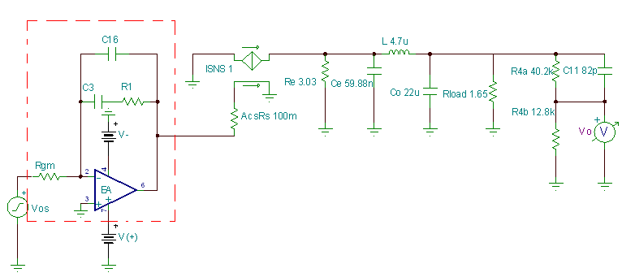
Design example based on TPS65270: --Type II compensation design

Slide 16
Design Example based on TPS65270:
Without compensation, the loop simulation is below:

Slide 17
Design example based on TPS65270
1. Assuming a crossover frequency “fc”=50kHz.
Let:
And:
2. Then: C16=52.9pF; Select C16=56pF
3. select C3=560pF;

Slide 18
Design example based on TPS65270:
Target compensation results:
Phase margin=70degree; Crossover frequency=50kHz
Employing type II compensation:
C16=56pF; C3=560pF; R1=18.8k

Slide 19
Design example based on TPS65270:
Simulation results:
The final crossover frequency is 49kHz and phase margin is 69degree.

Slide 20
Conclusion
The simplified model is easy to use with highly matched with practical results.
TPS65270 has 0.18V/us slope compensation, so that the inductor selection criteria is:
“L>(Vout/3.6) uH”
Type II compensation network works well for the compensation design:

Slide 21
Thanks very much for you time!
Q&A?

