Slide 1
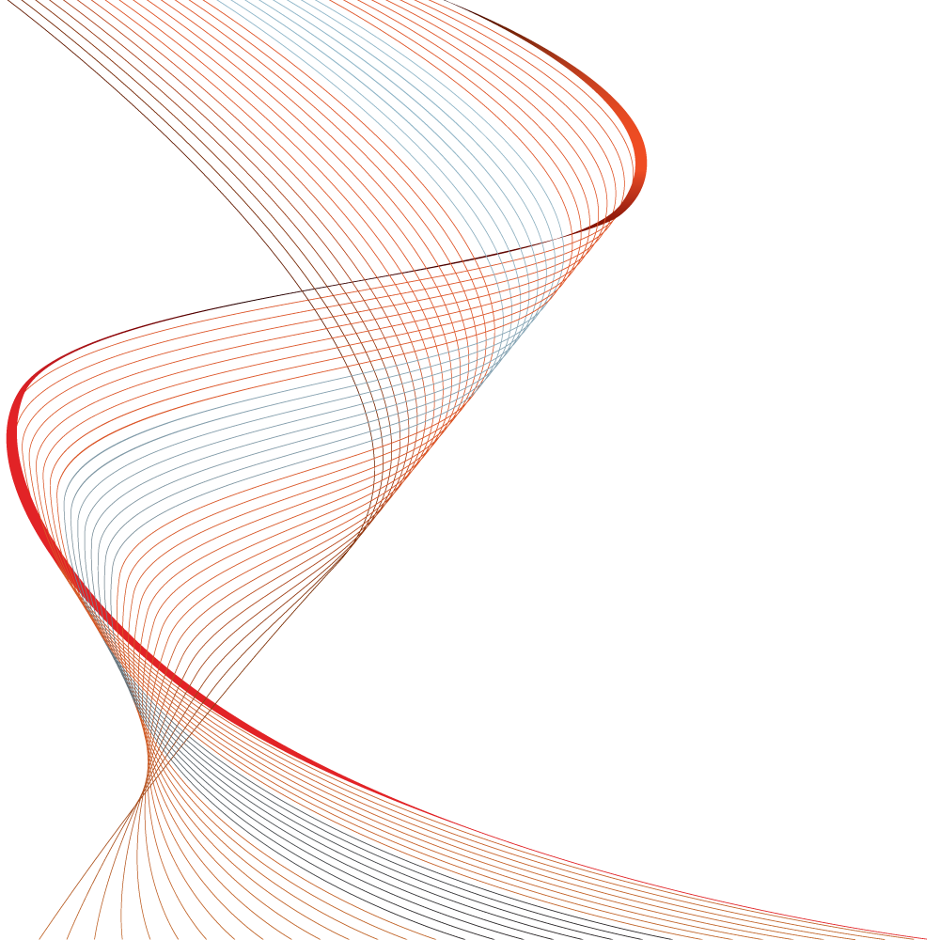

Thermal and Layout considerations for Integrated FET chargers
Charles Mauney
October 2013

Slide 2
Agenda
Why this Topic?
PCB Electrical Characteristics
DC Parasitics (Resistance)
AC Parasitics
Grounds and Grounding
PCB Thermal Characteristics
Conduction Concepts
Convection Concepts
Examples
Common “Poor” Thermal Layouts
Good Thermal Layout
Good Electrical Layout

Slide 3
Why this Topic?
What design component is most often Overlooked?
PCB Design
PCB is as critical as any other component
Use the same care with the design of the PCB as other designers take with designing the IC and FET switches
Why is layout Important?
Placement of Components effects connection impedance
Ground Plane design affects connection impedance
Electrical/thermal impedance affects current and heat flow
AC Current across impedance causes noise
Heat flow across thermal impedance causes temperature rise

Slide 4
Agenda
Why this Topic?
PCB Electrical Characteristics
DC Parasitics (Resistance)
AC Parasitics
Grounds and Grounding
PCB Thermal Characteristics
Conduction Concepts
Convection Concepts
Examples
Common “Poor” Thermal Layouts
Good Thermal Layout
Good Electrical Layout

Slide 5
Copper is Good, but Not a Perfect Conductor
Optimizing Placement, Copper Thickness & Routing impacts
Regulation
Transient Response
Efficiency
Temperature rise
Noise immunity

Slide 6
Metals are good Conductors Some better than others – ρ(Ω-length)
Material | ρ(μΩ-cm) | ρ(μΩ-in)
Copper | 1.70 | 0.67
Gold | 2.2 | 0.87
Lead | 22.0 | 8.66
Silver | 1.5 | 0.59
Silver (Plated) | 1.8 | 0.71
Tin -Lead | 15 | 5.91
Tin (Plated) | 11 | 4.33
Palladium | 11 | 4.3
t
w
Notes:
: The numbers given for Plated Copper are worst-case values. Typically, they will lie somewhere between pure copper and these values.

Slide 7
Count Squares to Estimate Trace Resistance
Copper resistivity is 0.67 μΩ in. at 25°C and doubles for 254°C rise
Copper Weight (Oz.) | Thickness (mm/mils) | mΩ per Square (25ºC) | mΩ per Square (100ºC)
1/2 | 0.02/0.7 | 1.0 | 1.3
1 | 0.04/1.4 | 0.5 | 0.65
2 | 0.07/2.8 | 0.2 | 0.26

Slide 8
Vias Have Resistance Too
Typical rule of thumb is 1 A to 3 A per via

Slide 9
Agenda
Why this Topic?
PCB Electrical Characteristics
DC Parasitics (Resistance)
AC Parasitics
Grounds and Grounding
PCB Thermal Characteristics
Conduction Concepts
Convection Concepts
Examples
Common “Poor” Thermal Layouts
Good Thermal Layout
Good Electrical Layout

Slide 10
Self Inductance of PWB Traces
Due to the natural logarithmic relationship, large changes in conductor width have minimal impact on inductance
w_mm (in) | t_mm (in) | Inductance nH/cm (nH/in)
0.25 (0.01) | 0.07 (0.0028) | 10 (24)
2.5 (0.1) | 0.07 (0.0028) | 6 (14)
12.5 (0.5) | 0.07 (0.0028) | 2 (6)

Slide 11
PWB Traces Over Ground Planes
Substantial inductance reduction
Inductance inversely proportional to width
Metric |  |  | English
h (mm) | w (mm) | Inductance (nH/cm) | h (in) | w (in) | Inductance (nH/in)
0.25 | 2.5 | 0.2 | 0.01 | 0.1 | 0.5
1.5 | 2.5 | 1.2 | 0.06 | 0.1 | 3.0

Slide 12
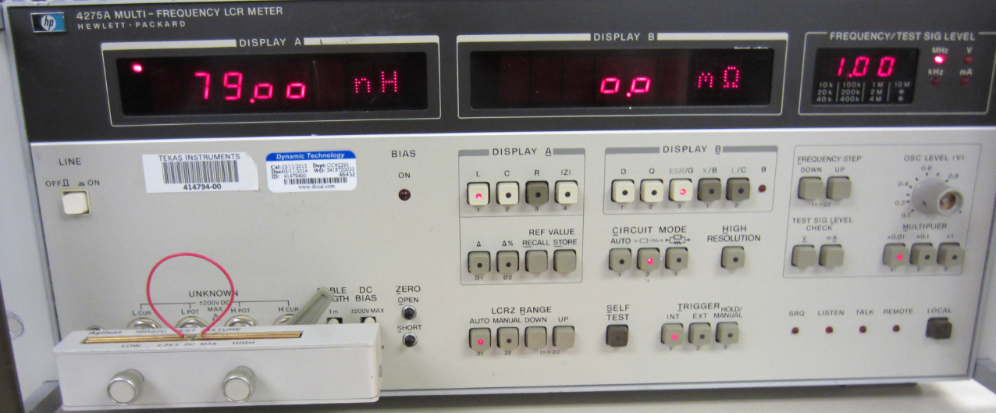

Leakage Inductance in AC (Pulsed) Circuits Matters – How much inductance is in a 3” wire?
HP 4275A LCR meter – Sample tested at 1MHz
Shows 79nH for this loop of wire

Slide 13
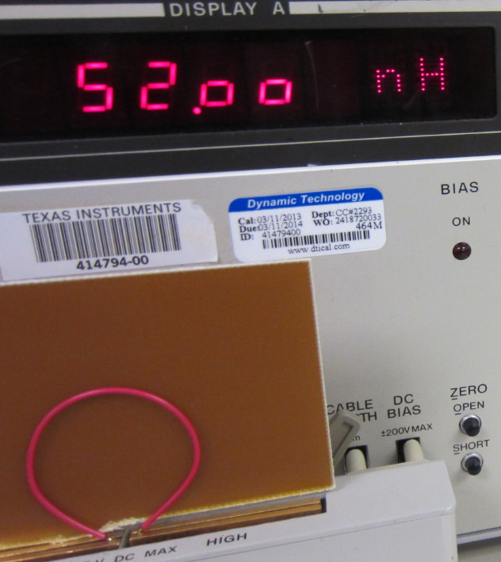
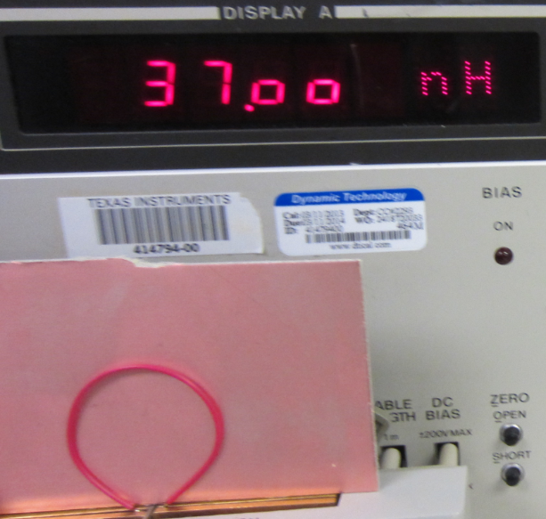
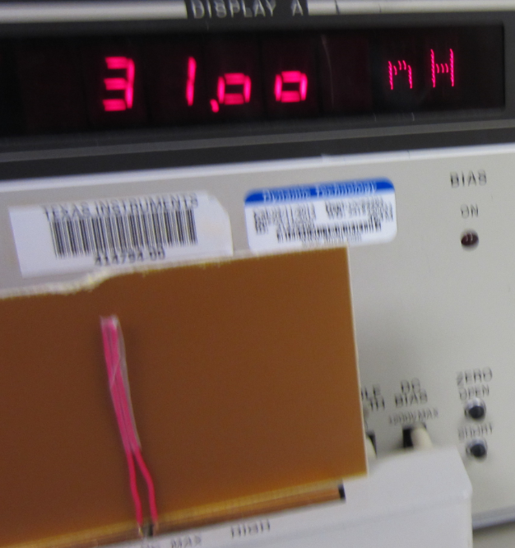
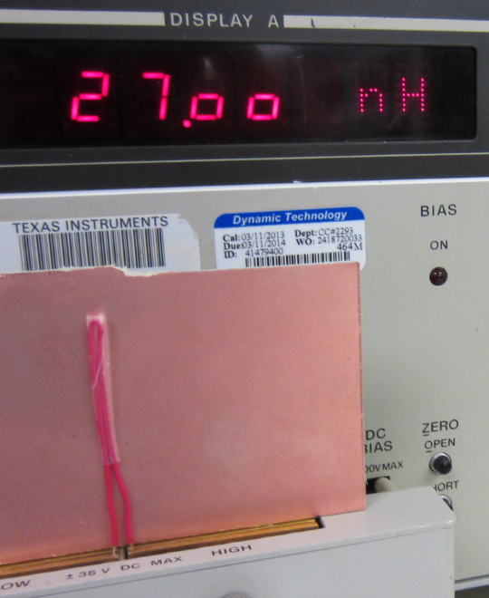
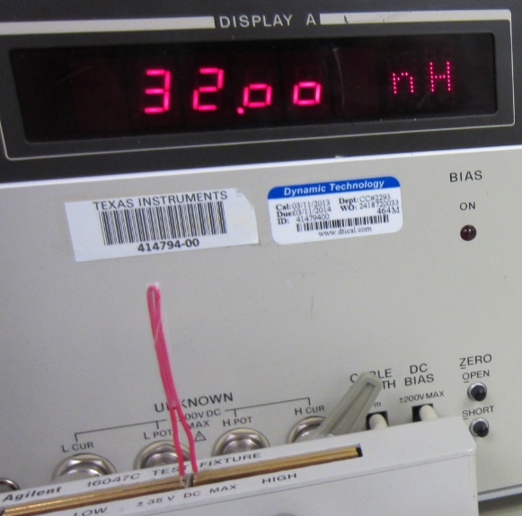
Inductance – Think again!
PCB with copper on bottom
Placed next to loop
AC current in loop generates opposing currents in copper plane to partially cancel inductance
PCB with copper on top
Placed next to loop
Same Loop area with PCB, copper on bottom; <L
Wire loop area reduced; <L
PCB with copper on top; <L

Slide 14
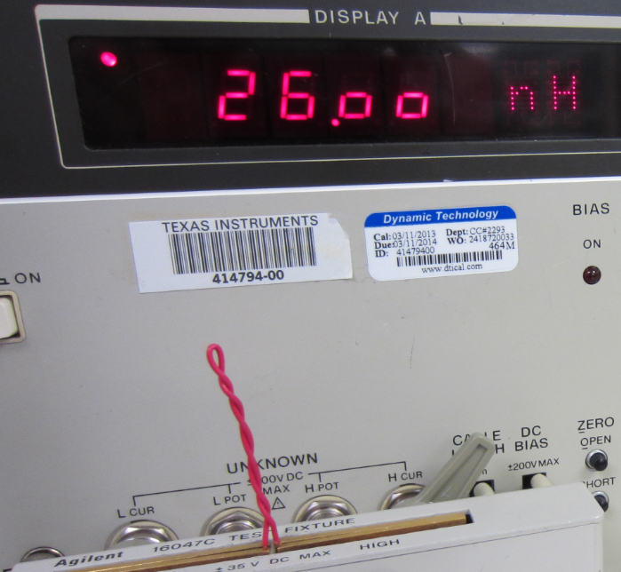
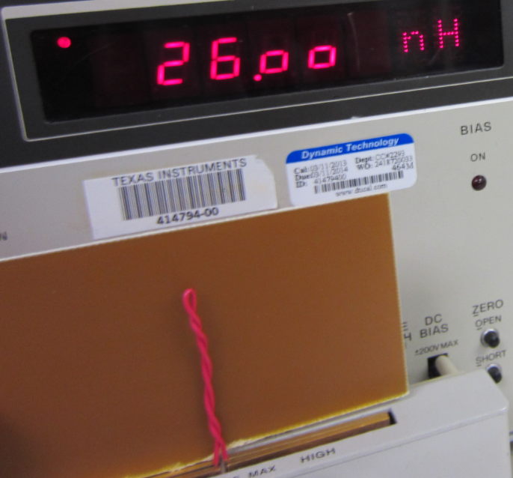
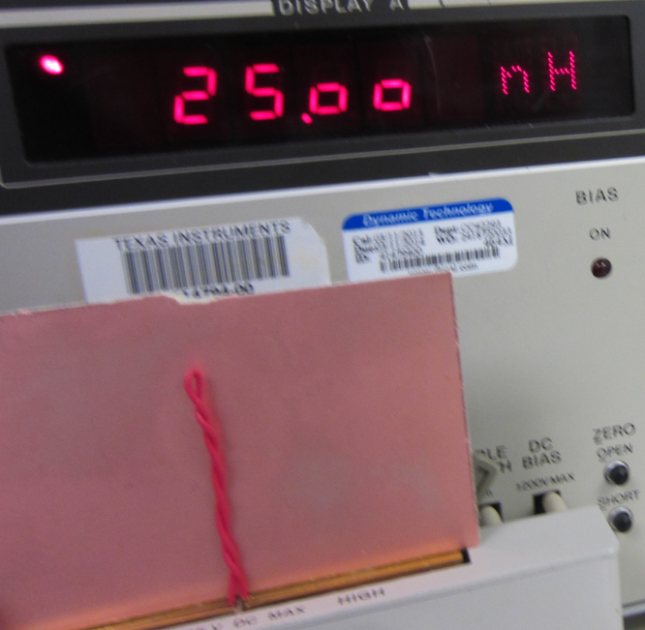
Leakage Inductance – 3” Wire cont’
Wire loop twisted – Reversing of current cancels inductance; <L
PCB with copper on bottom added but loop does not produce much of a field to cancel inductance
PCB with copper on top helps just a bit.
Loop area and length determine inductance
Leakage Inductance (Parasitic) becomes charged with current
When Current is abruptly stopped – Leakage inductance’s voltage flips polarity and discharges energy typically as noise

Slide 15
Sample Capacitance Calculation
Consider two 10 mil traces crossing with 10 mil PWB thickness
Capacitance is additive with multiple connected pads

Slide 16
Chaos Created by Noise Injection
Ten 0.05 x 0.02 in² pads in summing junction can increase parasitic capacitance to 2 pF
Keep high impedance node area small and away from switching waveforms – above clean ground

Slide 17
Bypass Capacitor Layout
Minimize lead inductance
Short lengths → Minimizes loop area
Use ground planes where possible
Bring current path across capacitor terminals
Parallel different capacitor types
Reduced impedance across a frequency
band
Parallel different ceramic capacitors values
and sizes
Reduce impedance in the 2-20 MHz frequency range (0.1 μF & 0.01 μF)
Use experienced Layout Person
Understands Circuit Operation and Layout concepts.

Slide 18
Capacitors Are Inductive…
Above Their Self-Resonant Frequency
Measured ESL correlates well with rule of thumb inductance of 15 nH/inch
High frequency converters use Ceramic caps of different values (10u, 1u, 0.1uF) for low impedance (low inductance) in MHz range.

Slide 19
And Inductors Turn Into Capacitors
Inductive at low frequency
High frequency, distributed capacitance and μ_{r} reduction
Maximize inductance by choosing inductor with resonance above “switching edge” frequencies
Wire wound inductor
Chip Inductor

Slide 20
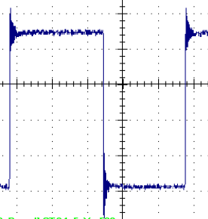
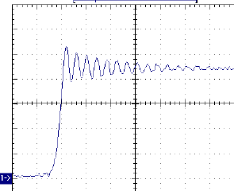
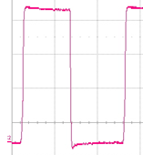
Effects of Layout Impedances
Other Circuit
L_{L}
L
L_{L}
V_{IN}
C_{IN}
Q_{H}
V_{OUT}
Q_{L}
C_{O}
V_{IN}+
Good ground plane
Small high frequency current loop
Parasitics, L_{L}, are reduce with integrated FETS
Small area for high dv/dt node
C_{IN}
Q_{H}
L
V_{IN}-
Q_{L}
C_{OUT1}
R_{S}
C_{OUT2}
V_{OUT}-
V_{OUT}+

Slide 21
Connect Power Components Properly
Draw schematic to reflect desired location relative to other components.
Understand circuit operation and AC currents
A pulses current is a noise signal – return this current to its source in smallest distance (loop area) – Loop area is antenna.
Place power stage to minimize connection impedance
Consider two sided mounting, FET’s one side, cap other
Use full ground planes to produce low impedance ground connection
Use VIAs to connect all component grounds to ground plane – Minimizes return impedance.
Any inductance in di/dt path results in ringing on switched node
Proper design can eliminate need for snubber

Slide 22
Watch Out for Parasitic Components
Wiring inductance
Added “parasitic” inductance raises impedance of low impedance circuits (filters, power switching) making them less effective.
Use wide conductors and ground planes to minimize impedance
Board capacitance
Allows path for AC signals
Good if part of design; Bad when coupling “noise” into sensitive circuits.
High impedance nodes are susceptible to switching waveforms.
Magnetic coupling
Loop to loop, minimize loop areas, use ground planes

Slide 23
Agenda
Why this Topic?
PCB Electrical Characteristics
DC Parasitics (Resistance)
AC Parasitics
Grounds and Grounding
PCB Thermal Characteristics
Conduction Concepts
Convection Concepts
Examples
Common “Poor” Thermal Layouts
Good Thermal Layout
Good Electrical Layout

Slide 24
Single Point Grounds
Parallel
Complicated wiring – one layer
Reduced differential potentials at low frequencies
High impedance at high frequency (>10 kHz)
Series
Simple wiring – one layer
Common impedance causes different potentials
High impedance at high frequency (>10 kHz)

Slide 25
Multipoint Grounding
Ground plane provides low impedance between circuits to minimize potential differences
Also, reduces inductance of circuit traces
Goal is to contain high frequency currents in individual circuits and keep out of ground plane
Segregated circuits
No current between Circuits
No current → No ground noise shared between circuits, V=IR

Slide 26
Agenda
Why this Topic?
PCB Electrical Characteristics
DC Parasitics (Resistance)
AC Parasitics
Grounds and Grounding
PCB Thermal Characteristics
Conduction Concepts
Convection Concepts
Examples
Common “Poor” Thermal Layouts
Good Thermal Layout
Good Electrical Layout

Slide 27
Modeling Temperature Rise
Rjc: Junction to Case (PWRPAD of IC), thermal resistance (ºC/W)
Rcs: Case to Heat Sink (PWRPAD-IC to PWRPAD-PCB), thermal resistance
Rsa: Sink (PCB surface) to ambient resistance
Heat is conducted through device base into circuit board
It spreads laterally through copper conductors
Final path is convection cooling from board surface to ambient

Slide 28
Thermal Conductivity of Other Materials
Material | W/(cm ºC) | W/(in ºC)
Air | 0.0002 | 0.0007
Alumina | 0.2 | 0.9
Aluminum | 1.8 | 4.4
Beryllia | 1.6 | 4
Copper (OFC) | 3.6 | 9
Epoxy (PC board) | 0.0003 | 0.007
Ferrite | 0.04 | 0.10
Silver | 3.8 | 9.5
Steel | 0.15 | 0.60
Tin-lead | 0.4 | 1.00
Thermal Conductivity is in the denominator
Thus a large value is good for a low thermal impedance.
Silver is slightly better than copper but costs too much
FR4 (Epoxy) is very poor.

Slide 29
Thermal Resistance
A single via has about 100°C/W thermal resistance and they can be paralleled
Multiple VIAs will reduce the thermal resistance proportionally
10VIAs would be 10C/W

Slide 30
Lateral Heat Flow
Metric | English
2-oz, 0.07-mm thick copper | 2-oz, 2.8-mils thick copper
1.5-mm FR4 | 0.06-inch FR4
A square of 2oz copper with 1W of heat applied will result in a 40C rise, R = 40C/W
A square of 0.060” thick FR4 with 1W of heat applied will result in a 2400C rise, R = 2400C/W
Only copper spreads out heat

Slide 31
Thermal Resistance Gap
Copper plane has cut out due to routing a signal.
Thermal resistance gap significantly adds to temperature rise
R = 23C/W for 10mil gap of FR4
R = 0.018 C/W for 10mil gap of Cu
Cutting the Cu plane added
(23C/W – 0.018C/W = 23C/W)

Slide 32
Thermal Resistance for FR4
Through board is much less than board-ambient
1W applied to 0.125 in sq, 0.060” thick, FR4 (IC area) has temp rise of 548C
1W applied to 1in sq, 0.06” thick, FR4 has a temp rise of 8C.
FR4 ok for thermally conductivity through large areas.
Poor through small area - IC power pad (need VIAs) or cross-section of PCB.

Slide 33
Agenda
Why this Topic?
PCB Electrical Characteristics
DC Parasitics (Resistance)
AC Parasitics
Grounds and Grounding
PCB Thermal Characteristics
Conduction Concepts
Convection Concepts
Examples
Common “Poor” Thermal Layouts
Good Thermal Layout
Good Electrical Layout

Slide 34
Convection Cooling
h - heat transfer coefficient ~0.006 W/in²/°C, 0.001 W/cm2/°C for air
1 W/1in² =166°C rise; 1 W/cm² = 1000°C rise
Equation for the nonlinearity of h
in²
cm²
in²
cm²

Slide 35
Typical Thermal Requirements
Ambient temperature: 70°C, T_{A}
Maximum semiconductor: 125°C, Max T_{J}
Maximum board temperature: 120°C
Typical semiconductor loss: 2 W
PowerPAD™ SO-8 thermal resistance: 2.3°C/W
Calculated PWB temperature under semiconductor is 125°C – (2 W x 2.3°C/W) = 120°C → Allowed PCB Temp
Allowed Temperature Rise of PCB = 120°C – 70°C = 50°C

Slide 36
Convection Cooling Area Calculations
Solving for Surface Area, for 2W dissipation & a 50°C rise
in²
in²
cm²
cm²
The component heat-sink (PWRPAD) is much smaller than the required cooling area 7 in², so a heat sink or PCB copper plane has to be used (~2 in² PCB).

Slide 37
Dissipation on Double-Sided Board
2 W of point source dissipation on double-sided board calculates to ~30°C rise under the source
Radius From Heat Source (cm)
Radius From Heat Source (inches)
Shown is ~ 33C rise for a 2.5”x2.5” PCB x 2 sides or 12.5in²

Slide 38
Even a Whisper of Air can Reduce Temperatures
Metric
English
System airflow yields 20% to 60% drop in temperature rise

Slide 39
PWB Cooling Strategy
Temperature Rise is a FCN of power dissipate divided by surface area; Low Temp Rise → P_{SMALL}/A_{LARGE} = dT_{SMALL}
Use thick copper, 2oz, to spread heat to larger area.
Use multiple common planes on different layers connected by vias
Internal Copper Planes are as effective as surface planes for spreading heat, but has temp rise through FR4 → Very little penalty once heat is spread out.
Use both side to cool
Avoid breaks in planes as they substantially degrade lateral heat flow → Reduce Area

Slide 40
Agenda
Why this Topic?
PCB Electrical Characteristics
DC Parasitics (Resistance)
AC Parasitics
Grounds and Grounding
PCB Thermal Characteristics
Conduction Concepts
Convection Concepts
Examples
Common “Poor” Thermal Layouts
Good Thermal Layout
Good Electrical Layout

Slide 41
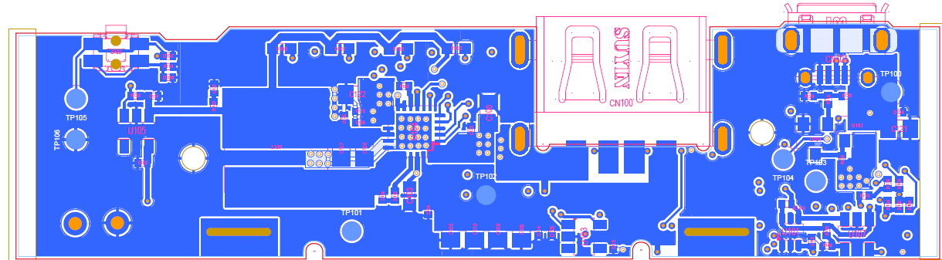
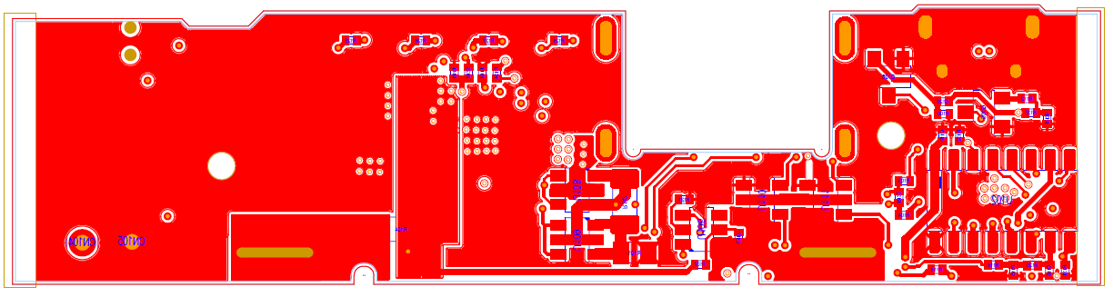
Top and Bottom Layers – Poor Thermal Design
Top Layer –
Quad bqIC is isolated from top copper plane – No Conduction of heat
Bottom Layer –
bqIC PWR-PAD vias connected to bottom plane, but area is cut away due to
a cutout, parts and Cu pours. Result is limited cooling area.

Slide 42
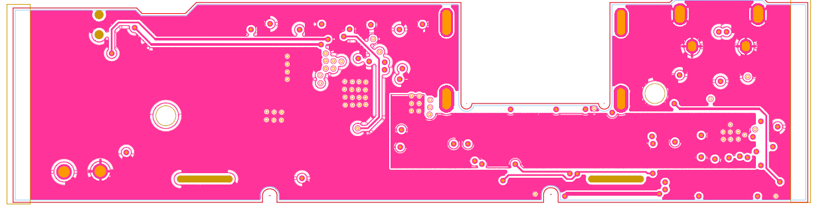
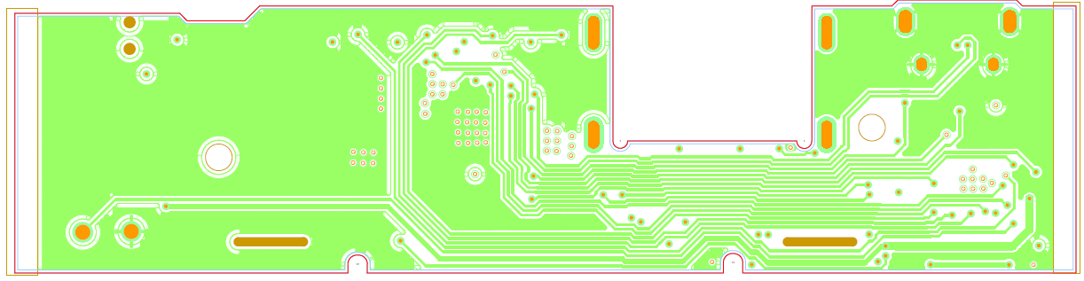
Two Inner Layers
1st Inner Layer – bqIC PWR-PAD vias connected to plane.
Plane is very small due to Routing, vias. Result is limited cooling.
2nd Inner Layer – bqIC PWR-PAD vias connected to plane.
Plane is very small due to Routing on all sides. Result is limited cooling.

Slide 43
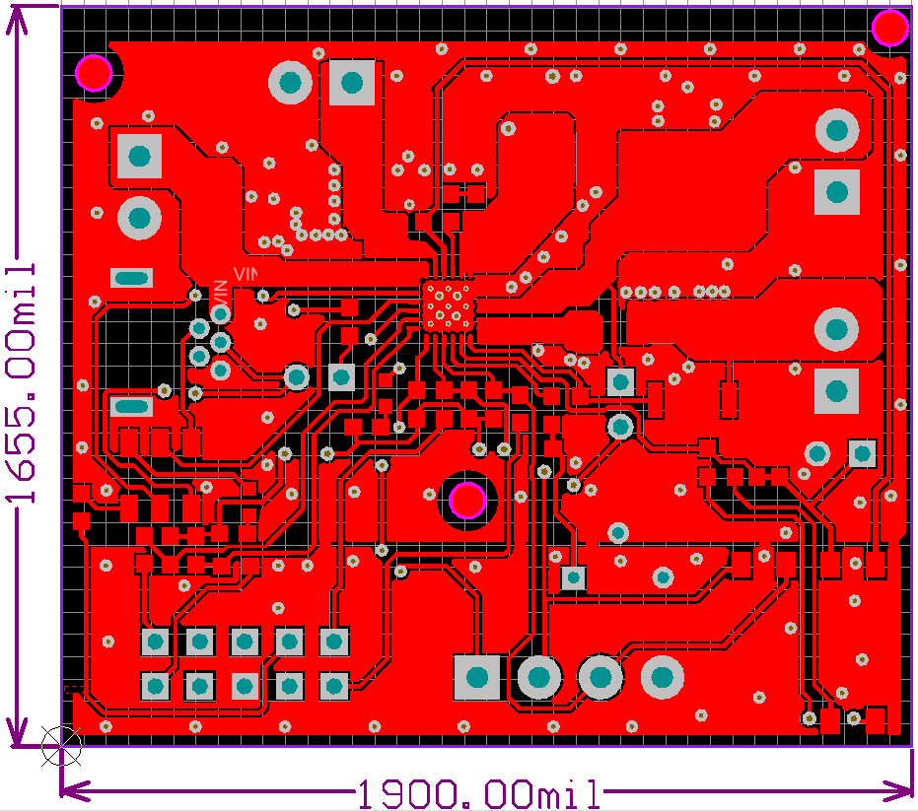
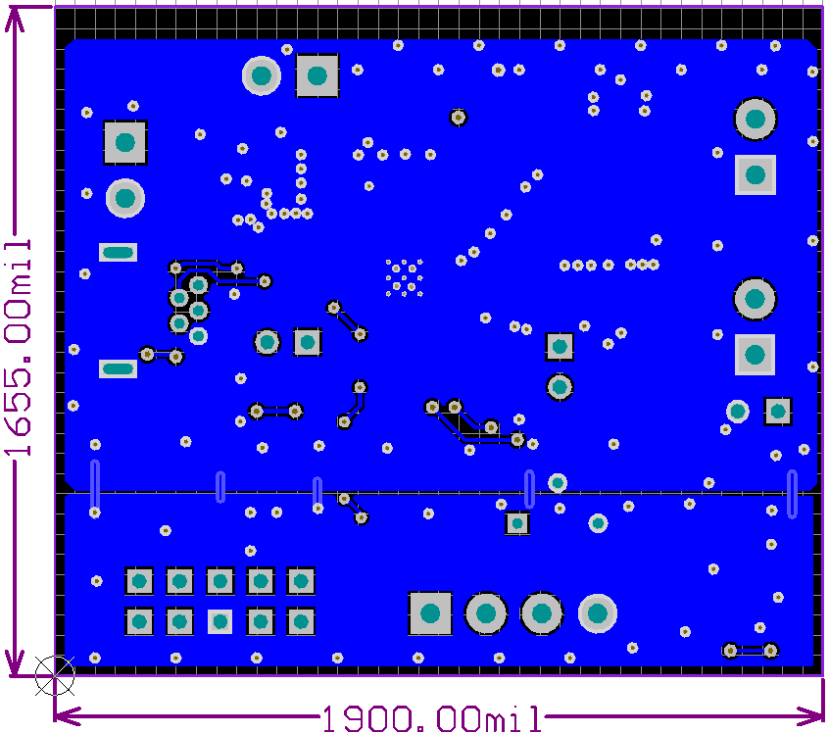
2 Layer bqIC Layout – Good Layout
Bottom Layer – bqIC PWR-PAD vias connected to bottom plane.
Best thermal layout – heat from vias can flow in all directions on bottom plane
Top Layer – Quad bqIC is isolated from top copper plane

Slide 44
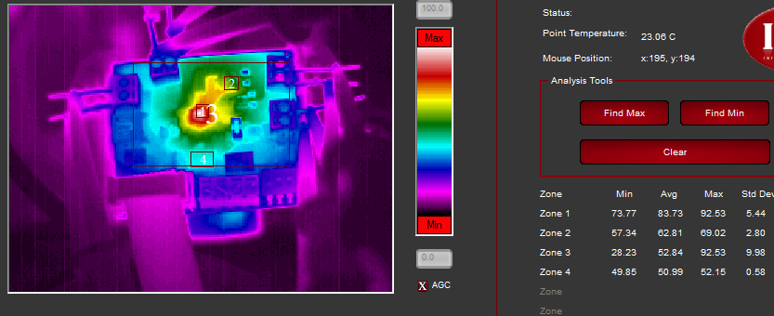
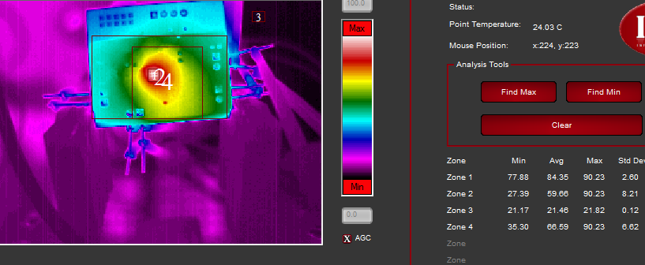
EVM Thermal Plot – 2.23W Dissipated 1”x2” 2 Layer, 2oz Cu, 0.031” Thick PCB
Boost Converter –Top Layer
Vbatin=3.3V, 5Vout, Iout=2.12A,
1) IC, 2) Inductor, 3) PCB, 4) Edge of PCB
Boost Converter – Bottom Layer
Vbatin=3.3V, 5Vout, Iout=2.12A,
1) IC, 2) Whole PCB, 3) Ambient, 4) ~1”sq Center

Slide 45
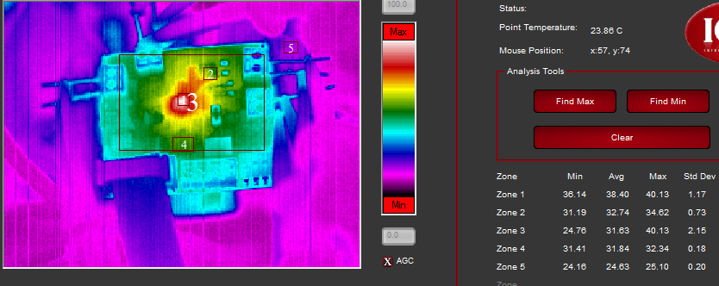
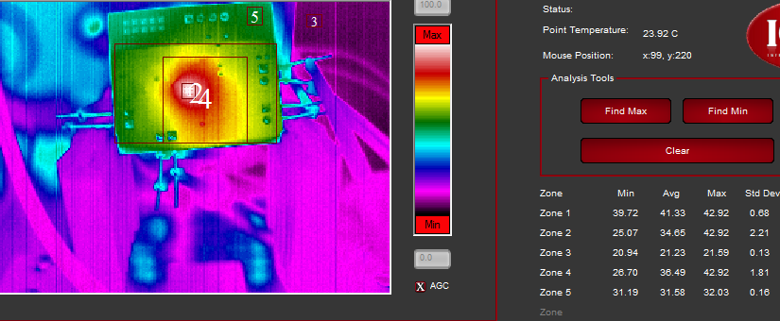
EVM Thermal Plot – 0.71W Dissipated 1”x2” 2 Layer, 2oz Cu, 0.031” Thick PCB
Boost Converter –Top Layer
Vbatin=3.3V, 5Vout, Iout=1A,
1) IC, 2) Inductor, 3) PCB, 4) Edge of PCB
Boost Converter – Bottom Layer
Vbatin=3.3V, 5Vout, Iout=1A,
1) IC, 2) Whole PCB, 3) Ambient, 4) ~1”sq Center

Slide 46
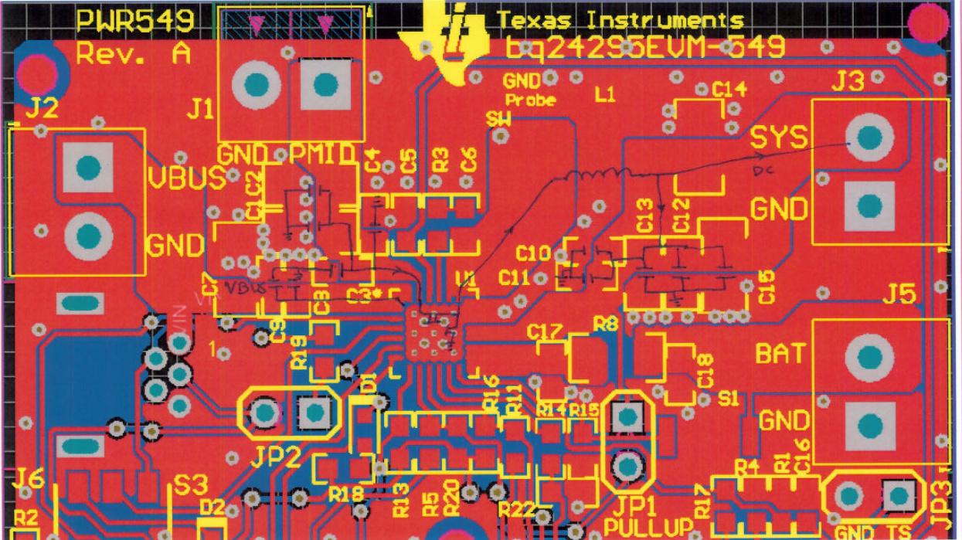
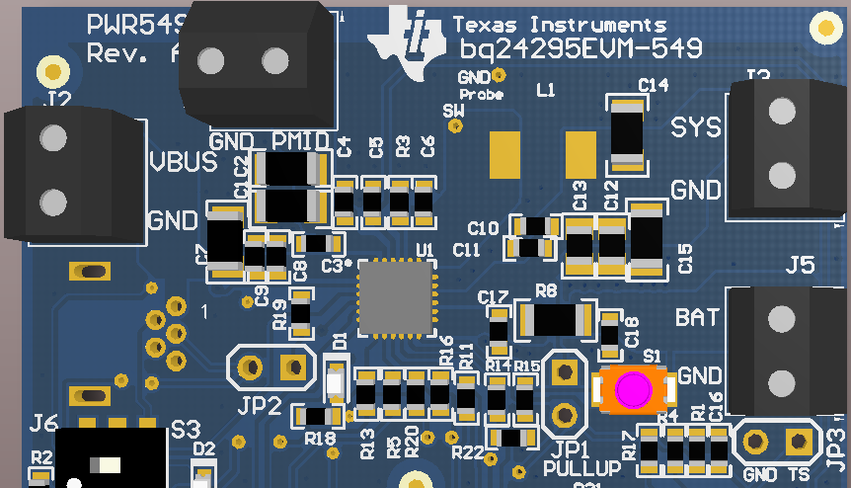
Good Electrical Layout

Slide 47
Electrical and Thermal Layout Summary
Place components to minimize inductive loops
Understand circuit operation
Keep loop area small for high frequency, di/dt, signals and away from high impedance circuits (Magnetic coupling)
Keep high dV/dt signal’s area small and away from high impedance circuits (Electric Coupling)
Use ground planes to lower over all impedance of the ground plane, thus reducing noise.
Identify hot components and make sure there is a at least one 2oz copper plane to remove heat, >1.5” Radius
Use multiple vias to conduct heat to different plane layers

Slide 48
A Good Layout
Makes For A Successful Design
Power supply layout is as important as any other design consideration
The power supply engineer must be involved in parts placement and routing
It is not black magic, but it is an understanding of AC and DC parasitics, grounding, and cooling that makes a successful design

