Slide 1
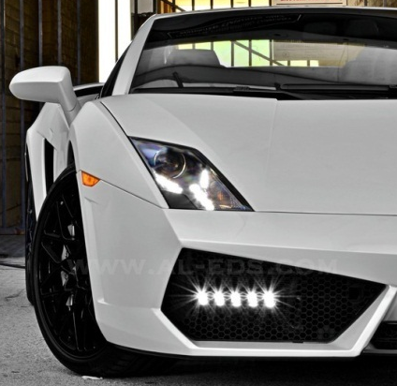
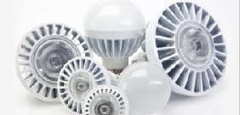
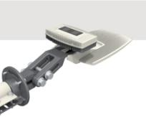
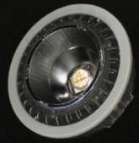
LED Lighting Solutions
Lighting Power Products (LPP)
JMP: 02/2014

Slide 2

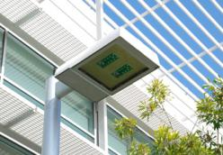


TI Lighting Segment Focus
Lamp and Downlight
Outdoor Area
Automotive
Secondary Markets
Architectural
Emergency/Safety
Entertainment
Portable Consumer
Projector and Copiers
Industrial
Retail and Display
Notes:
National has chosen to focus on areas where we see high potential for volume, revenue, and the opportunity for electronics to add value to the lighting system.
National has innovative, well-matched core IP
LM3445: best-in-class triac dimming
LM3464: ultra-efficient drive for large LED arrays
National can add value through vertical integration of electronics drive and control
Leverage LED drive and power supply design expertise
Apply intelligence/control capability to enable much more intelligent lighting
Markets have large volume and ROI potential
Market growth will benefit from:
Macro-economic factors such as “green” legislation
The need/drive to reduce “total cost of ownership”

Slide 3
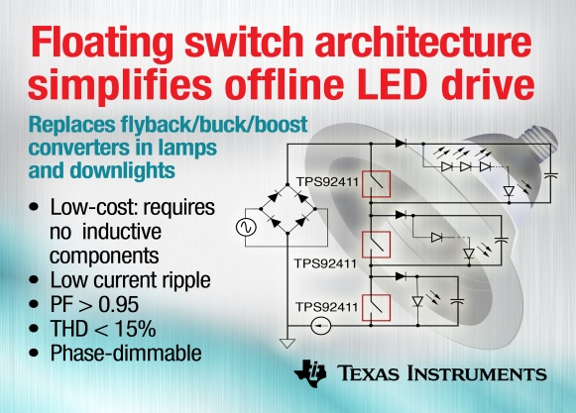
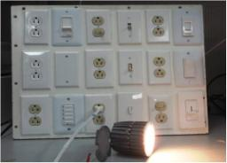
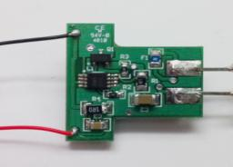
Energy-Efficient System Partner
How we partner
with our customers
Technology
Application
Solution
Power Management Technology Leadership
Deep Understanding of System Challenges
Collaborative Architecture and Design
Notes:
3

Slide 4













TI Lighting Power Products at a Glance
Light Bulbs & Low Power Luminaires
High Power Wide Area Luminaires
Automotive
B10, GU10, A19, PAR20-38
 | LM3447
 | LM3445
 | TPS92411
 | TPS92075
 | TPS92310/1/4
 | LM3444/TPS92074
 | TPS92561
 | TPS92210
 | TPS92075
Street Light, High Bay, Parking, Pathway, Troffers
 | UCC28810/1
 | TPS92020/3
 | TPS92210
 | LM3401/9
 | TPS92640/41/60
 | LM3402/4/5/5A/6/7
 | LM3414
 | TPS92510
 | TPS92511
 | LM3430/31
 | LM3410
 | LM3421/3/4/9
 | TPS92690
 | TPS40211
 | LM3432
 | LM3492
 | LM3463
 | LM3464
 | LM3466
Exterior, Interior & Infotainment backlighting
 | LM3424Q
 | LM3421Q/23Q/29Q
 | LM3409Q
 | LM3410Q
 | LM3431Q/92Q
 | TPS92690Q
 | LM3406Q
 | TPS92661Q
 | TPS92515Q
AC-DC
Dimmable
AC-DC
Front
End
AC-DC
External
Dimming, or non-dimming
Buck
Controllers
Buck
Converters
MR16, AR111
 | LM3401
 | LM3444
 | LM3492
 | TPS92560
 | TPS92561
Boost
Controller
Boost
Converter
Multi- topology
controllers
Industry’s Broadest Portfolio!!
Boost + Linear
Controllers
Architectural, Wall Washers, Sconces, Downlights
 | LM3450/A
 | TPS92370
 | TPS92210
Linear
Recently Released
In Qual/Development
In Definition

Slide 5
New LED Lighting Power Products (<1 yr)
Product | Description | Lamps | Area | Auto
TPS92023 | Resonant-Switching Driver Controller for LED Lighting (LLC) |  | ü
TPS92074 | Non-Isolated, Buck PFC LED Driver with Digital Reference Control | ü | ü
TPS92075 | Non-isolated, Phase Dimmable, Buck PFC LED Driver with Digital Reference Control | ü | ü
TPS92315 | Off-Line Primary-Side Sensing Controller for LED Lighting | ü
TPS92411 | Floating Switch for Offline AC Linear Direct Drive of LEDs with Low Ripple Current | ü | ü
TPS92560 | Simple LED Driver for MR16 and AR111 Applications | ü
TPS92561 | Phase Dimmable, Single Stage Boost Controller for LED Lighting | ü | ü
TPS92640/1 | Synchronous Buck Controllers for Precision Dimming LED Drive |  | ü | ü
TPS92660 | TPS92660 Two String LED Driver with I2C/EPROM Current Trim |  | ü
TPS92690 | N-Channel Controller for Dimmable LED Drives with Low-Side Current Sense |  | ü | ü
01/01/2013 ~ 01/01/2014

Slide 6
Offline (AC/DC) LED Lighting Solutions
LED Light Bulbs
LED Wide Area Lighting (High Bay / Street)

Slide 7
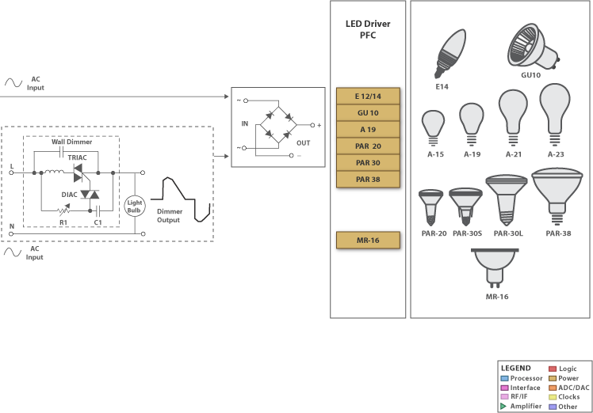
AC/DC LED Lighting Solutions
Integrated Dimmer Decode |  | Integrated Dimmer Detection |  | Features |  |  |  | Good fit for Power Level or Lamp Size
 | P/N | TRIAC | Rev Phase | PSR | PFC | Iso/ Non-Iso | Integrated MOSFET | < 5W GU10, E14, Candle | 5-10W A19, PAR20 | 10-25W A19, PAR30/28 | 25-50W+ Fixtures
 | TPS92411 |  |  |  |  | Non-Iso |  |  |  |  | 
 | LM3448 |  |  |  |  | Both | 600V |  | 
 | LM3447 |  |  |  |  | Iso |  |  |  | 
 | TPS92075 |  |  |  |  | Non |  |  |  | 
 | LM3445 |  |  |  |  | Both |  |  |  |  | 
 | LM3450 |  |  |  |  | Both |  |  |  |  | 
External Dimmer Decode or non-dimming | TPS92561 |  |  |  |  | Non |  |  |  |  | 
 | TPS92310 | Ext | Ext |  |  | Both |  |  |  | 
 | TPS92311 | Ext | Ext |  |  | Both | 600V |  | 
 | TPS92314/A | Ext | Ext |  |  | Both |  |  |  | 
 | TPS92074 | Ext | Ext |  |  | Non |  |  |  |  | 
 | TPS92210 | Ext | Ext |  |  | Iso |  |  |  |  | 
 | UCC28810 | Ext | Ext |  |  | Both |  |  |  |  | 
 | LM3444 | Ext | Ext |  |  | Both |  |  |  | 
Lamp Type | Power Range | Base Size (for PCB)
B10 (Candle), GU10, E14 | <5W | Tiny
A19, PAR/BR20 | 7-15W | Very Small
PAR30/38, Downlight, small Fixture | 12-20W | Small
Large Fixture / T8 | 15-30W | Small
Area Light | 25-50W+ | Medium

Slide 8
Common Offline LED Driver Topologies / Applications

Slide 9
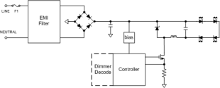
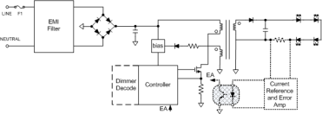
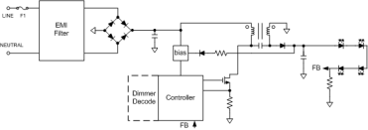
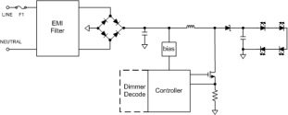
Offline LED Driver Configurations
Bulbs and Downlights (3-25W)
Buck
Flyback
 | Input Voltage |  | Dimming |  | PFC (>0.7)
 | 110V | 220V | TRIAC | TE
TPS92310/11/14 | Yes | Yes | No | No | Yes
LM3445 | Yes | Yes | Yes | Yes | Yes
LM3448 | Yes | Yes | Yes | Yes | Yes
TPS92075 | Yes | Yes | Yes | Yes | Yes
 | Input Voltage |  | Dimming |  | PFC (>0.9)
 | 110V | 220V | TRIAC | TE
TPS92310/11/14 | Yes | Yes | No | No | Yes
LM3447 | Yes | Yes | Yes | Yes | Yes
LM3445 | Yes | Yes | Yes | Yes | Yes
LM3448 | Yes | Yes | Yes | Yes | Yes
TPS92210 | Yes | Yes | External | External | Yes
SEPIC/Buck-Boost
Boost
 | Input Voltage |  | Dimming |  | PFC
 | 110V | 220V | TRIAC | TE
TPS92075 | Yes | Yes | Yes | Yes | Yes
 | Input Voltage |  | Dimming |  | PFC (>0.7)
 | 110V | 220V | TRIAC | TE
TPS92561 | Yes | Yes* | Yes | Yes | Yes
* Possible, but not verified

Slide 10
Offline LED Driver Configurations
Bulbs and Downlights (3-25W)
Buck
Flyback
Pros | Cons
Simple | Not Isolated
Good Efficiency | High LED Current Ripple
Pros | Cons
Isolated | Increased Complexity/Size
High PFC | High LED Current Ripple (if PFC)
Good EMI (Valley Sw)
SEPIC
Boost
Pros | Cons
Simple | Not Isolated
Good EMI, Efficiency | Non Dimming
Pros | Cons
Simple | Not Isolated
Great Efficiency | High 2° volt)
Good PF

Slide 11
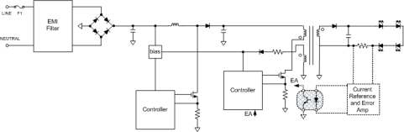
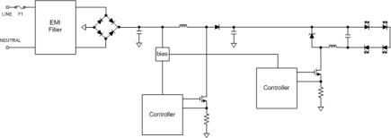
Offline LED Driver Configurations
Area Lights (20-100W)
Flyback
PFC Boost + FB
 | Input Voltage |  | Dimmable | PFC (>0.9)
 | 110V | 220V
TPS92310/11 | Yes | Yes | No | Yes
LM3450 | Yes | Yes | Phase | Yes
LM3447 | Yes | Yes | Phase | Yes
TPS92210 | Yes | Yes | External | Yes
UCC28810 | Yes | Yes | External | Yes
 | Input Voltage |  | Dimmable | Topology | PFC (>0.9)
 | 110V | 220V
UCC28810 | Yes | Yes | External | Boost/Flyback | Yes
LM3450 | Yes | Yes | Phase | Flyback | Yes
LM3447 | Yes | Yes | Phase | Flyback | Yes
TPS92210 | Yes | Yes | External | Flyback | Yes
SEPIC
PFC Boost + Buck
 | Input Voltage |  | Dimmable | PFC (>0.9)
 | 110V | 220V
TPS92210 | Yes | Yes | External | Yes
TPS92010 | Yes | Yes | External | No
 | Input Voltage |  | Dimmable | Topology | PFC (>0.9)
 | 110V | 220V
UCC28810 | Yes | Yes | External | Boost | Yes
LM3444 | Yes | Yes | External | Buck | Yes

Slide 12
Offline LED Driver Configurations
Area Lights (20-100W)
Flyback
PFC Boost + FB
Pros | Cons
Isolated | Large Transformer
High PFC | LED Current Ripple (2 x fac)
Pros | Cons
Isolated, High PFC | Two Stage Solution
No LED Current Ripple
SEPIC
PFC Boost + Buck
Pros | Cons
Simple | Not Isolated
Good EMI, Efficiency
Pros | Cons
No LED Current Ripple | Not Isolated
High PFC

Slide 13
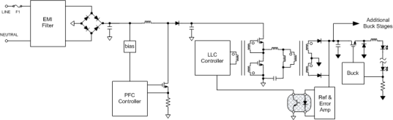
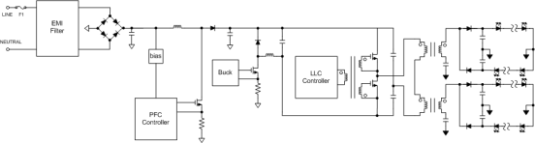
Offline LED Driver Configurations
Wide Area Lights (75-250W)
PFC Boost + LLC (CV) + Buck
Input Voltage |  | Dimmable | PFC (>0.9)
110V | 220V
Yes | Yes | PWM | Yes
UCC28810
TPS92020/3
LM3409/HV
PFC Boost + Buck (CC) + HB (CC)
Input Voltage |  | Dimmable | PFC (>0.9)
110V | 220V
Yes | Yes | PWM | Yes
UCC28810
UCC28811
TPS92020/3

Slide 14
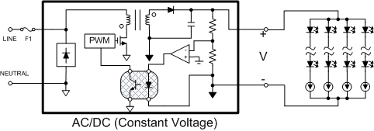
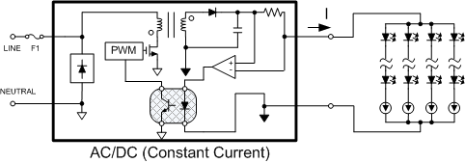
Offline LED Driver Configurations
Wide Area Lights (75-250W) – Off the Shelf Power Supply / Driver
Constant Voltage Power Supply with Linear LED String Regulation
LED Driver | LED Voltage | Dim | No. Channels | FET | DHC
LM3463 | 12-95V | Analog/PWM | 6 | External | Yes
LM3464 | 12-60V | Analog/ PWM | 4 | External | Yes
LM3464A | 12-95V | Analog/ PWM | 4 | External | Yes
TLC5960 | 0-34V | Analog/ PWM | 8 | External | Yes
DHC
LM3463
LM3464/A
TLC5960
DHC = Dynamic Headroom Control.
Constant Current Power Supply with Linear LED String Regulation
LED Driver | LED Voltage | LED Current (MAX) | No. Channels
LM3466 | 6-70V | 1.5A | 1
LM3466

Slide 15
Phase Dimmer Issues

Slide 16
TI Phase Dimming Solutions

Slide 17

The Trouble with TRIACs
Wall dimmer
L
TRIAC
AC Input
DIAC
R1
C1
Dimmer Output
N
Start of AC cycle TRIAC initially off
  C1 charges through R1 and light bulb
When voltage on C1 exceeds DIAC threshold voltage the TRIAC conducts
  R1 controls when TRIAC turns ON, dimming function
Light bulb load must maintain TRIAC holding current
  TRIAC turns off close to zero crossing and cycle repeats
LED lights do not always consume enough power to keep TRIAC ON
  Need to solve this with extra circuitry
Special care is required when making LED lighting compatible to standard TRIAC dimmers
Notes:
Typical TRIAC dimmer
It works by simply delaying the AC power to the light bulb
The blue sine wave is the input the red wave form is the output
The delay is controlled by the RC network formed by R1 and C1.

Slide 18
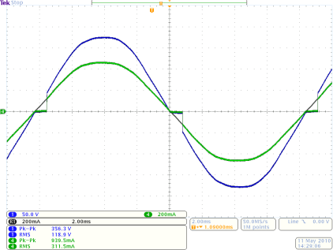
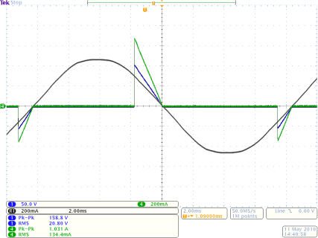
TRIAC Dimmer Phase Cut Waveforms
40W incandescent
Notes:
Sharp rising edge
Always some phase cut at max
Notes:
Always some phase cut at min
Can have some phase cut variation
Dimmer at maximum brightness
Dimmer at minimum brightness
LEGEND
Line Current
Line Current (ref trace w/o dimmer)
Line Voltage
Notes:
Here I have a couple of waveforms of a triac dimmer controlling a traditional 40W incandescent bulb. the legend is at the bottom of the slide:
- green is line current
- black is line current for the same bulb without a dimmer. this is just a reference trace.
- and blue is line voltage.
the figure on the left shows the dimmer at maximum conduction, or maximim light output. A couple of things to note are that at even at full light output, there is some phase cutting. It may be small, but is is always present. The second point here is that the
this phase cutting produces a sharp edge.
The figure on the right shows the dimmer at minimum brightness. There are a couple of things to note here too. first, notice that this dimmer, like most of the ones I have seen, does not dim all the way to zero. There is still some AC passing through even at the minimum setting. The second is that there can be some asymmetry related to the point where the triac conducts.
okay, so now we have mental picutre of how triac dimmers work. Let's talk about how the tps92070 manages this.

Slide 19
Phase Dimmable Offline LED Drivers

Slide 20



TPS92411/P
Floating Switch for Offline AC Linear Direct Drive of LEDs with Low Ripple Current
Features | Benefits
100V, 2-Ohm MOSFET | Controls LED Stacks to >90V
Controlled Open and Close | Very Low EMI.
Protection Features: Input Under-Voltage Output Over-Voltage (92411P) | Protects Against Faults and Abnormal Operating Conditions
Package: SOT23-5
Applications
LED Lamps and Luminaires
LED Indoor Area Lighting
Low Cost AC Drive Sol’n, replaces SMPS
No Magnetic Components
PFC > 0.95
Eff > 80%
Good Line Regulation
Phase Dimmer Compatible
Can mount to MC PCB
TPS92411EVM-001 (120V)
TPS92411EVM-002 (230V)
TOOLS

Slide 21
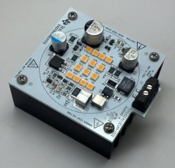
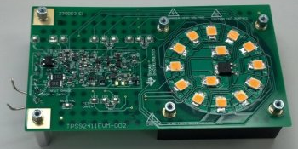
TPS92411 EVM Specifications

Slide 22

TPS92561
Phase Dimmable, Hysteretic Boost Controller for LED Lighting
Features | Benefits
Input Voltage Operating Range: 6.5V to 42V | Simplifies IC bias
Topologies: Boost | Flexible LED Load Configuration
Hysteretic Control Scheme | Control Loop Does Not Require Compensation
Natural Phase Dimmer Compatibility | Responds to VIN RMS
Power Factor > 0.9 THD < 20% | Meets Regulatory Requirements
LED Over-Voltage Protection, Thermal Shutdown | Protects IC During Fault and Abnormal Operating Conditions
Applications
Off-line Triac Dimmable Lamps (A, PAR)
Non-Dimmable Lamps (A, PAR)
DC/DC LED Lighting: Boost/SEPIC
MR16 Non-Dim
TPS92561EVM-001
Mini Small
Outline Package
(MSOP-8)
TOOLS

Slide 23
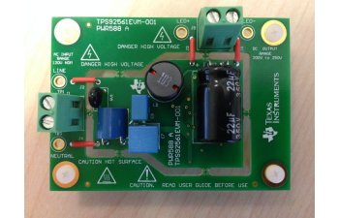
TPS92561 EVM Specifications

Slide 24


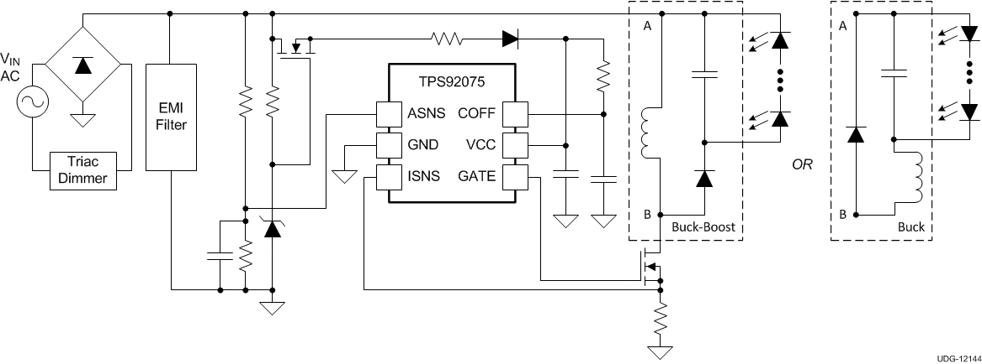
TPS92075
Non-Isolated, Phase Dimmable, Buck PFC LED Driver with Digital Reference Control
NEW
Features | Benefits
Application input voltage: 120VAC, 230VAC | Supports All Common Line Voltages
Controlled Reference Derived PFC | Meets Regulatory PFC Requirements for LED Lighting
Digital Phase Angle Decoding and Phase Symmetry Balancing Algorithms | Improved Dimmer Compatibility with Wide Dimming Range and Flicker-Free Performance
Topology: Non-Isolated Buck or Buck-Boost with PFC | Compact Design with Low Component Count
Constant Current Operation Using Peak Current Mode Control | Improved Line and Load Regulation
Protection Features: VCC Over-Voltage Protection, Cycle-by-Cycle Over-Current Protection, UVLO, Thermal Shutdown | Protects Against Fault and Abnormal Operating Conditions
TSOT6 & SO8 Package Options
Applications
5-30W LED Luminaires/lamps
Phase Dimmable LED Light bulbs (GU10, A19, E26/27, E14), PAR30/38
LED Ballasts / Troffers (T8/10 replacement)
TPS92075EVM-503 (120V)
TOOLS

Slide 25
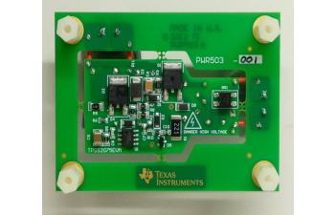
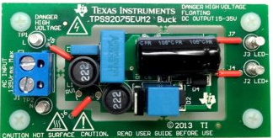
TPS92075 EVM Specifications

Slide 26

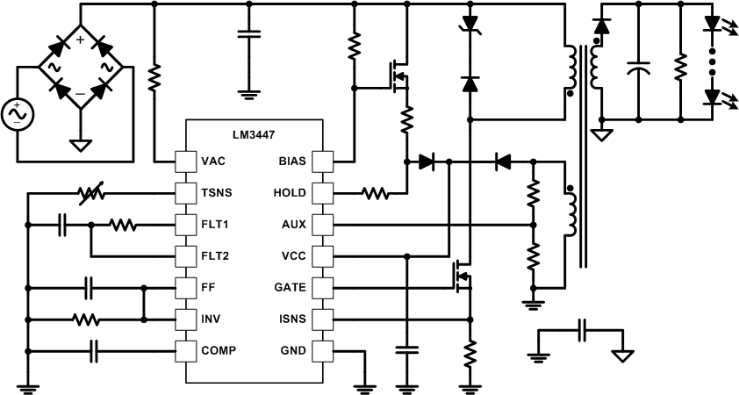
LM3447
Phase Dimmable, Primary Side Power Regulated, PFC Flyback Controller for LED Lighting
Features | Benefits
Application input voltage: 120, 230, 277VAC | Supports All Common Line Voltages
Power Factor Corrected | Meets Regulatory PFC Requirements for LED Lighting
Integrated Phase Dimmer Decoding | Over 50:1 Dimming Range
Topology: DCM Flyback with Valley Switching | Flexibility for Different Lighting / Regulatory Requirements
Constant Power Operation (based on input feed-forward) | Better efficacy (utilization) of LEDs; No Optocoupler or Secondary Error Amp Required
Fixed Switching Frequency (Fsw = 70kHz) | Simplifies EMI filtering requirements
Protection Features: LED Thermal foldback, Cycle-by-Cycle Current Limit, Over/Under Voltage Protection, IC Thermal Shutdown | Protects Against Fault and Abnormal Operating Conditions
TSSOP14 Package Option
Applications
5-30W LED Luminaires/lamps
Phase Dimmable LED Light bulbs (GU10, A19, E26/27, E14), PAR30/38
LED Ballasts / Troffers (T8/10 replacement)
LM3447EVM-128-001 (120V/11W A19)
LM3447EVM-128-002 (230V/11W A19)
LM3447EVM-130-001 (120V/18W PAR38)
LM3447EVM-130-002 (230V/18W PAR38)
TOOLS

Slide 27
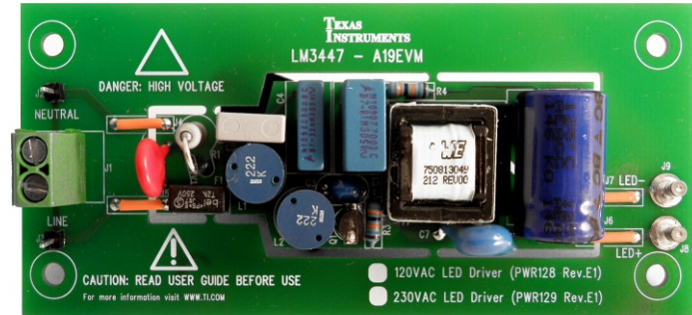
LM3447EVM Specifications
NEW

Slide 28

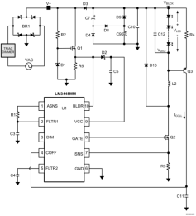
LM3445
TRIAC Dimmable Offline LED Driver
Features | Benefits
TRIAC Dimming Decoder for LED Dimming | Integrated TRIAC Detection Reduces Component Count and Solution Size
Master/Slave Operation | Single TRIAC Controls Multiple Strings with Consistent Dimming Performance
Application Voltage Range (80-277Vac) | Supports Residential and Commercial LED Lighting Applications
Controls LED Currents of up to1A | Supports a Wide Variety of LED Configurations
Adjustable Switching Frequency | Stable Operation Over Varying Input Line Conditions
Adaptive, Programmable Off-Time Control | Allows for Constant Output Ripple Current with no 120Hz Flicker
Thermal Shutdown, UVLO, Current Limit | Protects Against Faults and Abnormal Operating Conditions
Applications
Dimmable Residential LED Lighting Drivers: A19 (E26/27, E14), PAR30/38, GU10
Lighting Applications: Light Bulb Replacement, Wall Sconces, Wall Washers, Architectural and Display Lighting, Commercial Troffers and Downlights
LM3445-120VFLBK/NOPB (120V)
LM3445-120VSMEV/NOPB (120V)
LM3445-208277EV/NOPB (220-277V)
LM3445-230VFLBK/NOPB (230V)
LM3445-EDSNEV/NOPB(120V)
TOOLS

Slide 29



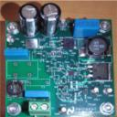
LM3445EVM Specifications

Slide 30
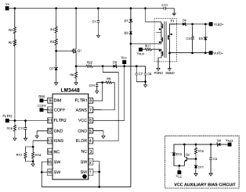
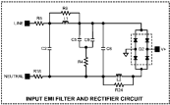

LM3448
TRIAC Dimmable Offline LED Driver
Features | Benefits
85~265V Application Voltage Range | Supports Residential LED Lighting Voltages
Integrated, vertical 600V MOSFET with Superior Avalanche Energy Capability | Reduced Component Count with High Solution Reliability/Robustness/Efficiency – Enables Space Constrained Bulb Designs Like GU10
Input Phase Angle Dimming Decoder for LED Dimming | High Performance / Wide Range Dimming. 120Hz Flicker-Free Designs
Adaptive programmable OFF time | Provides Constant LED Ripple Current
Multiple Topologies Supported: Buck, Buck-Boost, Flyback | Flexible LED Driver Designs
Applications
Dimmable LED Lighting Drivers: A19 (E26/27, E14), PAR30/38, GU10: 2W~8W
Isolated or Non-Isolated Configurations
LM3448-EDSNEV
LM3448-120VFLBK
LM3448-230VFLBK
TOOLS

Slide 31
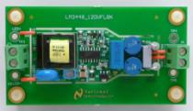
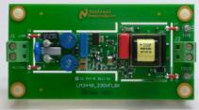
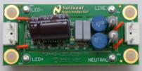
LM3448EVM Specifications

Slide 32
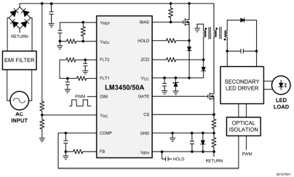
LM3450/A
LED Drivers with Active PFC and Phase Dim Decoder
Features | Benefits
Active Power Factor Correction Critical Conduction Mode with Zero Crossing Detection | Achieves Industry Lighting PFC Requirements with Low EMI
PWM Decoded from Forward and Reverse Phase Dimmer to 70:1 ratio using 500Hz PWM | High Dimming Ratio for Lighting with No Visible LED Flicker
Easily Supports Multi-String Designs | Open-Drain DIM Signal Can Be Used Across Isolation Boundary to Control Light Output Using Multiple LED Driver ICs
Integrated Dynamic Hold Circuitry | Ensures TRIAC remains in conduction for proper mapping of phase signal.
Applications
Dimmable Downlights, Troffers, and Low Bay LED Lights
Large Form Factor Bulb / Luminaire Designs
LM3450AEV-120V30/NOPB (120V)
LM3450AEV-230V30/NOPB (230V)
LM3450EV120V15W/NOPB (120V)
LM3450EV230V15W/NOPB (230V)
TOOLS

Slide 33


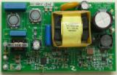
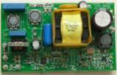
LM3450EVM Specifications

Slide 34
Non-Dimmable Offline LED Drivers
Products without integrated phase dimmer decoding

Slide 35
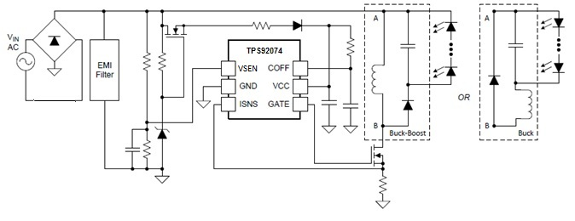
TPS92074
Non-Isolated, Buck (or Buck-Boost) PFC LED Driver with Digital Reference Control
Features | Benefits
Application input voltage: 120VAC, 230VAC | Supports All Common Line Voltages
Controlled Reference Derived PFC | Meets Regulatory PFC Requirements for LED Lighting
Topology: Non-Isolated Buck or Buck-Boost with PFC | Compact Design with Low Component Count
Constant Current Operation Using Peak Current Mode Control | Improved Line and Load Regulation
Protection Features: VCC Over-Voltage Protection, Cycle-by-Cycle Over-Current Protection, UVLO, Thermal Shutdown | Protects Against Fault and Abnormal Operating Conditions
TSOT6 & SO8 Package Options
Applications
5-50W LED Luminaires/lamps
Non- Dimmable LED Light bulbs (GU10, A19, E26/27, E14), PAR30/38
LED Ballasts / Troffers (T8/10 replacement)
TPS92075EVM2 (120V) – refer to dimmable EVM
TOOLS

Slide 36
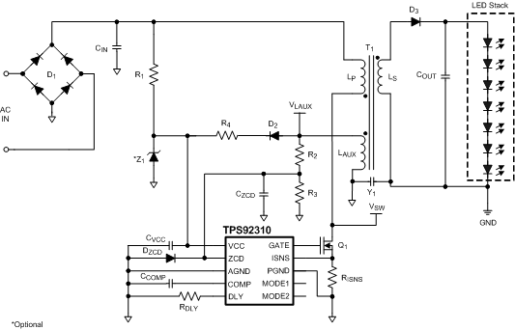
TPS92310
Off-line Primary Side Sensing Controller with PFC
Features | Benefits
Application input voltage: 120, 230, 85 -265, and 277 VAC | Supports all common line voltages
Primary-Side Regulated | No optocoupler or secondary error amp required
User Selectable Operating Modes
Adaptive Constant ON-Time (COT) Peak Current Mode | Inherent Power Factor Correction (low BoM count) Low LED Current Ripple
Critical-Conduction Mode with Zero-Current Detect (ZCD) | Valley Switching Improves Efficiency While Minimizing EMI
Protection Features: Cycle-by-Cycle Current Limit, Over/Under Voltage Protection, Thermal Shutdown | Protects Against Fault and Abnormal Operating Conditions
Small MSOP10 Package
Applications
Non-dimmable LED Light bulbs (GU10, A19, E26/27, E14), PAR30/38
Non-dimmable LED Area Lighting (T8, T10 replacement)
TPS92310-23FB (230V)
TPS92310-12FB (120V)
TOOLS
See also: TPS92311 w/ Integrated 600V FET for <8W applications

Slide 37
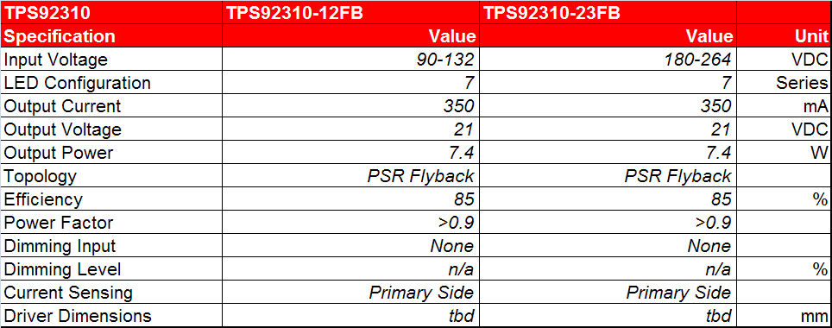
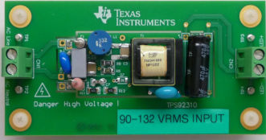
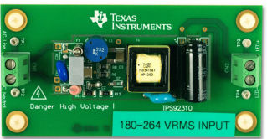
TPS92310EVM Specifications

Slide 38
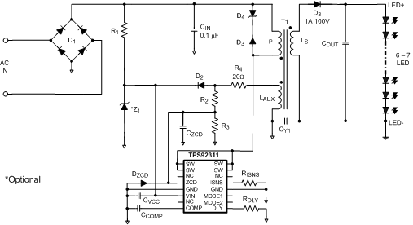
TPS92311
Off-line Primary Side Sensing Converter with PFC
Features | Benefits
Application input voltage: 120 or 230 VAC | Supports all common line voltages
Integrated 600V MOSFET, Suitable for < 8W LED Load Power | Reduces External Component Count / Size is Space Constrained LED Lighting Applications
Primary-Side Regulated | No optocoupler or secondary error amp required
User Selectable Operating Modes
Adaptive Constant ON-Time (COT) Peak Current Mode | Inherent Power Factor Correction (low BoM count) Low LED Current Ripple
Critical-Conduction Mode with Zero-Current Detect (ZCD) | Valley Switching Improves Efficiency While Minimizing EMI
Protection Features: Cycle-by-Cycle Current Limit, Over/Under Voltage Protection, Thermal Shutdown | Protects Against Fault and Abnormal Operating Conditions
SOIC16 Package
Applications
Non-dimmable LED Light bulbs (GU10, A19, E26/27, E14), PAR30
TPS92311EVM-xxx (230V)
TPS92311EVM-xxx (120V)
TOOLS
See also: TPS92310 w/o Integrated FET for >8W applications

Slide 39
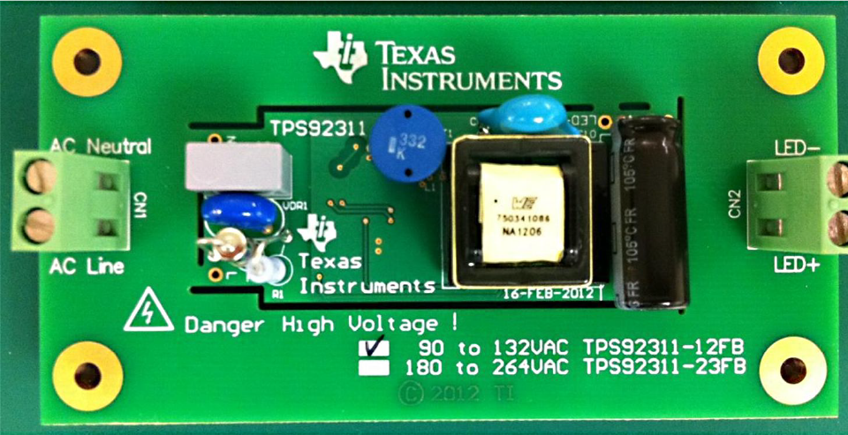
TPS92311EVM Specifications
TPS92311 | TPS92311A19120V EVM | TPS92311A19230V EVM
Specification | Value | Value | Unit
Input Voltage | 90-132 | 180-264 | VDC
LED Configuration | 7 | 7 | Series
Output Current | 350 | 350 | mA
Output Voltage | 21 | 21 | VDC
Output Power | 7.4 | 7.4 | W
Topology | PSR Flyback | PSR Flyback
Efficiency | 85 | 85 | %
Power Factor | >0.9 | >0.9
Dimming Input | None | None
Dimming Level | n/a | n/a | %
Current Sensing | Primary Side | Primary Side
Driver Dimensions | tbd | tbd | mm

Slide 40
TPS92314
Off-line Primary Side Sensing Controller with PFC
Features | Benefits
Application input voltage: 120, 230, 85-265 VAC | Supports all common line voltages
Primary-Side Regulated | No optocoupler or secondary error amp required
Adaptive Constant ON-Time (COT) | Inherent Power Factor Correction (low BoM count)
Critical-Conduction Mode with Zero-Current Detect (ZCD) | Valley Switching Improves Efficiency While Minimizing EMI
Protection Features: Cycle-by-Cycle Current Limit, Over/Under Voltage Protection, Thermal Shutdown | Protects Against Fault and Abnormal Operating Conditions
SOIC-8 Package
Applications
Non-dimmable LED Light bulbs (GU10, A19, E26/27, E14), PAR30/38
Non-dimmable LED Area Light (T8, down light)
TPS92314-xxx (230V)
TPS92314-xxx (120V)
TOOLS

Slide 41
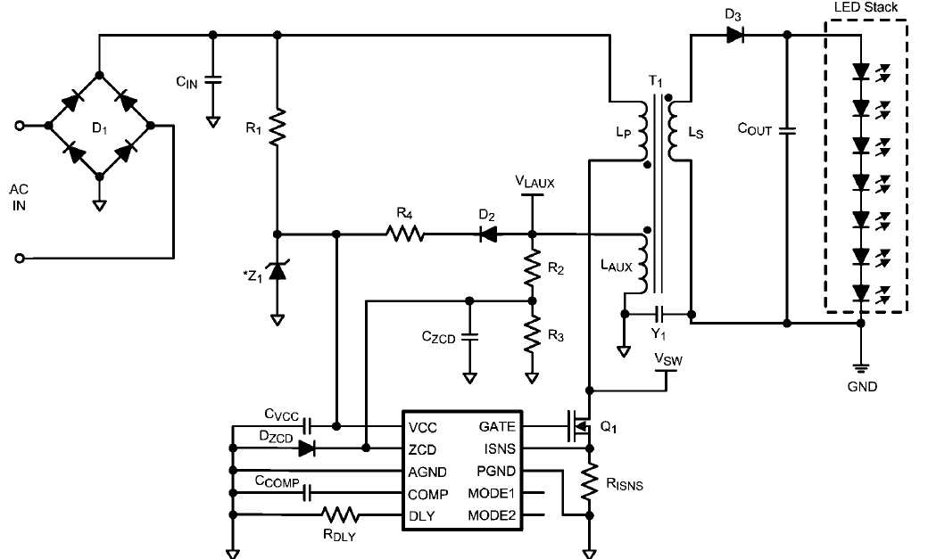
TPS9231x Positioning
 | TI | TI | TI
 | External Main Switch |  | Integrated Main Switch
IC Part Number | TPS92314 | TPS92310 | TPS92311
Application Voltage | 85-264V | 85-264V | 85-264V
Dimming | Non-Dimming | Non-Dimming | Non-Dimming
Topology | DCM Flyback | DCM Flyback | DCM Flyback
HV Startup | No | No | No
VCC Range | 13 ~ 35V | 13 ~ 35V | 13 ~ 35V
PFC | Yes | Yes | Yes
Current Regulation (primary, secondary) | Primary | Primary | Primary
Current Accuracy | ±5% | ±5% | ±5%
Integrated Switching FET | No | No | Yes (<8W LED)
fsw (max) | < 250kHz | < 250kHz | < 250kHz
Valley Switching | Yes | Yes | Yes
LED Open Protection | Yes | Yes | Yes
LED Short Protection | Yes | Yes | Yes
Thermal Shutdown | Yes | Yes | Yes
Dual Mode Operation (Constant ON time / Constant Peak Current) | No | Yes | Yes
Package/Pins | SOIC/8 | MSOP/10 | SOIC/16
A Lamp Solution Component Count (not incl. EMIF) | 21 | 21 | 18
Efficiency (A lamp) | >85% | >85% | >85%
TPS92310: Mode Select
TPS92311: 10 + FET
TPS92314: Fixed Mode

Slide 42
TPS92315
Off-Line Primary-Side Sensing Controller for LED Lighting
Features | Benefits
Application input voltage: 90 - 230VAC | Supports All Common Line Voltages
Primary Side Regulation (PSR) with +5% LED Current Regulation | Accurate Current Regulation without Opto-Coupler and Secondary Feedback Components
130kHz Maximum Switching Frequency | Enables High Power Density LED Lighting Designs
Quasi-Resonant (Valley) Switching | Improved System Efficiency
Frequency Jitter | Simplifies EMI Compliance
Wide VCC Range (35V) | Ease Transformer Design, Small Bias Capacitor
Protection Features: Over-Voltage, UVLO, Over-Current, Thermal Shutdown | Protects Against Faults and Abnormal Conditions
Small SOT23-6 Package | Small Package/Low External Component
Applications
LED Light bulbs: GU10, A19, E26/27, E14, PAR30/38
Recessed Down Lights, Pendent Lights
Architectural Lighting
TPS92315EVM-516 (85-265V)
TOOLS

Slide 43
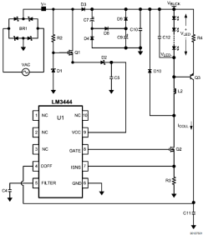
LM3444
AC/DC Offline LED Driver
Features | Benefits
Application Voltage Range (80-277Vac) | Supports Residential and Commercial LED Lighting Applications
Controls LED Currents up to 1A | Supports a Wide Variety of LED Configurations
Adjustable Switching Frequency | Stable Operation Over Varying Input Line Conditions
Adaptive, Programmable Off-Time Control | Allows for Constant Output Ripple Current with no 120Hz Flicker
Thermal Shutdown, UVLO, Current Limit | Protects Against Faults and Abnormal Operating Conditions
Applications
Non-Dimming Residential LED Lighting Drivers: A19 (E26/27, E14), PAR30/38, GU10
Lighting Applications: Light Bulb Replacement, Wall Sconces, Wall Washers, Architectural and Display Lighting, Commercial Troffers and Downlights
LM3444-120VFLBK/NOPB (120V)
LM3444-120VFLBK/NOPB (230V)
LM3444-EDSNEV (120V)
LM3444BOOST-REF (MR16)
LM3444BBRB (MR16)
TOOLS

Slide 44
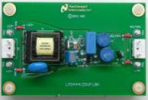
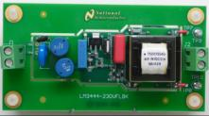

LM3444EVM Specifications

Slide 45

TPS92210
PFC Offline LED Lighting Driver Controller
Features | Benefits
Flexible Operating Modes: Peak Primary Current, Constant On-Time, or both | Constant On-Time implements Single Stage Power Factor Correction (PFC)
Cascoded MOSFET Configuration | Fast start up; Line Surge Ruggedness Better Than Internal HV FET
Works with TRIAC Dimmers | Continuous Exponential Dimming
Transformer Zero Energy Detection | High Efficiency, Low EMI
Discontinuous Conduction or Transition Mode Operation | No Reverse Recovery Loss in Output Rectifier
Advanced Over-Current Protection and Integrated Over-voltage Protection | Protects Driver Against Fault Conditions
Applications
Residential LED Lighting Drivers: A19 (E26/27, E14), PAR30/38, GU10
Lighting Applications: Light Bulb Replacement, Sconces, Wall Washers, Architectural and Display Lighting, Commercial Troffers and Downlights
TPS92210EVM-647 (110V)
TPS92210EVM-613 (230V)
TOOLS

Slide 46
TPS92210EVM Specification
Note: TRIAC dimming requires external (not integrated) dimmer decoding components

Slide 47

TPS92001/2
General Purpose LED Lighting Driver Controller
Features | Benefits
Ideal for Single Stage LED Driver Designs | Power Factor >0.7
Isolated and Non-Isolated Topologies | Supports Wide Configuration of LED Loads
TRIAC Dimmable Application Circuit with Low External Component Count | Low Cost Deep Dimming Solution with Small Form Factor
Convenient 5V Reference | Power for MCU or Linear Circuits
Two Under-Voltage Lockout Options (10V or 15V) | Protection from Abnormal Operating Conditions
Integrated Gate Drive: 0.4A Source / 0.8A Sink | External Gate Drivers Not Required
Applications
Residential LED Lighting Drivers: A19 (E26/27, E14), PAR30/38, GU10
Lighting Applications: Light Bulb Replacement, Wall Sconces, Wall Washers, Architectural and Display Lighting, Commercial Troffers and Downlights
3Q11
TPS92001EVM-645 (110V)
TOOLS

Slide 48
TPS92001EVM-645 Specification

Slide 49

UCC28810/1
LED Lighting Power Controller
Features | Benefits
Implements Single Stage Power Factor Correction | Meets Power Factor Correction Standards for Lighting Products
Transformer Zero Energy Detection Transition Mode Control | High Efficiency, Low EMI Performance
Application Circuit Implements Phase-Cut Dimming | Compatible with Large Installed base of TRIAC Based Dimmers
Advanced Transient Response, Accurate Internal Vref, Low Start Up Current, 750mA Gate Drive | Improves Reliability and Life Time of Lighting Fixture
UVLO, Over-Voltage, and Open-Loop Detection | Protects Against Faults and Abnormal Conditions
Applications
AC Input General Illumination, HB LED Applications
PFC Front-End for Multi-Stage Lighting Designs
UCC28810EVM-002 (Universal, 100W), Multi-Stage
UCC28810EVM-003 (Universal, 110W), Multi-Stage
TOOLS

Slide 50
UCC28810EVM-002 Block Diagram
1st stage: TM Boost for PFC
2nd stage: TM Buck for LED current
Applications
LED Street & Roadway Lighting
LED High Bay Industrial Lighting
DTV LED backlighting
Notes:
Here we see a block diagram for this design
It is based on a two stage design the first stage is a transition mode boost PFC which regulates a high voltage output to feed the second stage and also ensures the input current is sinusoidal
The second stage is a transition mode low side buck which regulates the LED current

Slide 51
UCC28810EVM-002 Specification
Universal input non isolated design
Regulated LED current
PWM Dimming, 200Hz to 1kHz
High Efficiency
  Maintained during dimming
Active power factor correction
Notes:
Specification summary
15 to 30 LED’s in series
Shows efficiencies up to 93%
PF > 0.97
0.9A output

Slide 52

TPS92020/23
Resonant-Switching Driver Controller for LED Lighting
Features | Benefits
LLC Resonant Switching Controller | Zero Voltage Switching for High-Efficiency
Half-Bridge Topology | High Power (High Light Output) Lighting Applications
Fixed or Variable Switching Frequency Control 92020: fclamp – 300kHz MIN w/Burst 92023: fclamp – 330kHz MIN no Burst | Tune to Resonant Frequency of LLC for Higher Efficiency
Programmable Soft-Start | Provides Flexible Dimming Option
Over-Temperature and Current Limit Protection | Protects Against Faults and Abnormal Operating Conditions
Implements TI SimpLEDrive™ Multi-String Topology | Transformer Scalable High Light Output Designs
Applications
Commercial and Industrial LED Lighting Applications: High Bay, Street Lighting, Area Lighting
UCC28810EVM-003 (Universal, 110W), Multi-Stage
TOOLS
SimpLEDrive™ shown

Slide 53


UCC28810EVM-003 - SIMPLEDrive™
Series Input, Multiple Parallel Equivalent LED Drive (SIMPLEDrive )
3rd stage:
Resonant Current Half Bridge
1st stage:
TM Boost for PFC
2nd stage:
TM Buck for LED current
http://focus.ti.com/docs/toolsw/folders/print/ucc28810evm-003.html
Notes:
This design uses TI’s Series Input Multiple Parallel Equivalent LED Drive or SIMPLEDrive
Consists of three stages.
First stages similar to the previous design discussed.
Third stage is a resonant current half bridge with multiple transforms, more on this later.
Here is a picture of the EVM which is available on the TI web site

Slide 54

UCC28810EVM-003 Specification

Slide 55
DC/DC LED Lighting Solutions

Slide 56
DC/DC LED Lighting Solutions
Boost |  | Buck
Controllers | Converters | Controllers | Converters
TPS40211* | LM3410 | LM3401 | TPS92510
LM3430 | TPS61165 | LM3409/HV | LM3402/HV
LM3421* | TPS61166 | LM3433 | LM3404/HV
LM3423* | TPS61195 | LM3434 | LM3406/HV
LM3424* | TPS61500 | TPS92640/1 | LM3405/A
LM3429* |  | TPS92660 | LM3407
LM3431/A |  |  | LM3414/HV
TPS92560 |  |  | TPS92550/1^
TPS92690*
* Primary Topology Listed. Additional Topologies Supported.
^ Integrated Micro-Module

Slide 57

DC/DC LED Lighting Controllers vs. Converters
 | Controller | Converter
Integration | External: Switch(es) Rectifying Element Sense Resistor(s) | Internal (can include): Switch(es) Rectifying Element Sense Resistors Integrated Protection Features
Flexibility | Tunable Switching Frequency Easier to Scale for Higher Output Power Low Power Dissipation in IC Package | May be Fixed or Adjustable Switching Frequency Limited Output Power Range Limited IC Package Power Dissipation
Ease of Use | ‘Cookbook’ of Equations to Select Component Values Can be Intimidating for Novice Designer | Some Products ‘Plug and Play’ – Common Application Components Pre-Selected
Basic Buck Controller
Basic Buck Converter
Includes switching element
May include rectifying element

Slide 58
LED Lighting DC/DC Controllers

Slide 59
LED DC/DC Controller Summary
 | TPS40211 | LM3401 | LM3409/ LM3409HV | LM3421/ LM3423 | LM3424 | LM3429 | TPS92690 | LM3431 | LM3433/ LM3434
Package | 10 MSOP | 8 MSOP | 10 MSOP | 16TSSOP 20TSSOP | 20TSSOP | 14TSSOP | 16TSSOP | 28HTSSOP | 24LLP
FET | NMOS | PMOS | PMOS | NMOS | NMOS | NMOS | NMOS | NMOS | NMOS
Vin Range | 4.5-52V | 4.5-30V | 6-42V 6-75V (HV) | 4.5-75V | 4.5-75V | 4.5-75V | 4.5-75V | 5-36V | -9—14V -9—30V
Vref | 0.260V | 0.200V | 0.248V | Adjustable | Adjustable | Adjustable | Adjustable | 100-300mV (adj) | 60mV
Fsw | ADJ Up to 1MHz | Variable up to 1.5MHz | Variable up to 1MHz | ADJ Up to 2MHz | ADJ Up to 2MHz | ADJ Up to 2MHz | ADJ Up to 2MHz | ADJ Up to 1MHz | ADJ Up to 1MHz
Fsync | Yes | No | No | No | No | No | Yes | No | No
Adj Soft Start | Yes | n/a | n/a | No | No | No | Yes | Yes | Yes
OCP threshold | 150mV | 130mV | 248mV | 245mV | 245mV | 245mV | Adjustable | Adj | No
Topology | Boost, Flyback, SEPIC - Current mode | Buck - Hysteretic | Buck - Hysteretic | Buck, Boost, Buck-Boost, SEPIC | Buck, Boost, Buck-Boost, SEPIC | Buck, Boost, Buck-Boost, SEPIC | Boost, SEPIC, Flyback, Cuk | Boost – Current Mode Control | Buck – Current Mode Control
Other Features |  |  | HS Current Sense | HS Current Sense, Flag, Err Tmr (23) | HS Current Sense, Thermal Foldback | HS Current Sense | LS Current Sense, | 3-Channel CC Sinks | Grounded Anode LED
Tj | -40°C to +125°C | -40°C to +125°C | -40°C to +125°C | -40°C to +125°C | -40°C to +125°C | -40°C to +125°C | -40°C to +125°C | -40°C to +125°C | -40°C to +125°C

Slide 60
Multi-Topology Controllers

Slide 61

Multi-Topology Controller Summary
 | TPS92690 | LM3421 | LM3423 | LM3424 | LM3429 | TPS40211
Package | 16TSSOP | 16TSSOP | 20TSSOP | 20TSSOP | 14TSSOP | 10 MSOP
FET | NMOS | NMOS | NMOS | NMOS | NMOS | NMOS
Vin range | 4.5-75V | 4.5-75V | 4.5-75V | 4.5-75V | 4.5-75V | 4.5-52V
Vref | Adjustable (50mV – 500mV) | Adjustable (50mV – 1.24V) | Adjustable (50mV – 1.24V) | Adjustable (50mV – 1.24V) | Adjustable (50mV – 1.24V) | 0.260V
Fsw | ADJ Up to 2MHz | ADJ Up to 2MHz | ADJ Up to 2MHz | ADJ Up to 2MHz | ADJ Up to 2MHz | ADJ Up to 1MHz
Fsync | Yes | No | No | Yes | No | Yes
Adj Soft Start | Yes | No | No | No | No | Yes
OCP threshold | Adjustable | 245mV | 245mV | 245mV | 245mV | 150mV
Topology | Boost, SEPIC, Flyback, Cuk | Buck, Boost, Buck-Boost, SEPIC | Buck, Boost, Buck-Boost, SEPIC | Buck, Boost, Buck-Boost, SEPIC | Buck, Boost, Buck-Boost, SEPIC | Boost, Flyback, SEPIC – Current mode
Other Features | LS Current Sense, Analog dimming PWM dimming | HS Current Sense Fast PWM Dimming | HS Current Sense, LED Output Status Flag, Fault Flag, Fault Timer, PWM Polarity | HS Current Sense, Thermal Foldback, Analog Dimming, Fast PWM Dimming | HS Current Sense | LS Current Sense, Analog dimming PWM dimming
Tj | -40°C to +125°C | -40°C to +125°C | -40°C to +125°C | -40°C to +125°C | -40°C to +125°C | -40°C to +125°C

Slide 62

TPS92690/TPS92690Q
N-Channel Controller for Dimmable LED Drives with Low-Side Current Sense
Features | Benefits
Input Operating Range 4.5 to 75V and Cuk, Boost, Flyback, and SEPIC Configurations | Suitable for a Wide Variety of LED Applications
Low Side Adjustable Current Sense | Can Be Used for Analog Dimming Control
Analog Dim / Thermal Foldback | Lowers LED Current for Coding/Binning and/or Thermal Protection
Switching Frequency Adjustable to 2MHz. Can be Synchronized in Multi-Controller Applications | Optimize for Efficiency, Size, or LED Ripple Current
PWM Dimming | Inexpensive PWM Dimming with Main FET
Applications
Indoor and Outdoor Area Lighting
Automotive Headlamps, Running Lights
TPS92690EVM
TOOLS

Slide 63

TPS40211
4.5V to 52V Current Mode N-Ch Controller for LED Lighting
Features | Benefits
Supports Boost, Flyback and SEPIC Topologies | Suitable for a Wide Variety of LED Lighting Applications
4.5 to 52V Input Voltage Range | Can Drive Up To 14 Series HB LEDs
Programmable Switching Frequency (35kHz to 1MHz) | Flexible Filter Design
Frequency Synchronization (with External Components) | Can Operate with an External Clock
260mV Internal Voltage Reference | Reduces Power Dissipation in Sense Resistor
Integrated Low-Side Driver | Reduces Component Count
Programmable Over-Current Limit and Internal UVLO | Protects Against Fault and Abnormal Operating Conditions
Applications
High Current LED Drivers (Street Lighting, High Bay)
LED Based MR-16 Light Bulb Replacement
LED Backlighting
TOOLS
TPS40211EVM-352

Slide 64

TPS40211EVM Specifications

Slide 65

LM3421/LM3421Q/LM3423/LM3423Q
N-Channel Controllers for Const. Curr. LED Drivers
Features | Benefits
Input Operating Range 4.5 to 75V and Buck, Boost, Buck-Boost, and SEPIC Configurations | Suitable for a Wide Variety of LED Applications
LM3423 adds: LED Output Status Flag, Fault Flag, Fault Timer, PWM Polarity Pin | Enhanced Reporting and Control
High Side Adjustable Current Sense | Can Be Used for Analog Dimming Control
Switching Frequency Adjustable to 2MHz | Optimize for Efficiency, Size, or LED Ripple Current
Dimming: PWM and Analog | Improved PWM Dimming by Using Internal Gate Driver for External DIM FET
UVLO, Over-Voltage, and Thermal Shutdown Protection | Protects Against Faults and Abnormal Operating Conditions
Applications
Indoor and Outdoor Area Lighting
Automotive Headlamps, Running Lights
LM3421-SEPICEV/NOPB
LM3423BBLSCSEV/NOPB
LM3423BS2LYEV/NOPB
TOOLS

Slide 66


LM3421/3423EVM Specifications

Slide 67

LM3424/LM3424Q
N-Channel Controller with TFB for Const. Curr. LEDs
Features | Benefits
Input Operating Range 4.5 to 75V and Buck, Boost, Buck-Boost, and SEPIC Configurations | Suitable for a Wide Variety of LED Applications
High Side Adjustable Current Sense | Can Be Used for Analog Dimming Control
Programmable Thermal Foldback | Lowers LED Current to Maintain Light Output During High Temperature Conditions
Switching Frequency Adjustable to 2MHz. Can be Synchronized in Multi-Controller Applications | Optimize for Efficiency, Size, or LED Ripple Current
Dimming: PWM and Analog | Improved PWM Dimming by Using Internal Gate Driver for External DIM FET
UVLO, Over-Voltage, and Thermal Shutdown Protection | Protects Against Faults and Abnormal Operating Conditions
Applications
Indoor and Outdoor Area Lighting
Automotive Headlamps, Running Lights
LM3424BKBSTEVAL/NOPB
TOOLS

Slide 68

LM3424EVM Specifications

Slide 69

LM3429/LM3429Q
N-Channel Controller with for Const. Curr. LEDs
Features | Benefits
Input Operating Range 4.5 to 75V and Buck, Boost, Buck-Boost, and SEPIC Configurations | Suitable for a Wide Variety of LED Applications
High Side Adjustable Current Sense | Can Be Used for Analog Dimming Control
Switching Frequency Adjustable to 2MHz. Can be Synchronized in Multi-Controller Applications | Optimize for Efficiency, Size, or LED Ripple Current
Dimming: PWM and Analog | Flexible Options for Controlling LED Brightness
UVLO, Over-Voltage, and Thermal Shutdown Protection | Protects Against Faults and Abnormal Operating Conditions
Applications
Indoor and Outdoor Area Lighting
Automotive Headlamps, Daytime Running Lights
LM3429BKBSTEVAL/NOPB
LM3429BSTEVAL/NOPB
TOOLS

Slide 70


LM3429EVM Specifications

Slide 71

LM3433/LM3434
Common Anode Capable High Brightness Buck LED Driver
Features | Benefits
Input Operating Range: LM3433: -9 to -14V w.r.t. LED Anode LM3434: -9 to -30V w.r.t. LED Anode | Able to Drive Common Anode HB LEDs
Negative Output Voltage Capability | Allows LED Anode to be Tied to Chassis for Maximum Heat Sink Efficacy
Output Current Greater than 6A | Capable of Driving Very High Power LEDs
Constant On-Time Boost Controller with Adjustable Switching Frequency to 1MHz | Provides Constant Current Source LED Drive Using Small External PCB Components
Analog and PWM Dimmable | LED Color Shift and Brightness Control
UVLO and Thermal Shutdown | Protects Against Abnormal Operating Conditions
Applications
LCD Backlighting
LED Based Projection Systems
Solid State Lighting
LM3433SQ-14AEV/NOPB
LM3433SQ-36AEV/NOPB
LM3434SQ-20AEV/NOPB
TOOLS

Slide 72


LM3433/3434EVM Specifications

Slide 73
Buck Controllers

Slide 74

TPS92640/1
Synchronous Buck Controllers for Precision Dimming LED Drivers
Features | Benefits
Input Operating Range 7 to 85V | Suitable for a Wide Variety of LED Applications
Low-Side Adjustable Current Sense (20mV – 250mV) | Optimize for Low Power Loss or Noise Immunity Can Be Used for Analog Dimming Control
Switching Frequency up to 1MHz | Optimize for Efficiency, Size, or LED Ripple Current
2Ω, 1A_{peak} MOSFET Gate Drivers | Operates with Wide Range of External MOSFETs
Dimming: [500:1 Analog; 2500:1 Standard PWM; 20000:1 Shunt FET PWM (TPS92641)] | Multiple, High Performance Dimming Control Options
UVLO, LED Over-Voltage, and Thermal Shutdown Protection | Protects Against Faults and Abnormal Operating Conditions
Applications
Architectural lighting, e.g. Wall washer Indoor and Outdoor Area Lighting
Infotainment, Displays, Projectors
LCD Backlighting
TPS92641EVM
TOOLS

Slide 75
TPS92660
Two String LED Driver with I²C OTP ROM Current Trim
Features | Benefits
Input Operating Range 10 to 80V | Suitable for a Wide Variety of LED Applications
Two-Output LED Current Controller (Buck + Linear) | Two LED String Color Mixing for High Efficacy, High CRI, and Warm Color Temperature (CT)
LED String Current Adjusted or Trimmed via I2C and OTP ROM | LED Currents Can be Trimmed in Production for Consistent LED Lamp Efficacy, CRI and CT
SADJ and LADJ pins for Analog-to-PWM (Internal 500Hz) or External PWM Dimming Input | Works with Multiple Dimming Control Schemes
Accurate 3V+3% Reference | Can be Used for Housekeeping Circuits
Output Over-Voltage, Input UVLO, Peak Switch Current, IC Thermal Shutdown | Protects Against Faults and Abnormal Operating Conditions
20 Pin HTSSOP (TSSOP w/exposed pad) Package
Applications
Professional Grade LED Lighting
General Illumination
2 LED Color Mixing
TPS92660EVM
TOOLS

Slide 76

LM3401
Hysteretic PFET Controller For High Power LED Drive
Features | Benefits
4.5V to 35V Input Operating Range External PFET for LED Currents to 4A | Suitable for a Wide Variety of LED Lighting Applications
Hysteretic Control for Speed and Simplicity 100% Duty Cycle Capable | Controller Frequency Adjusts Based on Operating Conditions
200mV Internal Voltage Reference | Low Power Dissipation in External Sense Resistor
High Speed CMOS Compatible Enable/Dim | MCU Can be Used to Control LED Brightness
Programmable Current Limit
No Output Capacitor Required | Reduces Component Count
Applications
High Current LED Drivers (Street Lighting, High Bay)
LED Based MR-16 Light Bulb Replacement
LED Backlighting
LM3401-MR16DEMO/NOPB
LM3401EVAL/NOPB
TOOLS

Slide 77

LM3401EVM Specifications
Supports Cree MT-G LEDs

Slide 78

LM3409/LM3409Q/LM3409HV/LM3409HVQ
PFET Buck Controller of HB LEDs
Features | Benefits
VIN range from 6V to 42V (LM3409) 6V to 75V (LM3409HV) | Suitable for a Wide Variety of LED Applications
Can Supply 5A LED Current (1A Peak Gate Drive) | Useful in Very High Light Output Applications
Differential High-Side Current Sense (Adjustable from 0 to 248mV) | LED Cathode Can Be Ground Connected
Dimming Range PWM: 10,000:1 Analog: 250:1 | PWM – Can Use MCU for Fine Brightness Adj Analog – No LED Flicker During Dimming
Hysteretic with Controlled Off Time | Simplifies Design, Fast Transient Response
Applications
Video Projectors
Industrial Lighting, LED General Illumination
Automotive Headlamps, Running Lights
LM3409EVAL/NOPB
TOOLS

Slide 79


LM3409EVM Specifications

Slide 80
Boost Controllers

Slide 81

TPS92560
Simple LED Driver for MR16 and AR111 Lighting
Features | Benefits
Input Voltage Operating Range: 6.5V to 42V | Compatible with 12V and 24V Systems
Topologies: Boost / SEPIC | Flexible LED Load Configuration
Controlled Peak Input Current | Prevents e-transformer Damage
Integrated Active Low-Side Input Rectifiers | Improves Lighting System Efficiency
Hysteretic Control Scheme | Control Loop Does Not Require Compensation
Power Factor > 0.9 (full load) | Meets Regulatory Requirements
LED Over-Voltage Protection, Thermal Shutdown | Protects IC During Fault and Abnormal Operating Conditions
Applications
LVAC Lighting: MR-16, AR-111 General Purpose Lighting Architectural Lighting
TPS92560MR16BSTEVM
Mini Small
Outline Package
(MSOP-10)
TOOLS

Slide 82
TPS40211
4.5V to 52V Current Mode N-Ch Controller for LED Lighting
Features | Benefits
Supports Boost, Flyback and SEPIC Topologies | Suitable for a Wide Variety of LED Lighting Applications
4.5 to 52V Input Voltage Range | Can Drive Up To 14 Series HB LEDs
Programmable Switching Frequency (35kHz to 1MHz) | Flexible Filter Design
Frequency Synchronization (with External Components) | Can Operate with an External Clock
260mV Internal Voltage Reference | Reduces Power Dissipation in Sense Resistor
Integrated Low-Side Driver | Reduces Component Count
Programmable Over-Current Limit and Internal UVLO | Protects Against Fault and Abnormal Operating Conditions
Applications
High Current LED Drivers (Street Lighting, High Bay)
LED Based MR-16 Light Bulb Replacement
LED Backlighting
TPS40211EVM-352
TOOLS

Slide 83
TPS40211EVM Specifications

Slide 84

LM3430
Boost Controller for LED Backlighting/Gen. Illumination
Features | Benefits
Input Operating Range 6 to 40V | Boost and SEPIC Topologies Useful for a Wide Variety of LED Applications
Duty Cycle Limit >90% | Wide Input Voltage Range Designs Possible
Headroom Voltage Feedback Input | Regulate LED Load for Maximum Efficiency (with LM3432)
1A Peak MOSFET Gate Drive | Eliminates Need for External Gate Drivers
Switching Frequencies Up To 2MHz | Optimize for Efficiency, Size, Cost
External Synchronization Option | Eliminate Beat Frequencies When Using Multiple Controllers
UVLO, Current Limit, Thermal Shutdown | Protects Against Fault and Abnormal Operating Conditions
Applications
LED Backlighting Driver
High-Bay, Street Lighting
LM3430EVAL/NOPB
TOOLS

Slide 85

LM3431/LM3431A
3-Channel Const. Current LED Driver w/ Integrated Boost Controller
Features | Benefits
Input Operating Range 5 to 36V with Integrated Current-Mode, PWM Boost Controller | Suitable for a Wide Variety of LED Applications
3-Channel Constant Current Programmable LED Current Up To 200mA/Channel | Capable of Driving 3, or More, HB LED Strings. LM3431A Improves LED Current Accuracy
Dimming: PWM or Analog | Selectable Dimming Modes Via MODE/F Pin. Can Achieve 100:1, or Greater Dimming Contrast
Switching Frequency Adjustable from 200kHz to 1MHz | Optimize for Efficiency Versus Component Size
LED Short / Open Protection with Selectable Shutdown or Automatic Restart | Flexible Protection Schemes for During Fault Conditions
IC Thermal Shutdown and LED Over-Temperature Shutdown | Protects IC and LED Array from Over-Temperature Conditions
Applications
LED Backlighting Driver (Small to Med Size)
Multi-String Low-Bay Lighting
Automotive (Q100 Version Available)
LM3431EVAL/NOPB
TOOLS

Slide 86
LM3431/A EVM Specifications

Slide 87
Buck Converters for LED Lighting

Slide 88
DC/DC Buck Converters for LED Lighting
2A
1.5A
1A
0.5A
0.35A
 | 10 | 20 | 30 | 40 | 50 | 60 | 70 | 80 | 90
TPS92510
LM3406
LM3406HV
LM3414
LM3414HV
MAX LED Current
LM3404
LM3404HV
LM3405
A
LM3402
LM3402HV
LM3407
Input Voltage (V)

Slide 89
Buck LED Driver Summary
 | TPS92510 | LM3402/HV | LM3404/HV | LM3406/HV | LM3405/A | LM3407 | LM3414/HV
Package | 10 MSOP | 8 MSOP 8 PSOP | 8 MSOP 8 PSOP | 14 HTSSOP | 6 TSOT | 8 MSOP | 8 PSOP 8 LLP
Vin range | 3.5-60V | 6-42V 6-75V (HV) | 6-42V 6-75V (HV) | 6-42V 6-75V (HV) | 3-15V 3-22V (A) | 4.5-30V | 4.5-42V 4.5-65V
Vref | 200mV | 200mV | 200mV | 200mV | 205mV | 198mV | n/a
Rds(on) (typ) | 200mΩ | 700mΩ | 370mΩ | 370mΩ | 300mΩ | 770mΩ | 1.8Ω
Fsw | ADJ: 100k-2.5MHz | Up to 2MHz | Up to 2MHz | Up to 2MHz | Fixed: 1.6MHz | ADJ: 300k-1MHz | ADJ: 250k-1MHz
Fsync | Yes | No | No | No | No | No | No
Adj Soft Start | No | No | No | No | No | No | No
OCP Limit | 4A | 0.735A | 1.5A | 2.1A | 2A | 0.42A | 1.2A
Dimming | PWM | PWM | PWM | PWM | PWM | PWM, Analog | PWM, Analog
Topology | Non-Synchronous Buck | Non-Synchronous Controlled On-Time Buck | Non-Synchronous Controlled On-Time Buck | Non-Synchronous Controlled On-Time Buck | Non-Synchronous, Current Mode Buck | Floating (Inverted) Buck | Floating (Inverted) Buck
Other Features | Thermal Foldback | No Loop Compensation Required, Thermal S/D | No Loop Compensation Required, Thermal S/D | Thermal S/D | Internally Compensated, Thermal S/D | No Loop Compensation Required, Thermal S/D | No Loop Compensation Required, Thermal S/D
Tj | -40°C to +125°C | -40°C to +125°C | -40°C to +125°C | -40°C to +125°C | -40°C to +125°C | -40°C to +125°C | -40°C to +125°C

Slide 90
TPS92510 & LM3402/4/6
Buck LED Driver Summary
 | TPS92510 | LM3402/HV | LM3404/HV | LM3406/HV
Package | 10 MSOP | 8 MSOP 8 PSOP | 8 MSOP 8 PSOP | 14 HTSSOP
Vin range | 3.5-60V | 6-42V 6-75V (HV) | 6-42V 6-75V (HV) | 6-42V 6-75V (HV)
Vref | 200mV | 200mV | 200mV | 200mV
Rds(on) (typ) | 200mΩ | 700mΩ | 370mΩ | 370mΩ
Fsw | ADJ: 100k-2.5MHz | Up to 2MHz | Up to 2MHz | Up to 2MHz
Fsync | Yes | No | No | No
Adj Soft Start | No | No | No | No
OCP Limit | 4A | 0.735A | 1.5A | 2.1A
Dimming | PWM | PWM | PWM | PWM
Topology | Non-Synchronous Buck | Non-Synchronous Controlled On-Time Buck | Non-Synchronous Controlled On-Time Buck | Non-Synchronous Controlled On-Time Buck
Other Features | Thermal Foldback | No Loop Compensation Required, Thermal S/D | No Loop Compensation Required, Thermal S/D | Thermal S/D
Tj | -40°C to +125°C | -40°C to +125°C | -40°C to +125°C | -40°C to +125°C

Slide 91
TPS92510
Wide VIN Range Buck Driver for HB LED Lighting
Features | Benefits
Input Operating Range: 3.5V to 60V | Suitable for a Wide Variety of LED Applications
IOUT up to 1.5A with Integrated MOSFET | Reduced BoM and PCB Space
VREF = 200mV | Low Power Dissipation in Current Sense Resistor
Thermal Foldback | Improves LED Reliability and Maintains Reduced Light Output During High LED Temp. Conditions
100kHz to 2.5MHz Adjustable Switching Frequency | Flexible Inductor Selection
PWM Dimming: 100Hz – 1kHz | Accurate Control of Light Intensity
UVLO, Over-Current, and Over-Temperature Protection | Protects IC During Fault and Abnormal Operating Conditions
Applications
Street Lighting, High-Bay Lighting, MR-16
Emergency, Flash Lights
Automotive Lighting
TPS92510EVM-011
TOOLS

Slide 92

TPS92510EVM-011 EVM Specifications

Slide 93

LM3402/LM3402HV
0.5A Constant Current Buck Reg. for Driving HB LEDs
Features | Benefits
VIN range from 6V to 42V (LM3402) 6V to 75V (LM3402HV) | Two voltage grades optimized for different application needs
Hysteretic Operation with Controlled On-Time | No Control Loop Compensation Required
Integrated 0.5A N-Channel MOSFET | Easily Drives 1W HB LEDs
PWM Dimming Input | Allows for External Source Such as a MCU to Control LED Brightness
Over-Temperature, LED Open/Short Protection | Protects Against Abnormal and Fault Conditions
Applications
LED General Illumination
Industrial Lighting
Automotive Lighting
LM3402EVAL/NOPB
TOOLS

Slide 94
LM3402/HV EVM Specifications

Slide 95

LM3404/LM3404HV
1A Constant Current Buck Reg. for Driving HB LEDs
Features | Benefits
VIN range from 6V to 42V (LM3404) 6V to 75V (LM3404HV) | Two voltage grades optimized for different application needs
Hysteretic Operation with Controlled On-Time | No Control Loop Compensation Required
Integrated 1A N-Channel MOSFET | Easily Drives 3W HB LEDs
PWM Dimming Input | Allows for External Source Such as a MCU to Control LED Brightness
Over-Temperature, LED Open/Short Protection | Protects Against Abnormal and Fault Conditions
Applications
LED General Illumination
Industrial Lighting
Automotive Lighting
LM3404EVAL/NOPB
LM3404FSTDIMEV/NOPB
LM3404MREVAL
TOOLS

Slide 96
LM3404/HV EVM Specifications

Slide 97

LM3406/LM3406HV
1.5A Constant Current Buck Reg. for Driving HB LEDs
Features | Benefits
VIN range from 6V to 42V (LM3406) 6V to 75V (LM3406HV) | Two Voltage Grades Optimized for Different Application Needs
Hysteretic Operation with Controlled On-Time | No Control Loop Compensation Required
Up to 1.5A Constant Current Output | Easily Drives a Variety of HB LEDs
PWM Dimming Input | Allows for External Source Such as a MCU to Control LED Brightness
Over-Temperature, LED Open/Short Protection | Protects Against Abnormal and Fault Conditions
Applications
LED General Illumination
Industrial Lighting
Automotive Lighting
LM3406MHEVAL/NOPB
TOOLS

Slide 98


LM3406/HV EVM Specifications

Slide 99

LM3405/LM3405A
1.6MHz Constant Current Buck Reg. for Driving HB LEDs
Features | Benefits
VIN range from 3V to 15V (LM3405) 3V to 22V (LM3405A) | Two voltage grades optimized for different application needs
Fixed 1.6MHz Switching Frequency | Small Surface Mount Inductor, Capacitors
1A Continuous Current Capability | Easily Drives 3W HB LEDs
PWM Dimming Input (100Hz to 5kHz) | Allows for External Source Such as a MCU to Control LED Brightness
Internally Compensated | Simplifies Design Complexity
Over-Temperature, LED Open/Short Protection | Protects Against Abnormal and Fault Conditions
Applications
LED General Illumination
Industrial Lighting
LED Flashlights
LM3405XEVAL
LM3405AXMYEVAL
TOOLS

Slide 100

LM3405/A EVM Specifications

Slide 101

LM3407
350mA Constant Current Floating Buck Reg. for Driving HB LEDs
Features | Benefits
Input Operating Range 4.5 to 30V | Suitable for a Wide Variety of LED Applications
Output Voltage Range: 0.1VIN to 0.9VIN
Adjustable Switching Frequency: 300kHz to 1MHz | Allows for Optimization of Efficiency Versus Inductor Size
Separate Enable and PWM Input Pins | External Source Can Control LED Brightness Disabling the Device Lowers IQ to < 60μA
Internally Compensated | Simplifies Design and Reduces Component Count
UVLO, Thermal Shutdown and Open-Circuit Protection | Protects Against Abnormal and Fault Conditions
Applications
LED General Illumination
Industrial Lighting
LED Flashlights
LM3407EVAL/NOPB
TOOLS

Slide 102
LM3407 EVM Specifications

Slide 103

LM3414/LM3414HV
1A Floating Buck for Driving HB LEDs
Features | Benefits
Input Operating Range 4.5 to 42V (LM3414) 4.5 to 65V (LM3414HV) | Two Voltage Grades Optimized for Different Application Needs
Adjustable LED current: 350-1000mA | Supports 1-3W HB LEDs
Adjustable Switching Frequency: 250kHz to 1MHz | Allows for Optimization of Efficiency Versus Inductor Size, Reduced EMI
Analog and PWM Dimming | Up to 1/10 Switching Frequency (PWM)
Internally Compensated | Simplifies Design and Reduces Component Count
UVLO, Thermal Shutdown and Open-Circuit Protection | Protects Against Abnormal and Fault Conditions
Applications
High Light Output Designs (Troffers, Architectural Lighting)
MR-16 Replacement
Automotive Lighting
LM3414HVMREVAL/NOPB
LM3414HVSDEVAL/NOPB
TOOLS

Slide 104


LM3414/HV EVM Specifications
PSOP-8
LLP-8

Slide 105


Buck LED Driver Micro-Modules

Slide 106


TPS92550/1
450mA Constant Current Buck LED Driver Micro-Module
Features | Benefits
Input voltage: TPS92550: 4.5 – 36V TPS92551: 4.5 – 60V | Supports Up to 10 Series LEDs @ 14W Up to 16 Series LEDs @ 23W
Switching Frequency: TPS92550: 400kHz TPS92551: 800kHz | Preset fSW to Optimize for Efficiency and Low EMI
Integrated DC/DC Module | Only One External Capacitor Required for 350mA Operation
LED Output Current: 300 – 450mA (350mA factory default) | Single External Resistor for Fine LED Current Adjustment
Protection Features: LED Open and Short Circuit Protection; UVLO, IC Thermal Shutdown | Protects Against Fault and Abnormal Operating Conditions
TO-PMOD 7 Package
Applications
Street Lighting Architectural Lighting LED Lamps and Luminaires
LED current setting
IADJ PIN | VREF PIN | ILED
499 Ω | OPEN | 300 mA
GROUND | OPEN | 350 mA
GROUND | 10.5k Ω | 450 mA
TPS92550EVM
TPS92551EVM
TOOLS

Slide 107

TPS92550/1 EVM Specifications

Slide 108
Boost Converters for LED Lighting

Slide 109
DC/DC Boost Converters for LED Lighting
3A
2.5A
2A
1.5A
1A
0.5A
0A
 | 10 | 20 | 30 | 40 | 50 | 60 | 70 | 80 | 90
TPS61500
LM3410
Peak Switch Current
TPS61165
TPS61166
Output Voltage (V)

Slide 110

LM3410
525kHz/1.6MHz Constant Current Boost/SEPIC LED Driver
Features | Benefits
Operating Voltage Ranges: VIN: 2.7V to 5.5V VOUT: VIN to 24V | Suitable for Use in Battery Operated Equipment
2.8A Peak Switch Current | Can be Used to Drive High Current LEDs
Switching Frequency Options 525kHz (LM3410-Y) 1.6MHz (LM3410-X) | High Efficiency Compact Design – Smaller Component Sizes
PWM Input (200Hz – 1kHz) | Prevents Visible LED Flicker
UVLO, Current Limit and Thermal Shutdown | Protects Against Abnormal and Fault Conditions
Applications
LED General Illumination
LED Flashlights
LM3410XBSTOVPEN/NOPB
LM3410XMFLEDEV/NOPB
LM3410XSDLEDEV
LM3410XSDSEPEV/NOPB
TOOLS

Slide 111

LM3410 EVM Specifications

Slide 112

TPS61165
350mA, 90% Efficient, Boost HB LED Driver
Features | Benefits
Operating Voltage Ranges VIN: 3-18V VOUT: VIN to 38V | Suitable for Use in Battery,12V, or 15V Systems
1.2A Peak Switch Current | Can be Used to Drive High Current LEDs
Fixed Switching Frequency: 1.2MHz | Optimized for Compact Designs
Dimming: PWM Input (5kHz – 100kHz) Maps to Analog Dimming EasyScaleTM | PWM Signal Lowers Internal Feedback Voltage Reducing Light Output One-wire Interface for Digital Brightness Control
UVLO, LED Open Detection, Current Limit and Thermal Shutdown | Protects Against Abnormal and Fault Conditions
Applications
LED General Illumination
LED Flashlights
LED Backlighting
TPS61165EVM-283
Design Tool: Analog Dimming using PWM
TOOLS
PWM or EasyScaleTM

Slide 113
TPS61165 EVM Specifications

Slide 114

TPS61500
3A, Boost High Brightness LED Driver
Features | Benefits
Operating Voltage Ranges: VIN: 2.9-18V VOUT: VIN to 38V | Suitable for Use in Battery,12V, or 15V Systems
3A Peak Switch Current | Can be Used to Drive High Current LEDs
Adjustable Switching Frequency: 200k-2.2MHz with up to 93% Efficiency | Allows Designed to be Optimized for Efficiency or Size
Dimming: PWM or PWM-to-Analog | Use PWM for No LED Color Shift. Use Analog to Eliminate Audible Noise from Pulsed Currents.
UVLO, Over-Voltage, Current Limit and Thermal Shutdown | Protects Against Abnormal and Fault Conditions
Applications
LED General Illumination
LED Flashlights
LED Backlighting
TPS61500EVM-369
TOOLS

Slide 115
TPS61500 EVM Specifications

Slide 116

TPS61166
1A, Boost High Brightness LED Driver w/Integrated Diode
Features | Benefits
Operating Voltage Ranges: VIN(IC): 2.5-6V, VIN(BAT): 4.5-10V VOUT: VIN to 18V | Suitable for Use in Battery, or 9V Systems
1.1A Peak Switch Current | Can be Used to Drive High Current LEDs
Fixed Switching Frequency: 1.2MHz | Optimized for Small External Components
PWM Dimming: 60Hz-40kHz | Output Capacitor Not Discharged During PWM Dimming, Reducing Audible Noise from Pulsed Currents.
UVLO, Over-Voltage, Current Limit and Thermal Shutdown | Protects Against Abnormal and Fault Conditions
Applications
LED General Illumination
LED Flashlights
LED Backlighting
TPS61166EVM-446
Design Tool for Analog Dimming Using A PWM Signal
TOOLS

Slide 117
TPS61166 EVM Specifications

Slide 118
Constant Current LED String Drivers

Slide 119

LM3463
6-Channel High Voltage, Constant Current LED Driver with Dynamic Headroom Control
NEW
Features | Benefits
Input Operating Range: 12V to 95V | Seamless connection to standard constant voltage power supplies
Dynamic Headroom Control | Provides Feedback to AC/DC or DC/DC converter to Ensure Maximum Efficiency
Dimming Control Options Direct PWM (4 pins-to-six outputs) 3-wire Serial Interface Analog-to-PWM Conversion Analog Current Set | Works with Common Dimming Control Schemes Simple PWM Operation from Ext. Controller Reduced Overhead from Ext. Controller Easy Connection to Analog Controller True Analog Dimming
LED Open Fault Detection | Faultb Flag Notifies MCU of Open LED Condition
LED Short / Ext MOSFET Protection | Protects LEDs and MOSFETs from Damage
UVLO, IC Over-Temperature Protection | Protects Driver from Fault Conditions
Applications
Street Lighting, Wide Area Lighting Multi-String LED Luminaires LED Ballasts
LM3463EVAL???
TOOLS

Slide 120
LM3463 EVM Specifications
LM3463 | LM3463EVAL
Specification | Value | Unit
Input Voltage | 12-95 (48) | VDC
LED Configuration | 14 per string x 6 strings | Series
Output Current | 200 per string x 6 strings | mA
Output Voltage | 42-45 w/DHC | VDC
Output Power | 54 | W
Topology | DHC String Control
Efficiency | 97 | %
Power Factor | n/a
Dimming Input | PWM
Dimming Level | 0-100 | %
Current Sensing | Resistive
Driver Dimensions | tbd | mm

Slide 121

LM3464/LM3464A
4-Channel High-Voltage, Constant Current LED Driver with Dynamic Headroom Voltage Monitoring
Features | Benefits
Wide Input Voltage Range 12 to 60V (LM3464) 12 to 95V (LM3464A) | Two voltage grades optimized for different application needs
Dynamic Headroom Control | Provides Feedback to AC/DC Converter to Ensure Maximum Efficiency
Analog and PWM Dimming | Optimize for LED Color Shift and Brightness Control
LED Open, LED Short Detection | Fault Flag Notifies MCU of Abnormal Condition
Thermal Detection with Foldback | Maintains LEDs ON, but at Reduced Brightness Until LED Over-Temperature Condition Clears.
Applications
LED Street Lighting, High-Bay Lighting
Multi-String LED Luminaires
LM3464-120V24W/NOPB
LM3464EVAL/NOPB
TOOLS

Slide 122


LM3464/A EVM Specifications

Slide 123

TLC5960
8-Channel High-Voltage, Constant Current LED Driver with Intelligent Headroom Voltage Monitoring
Features | Benefits
Wide Input Voltage Range VIN: 10 to 28V VD: GND to 34V | Operates from 12V or 24V Supplies
Intelligent Headroom Control | Provides Feedback to DC/DC Converters to Ensure Maximum Efficiency
Analog and PWM Dimming | Optimize for LED Color Shift and Brightness Control
LED Open, LED Short, FET Open, and FET Short Detection | Fault Flag Notifies MCU of Abnormal Condition
IC Thermal Shutdown | Protects Driver IC from Over-Temperature Conditions
Applications
LED Backlighting
LED Street Lighting, High-Bay Lighting
Multi-String LED Luminaires
TLC5960 HVM Calculator
TOOLS

Slide 124

LM3466
Smart Linear LED Driver for Multi-Channel LED Systems
Features | Benefits
Wide Input Voltage Range: 6 to 70V 70V, 1.5A MOSFET with 2A Limit | Support Up to 20 LEDs in Series
Works with Constant Current Power Supplies. Up to 10 LM3466’s can be cascaded. | Regulates LED String Current Based on User Settings
Automatic Equalization | Balances Current of Every Active String, Even if String Voltages Are Not Equal
LED Open, LED Short Detection | Fault Flag Notifies MCU of Abnormal Condition
Thermal Shutdown | Protects LM3466 Against High-Temperature Conditions
Applications
LED Street Lighting, High-Bay Lighting
Multi-String LED Luminaires
LM3466MREVAL
TOOLS

Slide 125


LM3466MREVAL Specifications

Slide 126

TPS61195
8-Channel Const. Current LED Driver w/Integrated Boost
Features | Benefits
Input Operating Range: VIN:4.5 to 21V VOUT: 0 to 45V | Suitable for Use in Multi-String LED Applications
8-Channel Constant Current Programmable LED Up To 30mA/Channel, +1% Matching | Tight Current Matching Ensure Uniform Brightness Between LED Strings
Integrated Boost Converter with Headroom Control | Maximizes Efficiency by Optimizing for LED String VF
PWM, Analog and Programmable Dimming | Multiple Options of Dimming Control
LED Open, LED Short Protection, Thermal Shutdown | Protects Against Faults and Abnormal Operating Conditions
Applications
LED Backlighting Driver
Multi-String Low-Bay Lighting
TPS61195EVM-460
TOOLS

Slide 127

TPS61195EVM-460 Specifications

Slide 128

LM3432/LM3432B
6-Channel Const. Current LED Driver w/Dynamic Headroom Control
Features |  |  |  |  | Benefits
Input Operating Range: VIN: 5 to 40V VOUTn: 0 to 80V |  |  |  |  | Suitable for Use in Multi-String LED Applications
6-Channel Constant Current Programmable LED From 15 to 40mA/Channel, +2% Matching |  |  |  |  | Tight Current Matching Ensure Uniform Brightness Between LED Strings
Dynamic Headroom Control (DHC) |  |  |  |  | Maximizes Efficiency when Used in Conjunction with LM3430
Analog or PWM Dimming |  |  |  |  | Can Achieve 4000:1 Contrast Ratio
Fault Protection / Indication |  |  |  |  | Protects Against Faults and Abnormal Operating Conditions
LM3432 | LED Open | LED Short | Over-Temp Indication | Thermal Shutdown
LM3432B |  | LED Short | Over-Temp Indication | Thermal Shutdown
Applications
LED Backlighting Driver
Multi-String Low-Bay Lighting
None
TOOLS

Slide 129

LM3430
Boost Controller for LED Backlighting/Gen. Illumination
Features | Benefits
Input Operating Range 6 to 40V | Boost and SEPIC Topologies Useful for a Wide Variety of LED Applications
Duty Cycle Limit >90% | Wide Input Voltage Range Designs Possible
Headroom Voltage Feedback Input | Regulate LED Load for Maximum Efficiency (with LM3432)
1A Peak MOSFET Gate Drive | Eliminates Need for External Gate Drivers
Switching Frequencies Up To 2MHz | Optimize for Efficiency, Size, Cost
External Synchronization Option | Eliminate Beat Frequencies When Using Multiple Controllers
UVLO, Current Limit, Thermal Shutdown | Protects Against Fault and Abnormal Operating Conditions
Applications
LED Backlighting Driver
High-Bay, Street Lighting
LM3430EVAL/NOPB
TOOLS

Slide 130
Additional Information

Slide 131

LED Lighting on ti.com
www.ti.com/led
  Reference Designs, Products, White Papers, Articles, Tools, Videos, etc.

Slide 132


WEBENCH LED Architect

Slide 133

LED Lighting Guides
Automotive Lighting Solutions
coming 2014
Notes:
Also available is a reference design cookbook showing details on many LED specific driver designs.

Slide 134

Engineer to Engineer Community

Slide 135
Thank You

