Slide 1
TMS320x2833x Analog-to-Digital Converter(ADC) Module

Slide 2
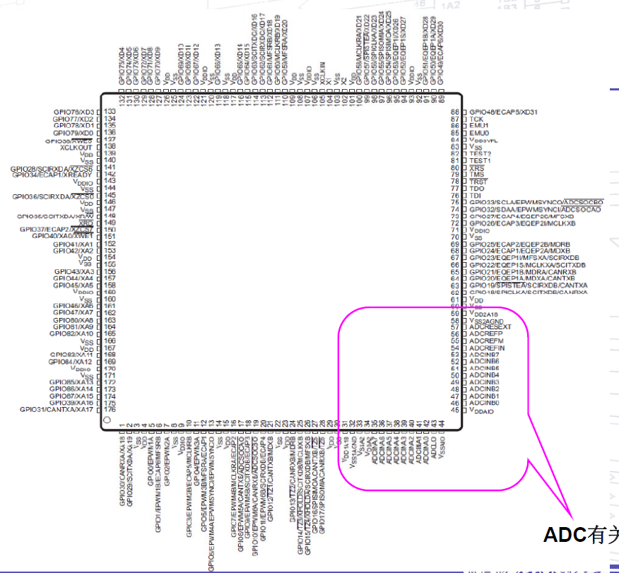
The pin of ADC

Slide 3
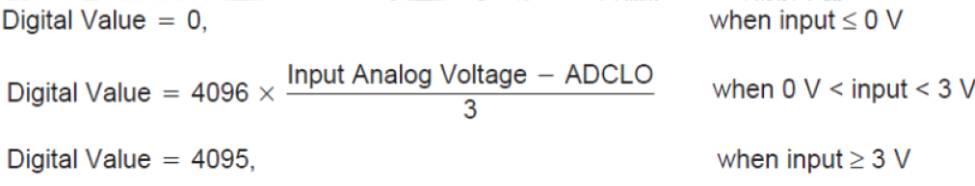
§Features and functions of ADC module：
12-bit ADC core with built-in dual sample-and-hold
Simultaneous sampling or sequential sampling modes
Analog input: 0 V to 3 V

Slide 4
Fast conversion time runs at 12.5 MHz, ADC clock
16-channel, multiplexed inputs
Sequencer can be operated as two independent 8-state sequencers or as one large 16-state sequencer (i.e.,two cascaded 8-state sequencers).
Sixteen result registers to store conversion values

Slide 5
Multiple triggers as sources for the start-of-conversion sequence
– S/W - software immediate start
– ePWM 1-6
– GPIO XINT2
Flexible interrupt control allows interrupt request on every end-of-sequence (EOS) or every other EOS
Sequencer can operate in "start/stop" mode Sample-and-hold (S/H) acquisition time window has separate prescale control

Slide 6
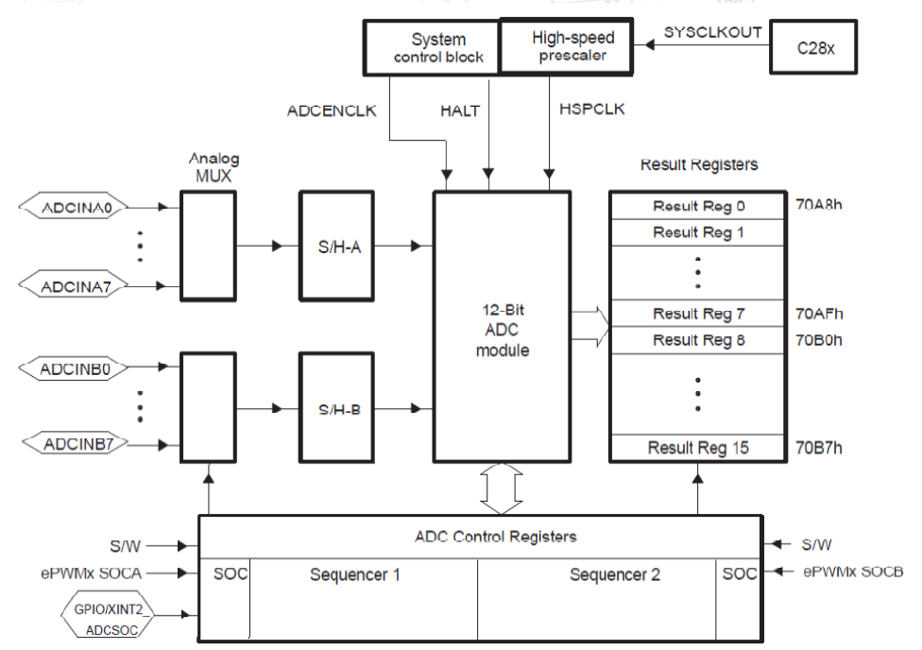
§Block diagram of ADC Module

Slide 7
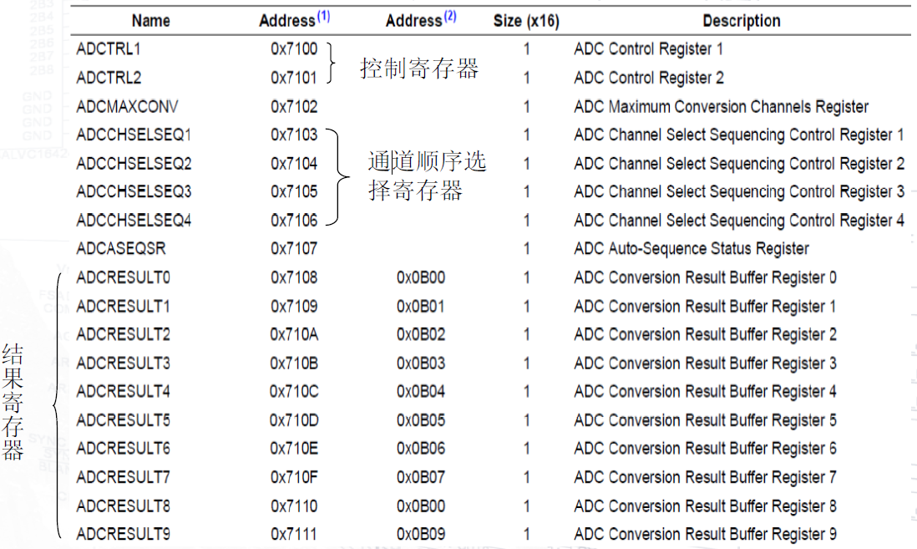
§The relevant register of ADC

Slide 8
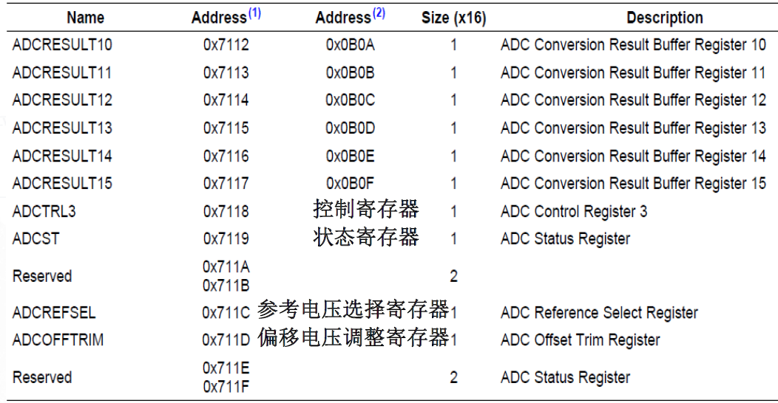

Slide 9
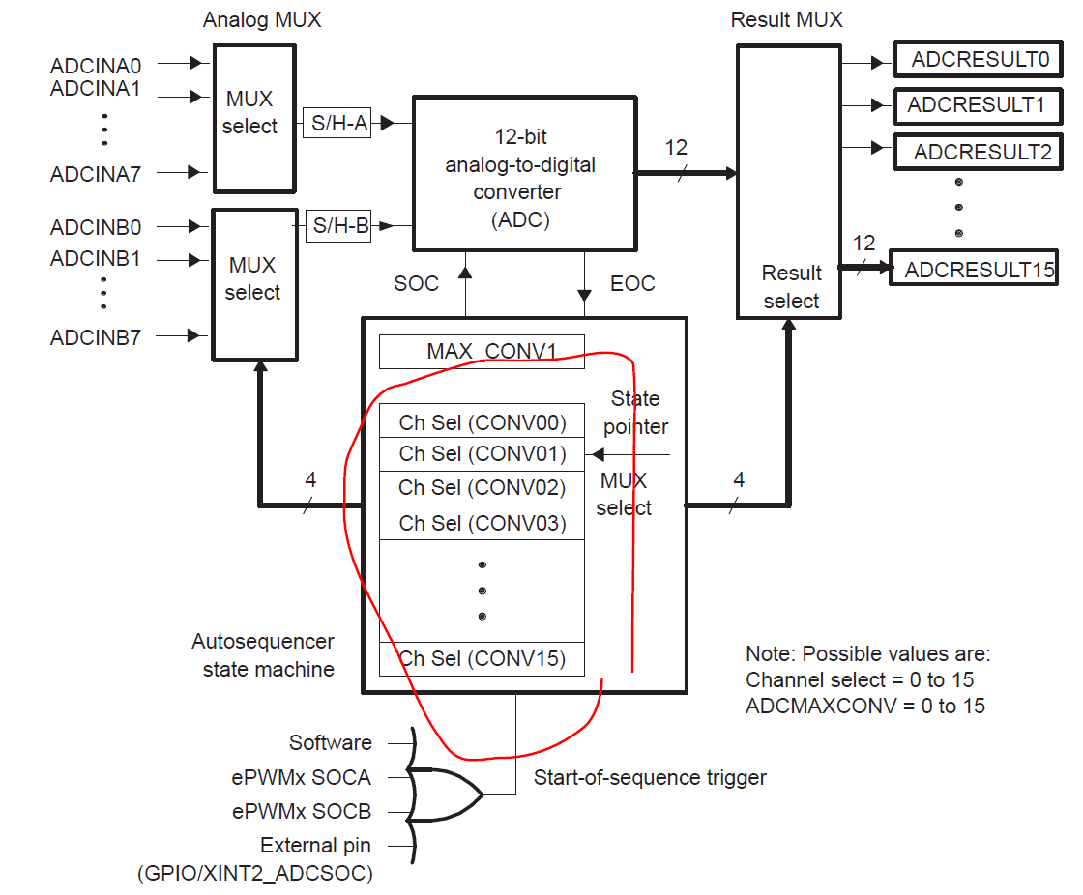
§Autoconversion Sequencer Principle of Operation(According to the Conversion mode)
1. Cascaded Mode

Slide 10
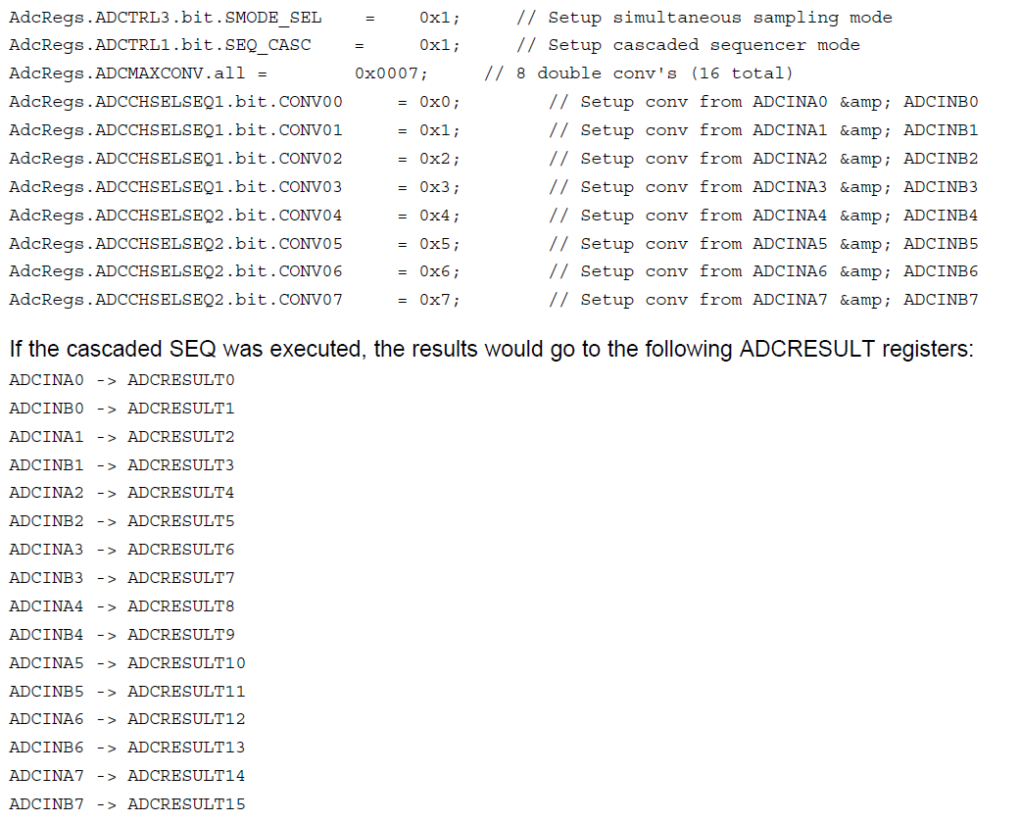
Simultaneous Sampling Cascaded Sequencer Mode Example

Slide 11
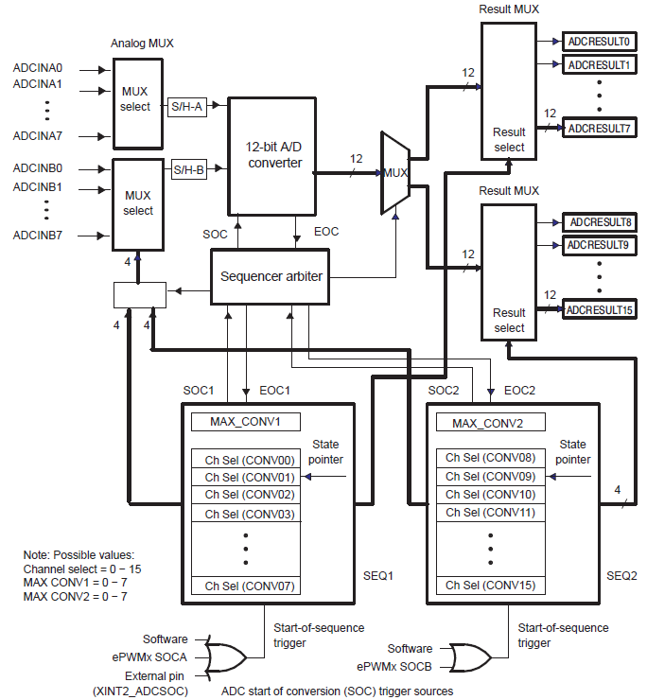
2. Dual Sequencers

Slide 12
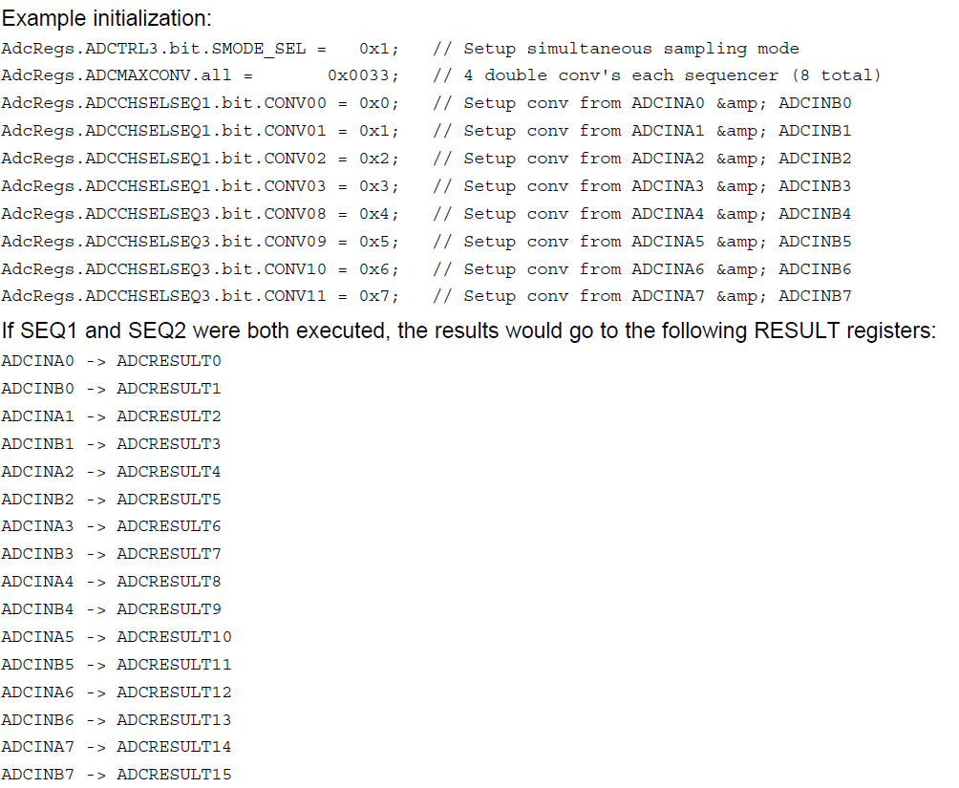
Simultaneous Sampling Dual Sequencer Mode Example

Slide 13
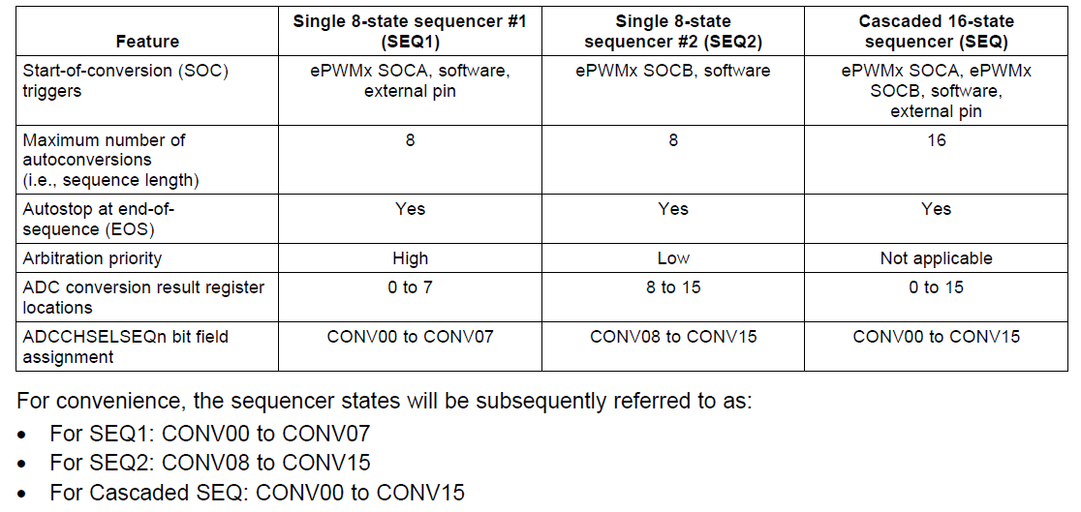
§Comparison of Single and Cascaded Operating Modes

Slide 14
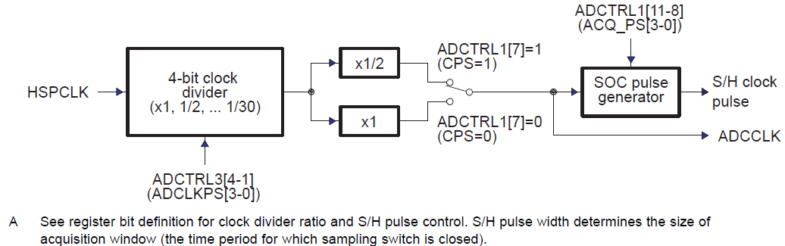
§ADC Clock Prescaler
ADC Core Clock and Sample-and-Hold (S/H) Clock

Slide 15
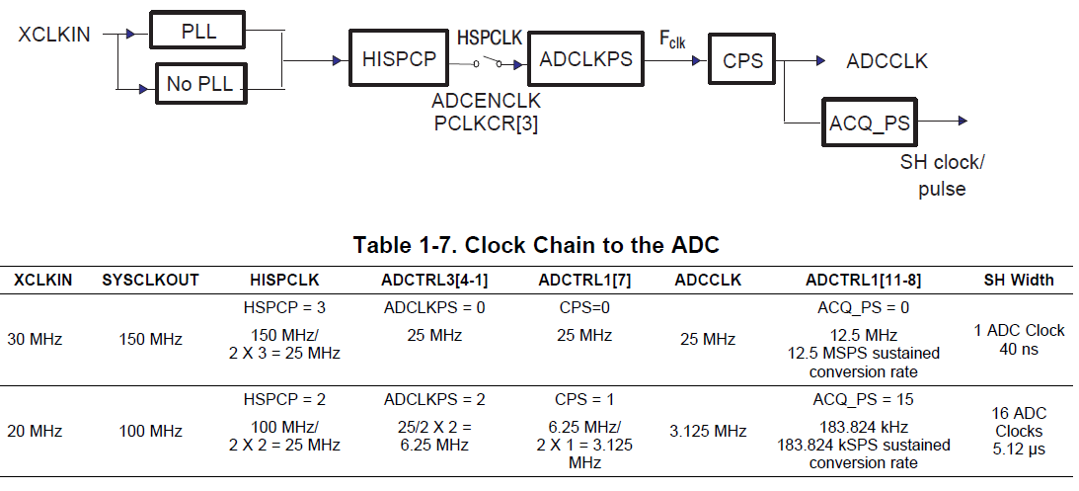
§ADC-module Clock and Sample Rate
Clock Chain to the ADC

Slide 16
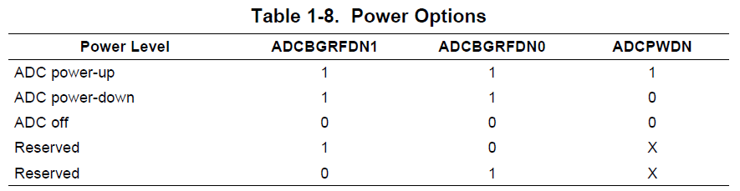
§ Low-power Modes

Slide 17
register
struct ADCTRL1_BITS { // bits description Uint16 rsvd1:4; // 3:0 reserved Uint16 SEQ_CASC:1; // 4 Cascaded sequencer mode Uint16 SEQ_OVRD:1; // 5 Sequencer override Uint16 CONT_RUN:1; // 6 Continuous run Uint16 CPS:1; // 7 ADC core clock pre-scalar ADC Uint16 ACQ_PS:4; // 11:8 Acquisition window size Uint16 SUSMOD:2; // 13:12 Emulation suspend mode Uint16 RESET:1; // 14 ADC reset ADC Uint16 rsvd2:1; // 15 reserved };

Slide 18
struct ADCTRL2_BITS { // bits description Uint16 EPWM_SOCB_SEQ2:1; // 0 EPWM compare B SOC mask for SEQ2 Uint16 rsvd1:1; // 1 reserved Uint16 INT_MOD_SEQ2:1; // 2 SEQ2 Interrupt mode Uint16 INT_ENA_SEQ2:1; // 3 SEQ2 Interrupt enable Uint16 rsvd2:1; // 4 reserved Uint16 SOC_SEQ2:1; // 5 Start of conversion for Uint16 RST_SEQ2:1; // 6 Reset SEQ2 SEQ2复位 Uint16 EXT_SOC_SEQ1:1; // 7 External start of conversion for SEQ1 Uint16 EPWM_SOCA_SEQ1:1; // 8 EPWM compare B SOC mask for SEQ1

Slide 19
Uint16 rsvd3:1; // 9 reserved Uint16 INT_MOD_SEQ1:1; // 10 SEQ1 Interrupt mode Uint16 INT_ENA_SEQ1:1; // 11 SEQ1 Interrupt enable Uint16 rsvd4:1; // 12 reserved Uint16 SOC_SEQ1:1; // 13 Start of conversion trigger for SEQ1 Uint16 RST_SEQ1:1; // 14 Restart sequencer 1 Uint16 EPWM_SOCB_SEQ:1; // 15 EPWM compare B SOC enable };

Slide 20
struct ADCASEQSR_BITS { // bits description Uint16 SEQ1_STATE:4; // 3:0 SEQ1 state Uint16 SEQ2_STATE:3; // 6:4 SEQ2 state Uint16 rsvd1:1; // 7 reserved Uint16 SEQ_CNTR:4; // 11:8 Sequencing counter status Uint16 rsvd2:4; // 15:12 reserved };

Slide 21
The ADC conversion software steps:
1. Initialize the DSP system; 2. Set the PIE the interrupt vector table, 3. Initialize the ADC module; 4. The ADC interrupt entry address into PIE interrupt vector table, open the interrupt; 5. Software to start the ADC conversion; 6. The ADC interrupt; 7. Read the ADC conversion results in the ADC interrupt, software to start the next ADC interrupt.

Slide 22
struct ADCMAXCONV_BITS { // bits description Uint16 MAX_CONV1:4; // 3:0 Max number of conversions Uint16 MAX_CONV2:3; // 6:4 Max number of conversions Uint16 rsvd1:9; // 15:7 reserved };

Slide 23
struct ADCTRL3_BITS { // bits description Uint16 SMODE_SEL:1; // 0 Sampling mode select Uint16 ADCCLKPS:4; // 4:1 ADC core clock divider Uint16 ADCPWDN:1; // 5 ADC powerdown Uint16 ADCBGRFDN:2; // 7:6 ADC bandgap/ref power down Uint16 rsvd1:8; // 15:8 reserved };

Slide 24
struct ADCST_BITS { // bits description Uint16 INT_SEQ1:1; // 0 SEQ1 Interrupt flag Uint16 INT_SEQ2:1; // 1 SEQ2 Interrupt flag Uint16 SEQ1_BSY:1; // 2 SEQ1 busy status Uint16 SEQ2_BSY:1; // 3 SEQ2 busy status Uint16 INT_SEQ1_CLR:1; // 4 SEQ1 Interrupt clear Uint16 INT_SEQ2_CLR:1; // 5 SEQ2 Interrupt clear Uint16 EOS_BUF1:1; // 6 End of sequence buffer1 Uint16 EOS_BUF2:1; // 7 End of sequence buffer2 Uint16 rsvd1:8; // 15:8 reserved };

Slide 25
struct ADCREFSEL_BITS { // bits description Uint16 rsvd1:14; // 13:0 reserved Uint16 REF_SEL:2; // 15:14 Reference select };
struct ADCOFFTRIM_BITS{ // bits description int16 OFFSET_TRIM:9; // 8:0 Offset Trim Uint16 rsvd1:7; // 15:9 reserved };

