Slide 1
Impedance Pneumography with ADS1298R
7/30/2012

Slide 2
Components on the ADS1298RECG-FE Board
Subhead text here

Slide 3
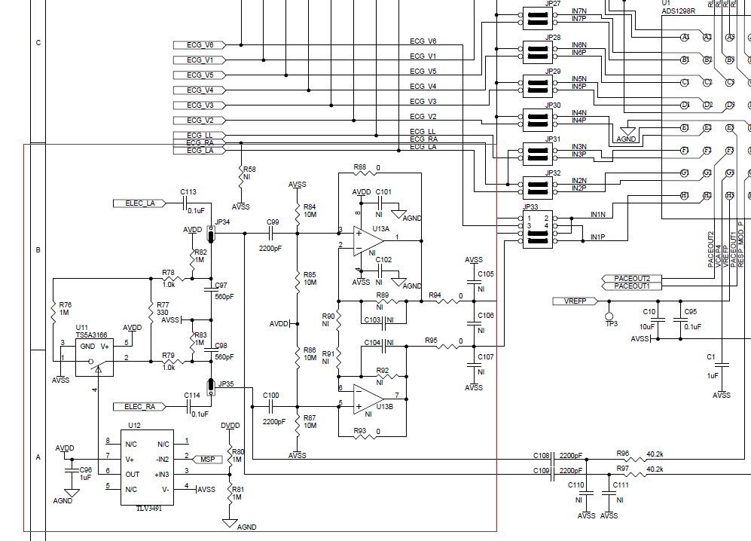
Portion of ADS1298RECG-FE Schematic
Switching in 1M impedance in parallel

Slide 4
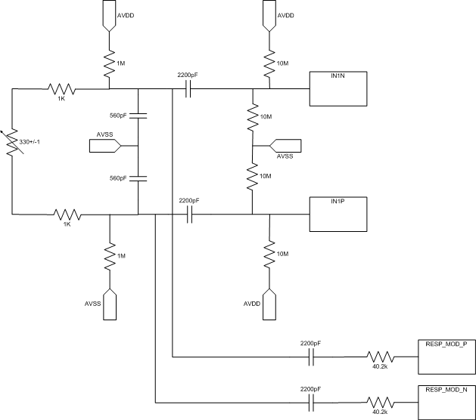
Schematic Simplified
Varies 0.11ohm
From Switcher in previous slide

Slide 5
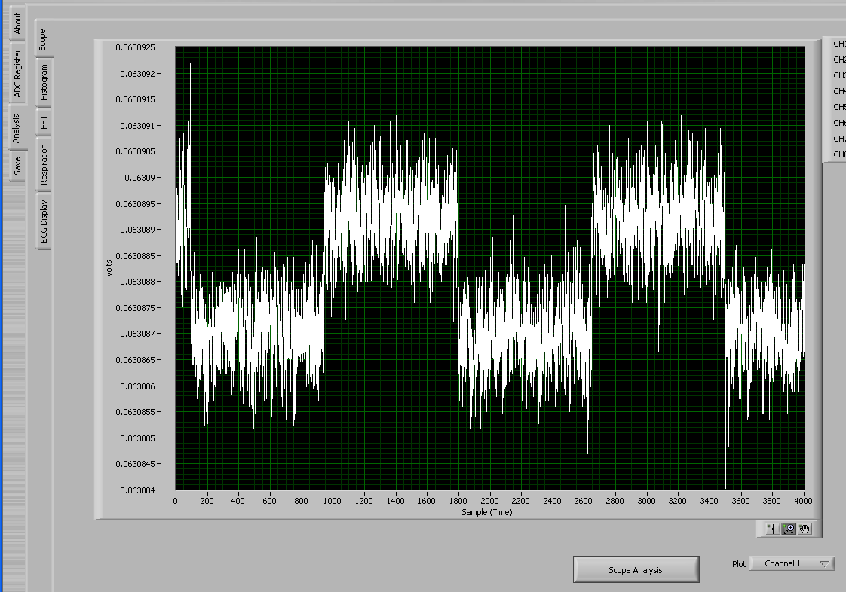
Conversion Results

Slide 6
Calculating Impedance
Subhead text here

Slide 7

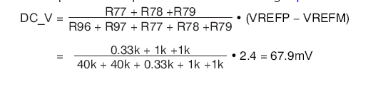
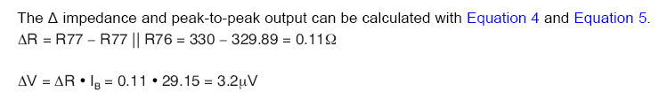
Equations From UG

Slide 8
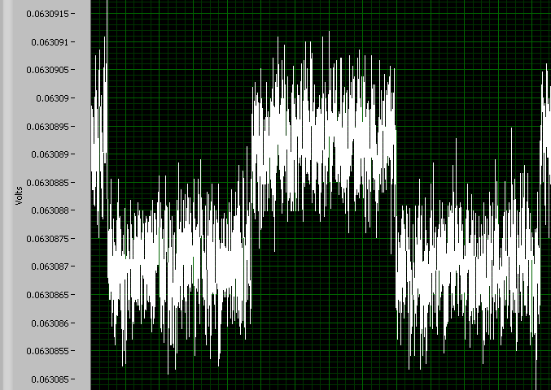
Conversion Results – A closer look
Estimated from Graph

