Slide 1
High Speed Layout Considerations
Op Amp
ADC
DAC
Clock

Slide 2
Agenda
General Considerations
Models: Resistors, Capacitors, Inductors, and Circuit Board
High Speed Op Amp Layout
Input and output considerations
Signal routing
Bypass capacitors
Layout examples
High Speed ADC/DAC Design and Layout
Input and output considerations
Bypass Capacitors
Splitting the Ground Plane
Filtering clocks to reduce jitter
High Speed Clock Layout Guidelines
Coupling (Interference or Cross Talk)
Power Supply Filtering
Power Supply Bypassing & Grounding
Layout Tricks to Reduce EMI

Slide 3
High Speed Layout Key General Considerations
Key points
Use short direct signal routing
Control parasitic capacitance
Use adequate local bypass capacitors
Manage ground planes
Avoid ground loops
We will discuss each of these with regard to
Op Amp, ADC, DAC, and Clock

Slide 4
Capacitor Models
Ideal Model
Better Model
Best Model
Notes:
Capacitors are utilized extensively within most systems. They are used for power-supply bypassing, AC-coupling, integrators, filtering, etc. But, capacitors are not perfect components. They have elements within them that limit their usefulness. The most pronounced elements are the true capacitance, the equivalent series resistance (ESR), and the equivalent series inductance (ESL). It is the ESL which causes the capacitor to stop behaving like a true capacitor at high frequencies as the impedance starts to increase rather than keep decreasing.
This ESL gets compounded when leaded capacitors are utilized rather than surface mount technology (SMT) capacitors. As the lead inductance increases, the high frequency impedance limitation also increases. This increase is directly proportional to the amount of lead inductance increase. For example, if the lead inductance of the example above increased from 1nH to 4nH by using a leaded ceramic capacitor, the impedance due to ESL increases by a factor of 4. The resonant frequency is also reduced by the square root of the increase, or by a factor of 2 for this example from 50MHz to 25MHz. It should be pretty clear that avoiding the use of any leaded device should be adhered to for high frequency designs.
It should also be noted that when multiple capacitors are placed in parallel, resonances can occur which cause a relatively high impedance to occur. If these resonances occur at the signal frequency or clock frequency, the effect of the capacitor is essentially nullified due to the high impedance at this resonant frequency. Sometimes adding a resistor in series should be done with one of the capacitors to dampen the resonance effect. Additionally, it has been found that sometimes simply removing one of the parallel capacitors actually can improve the system as the resonance is eliminated.

Slide 5
Inductor Models
Better Model
Best Model
Ideal Model
Notes:
Just as capacitors have other elements within them, inductors also have other elements. This includes the DC resistance (DCR) and the interwinding capacitance (IWC). Just as the capacitor stops behaving like a capacitor at high frequencies, an inductor stops behaving like an inductor at high frequencies. At the transition point the impedance will have a resonance causing a substantial rise in the impedance of the inductor. This resonance can cause issues in some situations and should not be ignored.

Slide 6
Resistor Models
Ideal Model
Better Model
Best Model
Using SMT resistors minimizes lead inductance to the point that PCB traces are the limiting factor
SMT packages also minimize the capacitance between the leads such that this parasitic is usually insignificant
Note that resistor packs CAN have significant lead inductance and resistor-to-resistor capacitance, so choose wisely based on the application
Resistors will have temperature coefficients, 200PPM is common, but higher precision is available
AVOID Wire-wound resistors and leaded resistors for high speed applications due to their large inductance
Notes:
Resistors also have elements which make them have a frequency dependence characteristic. The capacitance is usually caused by the resistor package and the PCB mounting pads. The inductance is caused by the resistor leads and the PCB trace length.
In general, these extra elements can be ignored if the resistance value is relatively low – below 1k-ohm for example. But, they cannot be ignored if leaded resistors or wire wound resistors are utilized.

Slide 7
Remember Current Return Path
I_{O} = total signal current (A)
h = PCB thickness (cm)
D = distance from center of trace (cm)
j(A/cm)
D
Return Current Flow is directly below the signal trace
Must have Solid return path (i.e. Solid Ground Plane) under the signal trace for lowest impedance.
Do not route high speed signals near edge of board; especially clocks
Notes:
Current density is the concentration of current flowing through a conductor. This is especially important when looking at return currents.
One thing that many people forget about is for a current to flow out to a point, there MUST be a return path or else current will Not flow. Since there is a current flow, then the return current flow will find a way back to its’ source one way or another. Return current density is highest directly under (or over) the signal trace it was sourced from. Even if a solid ground plane is used, the concentration of current flow will still be adjacent to the signal source trace.

Slide 8
PCB Components
Component: Microstrip Copper Traces
Purpose: Interconnect two or more points
Problem: Inductance and Capacitance
x = length of trace (cm)
w = width of trace (cm)
h = thickness of board (cm)
t = thickness of trace (cm)
e_{r} = PCB dielectric constant (FR-4 ≈ 4.5)
0.8mm (0.031”) trace on 0.8mm (0.031”)
thick PCB (FR-4) has:
≈ 4nH and 0.8pF per cm
≈ 10nH and 2.0pF per inch
Use Microstrip design to
control impedance
Notes:
The PCB consists of layers of metal and insulator and can consist of several layers. Examining some common elements of a PCB will help the reader understand what many people believe is “Black Magic”.
Copper traces are utilized to connect one element node to another node. The shape of these traces determine one very important aspect of a PCB – the characteristic inductance, capacitance, and ultimately the characteristic impedance. Resistance is generally ignored as most designs do not carry more than several mA of current and the results can often be negligible.
Characteristic impedance (Z₀) was covered previously, so this will not be discussed here. But what is important is the inductance and capacitance as determined by the trace dimensions and the PCB dielectric (ε_{r}). FR-4, probably the most common PCB material used by manufacturers today and has a permeability range normally from 4.0 to 5.0, but 4.5 is often used as a typical permeability. Check with the PCB manufacturer to determine what material they utilize and the associated permeability.
NOTE: Reference the book entitled “High-Speed Digital Design – A Handbook for Black Magic” written by Howard Johnson and Martin Graham, 1993, Prentice-Hall, ISBN 0-13-395724-1.

Slide 9
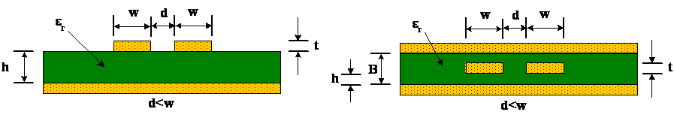
Impedance of Differential Traces
MICROSTRIP
Most Commonly Used
Less Propagation Delay
May Radiate more RF
Only requires 2 Layers
STRIPLINE
More Propagation Delay
Better Noise Immunity/Radiation
Requires at least 3 Layers
May be harder to control Z₀
Notes:
Just like single traces, differential traces also can have a characteristic impedance dictated by the inductance and capacitance. Keeping the differential traces close together is highly desirable as it minimizes noise injection problems and minimizes the radiated electromagnetic field.

Slide 10
PCB Components
Component: Copper Planes
Purpose: Used For Ground Planes and Power Planes
Problem: Stray Capacitance on Signal Traces
Benefit: At high frequencies (1G+) Adds Bypass Capacitance with low Inductance
h = separation between planes (cm)
A = area of common planes = l*w (cm²)
e_{r} = PCB dielectric constant (FR-4 ≈ 4.5)
0.8mm (0.031”) thick PCB (FR-4) has:
≈ 0.5pF per cm²
≈ 32.7pF per inch²
Notes:
Copper planes are typically found when power planes and ground planes are utilized. Planes make an excellent high frequency capacitor and can often be utilized for high frequency bypassing in complement with traditional capacitors.
The use of a solid ground plane is generally preferred over a grid plane. A solid plane minimizes inductance to the absolute minimum which is a desirable trait for high speed signals – which includes both Analog and Digital signals. But, as will be discussed later, this plane can cause capacitance problems to sensitive nodes of the circuit. Be aware of all attributes of the circuit and do not blindly use planes everywhere.
A side benefit of a solid plane is it becomes a very good thermal conductor and can act as a heat sink to keep thermal levels of all devices minimized. But on the flip side, temperature sensitive components may not want to have the ground plane nearby due to this heat spreading.

Slide 11
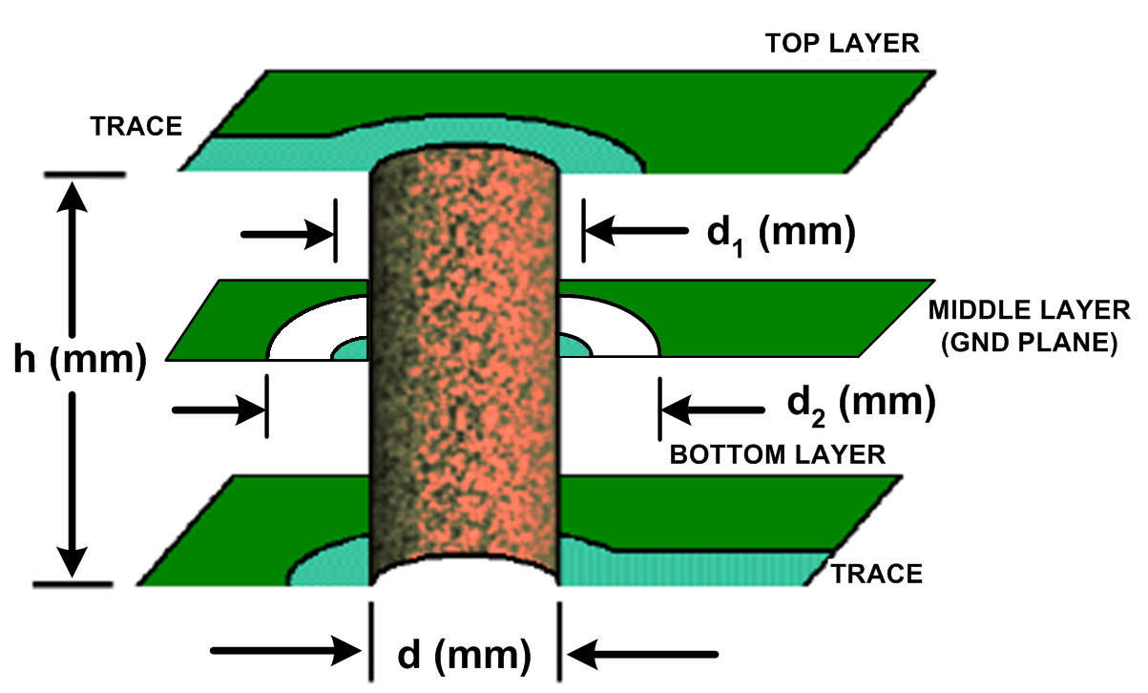
PCB Components
Component: Vias
Purpose: Interconnect traces on different layers
Problem: Inductance and Capacitance
0.4mm (0.0157”) via with 1.6mm (0.063”) thick PCB has ≈ 1.2nH
1.6mm (0.063”) Clearance hole around 0.8mm (0.031”) pad on FR-4 has ≈ 0.4pF
e_{r} = PCB dielectric constant (FR-4 ≈ 4.5)
Notes:
Vias are utilized to simplify trace routing around other components or when there is a high density of interconnections to be made (i.e. BGA packages). Just as a PCB trace had inductance and capacitance, so to does a via. Generally these elements are ignored as the length of the vias are typically very small relative to the rest of the trace. But, this Can cause issues if the signals are very high frequency (>100MHz) or have energy / harmonics at high frequencies.
The easiest way to minimize problems of a via is to simply not use them with signal traces. At the very least it should be minimized. If vias must be used, there are other issues to worry about that will be discussed later.

Slide 12
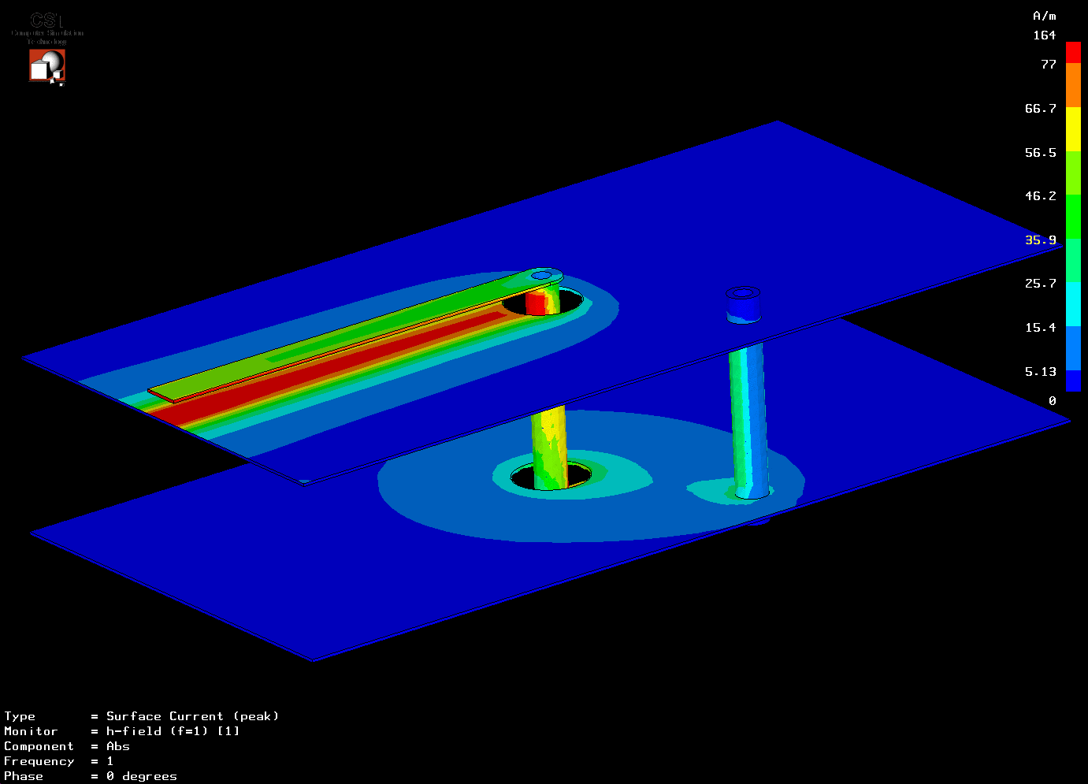
Taking a Look at Vias
Must have Return Path Vias next to Signal Path Vias.
Notice Large Current Density Area flow in return path.
Will have a change in impedance with this configuration.
2-Layer PCB showing Current Density of PCB trace and Single Return Path Via.
Notes:
Now let’s take a look at vias once again. We know that the return current density follows the trace path directly under the signal trace. But what happens when the signal trace goes through a via? How will the return current flow form the bottom ground layer to the top ground layer? The current WILL find a way to do this, one way or another and you may not like the path it chooses.
To minimize this return current flow path problem, every time a via is utilized, a ground via should also be utilized next to the signal via. This allows the return current to flow near the signal current flow. But, the signal via flows through essentially a cylinder that wants to have the return current flow 360° around it. If a single ground via is used for the return current, the characteristic impedance of the trace will be altered slightly and may be an issue.

Slide 13
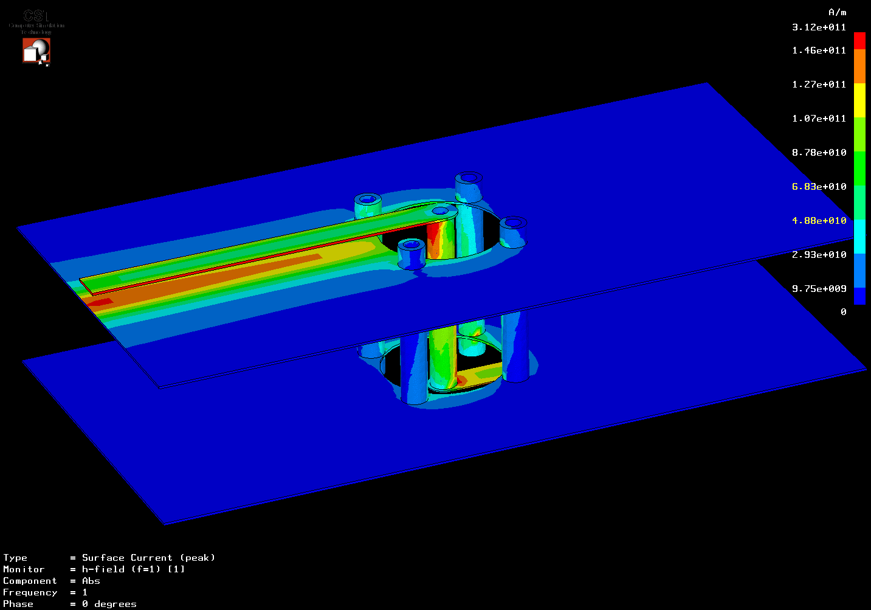
Controlled Impedance Vias
Better Solution is to add Multiple Return Path Vias.
Notice minimal Current Density Area Flow at vias.
Improved impedance – reduces reflections.
2-Layer PCB showing Current Density of PCB trace and Multiple Return Path Vias.
Notes:
The obvious solution to help maintain the characteristic impedance of the via is to use multiple ground vias around the signal via. Using 4-ground vias next to the signal via shows very good results and should be utilized if possible.

Slide 14
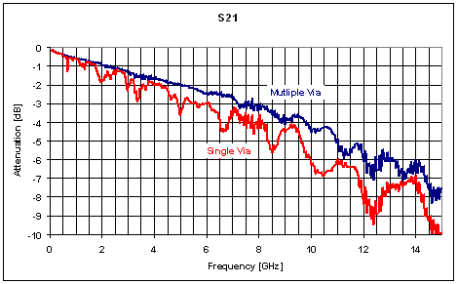
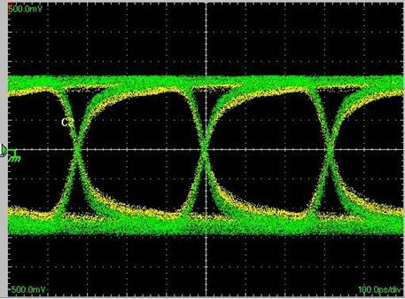
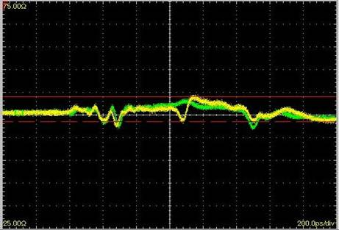
Controlled Impedance Vias
S21 Results
Green = Multiple Vias
Yellow = 1 Via
SMA Connector
Via(s)
Note Faster Rise Time w/Multiple Vias
3.125-Gbps PBRS Eye Pattern on 2.8” (7.1cm) PCB trace
SMA Connector w/50W Term.
TDR Pulse
Green = Multiple Vias
Yellow = 1 Via
Notes:
These graphs show the difference between a single ground via and the 4-ground via configuration. These tests are real results form a test PCB constructed to illustrate the differences between the two scenarios.
As these results show, using the 4-via configuration widens the PBRS (pseudorandom-bit-stream) eye pattern indicating a better high frequency system. It also improves the S21 (input reflection) considerably, and a TDR (time-domain-reflectometry) pulse shows improved impedance matching through the via.
For more information see the October 2, 2003 article in EDN magazine entitled “Designing Controlled-Impedance Vias” written by Thomas Neu, Texas Instruments.

Slide 15
Agenda
General Considerations
Models: Resistors, Capacitors, Inductors, and Circuit Board
High Speed Op Amp Layout
Input and output considerations
Signal routing
Bypass capacitors
Layout examples
High Speed ADC/DAC Design and Layout
Input and output considerations
Bypass Capacitors
Splitting the Ground Plane
Filtering clocks to reduce jitter
High Speed Clock Layout Guidelines
Coupling (Interference or Cross Talk)
Power Supply Filtering
Power Supply Bypassing & Grounding
Layout Tricks to Reduce EMI

Slide 16
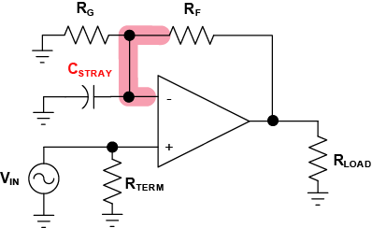
(-) Input Capacitance
Inverting input node of an op amp is sensitive to stray capacitance (C_{STRAY})
R_{F},R_{G} and C_{STRAY} add a zero to the noise gain which can lead to instability
As Little as 1pF of C_{STRAY} can cause stability problems
inverting input Node includes the entire trace up to the placement of R_{F}, R_{G}, and any other component on the inverting input
C_{STRAY} modifies the noise gain by adding a zero
Notes:
As discussed, having stray capacitance at the wrong place can cause serious concerns. Having stray capacitance at the inverting node of an amplifier is one of those places. The stray capacitance causes a zero in the transfer function. If the zero intersects the amplifier’s open-loop response at a 40-dB/decade rate of closure, this will cause the amplifier to be unstable and it will oscillate. Having as little as 1-pF can cause problems with the system.
Remember that the inverting input node includes everything connected to it up to the point there is some resistance or impedance of reasonable value (ie. >50-ohms).

Slide 17
Inverting Input Capacitance is Bad
Bode Plot
A_{OL}
Stability is determined by rate of closure between open loop gain and feedback factor
-
20
dB
/
dec
No issue if the zero after crossover point
Noise Gain
with capacitance on
inverting input
Rate of closure = 40dB/dec
≈ 360˚ Phase shift in loop
Noise Gain
Rate of closure = 20dB/dec = Stable
Ideal Noise Gain
Frequency in Hz
Notes:
The diagram shows an op amp that is stable with pure resistive feedback, but is not stable with capacitance added at the negative input with zero causing rate of closer greater than 20dB/dec.

Slide 18
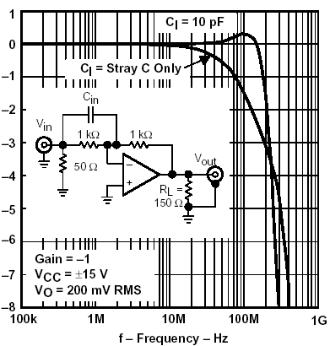
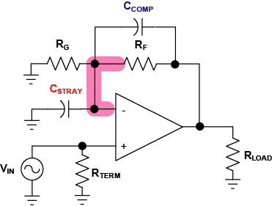
Minimizing Stray C at (-) Input
Solutions:
Eliminate Ground Planes and Power Planes under and near the inverting input (-)
Shorten trace by moving components closer to the inverting input (-)
Reduce R_{F} and R_{G} values
Increase noise gain of op amp
Place Compensation Capacitor Across R_{F}
Use Inverting Configuration
Increase Noise Gain
Inverting Configuration
Feedback Cap Compensation
Notes:
There are several ways to minimize the effects of stray capacitance at the inverting input node of an amplifier. These are illustrated above.
The fundamental task at hand to make the amplifier stable once again is to reduce the intersection point of the noise gain and the open-loop response to as close to a 20-dB/decade rate of closure as possible. Even if this is close, this should be sufficient to create a stable system.
For more information on some of these techniques, refer to the TI Application Report entitled “Effect of Parasitic Capacitance in Op Amp Circuits”, SLOA013.

Slide 19
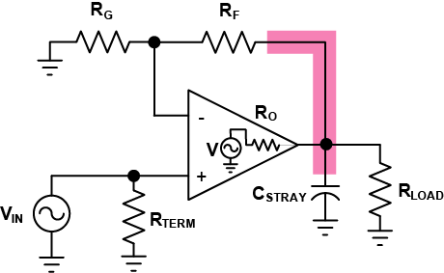
Output Capacitance
Op amps are sensitive to capacitance on output (C_{STRAY})
Real op amps have output Impedance (R_{O})
R_{O} and C_{STRAY} create another pole in the open loop gain which can lead to instability
Assuming:
R_{O} << R_{F}, R_{LOAD}
C_{STRAY} modifies the open loop gain by adding another pole
Notes:
Stray capacitance at the output of high speed amplifier can also cause the amplifier to become unstable. This is caused by the pole formed by the amplifier's internal resistance and the capacitive loading. This RC network causes excess phase shift in the loop gain of the amplifier.
Just like the stray capacitance at the inverting input node, stability is dictated by the noise gain of the amplifier intersecting the open-loop gain and should be as close as possible to the 20-dB/decade rate of closure as possible.

Slide 20
Output Capacitance is Bad
Bode Plot
Ideal Open Loop Gain
A_{OL}
Stability is determined by rate of closure between open loop gain and feedback factor
Open Loop Gain with
output capacitance
-
20
dB
/
dec
Rate of closure = 40dB/dec
≈ 360˚ Phase shift in loop
No issue if the pole after crossover point
Noise Gain
Rate of closure = 20dB/dec = Stable
Frequency in Hz
Notes:
The diagram shows an op amp that is stable with pure resistive feedback and no output capacitance, but is not stable with capacitance added at the output causing rate of closer greater than 20dB/dec.

Slide 21
Minimizing Effects of Output Capacitance
Solutions:
Eliminate Ground Planes and Power Planes under output node
Shorten traces by moving components closer to output pin – especially Series Matching R
Use series output resistor
Increase Noise Gain of System
Use Feedback Compensation
Do not use for CFB
Adding Series R for Isolation
Increasing Noise Gain Only
Feedback Compensation
Notes:
Solving the stability of the amplifier with a capacitive load can be relatively simple. Most common ways are to isolate the capacitive load by some real resistance. Another way to make the amplifier stable is to increase the gain of the amplifier, or increasing the noise gain of the amplifier, which both attempt to reduce the rate of closure to the 20-dB/decade goal for stability.

Slide 22
Input and Output Trace Impedance
Match impedance of input transmission line
Match impedance of output transmission line
x = length of trace (cm)
w = width of trace (cm)
h = height of trace (cm)
t = thickness of trace (cm)
e_{r} = PCB Permeability (FR-4 ≈ 4.5)
0.8mm (0.031”) trace on 0.8mm (0.031”)
thick PCB (FR-4) has:
≈ 4nH and 0.8pF per cm
≈ 10nH and 2.0pF per inch
Notes:
The PCB consists of layers of metal and insulator and can consist of several layers. Examining some common elements of a PCB will help the reader understand what many people believe is “Black Magic”.
Copper traces are utilized to connect one element node to another node. The shape of these traces determine one very important aspect of a PCB – the characteristic inductance, capacitance, and ultimately the characteristic impedance. Resistance is generally ignored as most designs do not carry more than several mA of current and the results can often be negligible.
Characteristic impedance (Z₀) was covered previously, so this will not be discussed here. But what is important is the inductance and capacitance as determined by the trace dimensions and the PCB dielectric (ε_{r}). FR-4, probably the most common PCB material used by manufacturers today and has a permeability range normally from 4.0 to 5.0, but 4.5 is often used as a typical permeability. Check with the PCB manufacturer to determine what material they utilize and the associated permeability.
NOTE: Reference the book entitled “High-Speed Digital Design – A Handbook for Black Magic” written by Howard Johnson and Martin Graham, 1993, Prentice-Hall, ISBN 0-13-395724-1.

Slide 23
Input Signal Routing
Use direct routing and avoid loops
WORST
Large Current Loop + Discontinuous GND Plane
BAD
Large Current Loop
BETTER
Reduced Current Loop
BEST
Minimum Current Loop
Notes:
As just discussed, the lowest impedance path of a high speed signal is directly under a PCB trace. This minimizes the current loop area substantially. The “worst” case scenario shows a long winding trace creates a large current loop area which is made even worse by the break in the ground plane. The obvious issue with this is the ground plane is often used as a reference point for other parts of the system. If the current flow density is high near one of these reference points, this can (and often does) cause noise to occur in the circuit and often propagates throughout the entire signal flow.
As the bad layout shows, also shows a long winding trace that does not follow the “shortest distance between two points is a straight line” method. The better layout minimizes the distance while reducing the current loop area. But, the best way to do the layout is to place the receiver part as close as possible to the input. This easily is the smallest loop area and delays in the signal path are drastically reduced. A key benefit of this method is the reference ground point for other circuits are kept “quiet” and should have no contribution from the undesirable current flow.
This also minimizes the need for adhering to strict strip-line techniques as the signal path acts as a lumped circuit and not a distributed circuit. A lumped circuit typically has rising edges much less than the delay time of the transmission line, thus minimizing issues. The construction of transmission lines naturally keeps the source and return currents close to each other. This helps minimize current loop area and drastically reduces noise along the path on the PCB and also EMI.

Slide 24
Output Signal Routing
Use direct routing and avoid loops
Problems:
Long winding path causing large current loop area.
HF bypass caps are placed too far away from amplifier and GND. Inductance eliminates benefit of bypass caps.
GND of bypass caps are too far away from amplifier output.
Series Resistor (RSOURCE) is too far away from the amplifier. Causes C-loading on amplifier and lack of a transmission line.
Single GND point on connector
Notes:
Looking at the Output current path shows the exact same phenomenon as the input current flow – the return current path will follow the signal trace path wherever it may go. One issue that is often overlooked is where does this return current flow once it reaches the output of the driver? As we all know, current must close the loop or else there is no current flow.
In the example above, the return current flows through the bypass capacitors and back into the power supply lines. Now we see that the bypass capacitors are part of the loop and will have impact on the performance of the system. Obviously it makes sense to place the capacitors as close as possible to the driver power supply pins and the actual output trace.
Another issue with the above system is the source resistance is very far away from the driver. As will be discussed later, this is a bad thing for the driver and may cause stability problems. Additionally, the transmission line typically starts at the load side of the resistor. This system may have a undefined characteristic impedance that may cause reflection concerns.
The last concern is the single ground connection point of the connector. This may cause a significant impedance mismatch in the return current flow.

Slide 25
Output Signal Routing
Use direct routing and avoid loops
Solutions:
Amplifier is next to Connector minimizing loop area.
HF bypass caps are now placed next to amplifier power supply pins and has short GND connection.
GND of bypass caps near amplifier output – but not too close to cause C-loading issues.
Source Resistance is next to amplifier output.
Multiple GND points on connector.
Notes:
As seen before, the simple solution is to simply minimize the current flow area as much as possible. Easily solved by moving the connector and the driver next to each other. The bypass caps are now very close to the driver power supply pins and have very short trace lengths that are near the driver output pin. The series resistor that matches the transmission line characteristic impedance is placed very close to the driver. Additionally the connector has multiple ground connection points to minimize impedance issues.

Slide 26
Differential Output Signal Routing From 2 Amplifiers
Guidelines
Minimize Loop Area on Driver Side.
Utilize a single Capacitor between opposite amplifier supplies as this should be the main current flow. Adding this Capacitor can reduce 2nd-Order Distortion by 6 to 10dB!
Use bypass caps to GND at a mid-point to handle stray-C return path currents but do not disrupt differential current flow.
Use direct routing and avoid loops
Notes:
Using two individual amplifiers in a differential drive configuration, such as a ADSL line driver, also must follow the same concepts discussed previously. The use of a transformer helps isolate the driver-side current flow and the line side current flow. Since the drivers’ outputs are differential, there must be a differential current flow from one driver to the other. The bypass capacitors allow this to occur and should follow the concepts previously discussed. The only difference here is we want to force the current to flow through a bypass capacitor connected from the positive supply of one driver to the negative supply of the other driver.
The use of bypass capacitors to the ground plane will still be required, as will be discussed later. To make sure the current does NOT flow into the ground, place these capacitors symmetrically to each other and connect the ground at the midpoint of the capacitors. The differential current flow should have no reason to go into the ground plane. Combined with the single capacitor across the supplies, this configuration can reduce even-order harmonics by 6 to 12dB.
Although not shown above, there will be interwinding capacitance across the transformer windings. There must be a way for high frequency current flowing through this capacitance to return back to the source, or else there can be issues.

Slide 27
Differential Output Signal Routing From FDA
Guidelines
Minimize Loop Area on Driver Side.
Utilize a single Capacitor between opposite amplifier supplies as this should be the main current flow.
Use bypass caps to GND at a mid-point to handle stray-C return path currents but do not disrupt differential current flow.
Filter Cap should allow for small Loop Areas – including “kick-back” current flow.
Use direct routing and avoid loops
Notes:
A fully differential amplifier follows essentially the same concepts as the single-ended differential driver. The only difference is the two outputs are in the same package. But, the bypass capacitors should follow the same principles as mentioned before – one capacitor form the positive supply to the negative supple, and the two bypass capacitors to ground should optimally be placed symmetrically to each other and connected to ground at the midpoint.
One of the most common uses for a fully differential amplifier is to drive an ADC. When doing this, pay attention to the current flows around the amplifier and the ADC (caused by the ADC’s internal capacitor). Keep the paths as symmetrical as possible.

Slide 28
Routing Differential Traces
Keep differential traces close together to keep noise injection as a Common-Mode signal which is rejected differentially
Route differential traces around obstacles together, or move obstacle
Keep trace lengths the exact same length to keep delays equal
Notes:
When routing differential traces, they should always be routed together (side-by-side). This keeps any noise injection into the signal a true common-mode noise which gets rejected by the receiver. If noise only gets into one channel and not the other, the amount of rejection is minimal at best.
Additionally, the lengths of both traces should be kept the same length. Otherwise the signals can arrive at the receiver at different times and cause performance issues. This is especially true for very fast switching digital signals and very high analog signals (>1-GHz).

Slide 29
Power Supply Bypass Capacitors
Simplified THS3001 schematic
All stages interconnect through the power supplies
Notes:
When we think about the internal operation of a complex, high speed, amplifier, we usually have these magical Vcc and Vee looking out the top and bottom of the schematic that we assume provide a current path for all the bias and load currents – with no interstage coupling. In simulation, this supply is ideal so AC current coming out of one stage is absorbed (ideally) into this perfect supply voltage and nothing finds its way back into earlier stages – an example schematic (from the +/-15V THS3001 high speed current feedback op amp data sheet) is shown.

Slide 30
Power supply parasitic elements
Our general recommendations for high speed op amp bypass capacitors are:
Place a 2.2µF to 10µF capacitor within 2” from device. It can be shared among other op amps
Use separate 0.01µF to 0.1µF as close as possible to each supply pin
Typical capacitor impedance
versus frequency curves
Notes:
One of the goals in laying the board is to emulate a good low impedance to high frequencies looking out of the supply pins. This will break these internal feedback loops through the supply bus. If a high frequency load current can generate an internal supply voltage wiggle (due to an inductive source looking out the supply) that will get back into the earlier stages to the extent that the PSRR is less than ideal – and in fact PSRR decreases with increasing frequency.
Supply decoupling caps. all go self-resonant at some frequency. Above that frequency, they will go inductive and show an increasing source impedance to the load current. A 3nH series inductance is shown in the next slide and where that implies self resonance for a 2.2µF (at 2Mhz) and for a .01µF (at 30Mhz) .
We essentially want that first parasitic inductance looking out of the supply pins to be as low as possible as well as the self resonance frequency of that first, lower valued, decoupling cap to be as high as possible in frequency.
This is where the recommendation that high speed amplifiers have a shared 2.2µF but separate .01µF at each supply pin as close as possible – to break these internal feedback paths at higher frequencies along the supply bus.

Slide 31
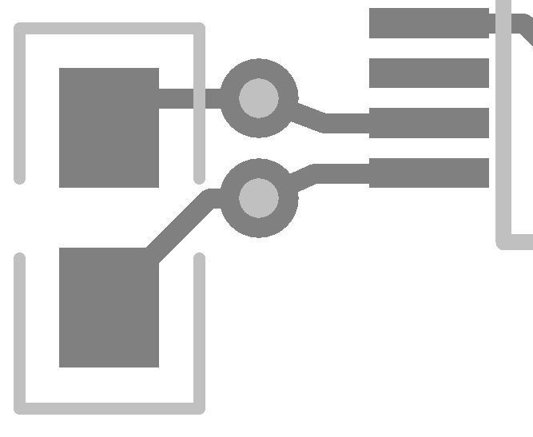
Bypass Capacitor Routing
DO NOT have vias between bypass caps and active device – Visualize the high frequency current flow !!!
Ensure Bypass caps are on same layer as active component for best results.
Route vias into the bypass caps and then into the active component.
The more vias the better.
The wider the traces the better.
The closer the better (<0.5cm, <0.2”)
Length to Width should not exceed 3:1
Poor Bypassing
Good Bypassing
Notes:
Now that the characteristics of a capacitor are known and the proper one has been selected, the next thing to do is place it on the PCB. For bypass capacitors this can be a concern if done without taking time to think about the high frequency implications of routing. The rule of thumb of placing capacitors as close as possible to the IC power input pins should be adhered to. Otherwise there can be too much inductance and a resonance effect can take place along with the straight forward impedance increase due to the inductance.
Typically the power and ground are on inner layers of the PCB and must be brought up to the IC level by vias. As we have learned, the more vias utilized, the lower the impedance. So using multiple vias is highly recommended for BOTH power supply voltage connection and Ground connection.
Additionally, the vias should run into the capacitor and then into the IC. This forces the current flow into the capacitor. Placing vias directly on the capacitor mounting pads can be an effective way to minimize routing area and still achieve the current flow routing.

Slide 32
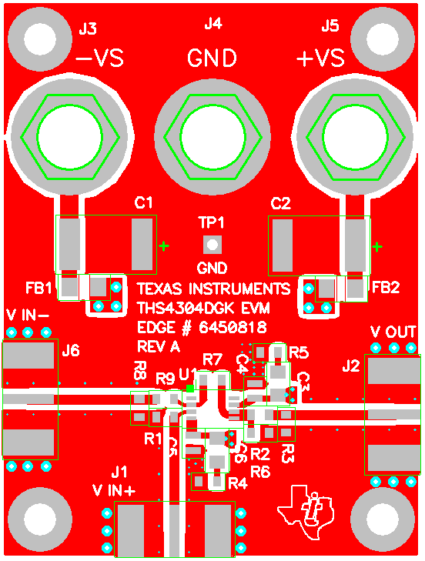
Example of High Speed Layout: Top Layer
Signal In/Out traces are microstrip line with Z0 = 50Ω.
Terminating Resistors next to Amp.
Output Series Resistor next to Amp.
100pF NPO Bypass Caps next to Amp.
Larger Bypass Caps Farther Away with Ferrite Chips for HF isolation.
MULTIPLE Vias Everywhere to Allow for easy Current Flow – no spokes
Short, Fat Traces to reduce inductance
Side Mount SMA connectors for Smooth Signal Flow
Notes:
The top layer of the PCB is shown. Because this si a relatively simple system, all of the components are mounted on the top layer. This eliminates the signal trace via concerns to ensure the best situation possible.

Slide 33
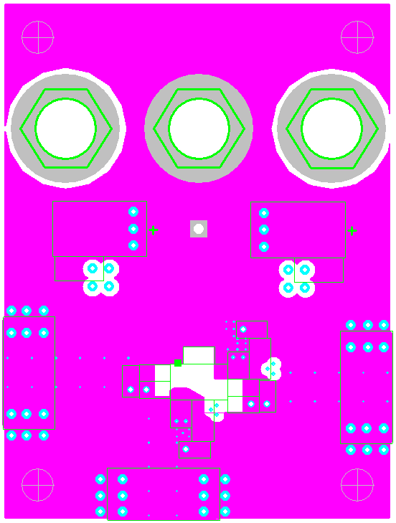
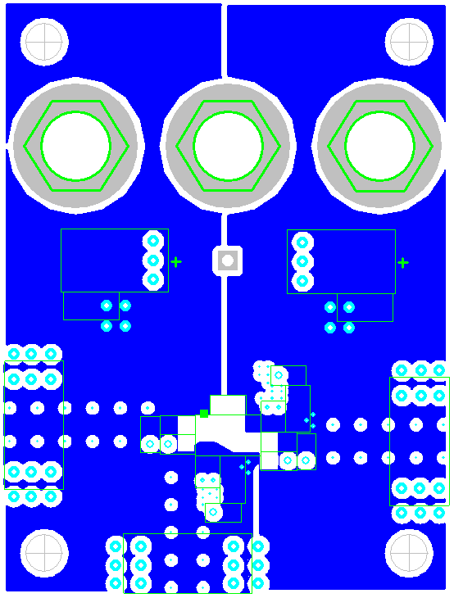
Example of High Speed Layout: Other Layers
Layer 2: Signal GND Plane
GND Plane Next To Signal Plane for Continuity in Return Current
Layer 3: Power Plane
Notice Cut-Out in Sensitive areas near Amplifier on ALL planes.
Notes:
Notice the Ground layer is directly below the signal layer. This is to allow for the return current signal flows to be as close a possible to the signal traces. The PCB material thickness also dictates the characteristic impedance input and output traces.
The power layer is below the ground layer, which helps form a good bypass capacitor by using the simple parallel plate capacitor method.
Notice the removal of ground plane and power plane around the sensitive areas of the amplifier. This includes the inverting input node, the feedback capacitor trace path, and the output node up to the series characteristic impedance matching resistor.
Also notice that multiple vias are placed on the component pads (SMA connectors and bypass capacitors for example).

Slide 34
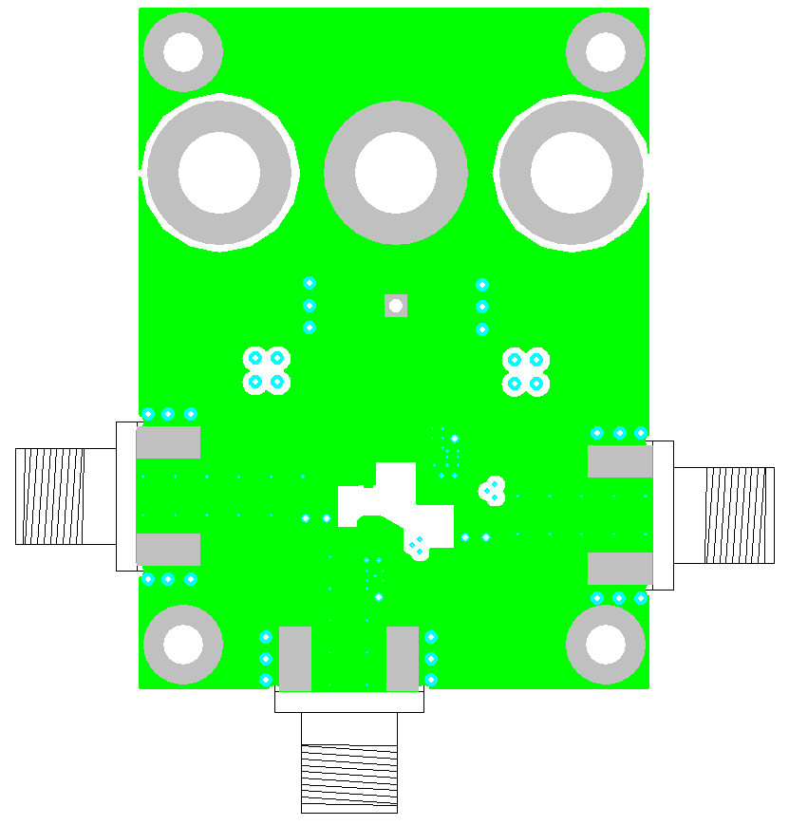
Example of High Speed Layout: Bottom Layer – ground plane
Solid GND plane to minimize inductance.
Layer-2 GND plane and Bottom Layer form excellent bypass capacitor with Power Plane.
All Signals are on Top Layer to minimize the need for signals to flow through vias.
Multiple Vias Everywhere – No spokes
Cut-Out around Amplifier to reduce Stray Capacitance
Notes:
Notice the number of vias utilized between the top layer ground, second-layer ground, and the bottom layer ground. This ensures minimal current loop areas allowing the return currents to flow where they want to flow – directly under the signal trace.
Lastly, there are NO spoke connections to any ground point. Spokes are typically used for thermal relief, which they provide along with increased impedance due to restricted current flow. This solid connection ensures minimal inductance and although not really required for this design, good thermal conductivity.

Slide 35
Agenda
General Considerations
Models: Resistors, Capacitors, Inductors, and Circuit Board
High Speed Op Amp Layout
Input and output considerations
Signal routing
Bypass capacitors
Layout examples
High Speed ADC/DAC Design and Layout
Input and output considerations
Bypass Capacitors
Splitting the Ground Plane
Filtering clocks to reduce jitter
High Speed Clock Layout Guidelines
Coupling (Interference or Cross Talk)
Power Supply Filtering
Power Supply Bypassing & Grounding
Layout Tricks to Reduce EMI

Slide 36
ADC inputs
The analog inputs represent the most sensitive node on the high speed ADC.
For a 2Vpp ADC input, and a 86dB SFDR target, the input error must be under 0.1mV to not degrade the converters performance.
Typical coupling sources:
ADC outputs (CMOS ADC outputs)
Unterminated clock lines
Keep maximum separation between adjacent channels to minimize crosstalk.
Modern ADCs have differential inputs, which should be routed tightly coupled and symmetrically routed.
To minimize stray capacitance, analog anti-aliasing filter could have the ground plane below it notched out.
Terminate analog inputs and clock inputs with terminations placed at the device input pins.
Ex. TSW1070

Slide 37
ADC Outputs
Output lengths should be matched.
FR4, 50mil matching ~ 9ps skew
LVDS Outputs (preferred)
Constant current output
Minimizes coupling back to analog input.
Minimizes EMI
100 ohm termination resistor should be physically located at the receiver inputs.
FR4=0.18ps/mil
Ex. TSW1070
Notes:
velocity of propagation in vacuum is c = 300 10**8 meters/second
= 0.3 meters /ns
= 0.984 feet/ns
Slowed down by square root of dielectric of ~4.7 is a factor of about 2.17
so velocity of propagation in FR4 is about 0.453 feet/ns
= 5.44 inches/ns
Inverse of that is 184 ps/inch,
= 0.184 ps/mil
So – every 5.44 mils of board trace length mismatch accounts for about a ps of skew.

Slide 38
ADC Outputs cont’d - CMOS
CMOS Outputs
At higher frequencies, parasitic board capacitance prevents full signal swing.
Procedure
Extract board resistance and capacitances (parasitic from stackup and receiver input capacitance)
Calculate RC time constant (67%)
Compare with receiver VIH, VIL
Conduct a timing analysis.
Several TI HS ADC have programmable output drive strengths.
For best SNR, use the least drive strength required to satisfy timing
To minimize parasitic capacitance, route CMOS outputs as micro strip traces.
8ns

Slide 39
DAC Inputs
LVDS inputs (DAC5682)
Should be routed as differential pairs.
Should have a characteristic impedance of 100 ohms.
CLKIN and Data inputs should be matched.

Slide 40
Decoupling
When a load is suddenly applied,
The circuit tries to suddenly increase its current
Inductance in the power supply line acts to oppose that increase
The voltage of the power line sags
Decoupling or bypass caps supply short bursts of current when the IC needs it
Rule of Thumb suggests one decoupling cap per power pin.
Many ADC’s now have decoupling built into the device

Slide 41
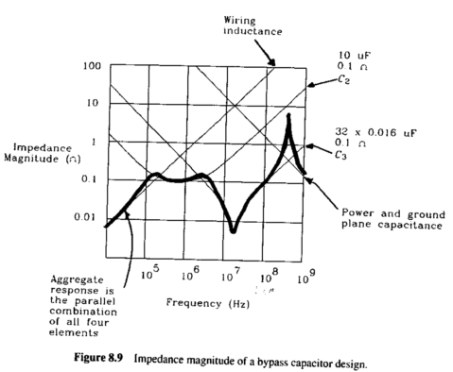
Decoupling
Multiple series impedances (bondwire, pin, trace) will act to reduce the effectiveness of the decoupling caps
A lot of high speed amps and data converters have on chip capacitors to help, but external caps are still recommended
Series Impedances
Power Supply
Ferrite Bead
Board stack up
Parasitic capacitance between planes
Bulk Capacitor
Low ESR recommended
Small Capacitor Array
Place close to power pins
Source: Johnson High Speed Digital Design

Slide 42
Split Ground Planes
Reasons to split the ground plane:
Precise control over current flows back to the source.
Isolate sensitive analog circuitry from digital switching.
ADC CMOS interfaces.
How to perform the split:
Identify each pin as either a digital pin or an analog pin.
Perform the split such that each pin has it’s respective GND plane underneath the pin.
DGND
AGND
Probably OK for lower speed design
with frequencies below 1MHz

Slide 43
Split Ground Planes
Reasons to not split the ground plane:
Strong chance for error in making the split.
Could cause a large inductive loop which gives rise to noise.
FACTS:
With proper decoupling and grounding, many single GND planes perform as good as split ground planes.
LVDS outputs/inputs minimize the need to split the plane.
DGND
AGND
Generally best to not split ground plane in very high speed design and you should plan to reconnect if you do
Notes:
We have tried both split ground planes and single ground planes and we rarely see a different in performance.
LVDS outputs are constant current and they are differential. The current already has a controlled path back to it’s source so their isn’t a need to control the current flow using split ground planes.

Slide 44
Total Data Converter SNR Performance
SNR contributions:
Quantization noise:
6 * N{# of bits} + 1.76 dB
Clock jitter
Jitter or Phase Noise Performance
Aperture jitter
Value extracted from the datasheet
Thermal Noise
Value estimated from SNR performance from the datasheet at lowest IF
Total SNR is RMS sum individual contributions
Clock jitter is only term the circuit designer can manage

Slide 45
Jitter SNR vs Analog Input Frequency
Jitter SNR is dependent on input frequency
Higher input frequencies lead to tighter jitter requirements

Slide 46
Band Limit Clock to Improve Phase Noise and Jitter
Clock jitter is due to noise integrated over clock input BW
Clock input BW can be up to 1 GHz for high speed converters
Add narrow band Crystal filter on clock for best jitter
Small SMT Crystal Filter devices available with narrow BW
May require amplifier to compensate for insertion loss

Slide 47
Agenda
General Considerations
Models: Resistors, Capacitors, Inductors, and Circuit Board
High Speed Op Amp Layout
Input and output considerations
Signal routing
Bypass capacitors
Layout examples
High Speed ADC/DAC Design and Layout
Input and output considerations
Bypass Capacitors
Splitting the Ground Plane
Filtering clocks to reduce jitter
High Speed Clock Layout Guidelines
Coupling (Interference or Cross Talk)
Power Supply Bypassing, Filtering & Grounding
Line Termination
Reducing EMI

Slide 48
Coupling, Interference, or Cross Talk
Coupling , Interference, or Cross Talk is when one signal affects another
General rules to reduce coupling:
Increase isolation between traces
Isolate the power supplies (bypass/filter)
Use low impedance ground reduce ground bounce (planes)
Terminate independently
Power
Traces
Termination
Coupling Zones
Ground

Slide 49
Minimizing Input Coupling
Keep maximum separation between inputs
Terminate independently
Differential Reference inputs should be tightly and symmetrically routed
Terminate close to the device input pins
Route Clocks on internal layers to minimize EMI

Slide 50
Minimizing Output Coupling
Bypass output buffer power pins on top layers
Match trace impedance between channels
Match trace lengths to minimize skew between channels
Differential outputs should be tightly and symmetrically routed
Single ended LVCMOS may need source termination for better integrity and reduce EMI
Route clocks on internal layers to minimize EMI

Slide 51
Clock Power Supply Decoupling
Place all bypass capacitors as close as possible to VCC Pins
Bypass capacitors shunt the noise generated by device to ground and reduces noise coupled via VCC
- Bypass capacitors provide low impedance power source

Slide 52
Clock Supply Grounding
Ground Bounce is common in a clocking Devices since all the outputs are sharing the Same ground and they are switching together
Make sure that the Grounds On the Clocking device is grounded with minimal inductance to reduce Ground bounce

Slide 53
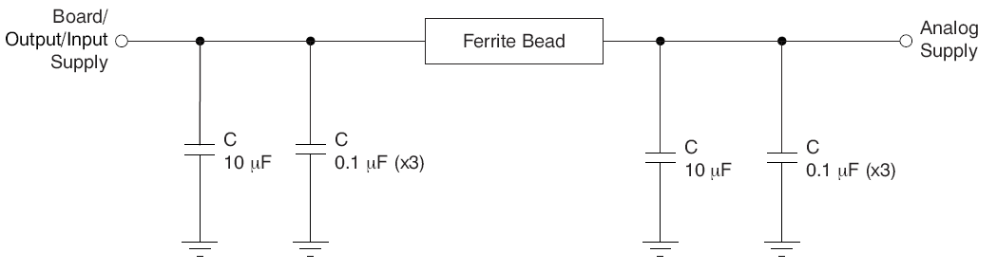
Power Supply Filtering for Critical Applications
LC Low pass filtering used to provide better power supply isolation between sensitive blocks
PLL-based frequency synthesizers are very sensitive to noise on the power supply, especially analog-based PLLs
Must reduce noise from power supply when jitter/phase noise is critical in applications
Rule of thumb: LPF ≤ 1/10 Bandwidth
Example: PLL with 400 kHz bandwidth, place LC corner ≤ 40 kHz
low ESR
Notes:
PLL-based frequency synthesizers are very sensitive to noise on the power supply, which can dramatically
increase the jitter of the PLL. This characteristic is especially true for analog-based PLLs. Thus, it is essential to
reduce noise from the system power supply, especially when jitter/phase noise is very critical to applications. A
PLL would have attenuated jitter as a result of power-supply noise at frequencies beyond the PLL bandwidth
because of attenuation by the loop response.
Filter capacitors are used to eliminate the low-frequency noise from the power supply, where the bypass
capacitors provide the very low impedance path for high-frequency noise and guard the power-supply system
against the induced fluctuations. These bypass capacitors also provide instantaneous current surges as required
by the device and should have low equivalent series resistance (ESR). To properly use these bypass capacitors,
they must be placed very close to the power-supply pins and laid out with short loops to minimize inductance. It
is recommended to add as many high-frequency (for example, 0.1-mF) bypass capacitors as there are supply
pins in the package.

Slide 54
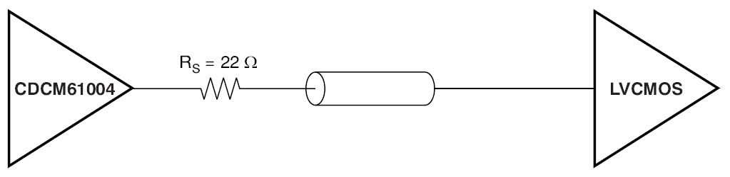
Termination: Single Ended LVCMOS Clock Outputs
Single ended LVCMOS may need source termination to reduce EMC
22 Ω series resistor should be located at the TX outputs
TX
RX
LVCMOS

Slide 55
Differential Clock Outputs Are Better
Higher isolation from common mode noise
Better protection against EMI
Minimizes coupling
Allows higher frequency operation

Slide 56
Termination: Differential LVPECL Clock Outputs
LVPECL needs to have a termination to V_{CC} – 2V
AC coupling: termination resistors should be used at TX output pins and RX input pins
DC coupling: termination resistors should be RX input pins
TX
RX
LVPECL
TX
RX

Slide 57
Termination: Differential LVDS Clock Outputs
LVDS is generally specified as DC coupled
although most people these days use AC coupling with it
For both AC and DC coupling, 100 Ω termination resistor should be located at the receiver inputs
AC coupling
TX
RX
LVDS
DC coupling
TX
RX

Slide 58
AC Coupling vs DC Coupling
AC coupling can be uses when signal is DC balanced (equal duration for zeros and ones)
Allows for different common mode biasing voltage in RX than the TX
DC coupling is used when date is random, or very slow signals that have large DC components

Slide 59
PCB Edge Acts as Antenna
L
PDB edge traces act as an antenna
Radiation increases as frequency approaches multiples of λ/4
Remember λ/4 is quarter wave antenna

Slide 60
Top and Bottom Traces Are Antennas
Power/Signals/Clocks
Power Planes
Signals
Clocks
GND
Top/bottom layer traces act as an antennas
Radiation increases as frequency approaches multiples of λ/4
Remember λ/4 is quarter wave antenna

Slide 61
Reduce PCB Trace Radiation
Creating a faraday cage on the PCB
to reduce PCB trace radiation:
Make top and bottom layers GND
Inner layers VCC planes and signal traces should be retracted from the board edge
GND Layers should be via stitched to create the PCB faraday cage
Spacing ≤ λ/10 of the highest harmonic
1
2
3
Clocks are usually biggest source of EMI in system

Slide 62
The End
Thank You
Are There Any Questions?

