Slide 1
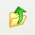
Sensor AFE
Parameter/ Device | Sensor Type | Lead Application | Release Date
 | Toxic Gas | Safety, Petro, Gas | In Production
 | Bridge | Industrial For example: FA, Scales | In Production
 | NDIR / Gas | CO2 Demand Control Ventilation | In Production
 | Ph | Water Quality | In Production
 | Bridge (Low Noise) | Weigh Scales, Industrial | 4Q12
 | ECG | Low Power ECG, Holter Monitors | 3Q12
LMP91000
LMP90100
LMP91050
LMP91200
LMP90101
LMP90507
EXISTING
NEW
ROADMAP
Up
Notes:
1

Slide 2
Sensor AFE Roadmap
Production
Sampling
Development
Future
LMP90507
ECG Sensor AFE
3, 20-bit low-power, low-noise ADC’s
Samples: May’12
RTP: 3Q12
Medical
LMP90100 Family
Bridge Sensor AFE
16-24 bit ∑∆ ADC
PGA
Cont Calibration & diagnostics
Digital I/O ECC
Process Control
LMP91200
pH Analyzer Sensor AFE
Low input Bias
Temperature compensation enabler
Sensor diagnostics
LMP91002
Toxic Gas Sensor AFE
Adjustable cell bias
TIA
Temp Sensor Diagnostics
Samples: Now
RTP: May12
LMP91000
Toxic Gas Sensor AFE
Adjustable cell bias
TIA
Temp Sensor Diagnostics
Environmental/
Gas Monitoring
LMP91050
CO2/Alcohol Sensor AFE
PGA
Adjustible CM generator
“dark phase” offset cancellation
Released
3Q2012
Up
Notes:
2

Slide 3

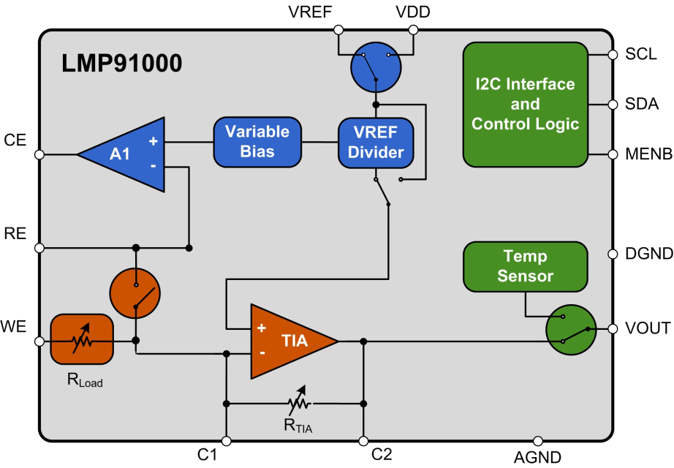

LMP91000
World’s first configurable AFE Potentiostat for Electrochemical Gas Sensing Applications
Features
Benefits
Industry’s first Fully Programmable AFE Potentiostat
  Programmable transimpedance gain
  Programmable cell bias voltage with low drift
  Cell conditioning currents up to 10mA
  Reference Electrode Bias Current 1000pA (max)
Integration
  On board TIA, Cell Bias, Temperature sensor
  , sensor diagnostics
Ultra Low Power Consumption
  Supply current (Average over time) <10uA
  Operating supply range: 2.7V to 5.5 V
Ease of Evaluation
  Supported by WeBench Sensor AFE Designer
Highly flexible chip allows use of one solution for nearly 20 different gases, wide range of gas concentrations from 0.5 nA/ppm to 9.5 nA/ppm and different electrochemical cells (3 lead amperometric and 2 lead galvanic cells)
Integrates multiple discrete components to save board space, reduce cost and minimize design time
Optimal for battery-operated systems, as well as 4mA to 20mA transmitter applications
Online evaluation tool enables quick evaluation, prototyping and faster time to market
Applications
Toxic gas detection platforms
3 lead toxic gas sensors
2 lead galvanic cell sensors
Amperometric applications
Chemical species detection
Electrochemical blood glucose meter
EVM PART # LMP91000SDE/NOPB

Slide 4
LMP90100
Multi-Channel Low Power 24-Bit Sensor AFE with
True Continuous Background Calibration
Features
Benefits
Multi-channel, 4 diff or 7 SE inputs (mix and match), 24- and 16-bit resolution
Only part in the industry to provide continuous background calibration
Non-invasive sensor diagnostics
CRC encoded data transmission
Pin compatible family at 16 bit and 24 bit
Supported by Sensor AFE WEBENCH tool
Interfaces with multiple sensor types such as RTD, thermocouple, pressure, load cells, and many more
Automatically calibrates offset & gain error over temp and time, reducing programming overhead
Detects open/short and out of range conditions without affecting measurements
Increased data reliability in noisy and remote operating environments and across isolation
Allows easy upgrade / downgrade paths and system flexibility
Enables quick system evaluation and board level verification leading to faster prototyping
Applications
Transducers and Transmitters
RTD, Thermocouple, Temperature Sensors
Pressure, Load and Force Sensing
Data Acquisition
EVM PART # LMP90100EB
Resolution | Current Src | 4 Diff. / 7SE | 2 Diff. / 4SE
24 Bit | Yes | LMP90100 | LMP90098
24 Bit | No | LMP90099 | LMP90097
16 Bit | Yes | LMP90080 | LMP90078
16 Bit | No | LMP90079 | LMP90077

Slide 5
LMP91050
World’s first configurable AFE for Optical/NDIR sensing Platforms
Features
Benefits
Programmability
  Programmable gain amplifier (163V/V to 8000V/V)
  On chip “Dark Signal” offset cancellation DAC
  Adjustable CM generator (1.15V/2.59V)
Integration and performance
  PGA with low gain drift (0.1% max), low phase delay (3.6 us) and low noise (0.1 uVrms)
  8 bit DAC for offset removal
  Output common mode shifting
Small Package: MSOP-10 package
Ease of Evaluation
  Supported by Webench Sensor AFE Designer
Enables the use of one chip across multiple thermopile platforms with different sensitivities thereby minimizing design time and enabling faster time to market
Integrates the functionality of several discrete components in a single chip resulting in simpler, reliable design and less overhead for microcontroller
Small package allows placement into thermopile and helps reduce system size
Online evaluation tool enables quick evaluation, prototyping and faster time to market
Applications
Non dispersive Infrared (NDIR) sensing
Demand control ventilation
Building monitoring
CO2 cabin control, Alcohol detection – Automotive
Industrial safety and security
Green house gases (GHG) & Freon detection platforms
EVM PART # LMP91050SDEVAL

Slide 6
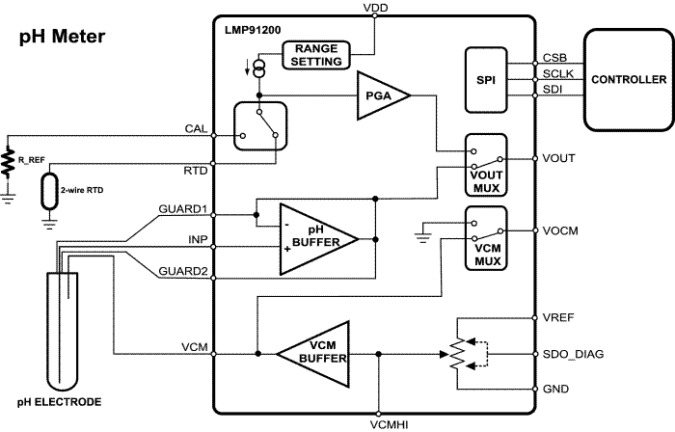
LMP91200
Fully Integrated Analog Front End for pH Analyzer Sensor Platforms
Features
Benefits
  Complete integrated front end for pH sensing
  Ultra low input bias current: 0.45 pA at 85°C
Programmable Output Common Mode Voltage
Active guard pins
Easy RTD hookup for temperature measurement
Supported by WeBench Sensor AFE Designer
World’s first single chip solution helps reduce design time, cost and board space
99% lower bias vs. competition allows reliable measurement with high impedance pH electrodes
Provides flexibility to use with several pH sensor output ranges
Provide high parasitic impedance wiring to eliminate leakage
Allows calibration of temp. drifts over time
Online & Hardware evaluation tools enable quick evaluation, prototyping and faster time to market
Low power consumption allows intelligent sensors
Applications
pH Sensor Platforms
  Chemical/Petrochemical Plants
  Refining & Gas production
  Emission Monitoring
  Steam & Water quality monitoring
EVM PART # LMP91200EVAL

Slide 7

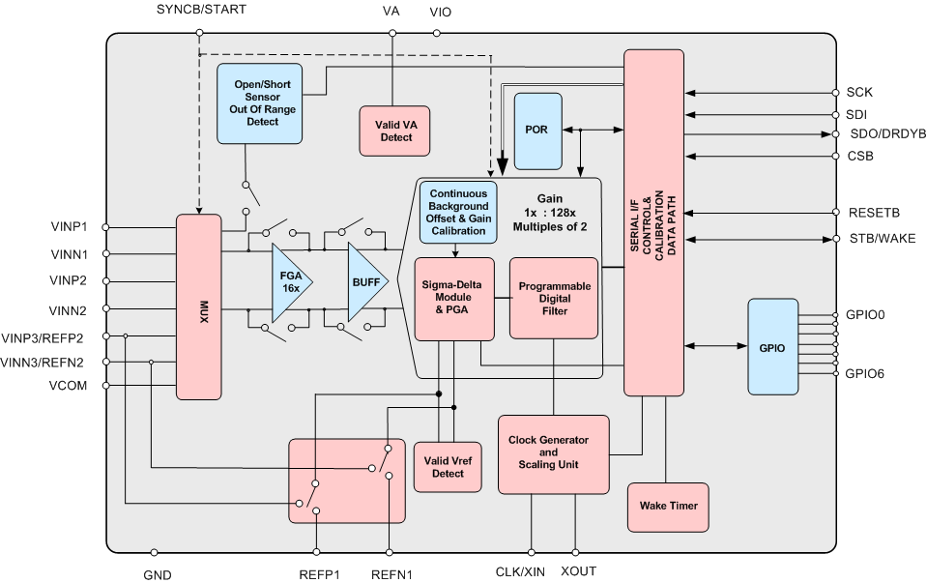
LMP90101
Ultra Low-Noise 24-bit ∑Δ 3-Channel Sensor AFE
Features
Benefits
True continuous background sensor calibration
Continuous non-invasive sensor diagnostics
4/3-wire SPI with CRC
24-bit ∑Δ ADC
3-fully differential or 6- single ended channels
Continuous & Incremental modes
Total noise <10 μV-rms
ODR upto 12 kSPS
Single cycle settling
Multiple reference inputs
6 GPIOs
Gain and Offset accuracy over temperature & lifetime
Open & Short, Overvoltage, Fault Detection without affecting measurement accuracy
Eliminates data corruption due to communication
Applications
Weight Scales
Temperature measurement
Strain gauge interface
Industrial process control
EVM PART # LMP90101EB along with WEBENCH
*Available Q3 CY12
Notes:
The font used in the body is Arial 16 pt. Make sure the font sized used is large enough to be easily seen.
Remember, you are not required to use this exact formatting, although you can. The requirements are the content and the master slide.

Slide 8
LMP90507
Low Power Analog Front End for ECG Applications
Features
Benefits
Very Low Power High Precision performance
  0.25mW/Ch
  Flexible Power Down Configurations
  Standby Mode Power 0.3mW
3 High Resolution ECG Channels
  Noise: 8.7uVp-p @ 0.1Hz to 131Hz, over 0.5sec
  CMRR: >100dB
  Integrated EMI Hardened Differential Signal Paths
  Continuous Lead Failure detection
  No Saturation due to Motion Artifacts
Full set of commonly needed features
  Programmable Bandwidth and Sampling Rates
  Battery Voltage Level Monitoring
  Continuous Lead Failure detection
Optimized for portable applications such as Holter Monitors, and ECG Patches. Provides over 80% power savings compared to a discrete solution
Complete ECG signal path with right Leg Drive, and Wilson reference and flexible mux that allows for dynamic lead connections and simultaneous pace and ECG signal detect
Allows ECG diagnostic equipment, sport and fitness medicine designers to quickly design their entire system
Applications
Medical Instrumentation including:
  Patient monitoring: Holter, event, stress, and vital signs ECG; AED; fetal ECG
  Bispectral index (BIS), Sleep study monitor
High-Precision, Simultaneous, Multichannel Signal Acquisition
Samples: 1Q’12
RTM : 3Q’12
Package: LLP28

