Slide 1
USB_DAC板 Pin脚说明

Slide 2
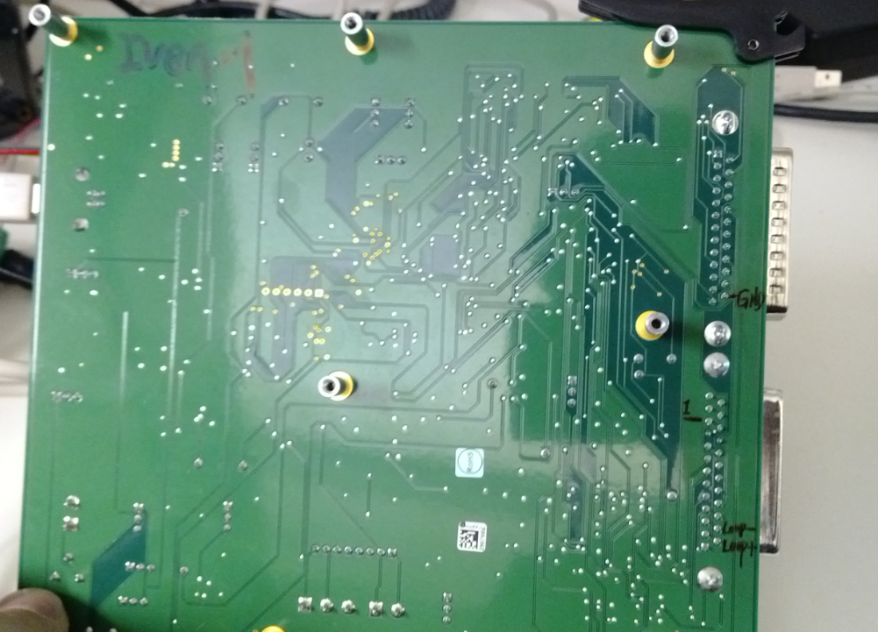
USB_DAQ
GND
1-wire
Vloop+
Vloop-

